Slide 1
A Comparative Analysis of Noise Reduction Methods in Sentiment Analysis on Noisy Bangla Texts
2024 The 9th Workshop on Noisy and User-generated Text (W-NUT)

Slide 2
Effect of Noise in Bangla Text
Performance of pre-trained language models (PLMs) drops significantly due to textual noise [1].
Auto-correction tools are still underdeveloped in Bangla.
“ভাই দয়াকরে খাবার নষ্ট করবেন্না” (Please don’t waste food brother) contains Spacing Error, Spelling Error.
[1] Srivastava et al., 2020. Noisy text data: Achilles’ heel of bert.

Slide 3
Relevant Research and Their Limitations
Recently introduced SentNoB dataset by Islam et al. [2] conducts sentiment analysis on noisy Bangla texts.
✔ 15,728 noisy Bangla texts labeled into positive, negative, and neutral sentiment.
✔ Experiments with both semantic and lexical features.
X Performance of the models are poor. Highest F1-Score: 64.61
X No information about residing noises in the texts.
X Noise reduction methods aren’t explored. [3][4]
[2] Islam et al., 2021. Sentnob: A dataset for analysing sentiment on noisy bangla texts.
[3] Haque et al., 2023. Multi-class sentiment classification on bengali social media comments using machine learning.
[4] Islam et al., 2023. Sentigold: A large bangla gold standard multi-domain sentiment analysis dataset and its evaluation.

Slide 4
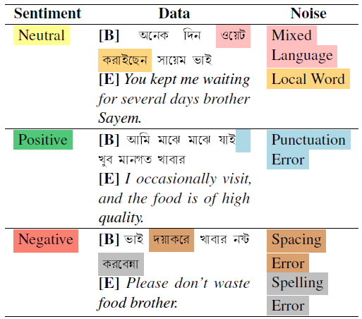
Our Contributions
Examples from dataset
Identify and label noises that are present in the SentNoB dataset
Employ and fine-tune different models to identify noises
Apply and evaluate different noise reduction methods
Assess the sentiment classification performance on both noisy and noise reduced data using PLMs

Slide 5
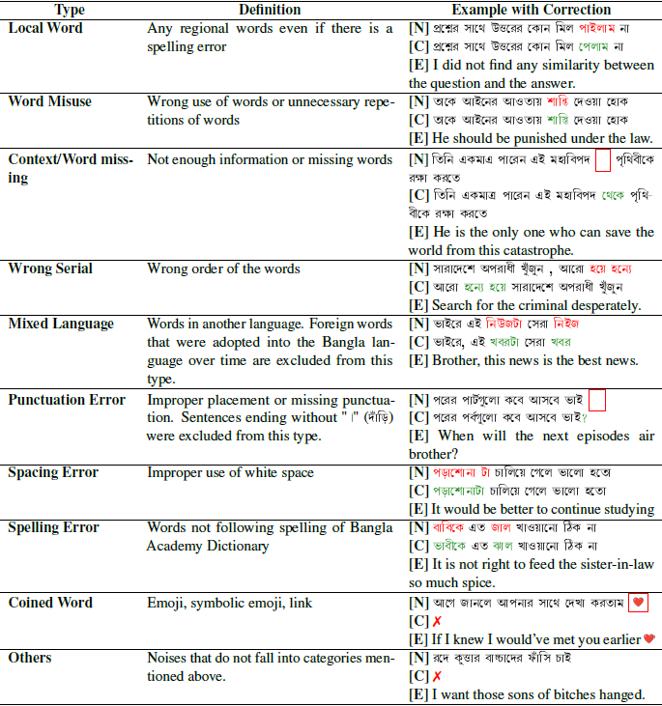
Annotation process of NC-SentNoB
Definition of Noise Categories
Invited 7 native Bangla speakers
Selected 4 speakers with 90% trustworthiness
Annotated 15,176 texts from SentNoB with 10 noise categories
Assessed annotation quality
Fleiss’ Kappa Score: 0.69

Slide 6
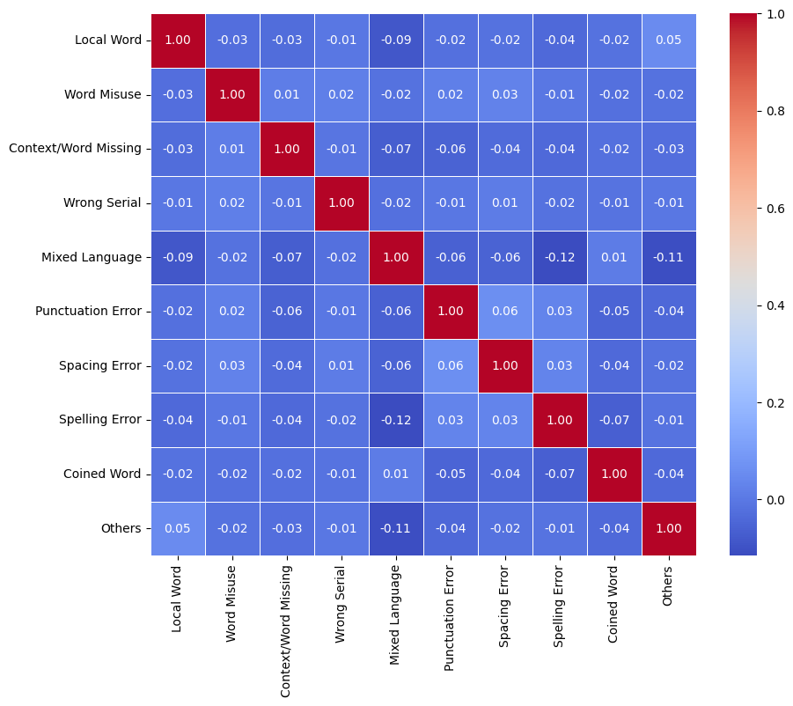
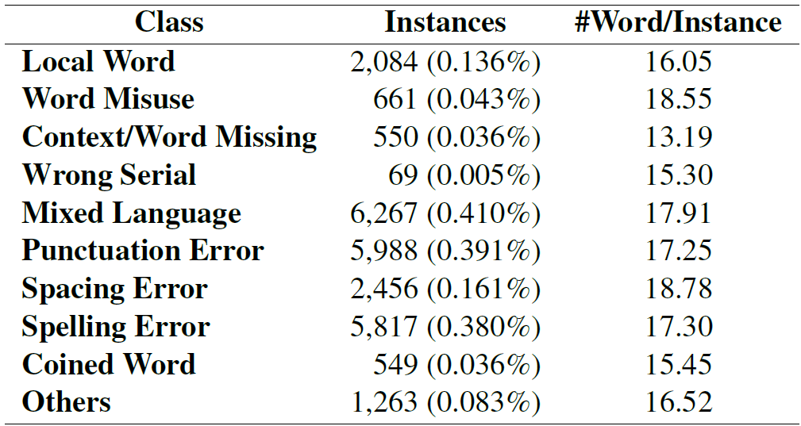
Dataset Statistics
Heatmap of correlation coefficients among different noise types
Statistics of NC-SentNoB per noise class

Slide 7
Setup for Noise Identification
SVM [5]
Utilized both character and word n-gram.
Regularization parameter of 1.
Tokenization with character level n-gram and word level n-gram.
Bi-LSTM [6]
Binary Cross Entropy Loss.
AdamW optimizer with learning rate of 1e-6.
Batch Size 256.
Bangla-BERT-Base [7]
Binary Cross Entropy Loss.
AdamW optimizer with learning rate of 1e-5.
Batch Size 128.
[5] Cortes and Vapnik, 1995. Support vector networks.
[6] Hochreiter and Schmidhuber, 1997. Long short-term memory.
[7] Sarker, 2020. Banglabert: Bengali mask language model for bengali language understanding.

Slide 8
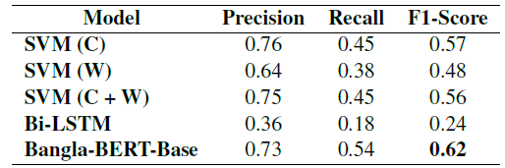
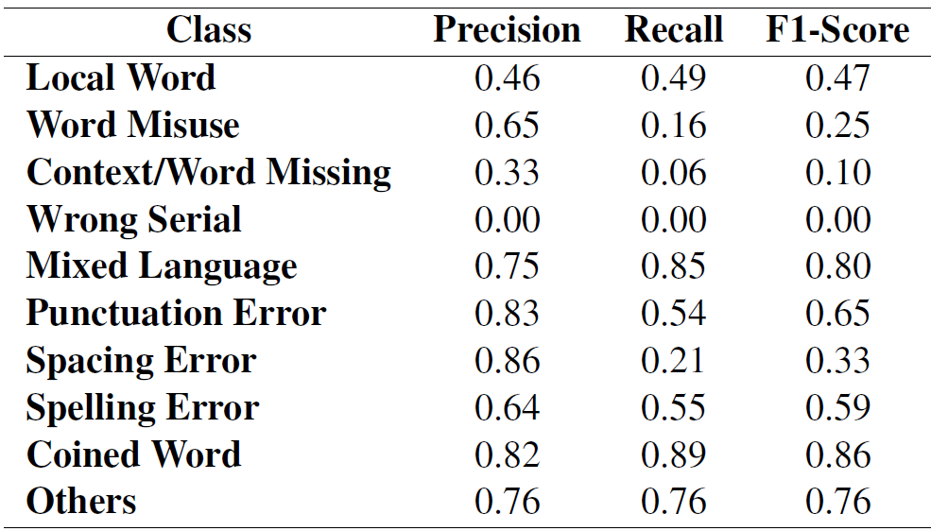
Result of Noise Identification
Performance of different models on noise identification
Class-wise performance of Bangla-BERT-Base
✔ SVM + Character n-gram attrains a higher score than SVM + Word n-gram.
X Bi-LSTM performs poorly.
！Character level tokenizer can be implemented to see if there is any performance improvement in Bi-LSTM.
X Fails to classify instances of Wrong Serial type.
！Additional data can be added to improve the imbalance which might lead to better performance.

Slide 9
Setup for Noise Reduction
Noise Reduction Methods:
Back-Translation
Google Translate
BanglaT5
Spelling Correction
Paraphrase
BanglaT5
Mask Prediction
Out of vocabulary
Random
Evaluation Metrics
BLEU
ROGUE-L
BERT-Score
SBERT-Score
BSTS
Word Coverage
Word2Vec [8]
FastText [8]
Bangla BERT [7]
Human Evaluation
[8] Sarker, 2021. Bnlp: Natural language processing toolkit for bengali language.

Slide 10
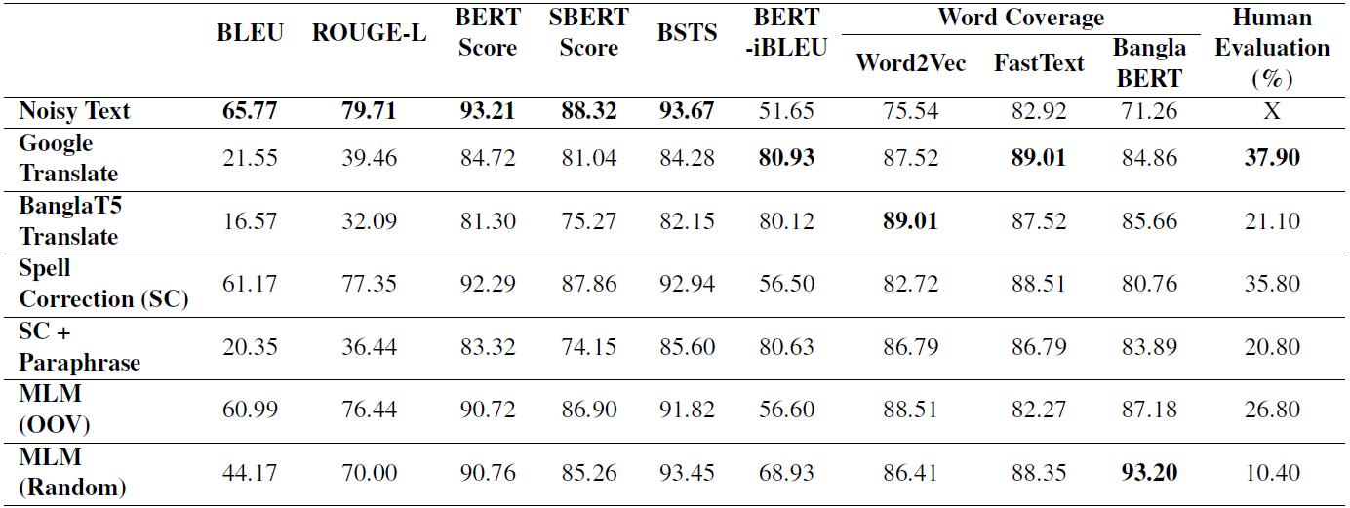
Result of Noise Reduction
Performance comparison of different noise reduction methods
X Results are inconclusive.
X Noisy text scores higher in metrics that focuses on identical word/sub-word.
✔ We prioritized Human Evaluation, where Google Translate has the highest score.

Slide 11
Setup for Sentiment Analysis
Pre-trained models:
Bangla-BERT-Base [7]
BanglaBERT [9]
BanglaBERT Large [9]
BanglaBERT Generator [9]
sahajBERT
Bangla-Electra
MuRIL [10]
Class weights (1.4496, 0.8106, 0.9289) used for cost-sensitive learning.
AdamW optimizer used for all the models with a leaning rate of 1e-5.
Batch Size 48 for sahaj BERT, 32 for Bangla BERT Large, and 128 for rest of the models.
[9] Bhattacharjee et al., 2022. Banglanlg: Benchmarks and resources for evaluating low-resource natural language generation in bangla.
[10] Khanuja et al., 2021. Muril: Multilingual representations for indian languages.

Slide 12
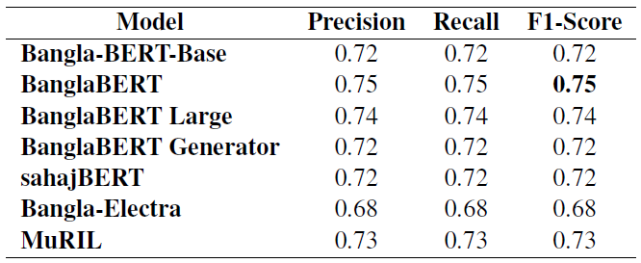
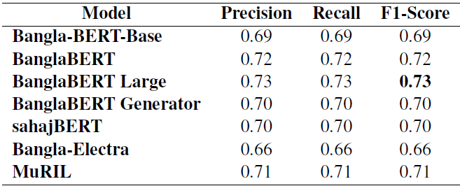
Result of Sentiment Analysis
On noisy texts
On noise reduced text
⏶
⏶
⏶
⏶
⏶
⏶
⏶
⏶
⏶
⏶
⏶
⏶
⏶
⏶
X Denoised texts performs worse than noisy text in sentiment analysis.
X Back translation is not suitable for Bangla sentiment analysis.
！Denoised texts by other methods can be tested for performance impact.

Slide 13
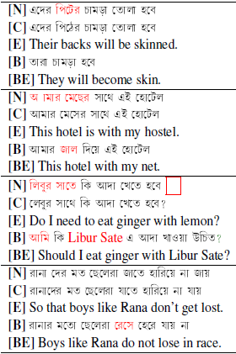
Failure Cases of Back-Translation
X Removes contextually important word.
X Removes contextually important word.
✔ Fixes punctuation error. X Converted words to romanized Bangla.
✔ Fixes spacing error. X Introduced mixed language.

Slide 14
Future Directions
Implement character-level NMT models for back-translation.
Study correlation between noise reduction with performance of sentiment analysis in Bangla.
Investigate noise specific reduction techniques.
Implement LLMs for noise reduction.
Develop a robust noise reduction model for Bangla.

Slide 15
Open Source
Codes are available at:
Github: t.ly/nc-sentnob
Dataset is available at:
Hugging Face: huggingface.co/datasets/ktoufiquee/NC-SentNoB
Papers With Code: paperswithcode.com/dataset/nc-sentnob
Kaggle: kaggle.com/datasets/kazitoufiqueelahi/nc-sentnob

Slide 16
Thank You

