Slide 1

Evaluating The Reliability Of CNN Models On Classifying Traffic And Road Signs Using LIME
2nd International Conference on Big Data, IoT and Machine Learning (BIM 2023)
Paper ID: 289
Md. Atiqur Rahman | Ahmed Saad Tanim | Sanjid Islam Chowdhury | Fahim Pranto | G. M. Shahariar | Md. Tanvir Rouf Shawon
Presenter – Sanjid Islam Chowdhury
Ahsanullah University of Science & Technology

Slide 2
Problem statement
Background: The continuous increment in the demand for autonomous cars is prevailing in the automobile industry in a rapid manner. This sector is entirely dependent on the application of artificial intelligence, where image segmentation and categorization are used widely. The traffic and road sign detection system is the most crucial requirement for an autonomous vehicle. CNNs (Convolutional Neural Networks) have become the most extensively used classification technique for images, such as traffic and road sign recognition, owing to their exceptional performance.
Difficulties: The interpretability of CNN models remains a critical challenge for researchers and practitioners alike. With millions of parameters, CNN models’ complexity poses significant hurdles in understanding how these models function.
2

Slide 3
RELATED WORKS
Deep pre-trained models for computer vision applications: traffic sign recognition ~ Bouaafia, Soulef and Messaoud, Seifeddine and Maraoui, Amna and Ammari
Contribution - Used deep pre-trained models to evaluate the performance and compare between them
Models - VGG-16, VGG-19, AlexNet, and Resnet-50. Accuracy 99.74%, Precision 0.9639%, Recall 0.9488%, f1-score 0.953 (AlexNet)
Limitations – Judged the model’s performance based on traditional performance metrics. There is no explanation why models are misclassifying images.
3

Slide 4
RELATED WORKS
ICTS: Indian Cautionary Traffic Sign Classification Using Deep Learning ~ Satish Kumar Satti, Suganya Devi K, Sekar K, Prasenjit Dhar, and Srinivasan P
Contribution - A standard definition of 40 classes of Indian Cautionary Traffic Signs. Using VGG Navigator, label the obtained images. On the proposed Dataset, train the four standard CNN classification architectures and assess the performance of the adopted CNNs on the Proposed Dataset and the GTSRB dataset.
Models - VGG-16, LeNet, AlexNet, and Resnet-50. Accuracy 98.73%, Precision 0.9992, Recall 0.9899, f1-score 0.9872 (ResNet-50)
Limitations – There is no justification or explanation of the high accuracy of outcomes. Thus, it reduces dependability.
4

Slide 5
RELATED WORKS
LiteNet: A Novel Approach for Traffic Sign Classification Using a Light Architecture ~ Soufiane Naim, Noureddine Moumkine
Contribution - Presented a deep convolutional neural network architecture to classify the traffic signs of the GTSRB dataset.
Models – LiteNet
Accuracy 99.15%, Precision 0.9915, Recall 0.9915, f1-score 0.9915
Limitations – Here only the improvement of existing architecture is focused, reducing the amount of memory and computational cost. Therefore, again the issue of dependability arises.
5

Slide 6
How can our research paper help?
6

Slide 7
OBJECTIVES
This study evaluates the performance of four CNN classification models on the GTSRB public dataset: VGG-19 ResNet-34 DenseNet-121 Inception V3
We assess their performance, and then use LIME to visually represent which image feature-regions they are using to make their predictions. We then take a few sample images which have been misclassified by the models and try our best to find the reason why they were misclassified through result analysis of the LIME outputs.
7

Slide 8
Outcome and impact
Our research gives us insights on which image feature-regions are useful for which model, and why a particular model may FAIL at classification. This information will help in development of more reliable and accurate models for traffic and road sign detection, particularly for use in self-driving cars/autonomous vehicles.
8

Slide 9
METHODOLOGY
Splitting Dataset
Split three ways: Train, valid and test sets. Ratio of 70:10:20
PRE-PROCESSED DATATSET
9

Slide 10
METHODOLOGY
Training Models (Using TRAIN and VALID SETS)
VGG-19 ResNet-34 DenseNet-121 Inception V3
No of Epochs: 10, Optimizer: AdamW, Batch Size: 8, Learning Rate: 0.0001
10

Slide 11
METHODOLOGY
Evaluate Models (Using TEST SET) by classifying images
Performance Matrices
Accuracy, Precision, F1 Score, Recall, ROC AUC Score, MCC Score
11

Slide 12
METHODOLOGY
Pre-processing
Model Testing
Dataset Splitting
Train, valid, test
70 10 20
Model Evaluation
Output Verification
Accuracy
Precision
F1 Score
Recall
ROC AUC Score
MCC Score
Sample Images (misclassified) Use LIME
Result Analysis
Model Training
VGG-19 ResNet-34 DenseNet-121 Inception V3
12

Slide 13
MODEL Evaluation Results
Classifier | Accuracy | Precision | Recall | F1-Score | MCC Score | ROC AUC
VGG-19 | 99.95% | 0.9990 | 0.9995 | 0.9992 | 0.9989 | 0.9999
ResNet-34 | 99.92% | 0.9982 | 0.9992 | 0.9987 | 0.9987 | 0.9999
DenseNet-121 | 99.94% | 0.9992 | 0.9994 | 0.9993 | 0.9991 | 0.9999
Inception V3 | 99.66% | 0.9971 | 0.9966 | 0.9968 | 0.9971 | 0.9999
13

Slide 14


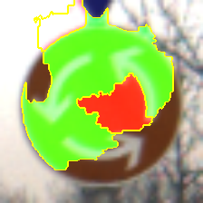


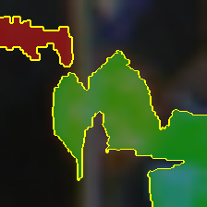

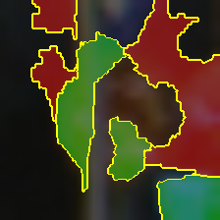
MODEL OUTPUT VERIFICATION
Inception V3
DenseNet-121
VGG-19
ResNet-34
Inception V3
DenseNet-121
VGG-19
ResNet-34
14

Slide 15
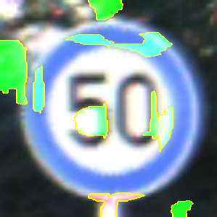

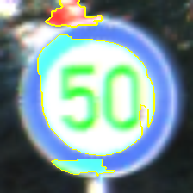
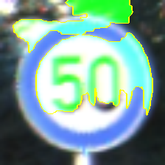
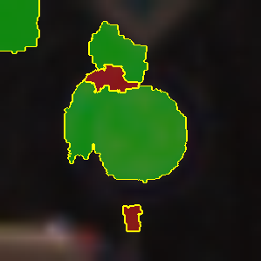

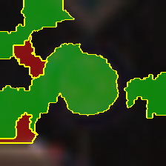
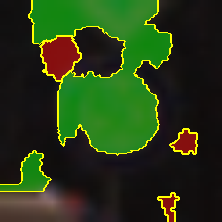
MODEL OUTPUT VERIFICATION
Inception V3
DenseNet-121
VGG-19
ResNet-34
Inception V3
DenseNet-121
VGG-19
ResNet-34
15

Slide 16
CONCLUSION
In conclusion, our study has demonstrated the potential of using the LIME framework to assess the performance of CNN classification models on the German GTSRB public dataset. This is done by firstly training the models to recognize the German GTSRB dataset, and then secondly using LIME to get a visual representation of how each model is making their prediction based on important feature regions of the images. Lastly, we take a few sample images, and their misclassified counterparts (if any) and extensively analyse and compare the different important image feature regions used by the different models for their classification.
16

Slide 17
FUTURE WORKS
Future directions of our work include expanding the study to cover more image classification models and datasets, refining the use of LIME for more insightful explanations, exploring different image pre-processing techniques, and evaluating the practical applications of these models in real-world scenarios, such as self-driving cars.
Our ultimate goal is to propose a new model that not only classifies images accurately but also relies on the correct feature-regions of the images, which will advance our understanding of CNN models and improve their performance in practical applications.
17

Slide 18
REFERENCES
https://ieeexplore.ieee.org/document/6706807
https://www.mdpi.com/1099-4300/24/4/487
https://ieeexplore.ieee.org/document/9429420
https://ieeexplore.ieee.org/document/6706807
https://arxiv.org/pdf/1602.04938.pdf
https://www.kaggle.com/datasets/meowmeowmeowmeowmeow/gtsrb-german-traffic-sign
18

Slide 19
THANK YOU for your time

