Slide 1


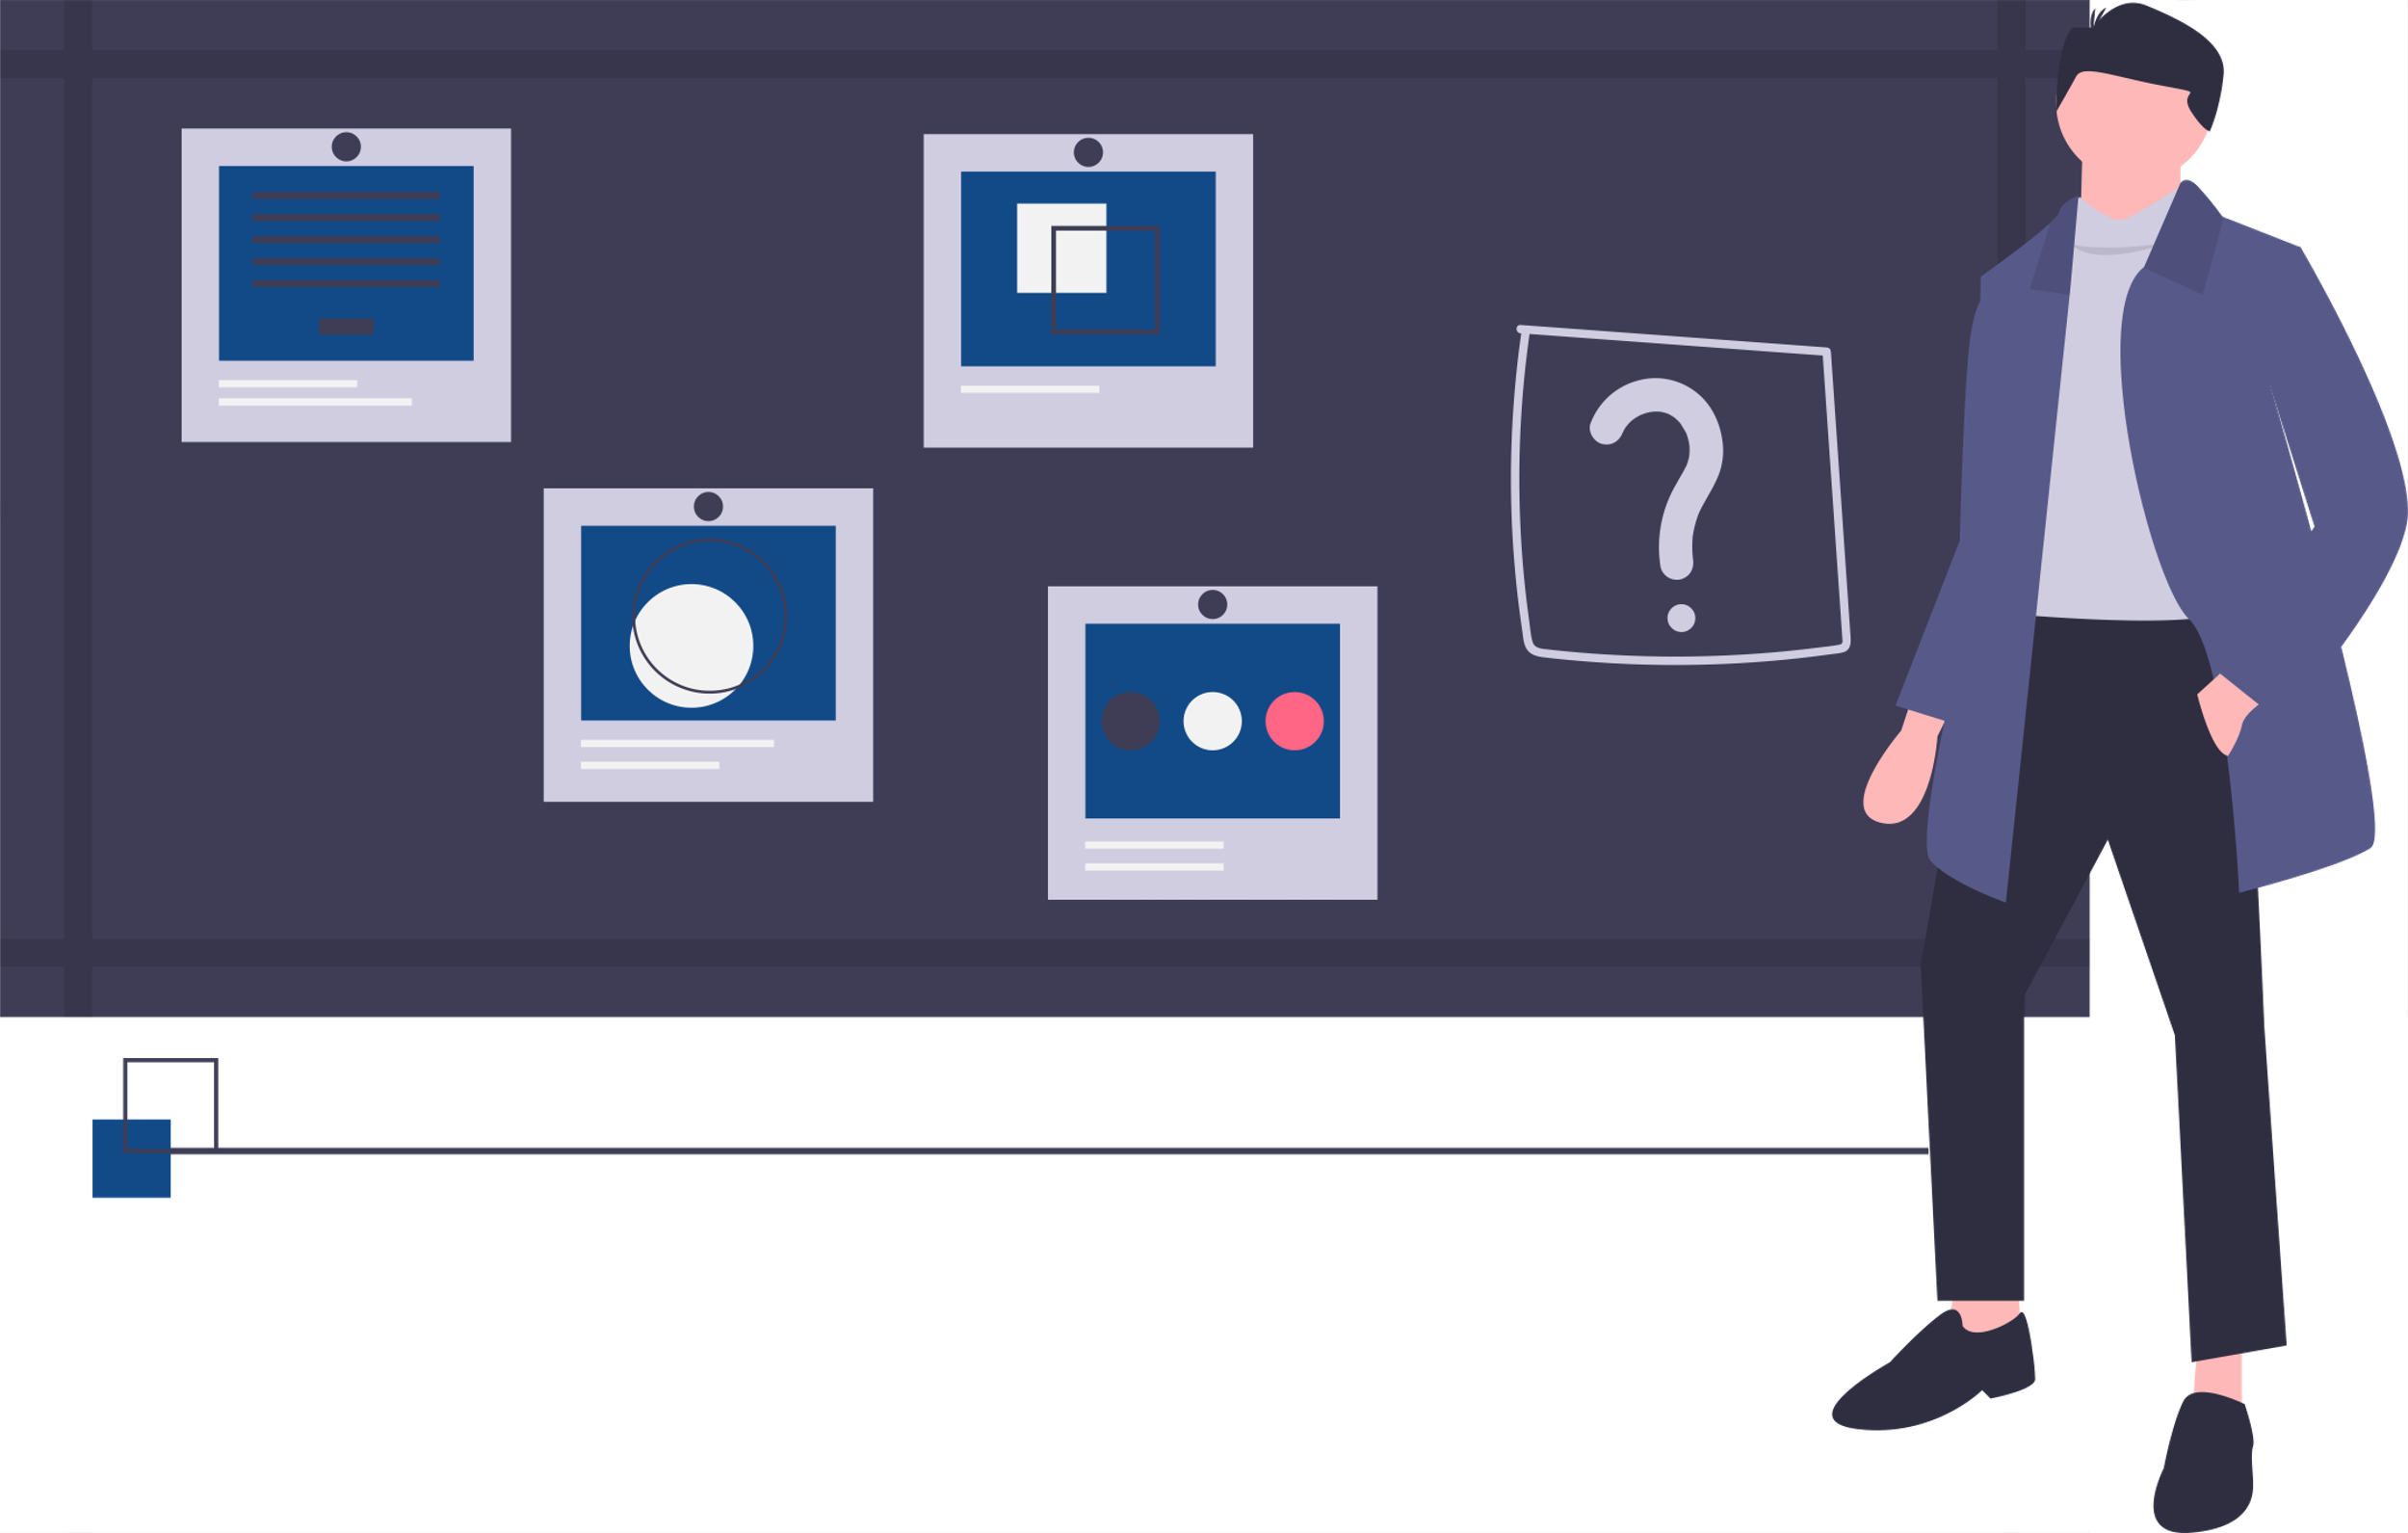
Structure Mapping
Shahar Jacob

Slide 2


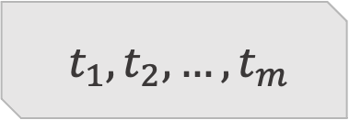
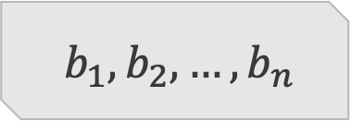
Problem definition
Base
Target
$${ b}_{1}, b_{2},…{,b}_{n}$$
$${ t}_{1}, t_{2},…{,t}_{m}$$

Slide 3

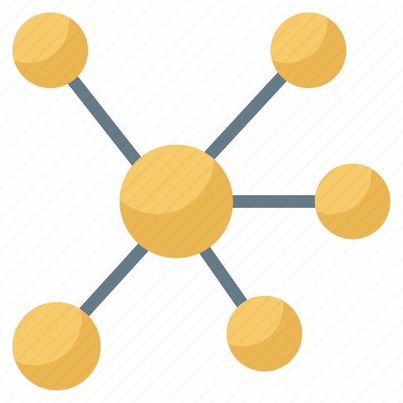


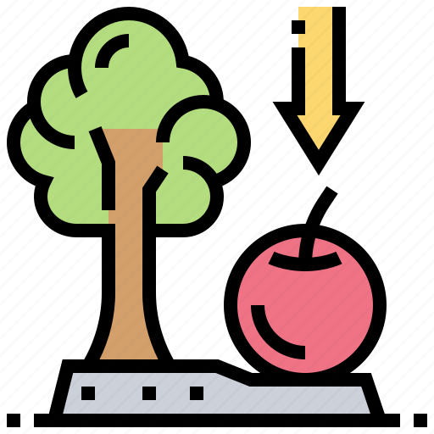

Example 1
Base
Target
Sun
Electrons
Earth
Nucleus
Gravity
Electricity
Earth revolve around the sun like the electrons circle around the nucleus.
Earth create gravity like the electrons produce electricity.

Slide 4


Example 2
Base
Target
Sun
Electrons
Earth
Nucleus
Gravity
Electricity
Newton

Slide 5

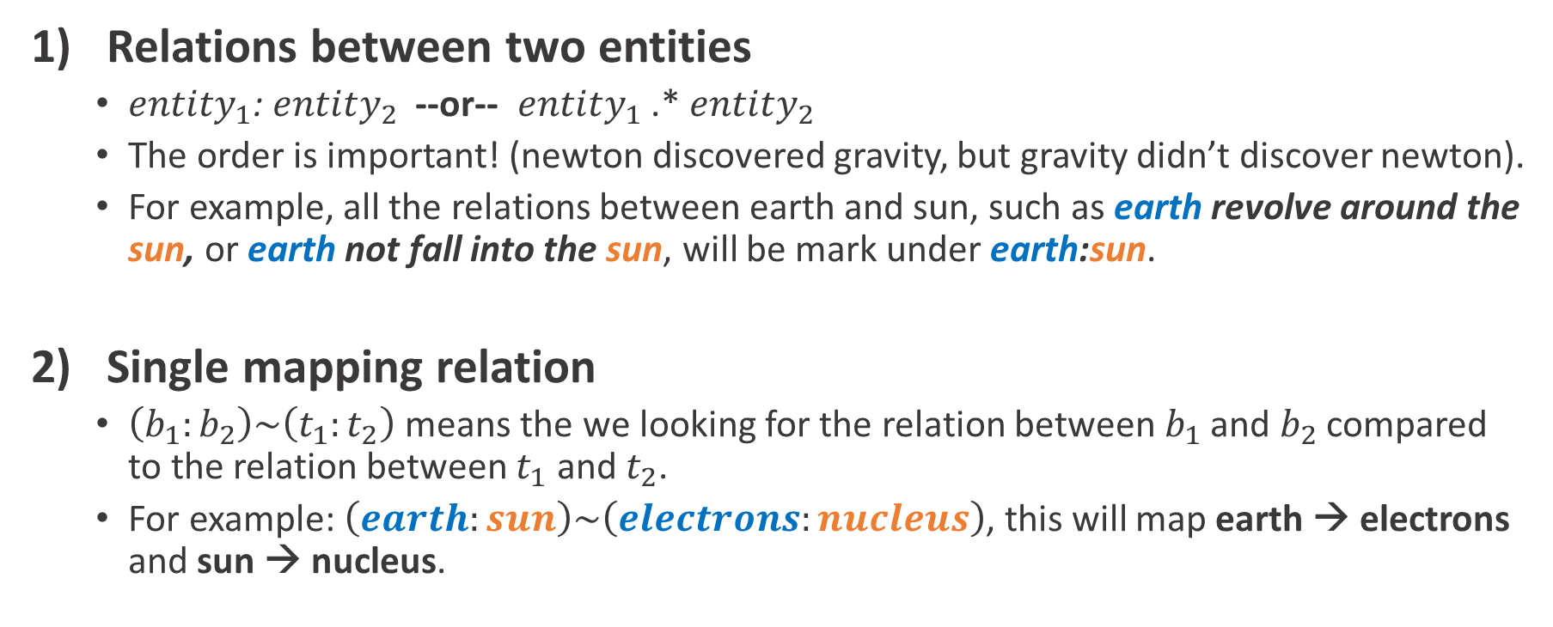
Notation
1) Relations between two entities
$entity_{1}$: $entity_{2}$ --or-- $entity_{1}$ .* $entity_{2}$
The order is important! (newton discovered gravity, but gravity didn’t discover newton).
For example, all the relations between earth and sun, such as earth revolve around the sun, or earth not fall into the sun, will be mark under earth:sun.
2) Single mapping relation
$\left(b_{1}:b_{2}\right)\sim \left(t_{1}:t_{2}\right)$ means the we looking for the relation between $b_{1}$ and $b_{2}$ compared to the relation between $t_{1}$ and $t_{2}$.
For example: $\left(earth:sun\right)\sim \left(electrons:nucleus\right)$, this will map earth → electrons and sun → nucleus.

Slide 6


Flow
Collecting data

Slide 7


Flow
Collecting data
Score for single mapping
Base
Target
$${ b}_{1}, b_{2}$$
$${ t}_{1}, t_{2}$$

Slide 8


Flow
Collecting data
Score for single mapping
Solution for multiple mappings
Base
Target
$${ b}_{1}, b_{2},…,b_{n}$$
$${ t}_{1}, t_{2},…,t_{m}$$

Slide 9
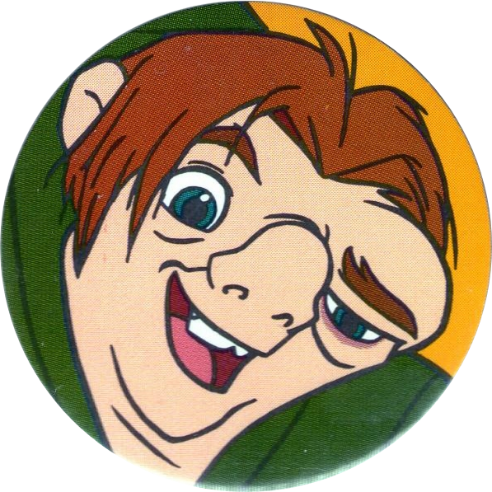
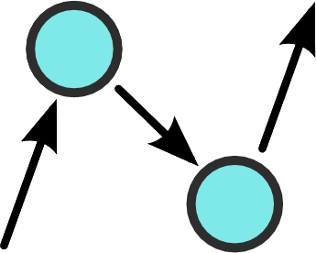

Data
earth .* sun
How do we get the relations between them?
Earth revolve around the sun
Earth not fall into the sun
Quasimodo
Google AutoSuggests
ConceptNet

Slide 10
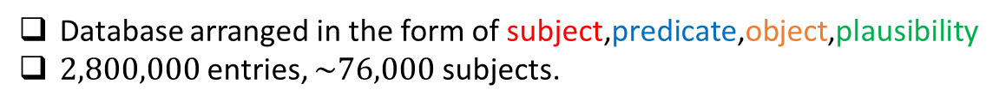
Quasimodo
Database arranged in the form of subject,predicate,object,plausibility
$2,800,000$ entries, $\sim 76,000$ subjects.
subject predicate object plausibility
astronaut be in space 1.0 plant grow in light 1.0
antibiotic work on bacteria 1.0
star move in the sky 1.0
student go to school 1.0
student receive financial aid 0.1302
antibiotic cause fever 0.6832

Slide 11

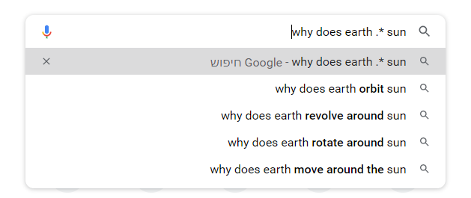
why do
why does
why does it
why did
why is
how do
how does
how does it
how did
how is
Google AutoSuggests
How? REGEX !!!

Slide 12
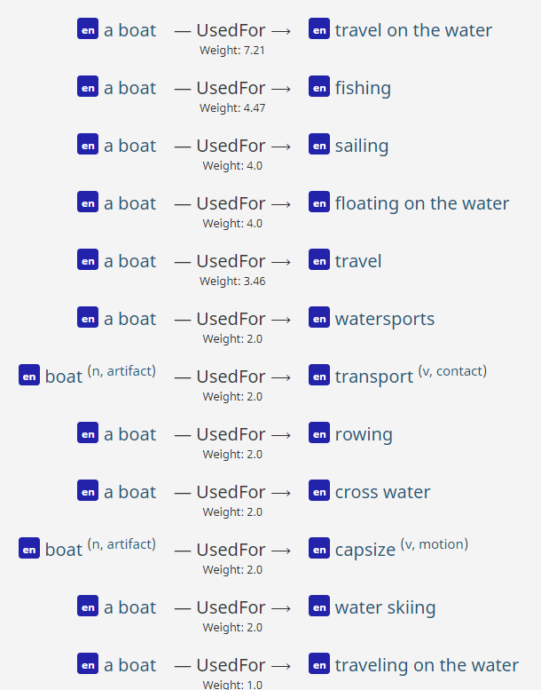
boat:water
ConceptNet

Slide 13
Score for single mapping
(earth:sun) ~ (electrons:nucleus)
This defines the mapping: earth→ electrons, sun→ nucleus
But how good is that mapping?

Slide 14
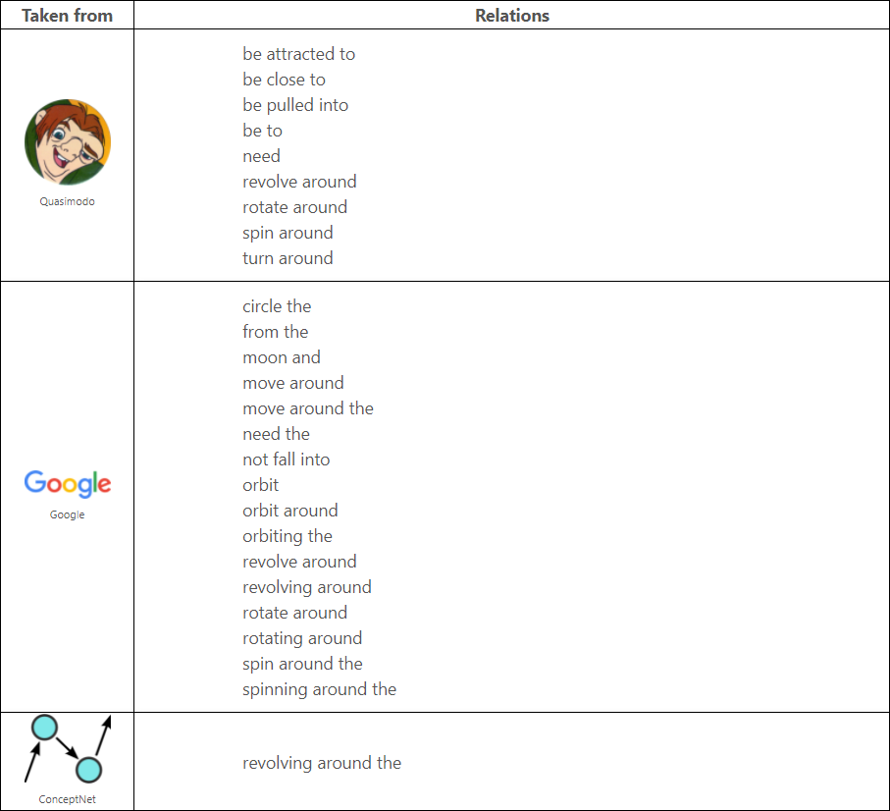
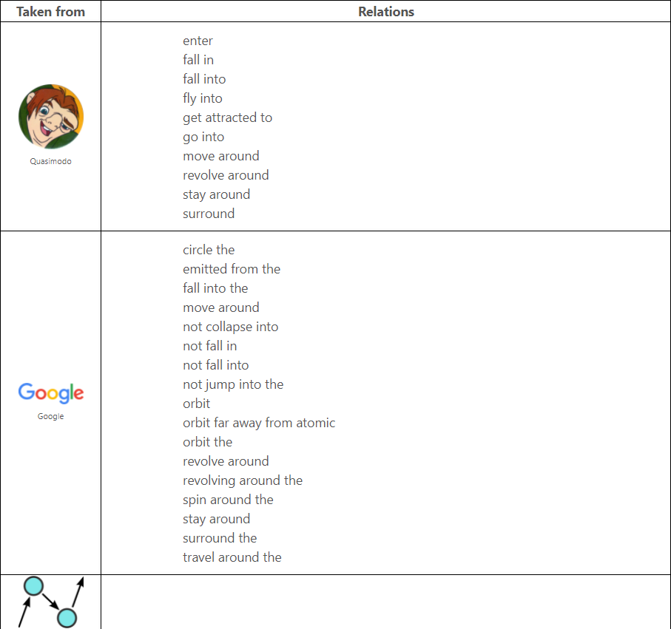
:
:
Earth
Sun
Electrons
Nucleus

Slide 15


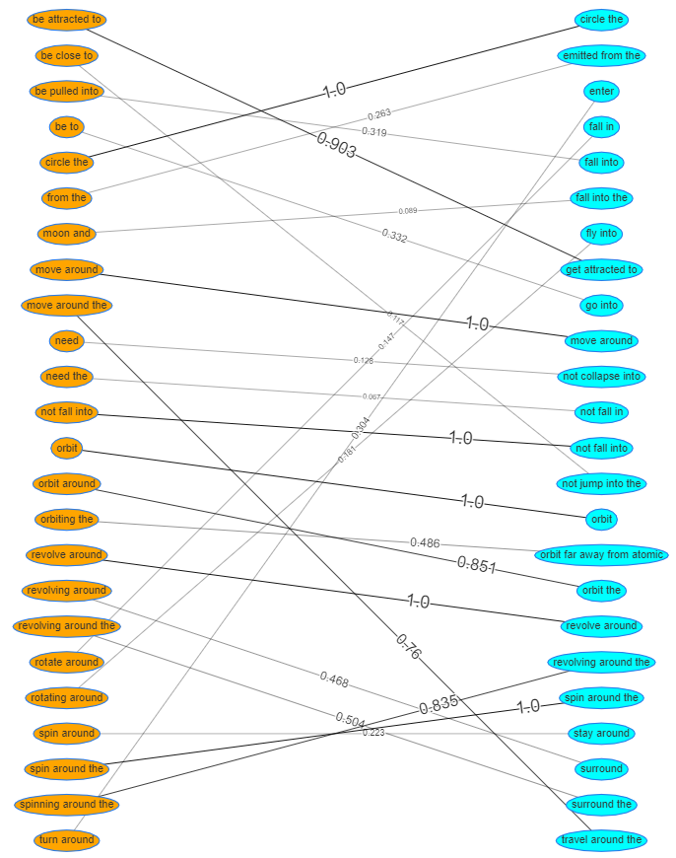

Maximum weights matching

Slide 16
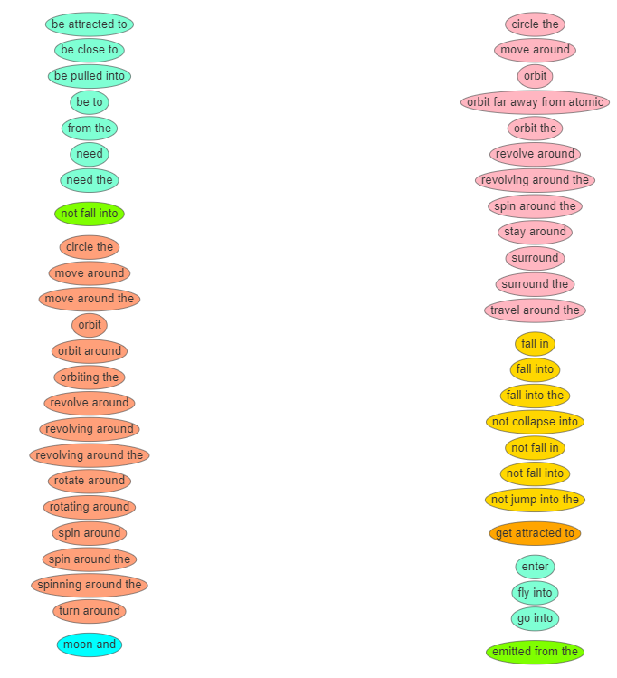
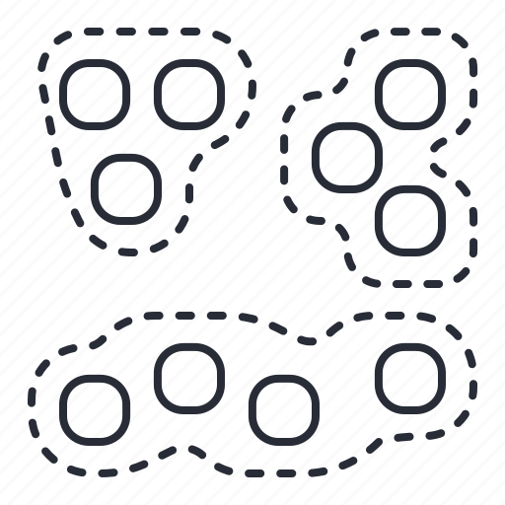
Clustering

Slide 17
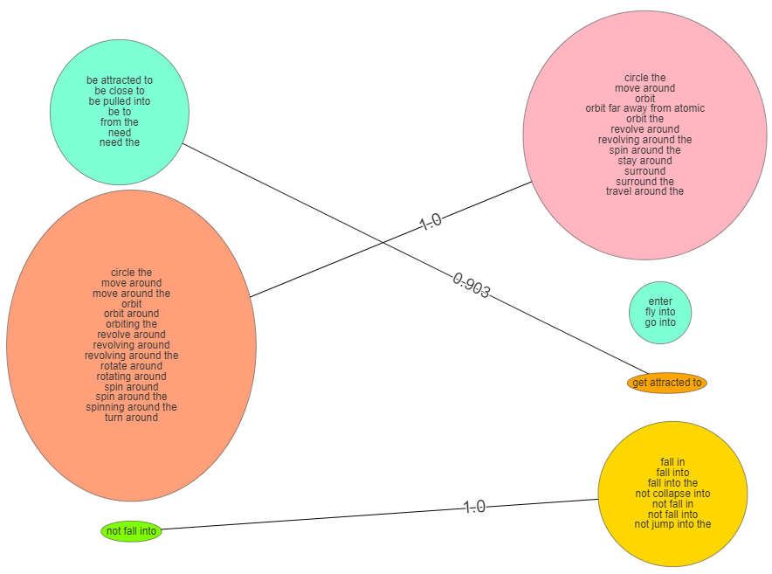
Maximum weights
Matching
+
Clustering

Slide 18
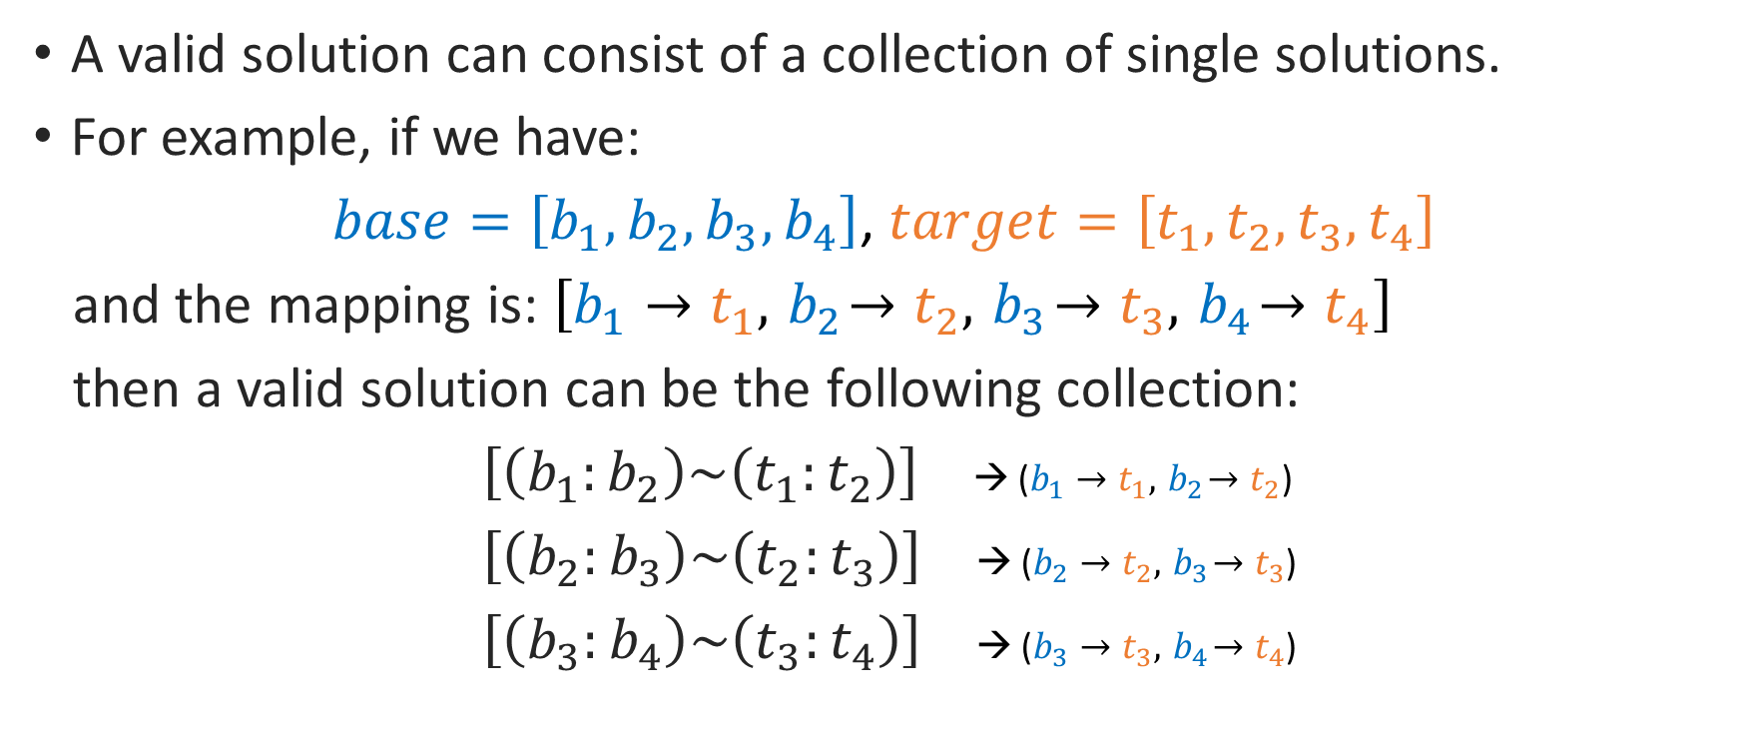
Solution for multiple mapping
A valid solution can consist of a collection of single solutions.
For example, if we have:
$base=\left[b_{1},b_{2},b_{3},b_{4}\right]$, $target=\left[t_{1},t_{2},t_{3},t_{4}\right]$
and the mapping is: $\left[b_{1}→t_{1}, { b}_{2}→t_{2}, { b}_{3}→t_{3}, { b}_{4}→t_{4}\right]$
then a valid solution can be the following collection:
$\left[\left(b_{1}:b_{2}\right)\sim \left(t_{1}:t_{2}\right)\right]$ → ($b_{1}→t_{1}, { b}_{2}→t_{2}$)
$\left[\left(b_{2}:b_{3}\right)\sim \left(t_{2}:t_{3}\right)\right]$ → ($b_{2}→t_{2}, { b}_{3}→t_{3}$)
$\left[\left(b_{3}:b_{4}\right)\sim \left(t_{3}:t_{4}\right)\right]$ → ($b_{3}→t_{3}, { b}_{4}→t_{4}$)

Slide 19
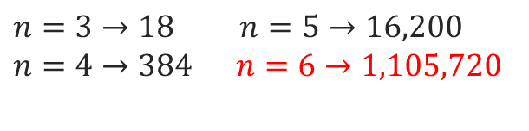
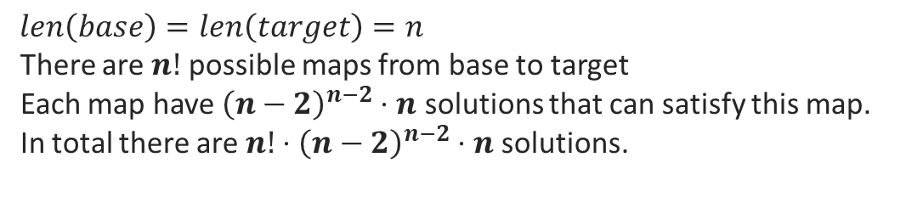
Solution for multiple mapping
We define the score of a solution to be the sum of the single-mappings that make it up
The solution space is huge. For example:
$$len\left(base\right)=len\left(target\right)=n$$
There are $n!$ possible maps from base to target
Each map have ${\left(n−2\right)}^{n−2}⋅n$ solutions that can satisfy this map.
In total there are $n!⋅{\left(n−2\right)}^{n−2}⋅n$ solutions.
$n=3→18$ $n=5→16,200$
$n=4→384$ $n=6→1,105,720$

Slide 20
Solution for multiple mapping
Greedy algorithm:
1. Choose the single mapping with the highest score from the
available single solutions that satisfy the current map.
Update the available single solutions. (should be satisfy the mappings
that chosen in the previous iteration).
3. If all single solutions have score=0 or we map all the entities → return
else → back to 1.
#1
$\left[\left(earth:sun\right)\sim \left(electron:nucleus\right)\right]$ → ($earth→sun, electron→nucleus$)
#2
$\left[\left(earth:gravity\right)\sim \left(electricity:electron\right)\right]$→ ($earth→electricity, gravity→electron$)

Slide 21

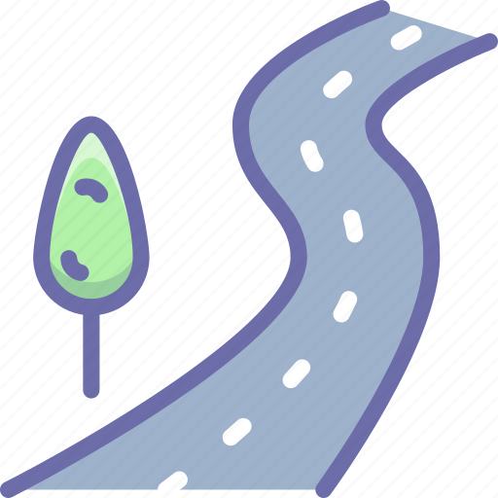




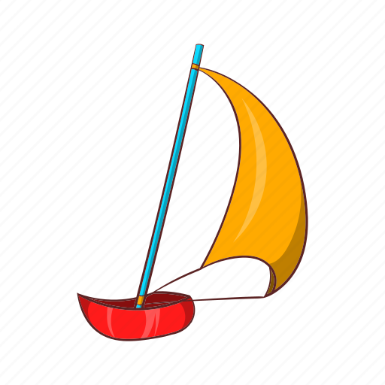
Examples
Base
Base
Earth
Sun
Gravity
Newton
Cars
Road
Wheels
Electrons
Nucleus
Electricity
Faraday
Boats
River
Sail
Target
Target

Slide 22

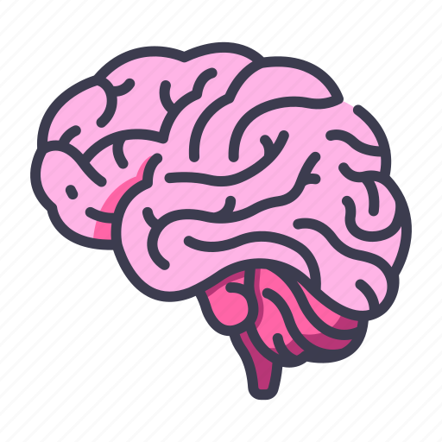
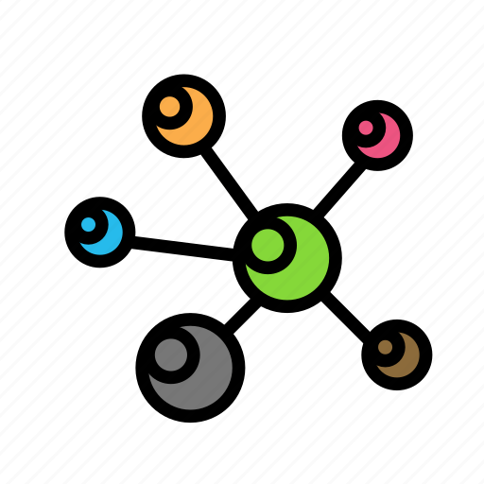


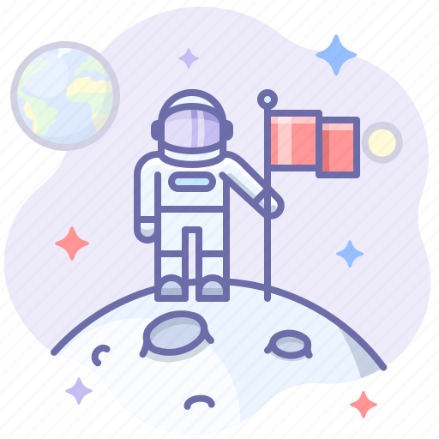





Examples
Base
Base
Thoughts
Brain
Neurons
Sunscreen
Sun
Summer
Astronaut
Space
Block hole
Umbrella
Rain
Winter
Target
Target

Slide 23

Examples
Base
Earth
Sun
Gravity
Newton
Electrons
Nucleus
Electricity
Faraday
Target

Slide 24
Examples
Base
Earth
Gravity
Newton
Electrons
Nucleus
Electricity
Faraday
Target

Slide 25
Examples
This wrong solution (actual) hold score of 2.54
The correct solution (expected) hold score of 2.625
Greedy algorithm was failed
Choosing the highest single-mapping not always lead to the best solution.
Earth
Gravity
Newton
Electrons
Nucleus
Electricity
Faraday
To handle with that problem, in each iteration of the greedy algorithm
we will go recursively with the best top N single-mappings

Slide 26
Entities Suggestions
Sometimes entities can be left without mapping
In that case, we would like to suggest entities for mapping
Base
Target
Sun
Electrons
Humans
Faraday (Michael Faraday)
Tesla (Nikola Tesla)
Einstein (Albert Einstein)
Earth
Nucleus
Gravity
Electricity
Newton

Slide 27
How it works?
Let say we found Newton has no mapping.
Iterate over the other entities in the same domain (sun, earth, gravity),
and extract the relations with Newton.
Iterate over the second domain, and use Google-Autosuggests
with the relations we found in the previous step.
The previous step give as new candidates for the missing mapping.
We run again the greedy algorithm, but just for the first stage,
it will give us the best entity.

Slide 28
Example
Steering wheel
Sails
Cars
Road
Wheels
Boats
River

Slide 29
Example
Sun ☺
Base
Earth
Gravity
Newton
Electrons
Nucleus
Electricity
Faraday
Target

Slide 30
Next…
Understanding which relation are more “important”.
For example, revolve around is much more unique than have or need
Re-check the similarity score of sBERT (affect also on the clustering).
It seems that the gap between similar and non-similar relations is not always large enough.
For example, affect ~ surround get score of 0.453 (not high but not low, it completely different).

Slide 31
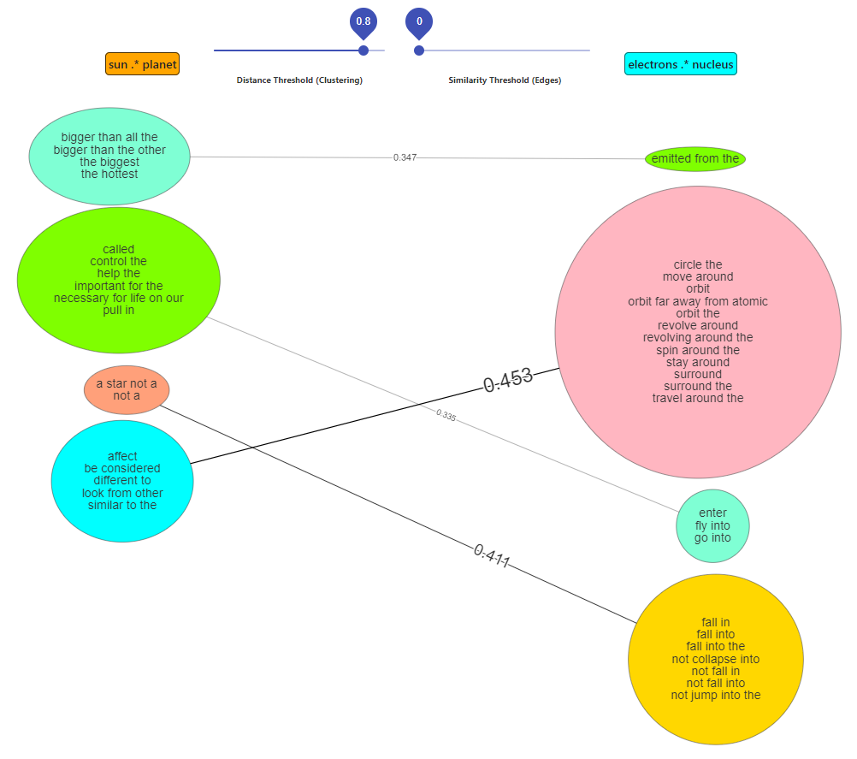

Slide 32
