Slide 1

Resource Optimization for LEO Constellation Networks:
A Multi-Satellite Cooperative Coverage Design
BY: Xu Ma, Haijun Zhang, Wei Song, Yang Lu, Yuan Wu, and Victor C. M. Leung
Final Project - Satellite and Mobile Communication
Prof. Shlomi Arnon
Shachar Lavi & Itamar Guerchon

Slide 2
Background & The Challenge
The Rise of LEO
The Problem
Mega-constellations (Starlink) provide global coverage but deploy hundreds to thousands of satellites simultaneously
Full-frequency multiplexing creates severe spectrum-sharing challenges between adjacent LEO satellites and legacy GSO systems
Interference Types
Co-layer Interference: Adjacent LEO beams share the same frequency band, causing severe interference
Cross-layer Interference: LEO transmissions interfere with legacy GSO earth stations

Slide 3
The Chosen Research Paper
📄 Paper
💡 Core Concept
“Resource Optimization for LEO Constellation Networks:
A Multi-Satellite Cooperative Coverage Design”,
Xu Ma, Haijun Zhang, Wei Song, Yang Lu, Yuan Wu, and Victor C. M. Leung, 2025
Multi-Satellite Cooperative Coverage Scheme (CCS)
⚙️ How It Works
🎯 Our Objective
Replaces K-means beam clustering with the Improved P-center algorithm to minimize beam overlap, while dynamically managing transmit power
Simulate the physical RF layer to demonstrate how network-level optimization directly improves BER and Throughput

Slide 4
Simulation Setup & System Parameters
📡 Modulation
🌡️ Thermal Noise & GSO Cross-layer Interference
QAM-16
Kept constant to isolate co-layer mitigation impact
⚠️ Baseline K-means (Current Method)
✅ Proposed CCS (New Method)
Algorithm: Standard K-means clustering
Beam Overlap: High - direct interference to users
Measured Interference Level: -132 dBW (high interference)
Algorithm: Improved P-center algorithm
Beam Overlap: Minimized - interference pushed to side lobes
Measured Interference Level: -150 dBW (significantly reduced)

Slide 5
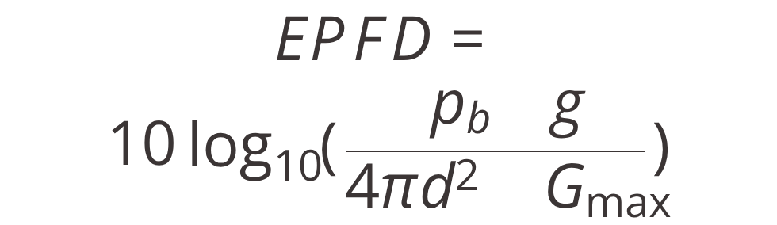

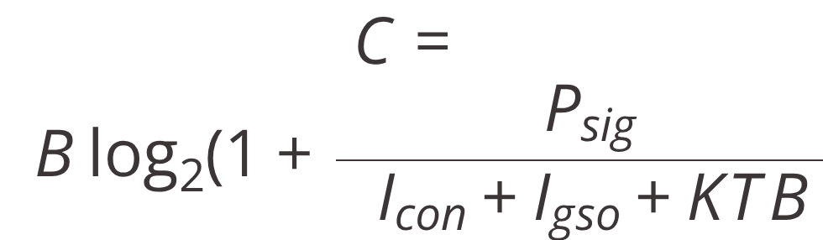



Key Formulas & Computational Framework
1. Shannon-Hartley Capacity under Interference
2. ITU EPFD Compliance
3. Phased Array Antenna Peak Gain
====================================
Where: $P_{b}$= transmit power, g = channel gain, d = distance, $G_{max}$= receiver gain
Formula 2 demonstrates the regulatory constraint that CCS must satisfy
Where: η = efficiency, N = number of antenna cells, $θ_{rad}$= half-power beamwidth in radians
Formula 3 illustrates the antenna design parameters that determine beam directivity and interference patterns
Where: $P_{sig}$ = signal power, $I_{con}$= co-layer interference $I_{gso}$= cross-layer interference, KTB = thermal noise
Formula 1 shows how interference reduction directly increases achievable capacity

Slide 6
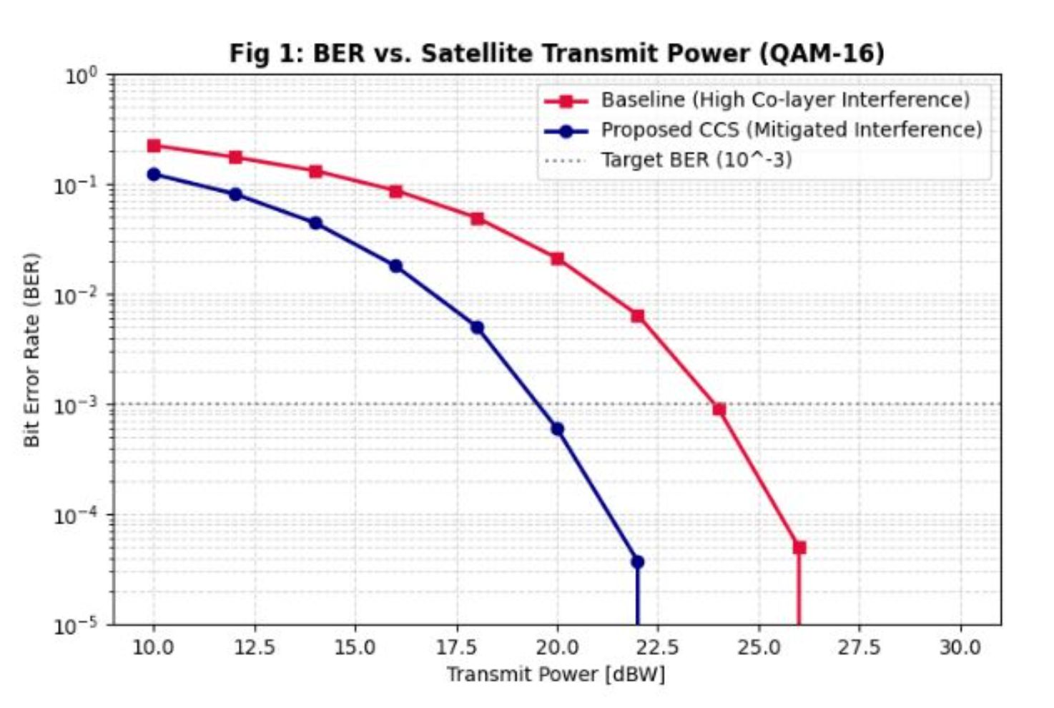
Impact on Bit Error Rate (BER)
Baseline
High interference flattens the BER curve, requires approximately ~24 dBW to reach the target BER
CCS
Pushes interference energy into lower-gain side lobes, reducing the interference floor seen by the receiver
Result
Baseline vs. CCS
Achieves target BER of 10⁻³ with 4 dBW less transmit power than the baseline

Slide 7
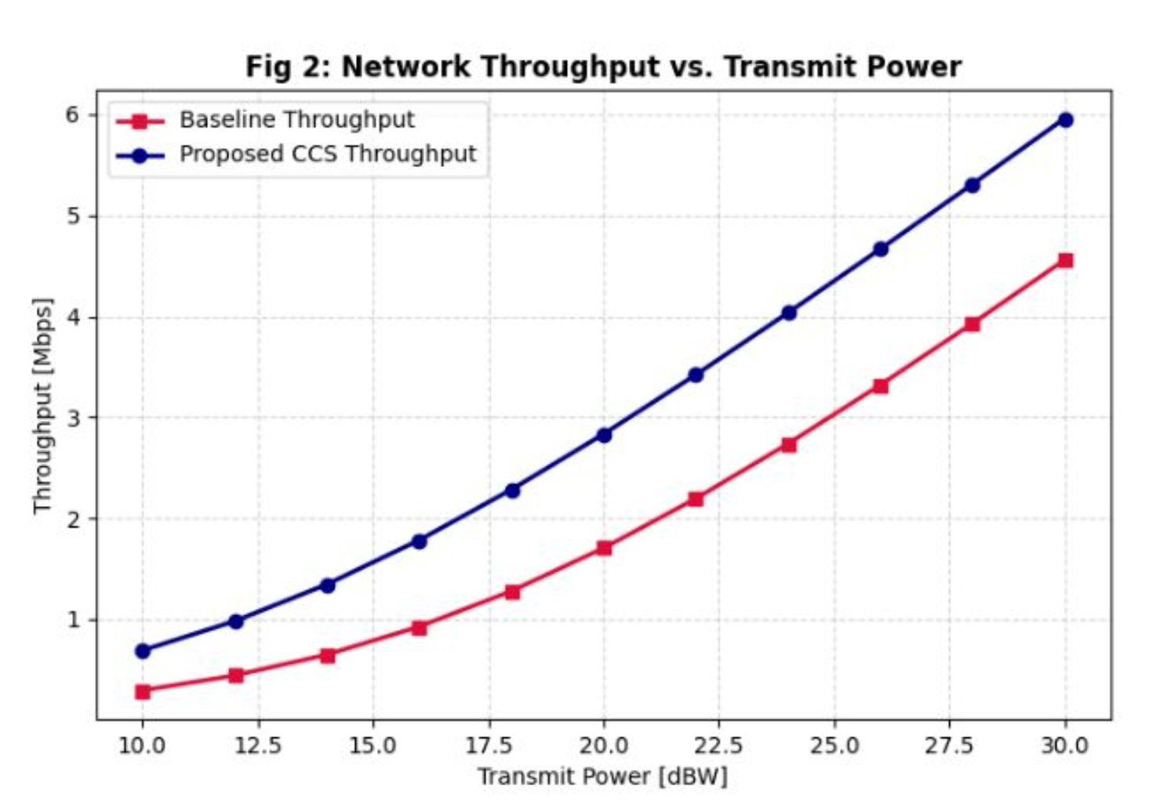
Impact on Network Throughput
Tx Power | Baseline | CCS
20 dBW | 1.7 Mbps | 2.8 Mbps (+64%)
30 dBW | 4.5 Mbps | 5.9 Mbps (+31%)
Higher Data Rates
CCS consistently achieves greater throughput than Baseline at every power level.
Better Power Utilization
Network Throughput vs. Transmit Power - CCS
vs.
Baseline across the full transmit power range
Interference suppression converts wasted power margin into usable capacity.

Slide 8
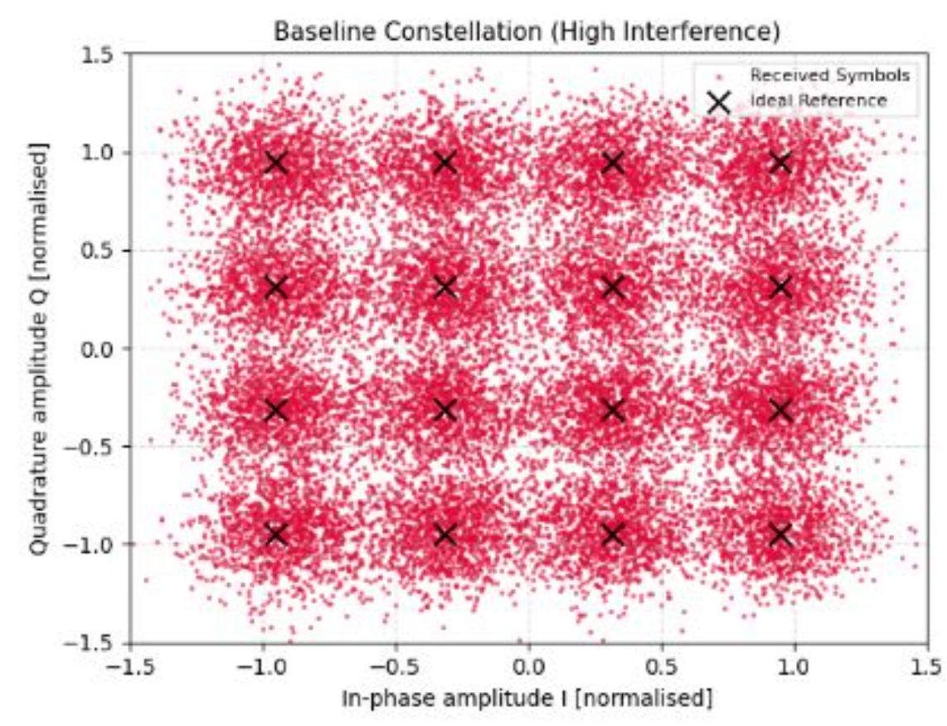
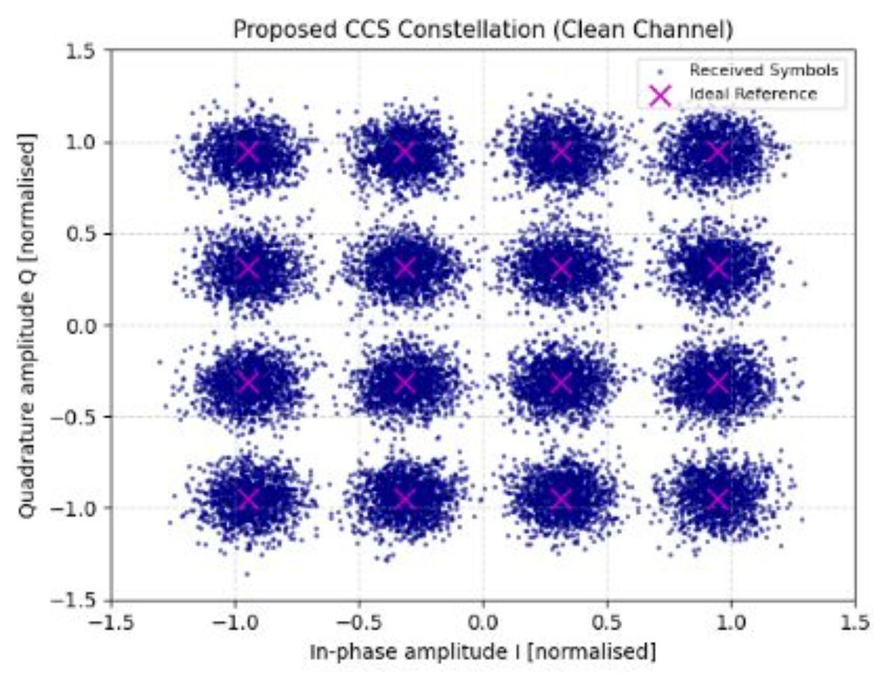
Visualizing the Interference - Constellation
Baseline
CCS
Severe interference causes symbols to spread, blur, and cross decision boundaries - leading to high demodulation error rates
Tight, well-defined QAM-16 clusters with significantly improved demodulation reliability

Slide 9
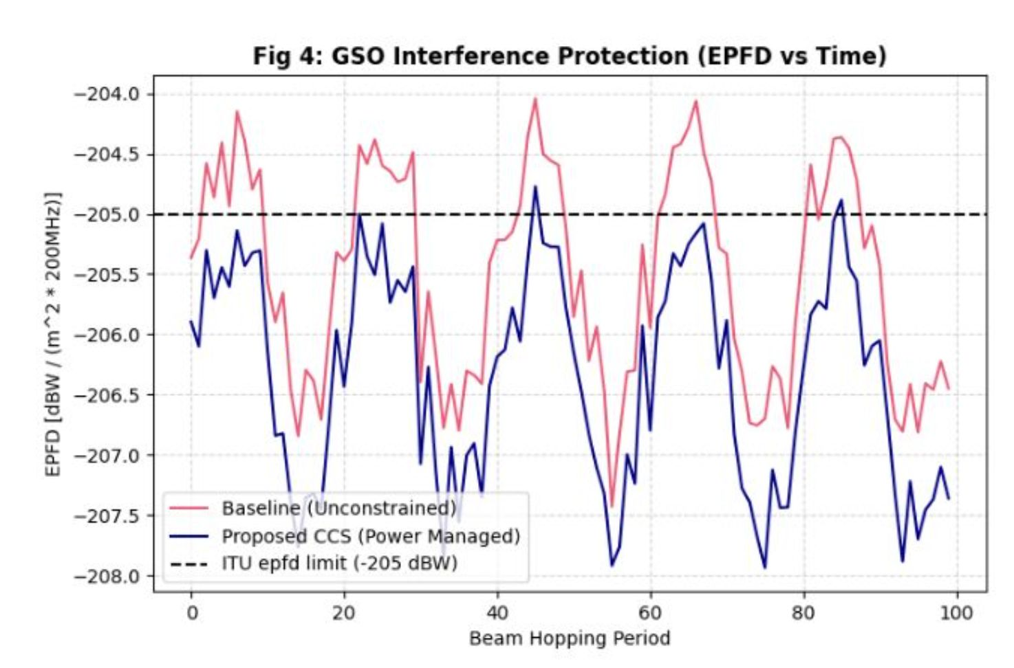
Regulatory Compliance - Protecting GSO
  ITU Constraint: EPFD must not exceed
  -205 dBW/(m² * 200MHz) at GSO earth stations.
  Baseline ✗: Blindly transmits at full power, periodically violates ITU threshold.
  CCS ✓: Actively suppresses power when approaching GSO line-of-sight, maintains strict compliance.
Regulatory Compliance:
GSO Interference Protection (EPFD)

Slide 10
Architectural Trade-offs
Dimension | Baseline | CCS
Beam Placement | K-means (High overlap) | Improved P-center (Minimal overlap)
GSO Protection | Blind transmission (Violates ITU) | Active power suppression (Compliant)
Resource Allocation | Static | Dynamic
Computational Complexity | Low | Moderate
Traffic Resilience | Degrades severely | Robust

Slide 11
Conclusion
Network-level optimization (beam placement) has a dramatic and measurable effect on physical RF link performance
CCS framework successfully lowers BER, increases throughput, and ensures spectral coexistence with GSO systems.
Meets ITU regulatory requirements while delivering meaningful performance gains
Future Work
Extend to multi-orbit architectures (LEO, MEO, GSO)
Integrate predictive machine learning models for dynamic traffic forecasting
Proactive interference management under time-varying channel conditions

Slide 12
Questions
1. המאמר מנסח את ה- CCS כבעיית MINLP (תכנון לא-ליניארי מעורב בשלמים) שהיאNP-hard . הרחיבו על האופי המתמטי של הצימוד בין המשתנים, והסבירו כיצד המאמר משתמש בפרישה דואלית של לגרנז' כדי לפתור את תת-הבעיה המשולבת של שיוך אלומות והקצאת ההספק בזמן פולינומיאלי?

Slide 13
Questions
2. המאמר מציג בעיית אופטימיזציה מרובת יעדים המתמקדת הן בתפוקת הרשת והן ב- time coverage. כיצד תת-הבעיה השלישית, Beam Hopping Time Slot Allocation מאזנת מבחינה מתמטית בין יעדים מנוגדים אלו כדי להבטיח Fairness מסוג Max-Min לאורך הקונסטלציה כולה?

Slide 14
Questions
3. המוטיבציה המרכזית של המאמר היא תרחיש הדו-קיום בין מערכות LEOל- ,GSO תוך הדגשת היחסים הדינמיים התלת-שכבתיים בין לוויינים, אלומות ומשתמשים. כיצד שיטת הCCS - המוצעת מדכאת באופן דינמי הפרעות בין-שכבתיות כדי לעמוד באופן קשיח במגבלות ה-EPFD , מבלי לפגוע באופן חמור בביצועי רשת ה-LEO?

Slide 15

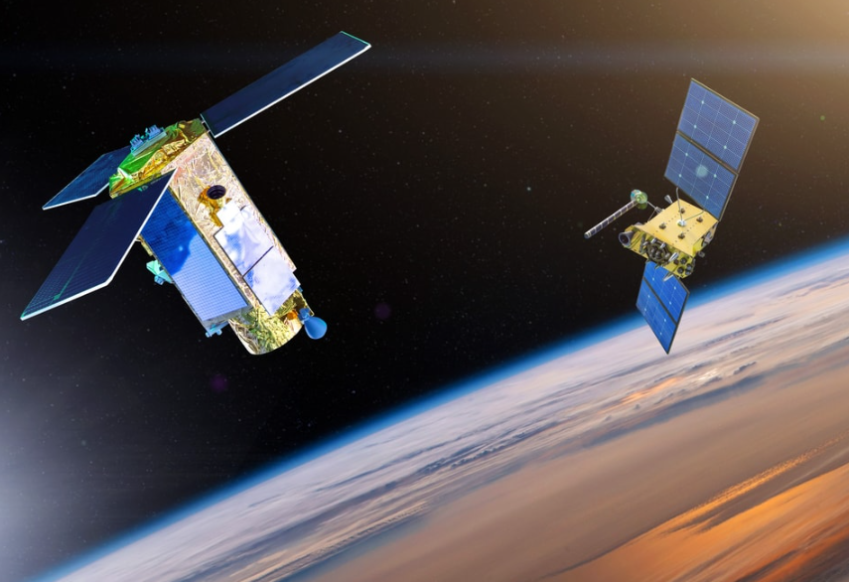
Thank you for listening!

