Slide 1
Assemblers
Chapter 3
System Programming and Operating Systems

Slide 2
Assembler: Definition
Translating source code written in assembly language to object code.

Slide 3
Language Levels
High Level Language
Assembler Language
Machine Language
Micro -programming
Firmware
Hardware

Slide 4
Machine code
Machine code:
Set of commands directly executable via CPU
Commands in numeric code
Lowest semantic level

Slide 5
Machine code language
Structure:
Operation code
Defining executable operation
Operand address
Specification of operands
Constants/register addresses/storage addresses
OpCode
OpAddress

Slide 6
Elements of the Assembly Language Programming
An Assembly language is a
machine dependent,
low level Programming language specific to a certain computer system.
Three features when compared with machine language are
Mnemonic Operation Codes
Symbolic operands
Data declarations

Slide 7
Elements of the Assembly Language Programming
Mnemonic operation codes: eliminates the need to memorize numeric operation codes.
Symbolic operands: Symbolic names can be associated with data or instructions. Symbolic names can be used as operands in assembly statements (need not know details of memory bindings).
Data declarations: Data can be declared in a variety of notations, including the decimal notation (avoids conversion of constants into their internal representation). Example(110101)2 and (4100AF)16

Slide 8
Assembly language-structure/statement format
<Label>
<Mnemomic>
<Operand>
Comments
Label
symbolic labeling of an assembler address (command address at Machine level)
Mnemomic
Symbolic description of an operation
Operands
Contains of variables or addresse if necessary
Comments : Optional field

Slide 9
Statement format
An Assembly language statement has following format:
[Label] <opcode> <operand spec>[,<operand spec>..]
If a label is specified in a statement, it is associated as a symbolic name with the memory word generated for the statement.
<operand spec> has the following syntax:
<symbolic name> [+<displacement>] [(<index register>)]
Eg. AREA, AREA+5, AREA(4), AREA+5(4)
AREA – memory word with which name AREA is associated
AREA +5 : The memory word, which is 5 words away from the word which name is AREA, here ’5’ is displacement offset from AREA
AREA(4) : indexing with index register 4 : the operand address is obtained by adding the content of index register 4 to the address of area

Slide 10
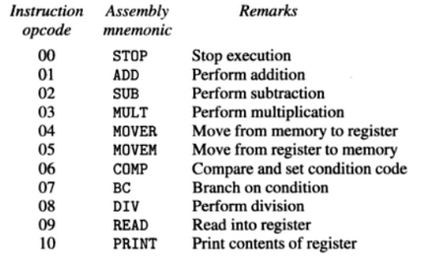
Mnemonic Operation Codes
Each statement has two operands, first operand is always a register which may be any one of AREG, BREG, CREG and DREG and second operand refers to a memory word using a symbolic name and optional displacement. (INDEXING IS NOT PERMITTED)

Slide 11
Operation Codes
MOVE instructions move a value between a memory word and a register
MOVER – First operand is target and second operand is source
MOVEM – first operand is source, second is target
All arithmetic is performed in a register (replaces the contents of a register) and sets condition code.
A Comparision instruction sets condition code analogous to arithmetics, i.e. without affecting values of operands.
condition code can be tested by a Branch on Condition (BC) instruction and the format is:
BC <condition code spec> , <memory address>
It transfers control to memory word with the address <memory address> if current value of condition matches <condition code spec>. assume that condition code be a character string with meanig e.g. GT, LT. A BC statement with condition code spec ANY implies unconditional transfer to control

Slide 12

Machine Instruction Format
sign is not a part of the instruction
Opcode: 2 digits, Register Operand: 1 digit, Memory Operand: 3 digits
Condition code specified in a BC statement is encoded into the first operand using the codes 1- 6 for specifications LT, LE, EQ, GT, GE and ANY respectively
In a Machine Language Program, all addresses and constants are shown in decimal as shown in the next slide

Slide 13
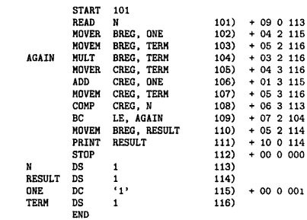
Example: ALP and its equivalent Machine Language Program

Slide 14
Assembly Language Statements
An assembly program contains three kinds of statements:
Imperative Statements
Declaration Statements
Assembler Directives
Imperative Statements: They indicate an action to be performed during the execution of an assembled program. Each imperative statement is translated into one machine instruction.
Example, MOVER,MOVEM, ADD, SUB, BC etc.

Slide 15
Assembly Language Statements
Declaration Statements: syntax is as follows:
[Label] DS <constant>
[Label] DC '<value>'
The DS (declare storage) statement reserves memory and associates names with them.
Ex:
A DS 1 ; reserves a memory area of 1 word, associating the name A to it
G DS 200 ; reserves a block of 200 words and the name G is associated with the
first word of the block (G+5 is sixth word of memoty block)
The DC (declare constant) statement constructs memory words containing constants.
Ex:
ONE DC '1’ ; associates name one with a memory word containing value 1
The programmar can declare constants in different forms –decimal, binary, hexadeimal, etc. The assembler convert them in to the appropreate internal form.

Slide 16
Assembly Language Statements
Use of Constants
The DC statement does not really implement constants
it just initializes memory words to given values.
The values are not protected by the assembler and can be changed by moving a new value into the memory word.
In the above example, the value of ONE can be changed by executing an instruction
MOVEM BREG, ONE

Slide 17
Assembly Language Statements
Use of Constants
An Assembly Program can use constants just like HLL, in two ways – as immediate operands, and as literals.
1) Immediate operands can be used in an assembly statement only if the architecture of the target machine includes the necessary features.
Ex: ADD AREG,5
This is translated into an instruction from two operands – AREG and the value '5' as an immediate operand

Slide 18
Assembly Language Statements
Use of Constants
2) A literal is an operand with the syntax = '<value>'.
It differs from a constant because its location cannot be specified in the assembly program.
Its value does not change during the execution of the program.
It differs from an immediate operand because no architectural provision is needed to support its use.
ADD AREG, =‘5’ ➔ ADD AREG, FIVE
FIVE DC ‘5’
Use of literals vs. Use of DC
(a)
(b)
When assembler encounter the use of literal in operand field of statement, it handles the literal using arrangement shown in (b) - it allocates memory word to contain the value of literal, and replaces the use of literal in statement by an operand expression referring to this word. The value of literal is protected by the fact that name and address of this word is not known to the assembly language programmer.

Slide 19
Assembly Language Statements
Assembler Directive
Assembler directives instruct the assembler to perform certain actions during the assembly of a program.
Some assembler directives are described in the following:
1) START <constant>
This directive indicates that the first word of the target program generated by the assembler should be placed in the memory word having address <constant>.
2) END [<operand spec>]
This directive indicates the end of the of the source program. The optional <operand spec> indicates the address of the instruction where the execution of the program should begin.

Slide 20
Advantages of Assembly Language
The primary advantages of assembly language programming over machine language programming are due to the use of symbolic operand specifications.
(in comparison to machine language program)
Assembly language programming holds an edge over HLL programming in situations where it is desirable to use architectural features of a computer.
(in comparison to high level language program)

Slide 21
Advantages of Assembly Language
Consider the assembly code of next slide. In previous slide program computes N!. and program of next slide computes ½ * N! where rectangular boxes are used to highlight changes in the program.
Once statement has been inserted before the PRINT statement to implement division by 2. In the machine language program, this leads to changes in address of constants and reserve memory areas.
Because of these addresses used in most instructions of the program had to change.
Such changes are not needed in assembly program since operand specifications are symbolic in nature.

Slide 22
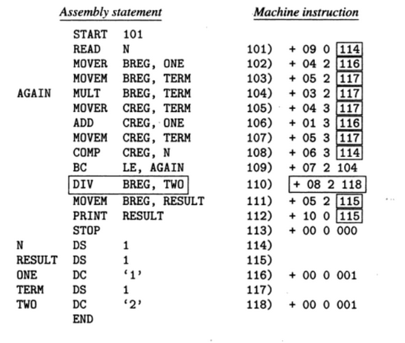

Slide 23
Fundamentals of LP
Language processing = analysis of source program + synthesis of target program
Analysis of source program is specification of the source program
Lexical rules: formation of valid lexical units(tokens) in the source language
Syntax rules : formation of valid statements in the source language
Semantic rules: associate meaning with valid statements of the language

Slide 24
Fundamentals of LP
Synthesis of target program is construction of target language statements
Memory allocation : generation of data structures in the target program
Code generation

Slide 25
A simple Assembly Scheme
There are two phases in specifying an assembler:
Analysis Phase
Synthesis Phase(the fundamental information requirements will arise in this phase)

Slide 26
A simple Assembly Scheme
Design Specification of an assembler
There are four steps involved to design the specification of an assembler:
Identify information necessary to perform a task.
Design a suitable data structure to record information.
Determine processing necessary to obtain and maintain the information.
Determine processing necessary to perform the task
The fundamental information requirement arise in synthesis phase of an assembler. Hence it is best to begin by considering the information requirements of synthesis tasks.

Slide 27
Synthesis Phase: Example
Consider the following statement:
MOVER BREG, ONE
The following info is needed to synthesize machine instruction for this stmt:
Address of the memory word with which name ONE is associated [depends on the source program, hence made available by the Analysis phase].
Machine operation code corresponding to MOVER [does not depend on the source program but depends on the assembly language, hence synthesis phase can determine this information for itself]
Note: Based on above discussion, the two data structures required during the synthesis phase are described next

Slide 28
Data structures in synthesis phase
Symbol Table --built by the analysis phase
The two primary fields are name and address of the symbol used to specify a value.
Mnemonics Table --already present
- The two primary fields are mnemonic and opcode, along with length.
Synthesis phase uses these tables to obtain
The machine address with which a name is associated.
The machine op code corresponding to a mnemonic.
The tables have to be searched with the
Symbol name and the mnemonic as keys

Slide 29
Analysis Phase
Primary function of the Analysis phase is to build the symbol table.
It must determine the addresses with which the symbolic names used in a program are associated
It is possible to determine some addresses directly like the address of first instruction in the program (ie.,start)
Other addresses must be inferred
To determine the addresses of the symbolic names we need to fix the addresses of all program elements preceding it through Memory Allocation.
To implement memory allocation a data structure called location counter is introduced.

Slide 30
Analysis Phase – Implementing memory allocation
LC(location counter) :
is always made to contain the address of the next memory word in the target program.
It is initialized to the constant specified at the START statement.
When a LABEL is encountered,
it enters the LABEL and the contents of LC in a new entry of the symbol table.
LABEL – e.g. N, AGAIN, SUM etc
It then finds the number of memory words required by the assembly statement and updates the LC contents
To update the contents of the LC, analysis phase needs to know lengths of the different instructions
This information is available in the Mnemonics table and is extended with a field called length
We refer the processing involved in maintaining the LC as LC Processing

Slide 31
Example
START 100
MOVER BREG, N LC = 100 (1 byte)
MULT BREG, N LC = 101 (1 byte)
STOP LC = 102 (1 byte)
N DS 5 LC = 103
Symbol | Address
N | 103

Slide 32
Since there the instructions take different amount of memory, it is also stored in the mnemonic table in the “length” field
Mnemonic | Opcode | Length
MOVER | 04 | 1
MULT | 03 | 1

Slide 33
Data structures of an assembler
During analysis and
Synthesis phases
Mnemonic | Opcode | length
ADD | 01 | 1
SUB | 02 | 1
Mnemonic Table
Analysis Phase
Synthesis
Phase
Target
Program
Source
Program
--------------------------------->
Symbol | Address
N | 104
AGAIN | 113
Data Access
-- > Control Access
Symbol Table

Slide 34
Data structures
Mnemonics table is a fixed table which is merely accessed by the analysis and synthesis phases
Symbol table is constructed during analysis and used during synthesis

Slide 35
Tasks Performed : Analysis Phase
Isolate the labels, mnemonic opcode and operand fields of a statement.
If a label is present, enter (symbol, <LC>) into the symbol table.
Check validity of the mnemonic opcode using mnemonics table.
Update value of LC.

Slide 36
Tasks Performed : Synthesis Phase
Obtain machine opcode corresponding to the mnemonic from the mnemonic table.
obtain address of the memory operand from symbol table.
Synthesize a machine instruction or machine form of a constant, depending on the instruction.

Slide 37
Assembler’s functions
Convert mnemonic operation codes to their machine language equivalents
Convert symbolic operands to their equivalent machine addresses
Build the machine instructions in the proper format
Convert the data constants to internal machine representations
Write the object program and the assembly listing

Slide 38
Assembler:Design
The design of assembler can be of:
Scanning (tokenizing)
Parsing (validating the instructions)
Creating the symbol table
Resolving the forward references
Converting into the machine language

Slide 39
Assembler Design
Pass of a language processor – one complete scan of the source program
Assembler Design can be done in:
Single pass
Two pass
Single Pass Assembler:
Does everything in single pass
Cannot resolve the forward referencing
Two pass assembler:
Does the work in two pass (pass 1 analysis, pass2 synthesis)
Resolves the forward references

Slide 40
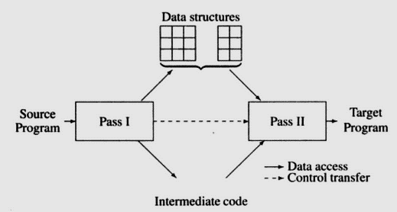
Assembler Design
Two pass assembler:
Does the work in two pass (pass 1 analysis, pass2 synthesis)
Pass 1: LC processing, symbols entered in symbol table
Pass 2: Synthesize the target form using address information found in symbol table.
Resolves the forward references
First pass constructs intermediate representation of source program for use by second pass. Here two main components - data structures, symbol table and a processed form of the source program which is known as intermediate code

Slide 41
Difficulties: Forward Reference
Forward reference: reference to a label that is defined later in the program.
Loc Label Operator Operand
1000 FIRST MOVR BREG, ONE
1003 CLOOP MULT BREG, TERM
… … … …
1012 TERM DC 2
… … … …
1033 ONE DC 1

Slide 42
Backpatching
The problem of forward references is handled using a process called backpatching
Initially, the operand field of an instruction containing a forward reference is left blank
Ex: MOVER BREG, ONE can be only partially synthesized since ONE is a forward reference
The instruction opcode and address of BREG will be assembled to reside in location 101
To insert the second operand’s address later, an entry is added as Table of Incomplete Instructions (TII)
The entry TII is a pair (<instruction address>, <symbol>) which is (101, ONE) here

Slide 43
Backpatching
The problem of forward references is handled using a process called backpatching
When END statement is processed, the symbol table would contain the addresses of all symbols defined in the source program
So TII would contain information of all forward references
Now each entry in TII is processed to complete the instruction
Ex: the entry (101, ONE) would be processed by obtaining the address of ONE from symbol table and inserting it in the operand field of the instruction with assembled address 101.
Alternatively, when definition of some symbol L is encountered, all forward references to L can be processed

Slide 44
Single pass translation :Assembler Design
Symbol Table:
This is created during pass 1
All the labels of the instructions are symbols
Table has entry for symbol name, address value.
Forward reference:
Symbols that are defined in the later part of the program are called forward referencing.
There will not be any address value for such symbols in the symbol table in pass 1. This can be tackled using backpatching.

Slide 45
Assembler Design
Assembler directives are pseudo instructions.
They provide instructions to the assemblers itself.
They are not translated into machine operation codes.

Slide 46
Assembler Design
First pass:
Scan the code by separating the symbol, mnemonic op code and operand fields
Build the symbol table
Perform LC processing
Construct intermediate representation
Second Pass:
Solves forward references
Converts the code to the machine code

Slide 47
Two Pass Assembler
Read from input line
LABEL, OPCODE, OPERAND
Source
program
Intermediate
file
Object
codes
Pass 1
Pass 2
Mnemonic TAB
SYMTAB
SYMTAB

Slide 48
Advanced Assembler Directives
1. ORIGIN
This directive is like START instruction, which indicates address of the next consecutive instruction or data.
Format of this statement is as follows
ORIGIN <address spec>
<address spec> may be operand or constant, symbol or symbolic expression.
This directive indicates that LC should be set to The address given by <address spec>
The ORIGIN directive is useful when the machine code is not stored in consecutive memory location.
ORIGIN provides ability to perform LC processing in relative manner rather than absolute manner

Slide 49
Advanced Assembler Directives
1. ORIGIN
ORIGIN in Relative manner
ORIGIN LOOP +2
MULT CREG, B
here LC at LOOP is 202, than now LC will set to location 204 and the address of machine code for MULT CREG,B will become 204
The statement LAST+1 sets LC to location 217
Equivalent effect can be achieved by using statement ORIGIN 204 and ORIGIN 217, however absolute addresses used in these statements would needed be changed if the address specification of START statement is changed.

Slide 50
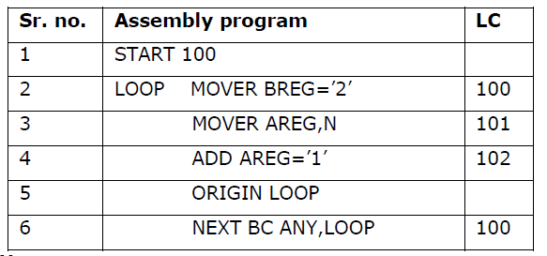

Slide 51
Advanced Assembler Directives
2. EQU
<symbol> EQU <address spec>
Ex: A EQU B
Address of B is assigned to A in symbol table.
This directive simply associate the name <symbol> with < address spec>.
where <address spec> may be constant or operand.
The EQU statement is defers from the DC/DS statement as no LC processing is implied

Slide 52
Advanced Assembler Directives
2. LTORG
LTORG
‘=5’
‘=1’
This directive allocates memory to all literals of current pool and update literal table, pool table
Format of this instruction is as follows
LTORG.
If LTORG statement is not present, literals are placed after the END statement.

Slide 53
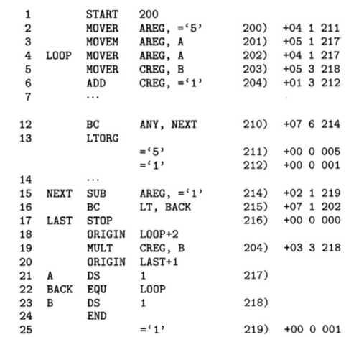
ASSEMBLY PROGRAM ILLUSTRATING ORIGIN AND LTORG

Slide 54
The LTORG statement permits programmer to specify where literal should be placed. by default assembler places literals after end statement
At Every LTORG statement, as also at END statement The assembler allocates memory to the literals of the literal pool. The pool contains all literals used in the program since start of program or start of LTORG statement.
in Program of previous slide , literals ‘=5’ and ‘=1’ are added to literal pool with addresses 211 and 212
A new literal pool now started and value ‘=1’ is put in to this pool in statement 15. this value is allocated at address 219 of second pool of literals rather than location 213 of first pool

Slide 55
Data Structures in Pass I
OPTAB – a table of mnemonic op codes
Contains mnemonic op code, class and mnemonic info
Class field indicates whether the op code corresponds to
an imperative statement (IS),
a declaration statement (DL) or
an assembler Directive (AD)
For IS, mnemonic info field contains the pair ( machine opcode, instruction length)
Else, it contains the id of the routine to handle the declaration or a directive statement
In case of DS statement , routine R#7 would be called.
The routine processes the operand field of the statement to determine the amount of memory required and updates LC and the SYMTAB entry of the symbol defined

Slide 56
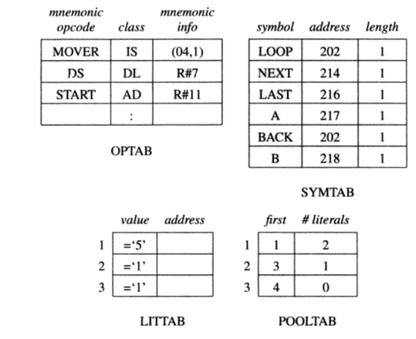
Literal No
#1
#3
---
POOLTAB : A table of information concerning literal pools

Slide 57
Data Structures in Pass I
SYMTAB - Symbol Table
Contains address and length
LOCCTR - Location Counter
LITTAB – a table of literals used in the program
Contains literal and address
Awareness of different literal pools is maintained using auxiliary table POOLTAB.
This table contains literal number of starting literal of each pool.
At any stage current literal pool is the last pool in literal table.
In previous program first two literals will be allocated the addresses 211 and 212, At the end third literal will be allocated address 219
Pooltab_ptr : points to entry in pool table
littab_ptr : points to entry in literal table

Slide 58
Algorithm for first pass of assembler
1) loc_cntr=0(default value)
pooltab_ptr=1; POOLTAB[1]=1;
littab_ptr=1;
2) While next statement is not END statement
a) If a label is present then
this_label=symbol in label field
Enter (this_label, loc_cntr) in SYMTAB
b) If an LTORG statement then
(i) Process literals LITTAB to allocate memory and put the address field. update loc_cntr accordingly
(ii) pooltab_ptr= pooltab_ptr+1;
(iii) POOLTAB[ pooltab_ptr]= littab_ptr
c) If a START or ORIGIN statement then
loc_cntr=value specified in operand field;
d) If an EQU statement then
(i) this_address=value specified in <address spec>;
(ii) Correct the symtab entry for this_label to (this_label, this_address);

Slide 59
e) If a declaration
(i) Code= code of the declaration statement
(ii) Size= size of memory area required by DC/DS
(iii) is symbol is present in label field than correct entry in symbol table entry for this_label to (this_label, <LC >, size)
(iV) loc_cntr=loc_cntr+size;
(V) Generate IC ’(DL,code)’..
f) If an imperative statement then
(i) Code= machine opcode from OPTAB
(ii) loc_cntr=loc_cntr+instruction length from OPTAB;
(iii) if operand is a literal then
this_literal=literal in operand field;
LITTAB[littab_ptr]=this_literal;
littab_ptr= littab_ptr +1;
else this_entry= SYMTAB entry number of operand
generate IC ‘(IS, code)(S, this_entry)’;
3) (processing END statement)
a) Perform step2(b)
b) Generate IC ‘(AD,02)’
c) Go to pass II

Slide 60
Intermediate code form
Intermediate code consist of a set of IC units, each unit consisting of the following three fields
1. Address
2. Representation of mnemonics opcode
3. Representation of operands
ADDRESS | OPCODE | OPERANDS

Slide 61
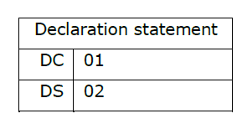
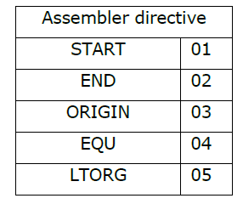
MNEMONIC filed
The mnemonics field contains a pair of the form
(statement class, code)
Where statement class can be one of IS, DL, and AD standing for imperative statement,
declaration statement and assembler directive respectively.
For imperative statement, code is the instruction opcode in the machine language.
For declarations and assembler directives, code is an ordinal number within the class.
Thus, (AD, 01) stands for assembler directive number 1 which is the directive START.
Codes for various declaration statements and assembler directives are given in table.

Slide 62
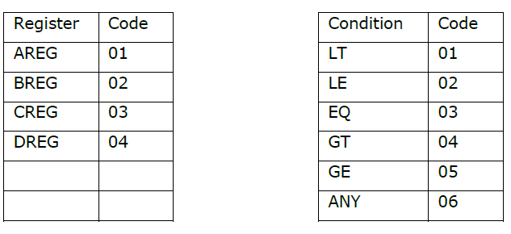
INTERMEDIATE CODE FOR IMPERATIVE STATMENTS
Variant I
First operand is represented by a single digit number which is a code for a register or the condition code.
The second operand, which is a memory operand, is represented by a pair of the form

Slide 63
INTERMEDIATE CODE FOR IMPERATIVE STATMENTS
Variant I
Where operand class is one of the C, S and L standing for constant, symbol and literal.
For a constant, the code field contains the internal representation of the constant itself.
Ex: the operand descriptor for the statement START 200 is (C,200).
For a symbol or literal, the code field contains the ordinal number of the operand’s entry in SYMTAB or LITTAB.
Variant II
This variant differs from variant I of the intermediate code because in variant II symbols, condition codes and CPU register are not processed.here for declarative statement and assembler directives processing of operand field is essential to support LC processing. Hence these field contains the processed forms. For imperative statements the operand field is only to identify literal references.
So, IC unit will not generate for that during pass I.

Slide 64
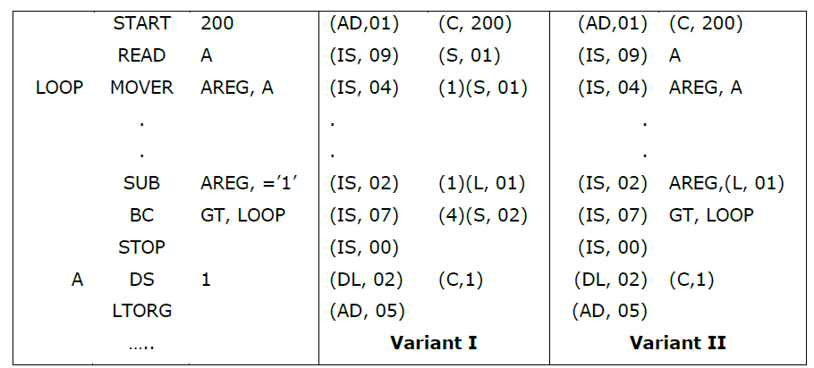

Slide 65
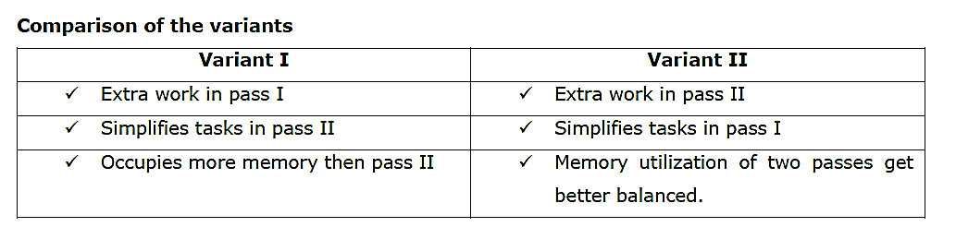
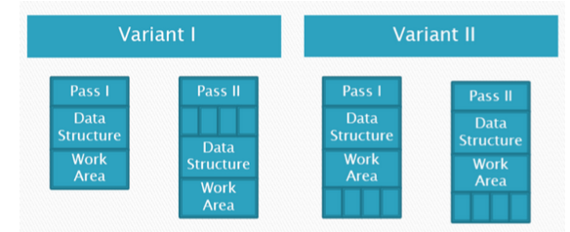
Memory requirement using variant I and variant II

Slide 66
INTERMEDIATE CODE FOR IMPERATIVE STATMENTS
Variant II is preferably suited for
Where expressions are permitted in operand fields.
Eg: MOVER AREG,A+5
Preferably suited for:
Not at all processed operand fields.
Eg: (IS,05)(1)(S,01)+5

Slide 67
PROCESSING OF DECLARATIONS AND ASSEMBLER DIRECTIVES:
Our focus is: identify alternative ways of processing declaration statements and assembler directives.
This depends on answers of two related questions.
1. Is it necessary to represent the address of each source statement in IC ?
2. Is it necessary to have an explicit representation of DS statements and assembler directives in IC?
Consider following code and its IC.
START 200 -----) (AD,01) (C,200)
AREA DS 20 200) (DL,02) (C,20)
SIZE DC 5 220) (DL,01) (C,5)

Slide 68
PROCESSING OF DECLARATIONS AND ASSEMBLER DIRECTIVES:
It is redundant to have the representation of START and DS statements in IC.
Thus, its not necessary to have representation of DS and START in IC if IC contains address field.
If the address field of the IC is omitted, a representation for DS statements and assembler directives becomes essential.
Now pass-II can determine the address of SIZE only after analyzing the intermediate code units for the START and DS statements.
If the representation of address of each source statement existence in IC, it avoids the processing of START and DS statement.
So, space –time tradeoff.

Slide 69
DC STATEMENT
A DC statement must be represented in IC.
If a DC statement defines many constants,
e.g. DC ‘5, 3, -7’
A series of (DL,01) units can be put in the IC.
Example : (DL,01) (C,5)
(DL,01)(C,3)
(DL,01)(C,-7)
START and ORIGIN
These directives set new values into the LC.
It is not necessary to retain START and ORIGIN statements in the IC if the IC contains an address field.

Slide 70
LTORG STATEMENT
Pass-I checks for the presence of literal reference in the operand field of every statement. If exists, it enters the literal in the current literal pool in LITTAB.
When an LTORG statement appears in the source program, it assigns memory addresses to the literals in current pool.
Pass-I construct an IC unit for the LTORG statement and values of literals can be inserted in the target program when this IC unit is processed in pass-II.
Literals of the first pool are copied into the target program when the IC unit for LTORG is encountered in pass-ii and second pool once END statement is encountered.
Alternatively pass I could itself copy out the literals of the pool in the IC. This avoids duplication of pass I action in to pass II. and no special processing will be required in pass II

Slide 71
LTORG STATEMENT
START 200 (AD,01) (C,200)
MOVER AREG, ‘=5’ (IS, 04)(1)(L,01)
MOVEM AREG, A (IS, 05) (1)(S,01)
LOOP MOVER AREG, A (IS, 04)(1) (S,01)
BC ANY, NEXT (IS, 07)(6)(S,04)
LTORG (DL,01)(C,5)
However this alternative increases the task to be performed by pass I, consequently increases the size.
It leads to unbalanced pass structure

Slide 72
PASS II OF TWO PASS ASSEMBLER
It has been assumed that the target code is to be assembled in the area named code_area.
1. Code_area_adress= address of code_area;
Pooltab_ptr=1;
Loc_cntr=0;
2. While next statement is not an END statement
a) Clear machine_code_buffer;
b) If an LTORG statement
i) Process literals in LITTAB and assemble the literals in machine_code_buffer.
ii) Size= size of memory area required for literals
iii) Pooltab_ptr=pooltab_ptr +1;
c) If a START or ORIGIN statement
i) Loc_cntr=value specified in operand field;
ii) Size=0;
d) If a declaration statement
i) If a DC statement then assemble the constatnt in machine_code_buffer;
ii) Size= size of memory area required by DC/DS;

Slide 73
PASS II OF TWO PASS ASSEMBLER
e) If an imperative statement
i) Get operand address from SYMTAB or LITTAB
ii) Assemble instruction in machine_code_buffer;
iii) Size=size of instruction;
f) If size≠ 0 then
i) Move contents of machine_code_buffer to the address code_area_address+loc_cntr;
ii) Loc_cntr=loc_cntr+size;
3. Processing end statement
a) Perform steps 2(b) and 2(f)
b) Write code_area into output file.

Slide 74
ERROR REPORTING IN PASS I
Listing an error in first pass has the advantage that source program need not be preserved till pass II But, listing produced in pass I can only reports certain errors not all.
From the program of next side , error is detected at statement 9 and 21.
Statement 9 gives invalid opcode error because MVER does not match with any mnemonics in OPTAB.
Statement 21 gives duplicate definition error because entry of A is already exist in symbol table.
Undefined symbol B at statement 10 is harder to detect during pass I, this error can be detected only after completing pass I.

Slide 76
ERROR REPORTING IN PASS II
During pass II data structure like SYMTAB is available.
Error indication at statement 10 is also easy because symbol table is searched for an entry B. if match is not found, error is reported.

Slide 77
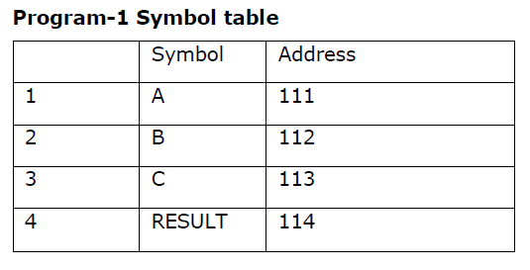
GENERATE INTERMEDIATE CODE FOR FOLLOWING STATEMENTS
START 100
READ A
READ B
READ C
MOVER AREG,A
ADD AREG,B
ADD AREG,C
MULT AREG,C
MOVEM AREG,RESULT
PRINT RESULT
STOP
A DS 1
B DS 1
C DS 1
RESULT DS 1
END
(AD,01) (C,100)
(IS,09) (S,01)
(IS,09) (S,02)
(IS,09) (S,03)
(IS,04) (01)(S,01)
(IS,01) (01)(S,02)
(IS,01) (01)(S,03)
(IS,03) (01)(S,03)
(IS,05) (01)(S,04)
(IS,10) (S,04)
(IS,00)
(DL,02) (C,01)
(DL,02) (C,01)
(DL,02) (C,01)
(DL,02) (C,01)
(AD,02)
IC USING VARIANT 1

Slide 78
GENERATE INTERMEDIATE CODE FOR FOLLOWING STATEMENTS
START 101
READ A
READ B
MOVER BREG,A
MULT BREG,B
MOVEM BREG,D
STOP
A DS 1
B DS 1
D DS 1
END
(AD,01) (C,101)
(IS,09) (S,01)
(IS,09) (S,02)
(IS,04) (2)(S,01)
(IS,03) (2)(S,02)
(IS,05) (2)(S,03)
(IS,00)
(DL,02) (C,01)
(DL,02) (C,01)
(DL,02) (C,01)
(AD,02)
(AD,01) (C,101)
(IS,09) A
(IS,09) B
(IS,04) BREG,A
(IS,03) BREG,B
(IS,05) BREG,D
(IS,00)
(DL,02) (C,01)
(DL,02) (C,01)
(DL,02) (C,01)
(AD,02)

Slide 79
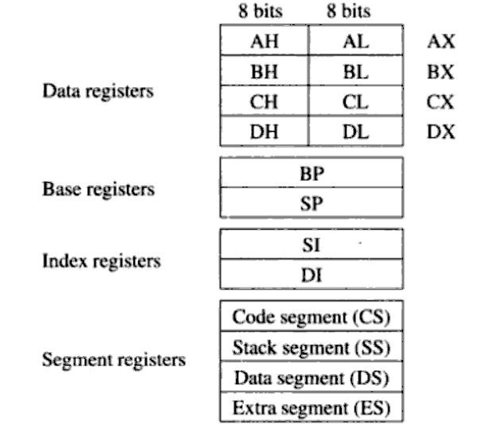
Single pass assembler
In this section we will discuss a single pass assembler for the intel 8088 processor used in IBM PC
The main feature of single pass assembler of 8088 is forward reference handling in segment based environment
THE ARCHITECTURE OF INTEL 8088
It supports 8 and 16 bit arithmetic and also provides special instruction for string manipulation.

Slide 80
Single pass assembler
Each data register is 16 bit in size. split in upper and lower halves, either half can be used for 8 bit arithmetic, while two halves together constitute the data register for 16 bit arithmetic.
8088 supports stack for storing subroutine and return addresses, parameters and other data.
The index register SI and DI are used to index source and destination addresses in string manipulation instruction. They are provided with auto increment and decrement facility.
stack pointers SP and BP are provided to address the stack. SP points to stack implicitly used by architecture to store subroutine and return address. BP can be used by programmer in desired manner. Push and pop instructions are provided for this purpose.
8088 provides addressing capability of 1 MB of primary memory.
Memory is used to store components of program : program code, data, stack. The code, data and stack segments are used to contain the start addresses of these three components

Slide 81
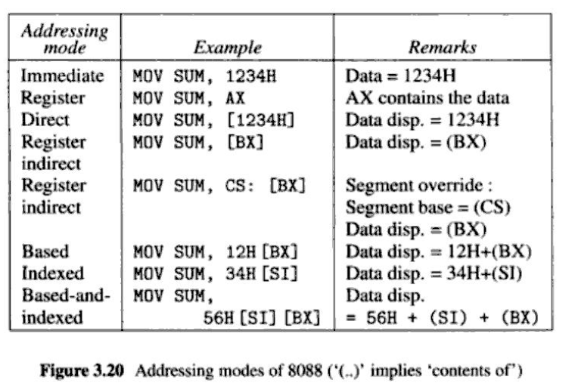
Single pass assembler
The Extra segment register points to another memory area which can be use to store data.
To address memory location, an instruction designates a segment register and provides 16 bit logical address.

Slide 82
Single pass assembler
In direct addressing mode the operand is of 16 bit number which is taken to be displacement from segment base contained in segment register.
A segment register may be explicitly indicated in a prefix of the instruction, else a default segment register is used.
In indexed mode , content of index register(SI or DI) are added to 8 or 16 bit displacement contained in the instruction. The result is taken to be displacement from the segment base of data segment.

Slide 83
8088 instructions
Memory
The basic units of memory are:
Declarative statements
Declaration of constant and reservation of storage both done using single statement
Units of memory | Bytes | Length in bits
Byte | 1 | 8
word | 2 | 16
Double word | 4 | 32
Quadra Word | 8 | 64
Tetra word | 10 | 80
Declarative statement | Description | Length in byte
DB | Reserve a Byte | 1
DW | Reserve word | 2
DD | Reserve Double word | 4
DQ | Reserve Quadra word | 8
DT | Reserve tetra word | 10

Slide 84
Assembler Directive statements
Example :
A DB 25 ; Reserve byte and initialize with 25 value
B DW ? ; Reserve word, no initialization
C DD 6DUP(0) ; 6 Double words , all 0’s
ADDR_A DW A ; initializes the word to the logical address of A (i.e. offset from the segment base)

Slide 85
Assembler Directive statements
1. SEGMENT : It indicates the start of segment
for arithmetic MOV instruction the architecture uses data segment by default
If code segment is used instead of data segment , it is rewritten as
ADD AX, CS : 12H[SI]
To assemble a symbolic reference assembler must determine the offset of symbol from the start of segment containing it. To facilitate this the programmer must perform following actions in assembly program
(a) Load a segment register with segment base
(b) let assembler know which segment register contains the segment base
seg | Segment Register
00 | ES
01 | CS
10 | SS
11 | DS

Slide 86
Assembler Directive statements
The second task is performed using the ASSUME directive which has the syntax
ASSUME <register> : <segment name>
and tells assembler that it can assume that the address of indicated segment to be present in <register>
(2) ENDS : It indicate the end of the segment
(3) ASSUME : The assembler has to determine its offset (offset refers to a value added to a base address to produce second address). for example if B represents address 100 then expression B+5 would signify the address 105. The 5 in the expression is the offset specifying address using an offset is called relative addressing because the resulting address is relative to some other point. offset is also known as displacement.
ASSUME <register> : <segment name>
tells assembler that it can assume that the address of indicated segment to be present in <register>

Slide 87
Assembler Directive statements
The directive ASSUME<register> : NOTHING cancels any prior assumptions indicated for <register>
(4) ORG :- This is pseudo opcode used to manipulation of the value of location counter
(5) DB : It is used to define bytes
(6) EQU : It defines symbolic names to represent values or other symbolic names .
(7) PURGE : the names defined by EQU can be ‘ubdefined’ by a PURGE statement. Such name can be reused for other purpose later in the program.
Example
XYZ DB ?
ABC EQU XYZ ; ABC represents name XYZ
PURGE ABC ; ABC no longer XYZ
ABC EQU 25 ; now ABC stands for ‘25’

Slide 88
Assembler Directive statements
Consider the program
SAMPLE_DATA SEGMENT
ARRAY DW 100DUP ?
SUM DW 0
SAMPLE_DATA ENDS
SAMPLE_CODE SEGMENT
ASSUME DS : SAMPLE_DATA
HERE: MOV AX, SAMPLE_DATA
MOV DS,AX
MOV AX, SUM
-------
SAMPLE_CODE ENDS
END HERE

Slide 89
Assembler Directive statements
The program of previous slide contains two segments
SAMPLE_DATA in DS regiter. While assembling MOV AX,SUM the assemble first compute offset of SUM from SAMPLE_DATA segment which is 0 + 100*2 = 200 bytes from DS register.
Programmer must have to load segment to segment register before using SUM at here
If the address of SAMPLE_DATA were to be loaded in to some other register e.g. register ES, It would be indicated through statement
ASSUME ES : SAMPLE_DATA

Slide 90
ANALYTIC OPERATORS
The analytic operators split the memory address in to components or provide information regarding to type and memory requirement of operands.
1. SEG – provides segment register name
2. OFFSET – Provide offset component of the memory address of the operand
3. TYPE – Indicates the manner in which operand is defined and returns the following numeric codes :
1 (byte)
2 (word)
4 (double word)
8 (Qudra word)
10 (ten bytes)
-1 (near instruction)
-2 (far instruction)

Slide 91
ANALYTIC OPERATORS
The analytic operators split the memory address in to components or provide information regarding to type and memory requirement of operands.
1. SEG – provides segment register name
2. OFFSET – Provide offset component of the memory address of the operand
3. TYPE – Indicates the manner in which operand is defined and returns the following numeric codes :
1 (byte)
2 (word)
4 (double word)
8 (Qudra word)
10 (ten bytes)
-1 (near instruction)
-2 (far instruction)

Slide 92
ANALYTIC OPERATORS
4. SIZE : It indicates number of units declared for an operand.
LENGTH : Indicates number of bytes allocated to the operand
EXAMPLE
BUFFER DW 100DUP(0)
MOV CX, LENGTH XYZ
The size of BUFFER is 100 and LENGTH is 100*2 = 200 bytes
MOV instruction will load length of XYZ in to CX register

Slide 93
Problems with single pass Assembler
1) Forward references
2) error reporting

Slide 94
Problems with single pass Assembler
1) Forward references
A symbolic reference may be forward reference in variety of ways
(i) as a data operand : assembly is simple.
An entry can be made in table of incomplete instruction(TII).
This entry would identify bytes in code where the address of referenced symbol should be put. when symbol’s definition encountered , this entry would be analysed to complete the instruction
Symbolic reference as destination in a branch instruction gives rise to peculiar problem. some generic branch opcodes like JMP in the 8088 assembly language can give rise instructions of different formats and different lengths depending on whether the jump is near or far.

Slide 95
Problems with single pass Assembler
If the destination symbol is less than 128 bytes away from JMP instruction than near JMP is considered otherwise far JMP is considered. However it will be considered after sometime in assembly process. This problem is solved by assembling such instruction by 16 bit logical address.
Another serious problem is type of forward reference symbol used in an instruction. The type may be used in manner which influences the size/length of a declaration. Such usage will have to be disallowed to facilitate single pass assembly
EXAMPLE:
XYZ DB LENGTH ABC DUP(0)
-----
ABC DD ?
here forward reference to ABC makes it impossible to assemble the DB statement in a single pass.

Slide 96
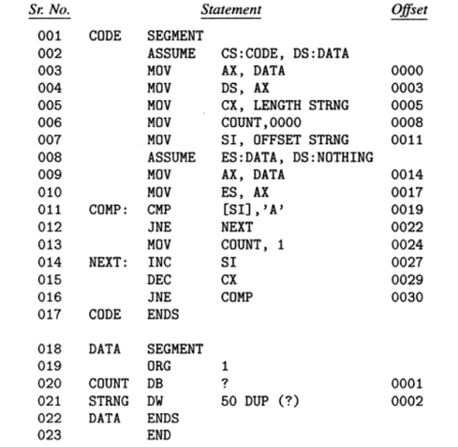

Slide 97
Problems with single pass Assembler
2. SEGMENT REGISTERS
An ASSUME directive indicates that a segment register contains the base address of a segment.
Assembler represents this information by pair of the form(segment register, segment name). This information can be stored in a segment register table(SRTAB). SRTAB is updated on processing of ASSUME statement.
for processing the reference to a symbol ‘symb’ in assembly statement, the assembler accesses the symbol table entry of ‘symb’ and finds (seg _{symb}, offset _{symb}). where seg _{symb} is the name of symbol containing the definition of symb. It uses information in SRTAB to find register which contains seg _{symb .} Let it be register ‘r’. It now synthesizes the pair (r, offset _{symb}) . This pair is used in the address field of the target instruction
But this strategy will not work in case of forward reference.

Slide 98
Problems with single pass Assembler
Consider statement 6 and 13 of previous program which make forward reference to COUNT. When the definition of count encountered in statement 20, information concerning this forward reference can be found in table of incomplete instruction (TII)
What segment register should be used to assemble these reference ? The first reference was made in statement 6 when DS was segment register containing segment base of DATA. However SRTAB presently contains the pair (ES, DATA) as the result of statement 8.
The following provisions are made to handle this problem
1. A new SRTAB is created while processing ASSUME directive. This SRTAB differs from the old SRTAB on in the entries for segment register named in the ASSUME statement. since many SRTAB’s exists at any time, an array named SRTAB_ARRAY is used to store SRTAB’s. This array is indexed using a counter srtab_no

Slide 99
Problems with single pass Assembler
2. In stead of TII, forward reference table(FRT) is used. Each entry of FRT contains following entries:
(a) Address of instruction whose operand field contains the forward reference
(b) symbol to which forward reference is made
(c) Kind of reference (eg. T : Analytic operator TYPE, D: Data address. L: length, F : offset, etc)
(d) Number of the SRTAB to be used for assembling the reference.
EXAMPLE
two SRTAB’s would be built for the program . SRTAB#1 contains the pair (CS, CODE) and (DS, DATA) while SRTAB#2 contains the pair (CS, CODE) and (ES, DATA). while processing statement 6 , SRTAB#1 is the current SRTAB. Hence FRT entry for this entry(008, COUNT, D, SRTAB#1). similarly for FRT entry of statement 13 is (024, COUNT, D,SRTAB#2). Theses entries are processed on encountering the definition of COUNT, giving the address pair (DS,001) and (ES,001)

Slide 100
Design of ASSEMBLER
LC Alignment : In 8088 the unit of memory is byte, however certain entities require their starting byte to be aligned on specific boundary in the address space. For example word requires even boundary (i.e. even start address). Such alignment requirements may force some bytes to be left unused memory allocation. Hence while processing DB statements assembler first aligns LC on requisite boundary. we call this LC alignmet
Allocation of memory and entering its label in symbol table is performed after LC processing.

Slide 101
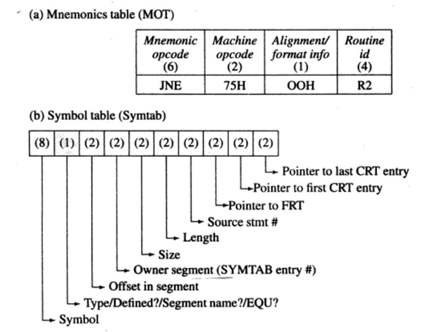
DATA STRUCTURES OF 8088 ASSEMBLER

Slide 102
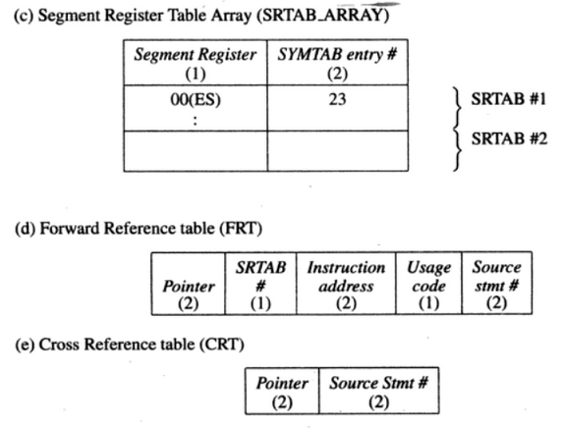
DATA STRUCTURES OF 8088 ASSEMBLER

Slide 103
Design of ASSEMBLER
In figures on previous two slides, number in parenthesis indicates the number of bytes required for a fileld.
1)MOT table (Mnemonic Opcode Table)
It contains field Mnemonic opcode, machine opcode, alignment/format info and routine id. The Routine id filed of an entry specifies the routine which processes the opcode. Alignment /format info is specific to given routine. for example the code of ‘00H’ for routine R2 implies that only one instruction format is supported (Self Relative displacement instruction). FFH for same routine implies that all the formats are supported, hence routine must decide which machine opcode to use.
2) The SYMTAB (symbol table) is also a hash organized and contains all relevant information about symbols defined and used in the source program.

Slide 104
Design of ASSEMBLER
Contents of some important fields are:
a) the owner segment field : Indicates id of segment in which segment is defined.
b) Type/Defined/Segment name?EQU : for non EQU symbol the type field indicates the alignment information. For EQU symbol , type field indicates whether the symbol is to be given a numeric value or texual value.
c) Offset in segment : contains offset value.
3)SRTAB (segment Register table)
An SRTAB can contains up to four entries, one for each register. The current SRTAB exists in the last entry of SRTAB_ARRAY.SRTAB_no

Slide 105
Design of ASSEMBLER
4) Forward reference table (FRT)
Information concerning forward references to symbol is organized in the form of linked list., Thus forward reference table contains a set of linked lists.
The FRT pointer field of symbol table entry points to the head of this linked list.
Each FRT entry contains SRTAB# to be used to assemble the forward reference.
5) CROSS REFERENCE TABLE
A cross reference directory is a report produced by the assembler which lists all references to symbol sorted in ascending order of statement numbers.
Assembler uses CRT to collect information concerning references to all symbols in the program.
Each symbol table entry points to the head and tail of the linked list in the CRT. CRT and FRT can be organized in to single memory area

Slide 106
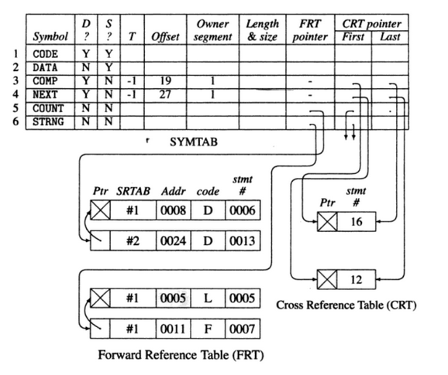
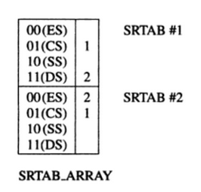
Data structures after processing statement 19

Slide 107
Design of ASSEMBLER
when definition of NEXT was processed (statement 14) the validity of forward reference in term of this requirement was checked and the corresponding instruction was completed. The FRT was then discarded.
After statement 19, only 2 forward references are exist. COUNT and STRING
two entries exists for COUNT in FRT and CRT. The first entry has #1SRTAB_No and second entry has #2 SRTAB_No.
similarly two FRT and CRT entries exists for STRING
Usage field of FRT entries what information is required in the referencing instruction. e.g. Data address (D), self relative address(‘S’), length (L), Offset (F)

Slide 108
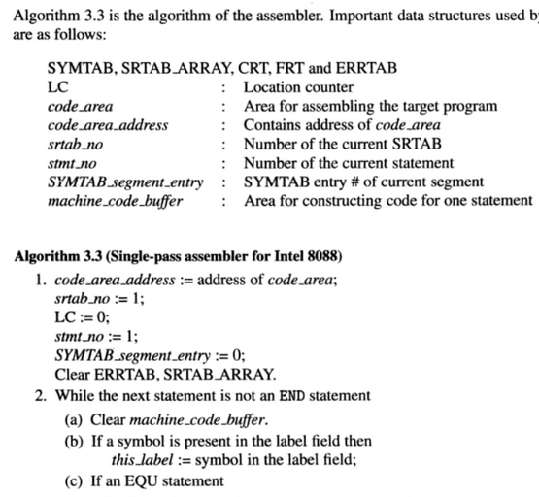
ALGORITHM FOR SINGLE PASS ASSEMBLER 8088

Slide 109
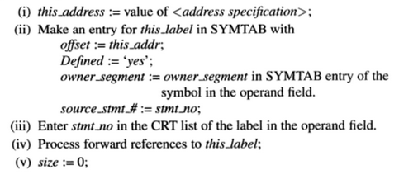
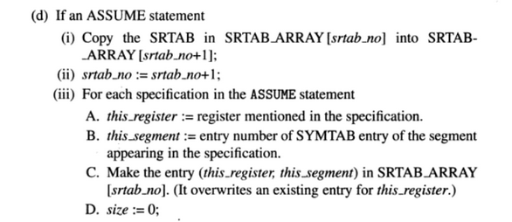
ALGORITHM FOR SINGLE PASS ASSEMBLER 8088

Slide 110
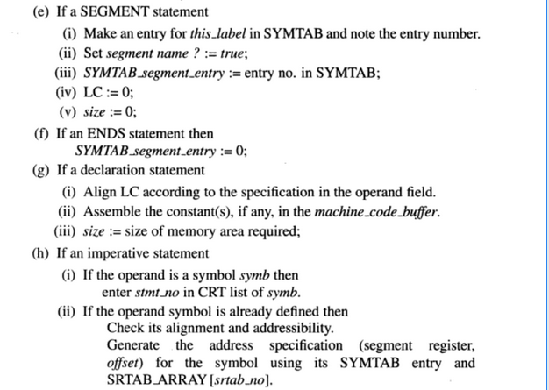
ALGORITHM FOR SINGLE PASS ASSEMBLER 8088

Slide 111
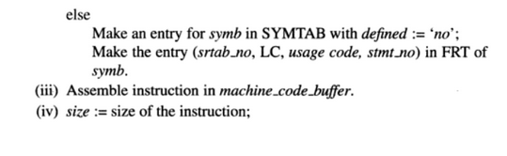
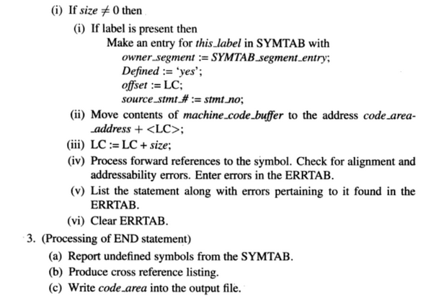
ALGORITHM FOR SINGLE PASS ASSEMBLER 8088

