Slide 1
Logic Gates

Slide 2
Review of Boolean algebra
Just like Boolean logic
Variables can only be 1 or 0
  Instead of true / false

Slide 3
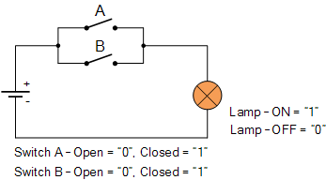
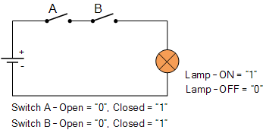
Review of Boolean algebra
_
_
Not is a horizontal bar above the number
  0 = 1
  1 = 0
Or (is a plus)
  0+0 = 0
  0+1 = 1
  1+0 = 1
  1+1 = 1
And (is a dot)
  0.0 = 0
  0.1 = 0
  1.0 = 0
  1.1 = 1

Slide 4
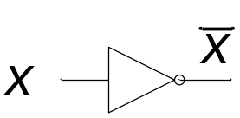
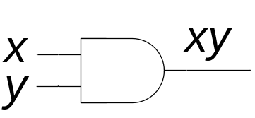
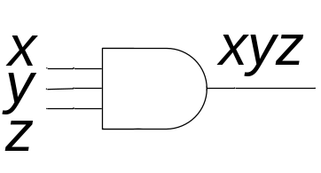
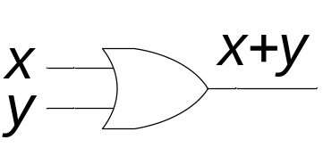
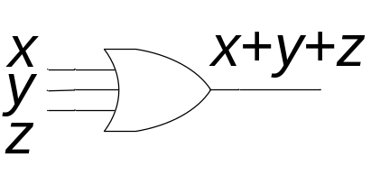
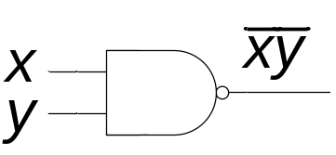
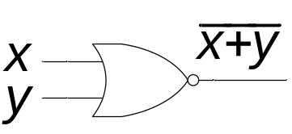
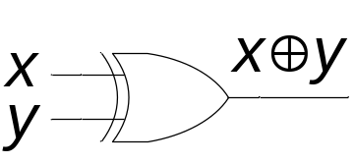
Basic logic gates
Not
And
Or
Nand
Nor
Xor

Slide 5
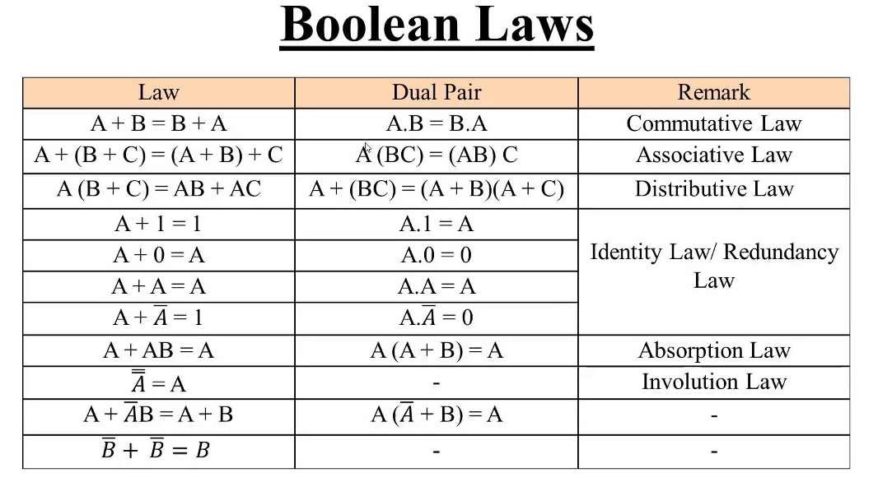
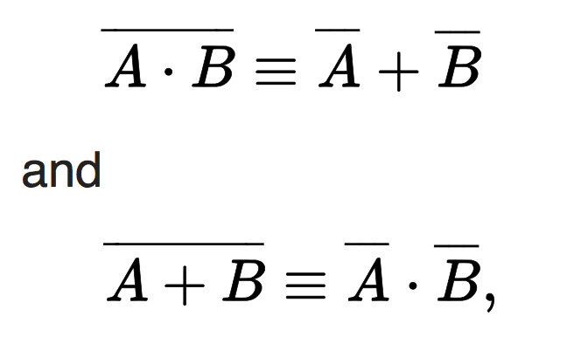
DeMorgan’s Law

Slide 6
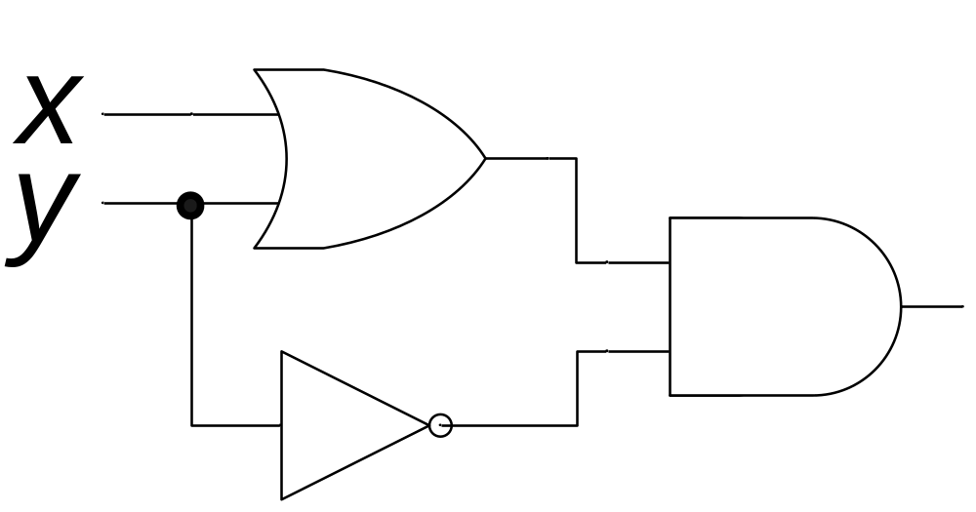
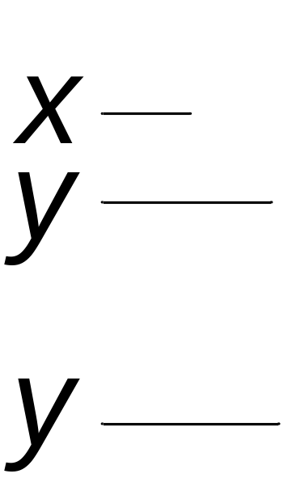
Converting between circuits and equations
Find the output of the following circuit
x+y
(x+y)y
y

Slide 7
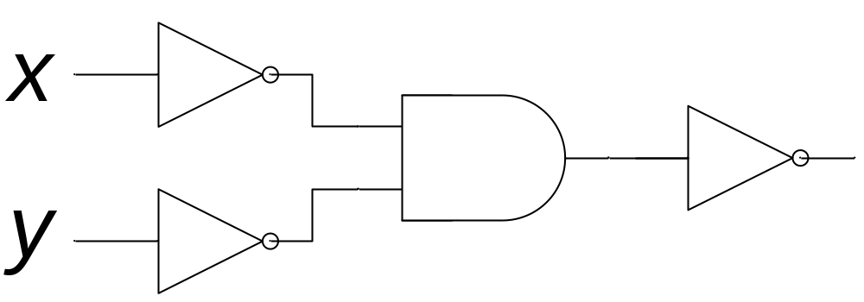
Converting between circuits and equations
Find the output of the following circuit
x
x
y
x
y
y

Slide 8
Converting decimal numbers to binary
53 = 32 + 16 + 4 + 1
  = 2⁵ + 2⁴ + 2² + 2⁰
  = 1*2⁵ + 1*2⁴ + 0*2³ + 1*2² + 0*2¹ + 1*2⁰
  = 110101 in binary
  = 00110101 as a full byte in binary
211= 128 + 64 + 16 + 2 + 1
  = 2⁷ + 2⁶ + 2⁴ + 2¹ + 2⁰
  = 1*2⁷ + 1*2⁶ + 0*2⁵ + 1*2⁴ + 0*2³ + 0*2² +
  1*2¹ + 1*2⁰
  = 11010011 in binary

Slide 9
Converting binary numbers to decimal
What is 10011010 in decimal?
  10011010 = 1*2⁷ + 0*2⁶ + 0*2⁵ + 1*2⁴ + 1*2³ +
  0*2² + 1*2¹ + 0*2⁰
  = 2⁷ + 2⁴ + 2³ + 2¹
  = 128 + 16 + 8 + 2
  = 154
What is 00101001 in decimal?
  00101001 = 0*2⁷ + 0*2⁶ + 1*2⁵ + 0*2⁴ + 1*2³ +
  0*2² + 0*2¹ + 1*2⁰
  = 2⁵ + 2³ + 2⁰
  = 32 + 8 + 1
  = 41

Slide 10
How to add binary numbers
Consider adding two 1-bit binary numbers x and y
  0+0 = 0
  0+1 = 1
  1+0 = 1
  1+1 = 10
Carry is x AND y
Sum is x XOR y
The circuit to compute this is called a half-adder
x | y | Carry | Sum
0 | 0 | 0 | 0
0 | 1 | 0 | 1
1 | 0 | 0 | 1
1 | 1 | 1 | 0

Slide 11
More about logic gates
To implement a logic gate in hardware, you use a transistor
Transistors are all enclosed in an “IC”, or integrated circuit
The current Intel core i5 or i7 processors have around 1.8 billion transistors!

