Slide 1
Karnaugh Maps (K-Maps)

Slide 2
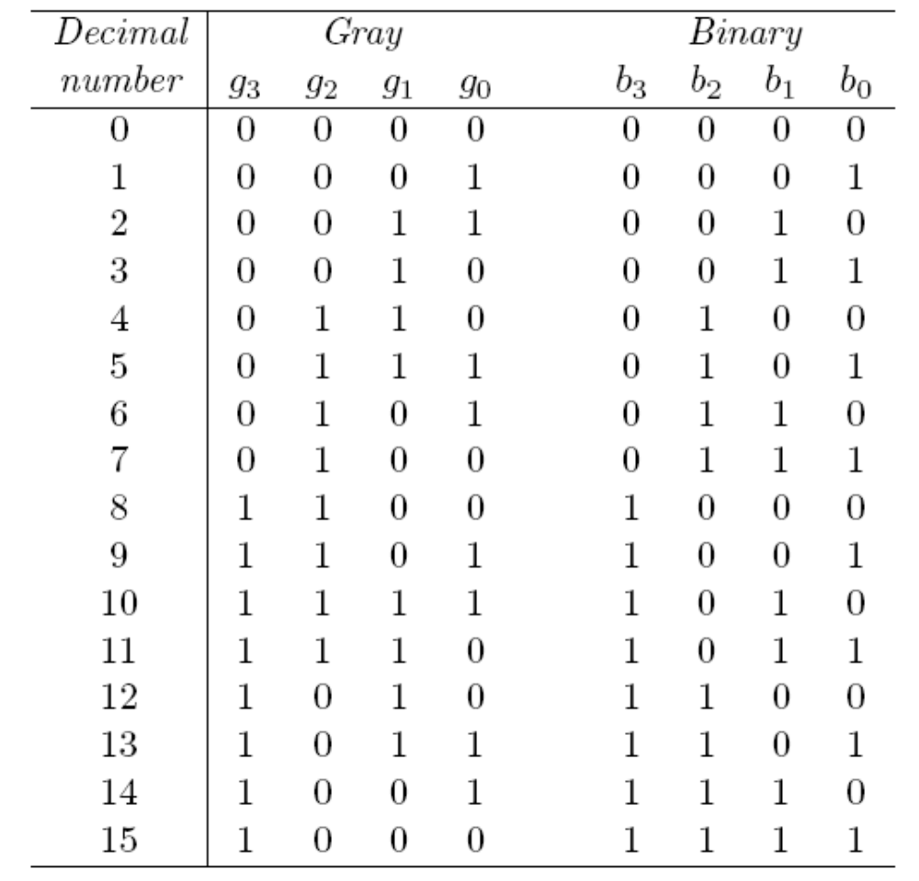
Gray Code

Slide 3
K-Maps
A visual way to simplify logic expressions
It gives the most simplified form of the expression
A Karnaugh map is a graphical method used to obtained the most simplified form of an expression in a standard form (Sum-of-Products or Product-of-Sums).
The simplest form of an expression is the one that has the minimum number of terms with the least number of literals (variables) in each term, thus the function will be implemented with the minimum number of gates with minimum number of input.

Slide 4
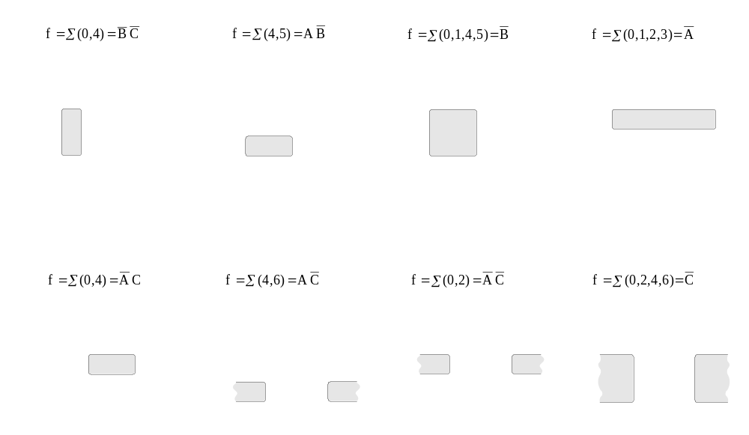
Three-Variable K-Maps

Slide 5
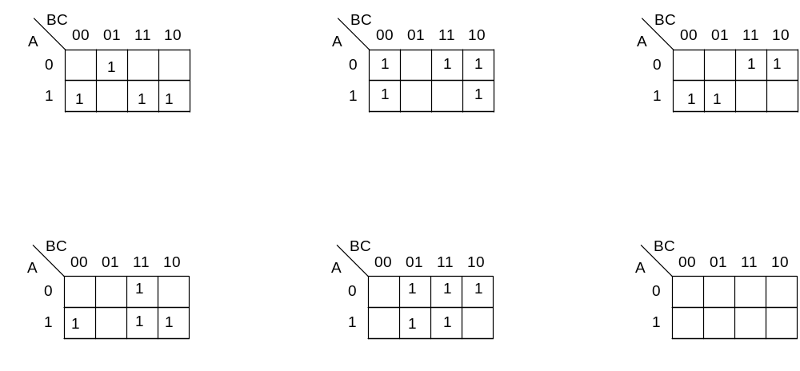
Three-Variable K-Maps

Slide 6
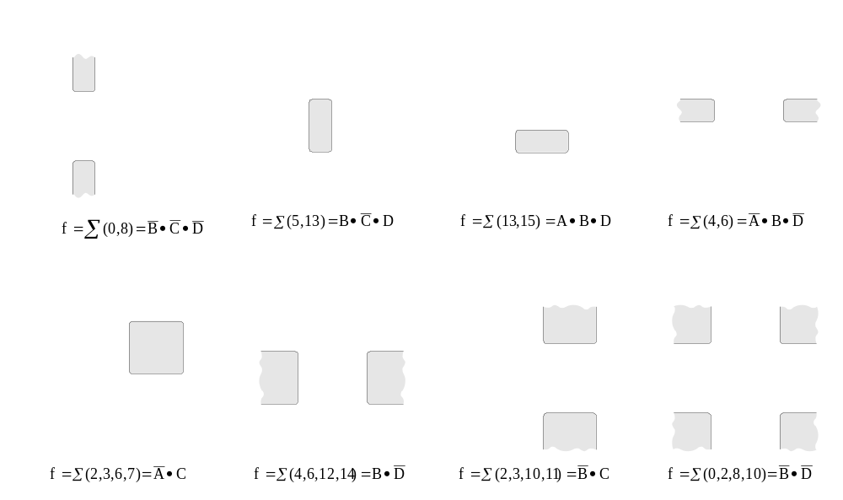
Four-Variable K-Maps

Slide 7
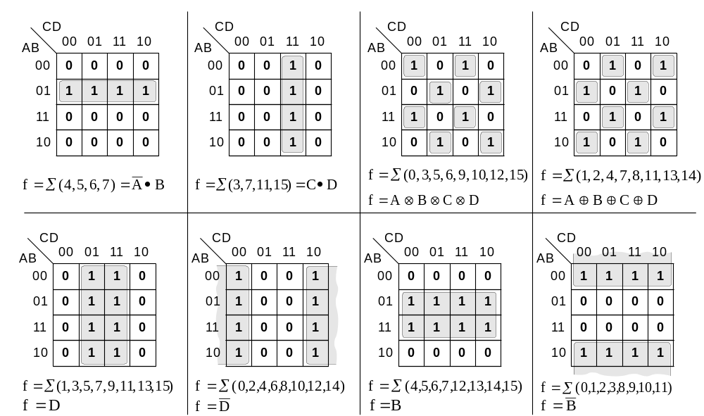
Four-Variable K-Maps

Slide 8
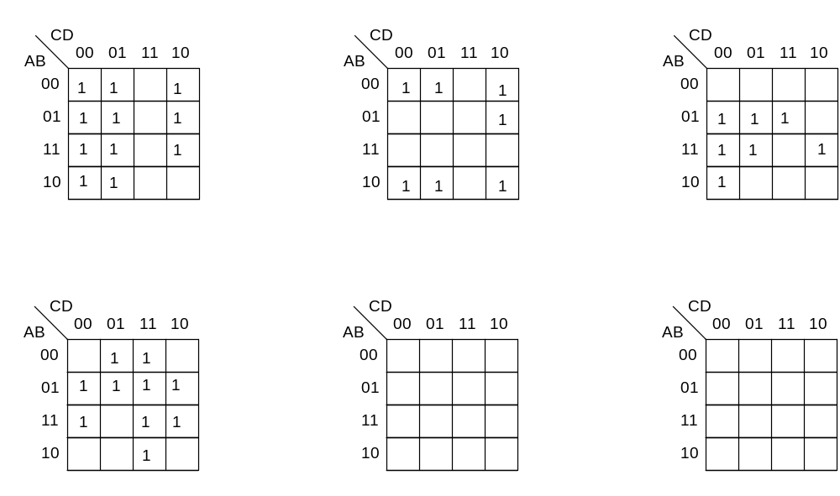
Four-Variable K-Maps

Slide 9
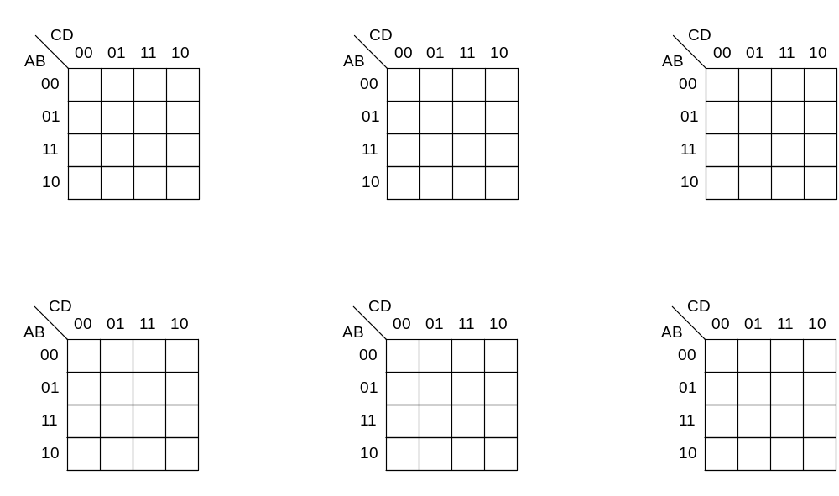
Four-Variable K-Maps

Slide 10
Four-Variable K-Maps

Slide 11
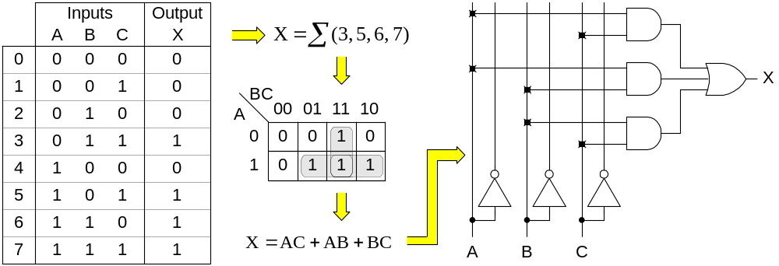
Design of combinational digital circuits
Steps to design a combinational digital circuit:
  From the problem statement derive the truth table
  From the truth table derive the unsimplified logic expression
  Simplify the logic expression
  From the simplified expression draw the logic circuit
Example: Design a 3-input (A,B,C) digital circuit that will give at its output (X) a logic 1 only if the binary number formed at the input has more ones than zeros.

Slide 12
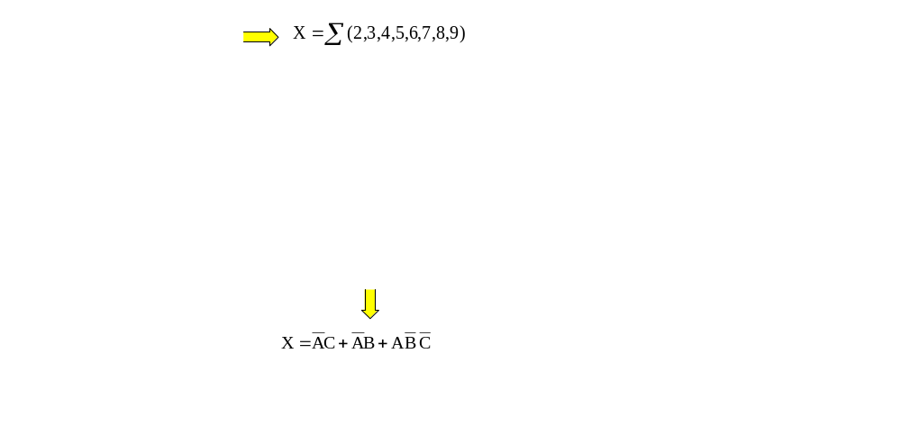
Design of combinational digital circuits
Example: Design a 4-input (A,B,C,D) digital circuit that will give at its output (X) a logic 1 only if the binary number formed at the input is between 2 and 9 (including).

Slide 13
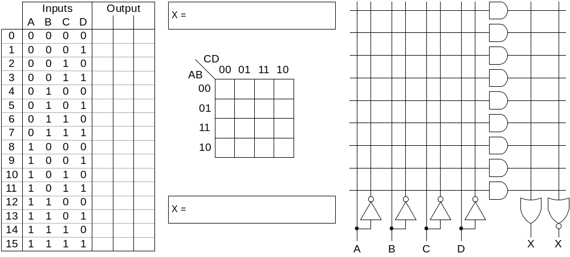
Design of combinational digital circuits
Example: Design a 4-input (A,B,C,D) digital circuit that will give at its output (X) a logic 1 only if there more ones than zeros in the binary number formed at the input.

Slide 14
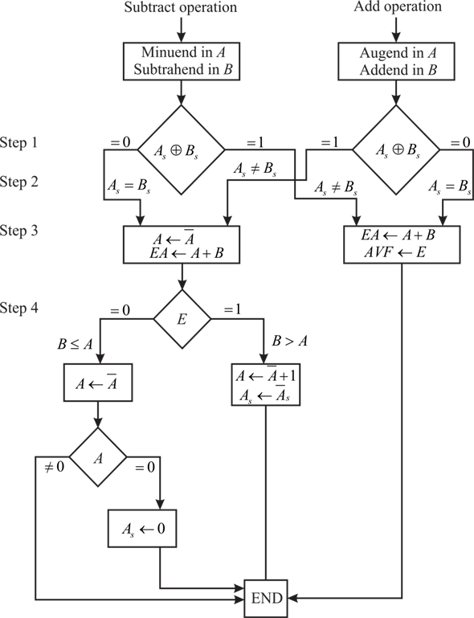
Addition - Subtraction

