Slide 1
1’s and 2’s Complement

Slide 2
Complements
Subtraction of numbers requires a different algorithm than addition.
Adding a complement of a number is equivalent to subtraction.
We will discuss two complements:
  Diminished Radix Complement
  Radix Complement
Subtraction will be accomplished by adding a complement.

Slide 3
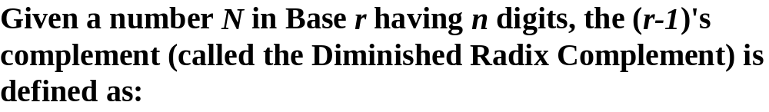


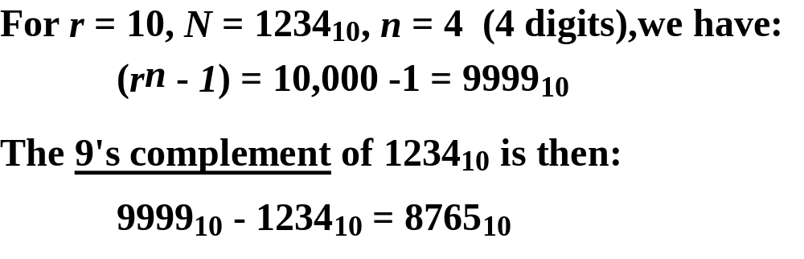
Diminished Radix Complement

Slide 4
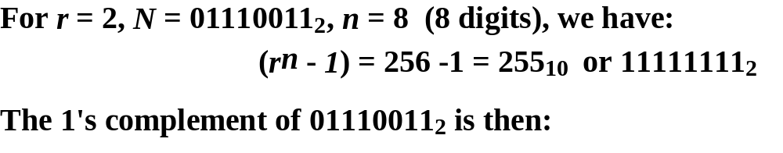
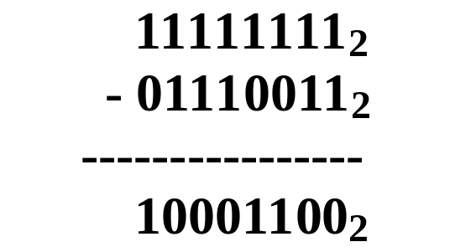
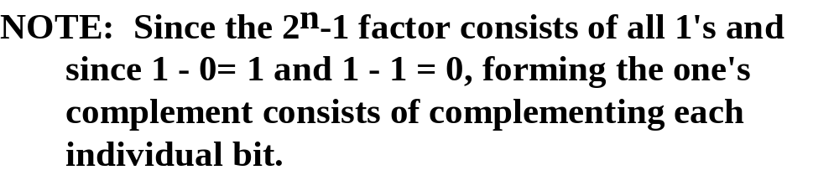
Binary 1's Complement

Slide 5



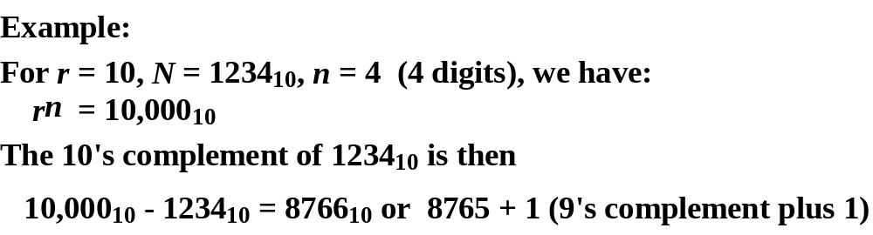
Radix Complement

Slide 6
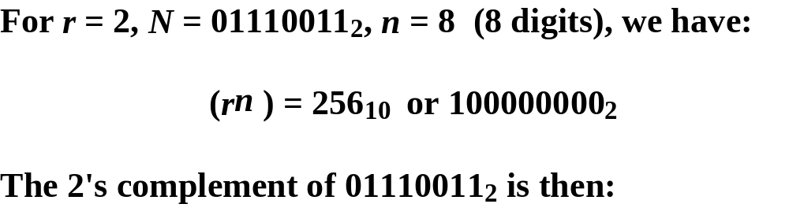
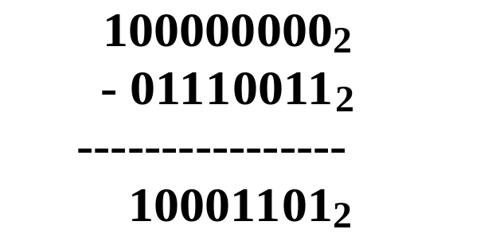

Binary 2's Complement

Slide 7
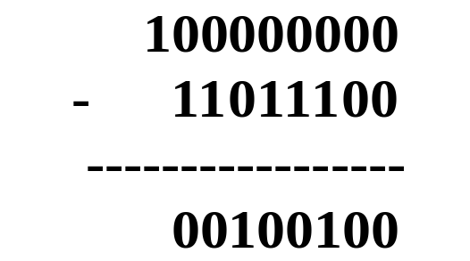
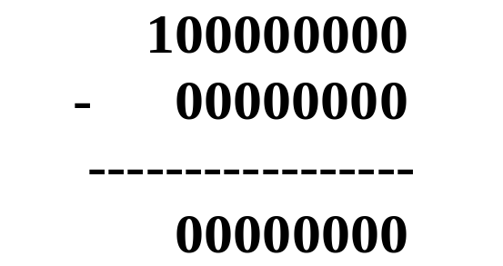
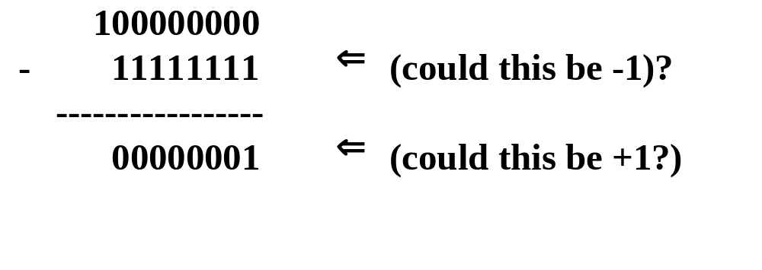
Binary 2's Complement Examples

Slide 8



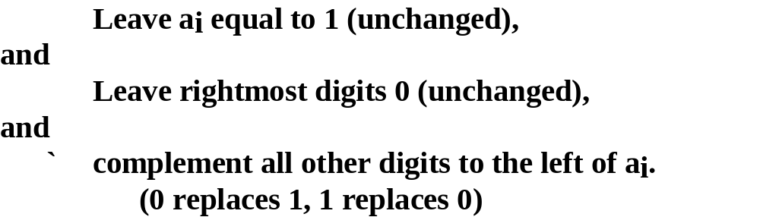
Efficient 2’s Complement

Slide 9
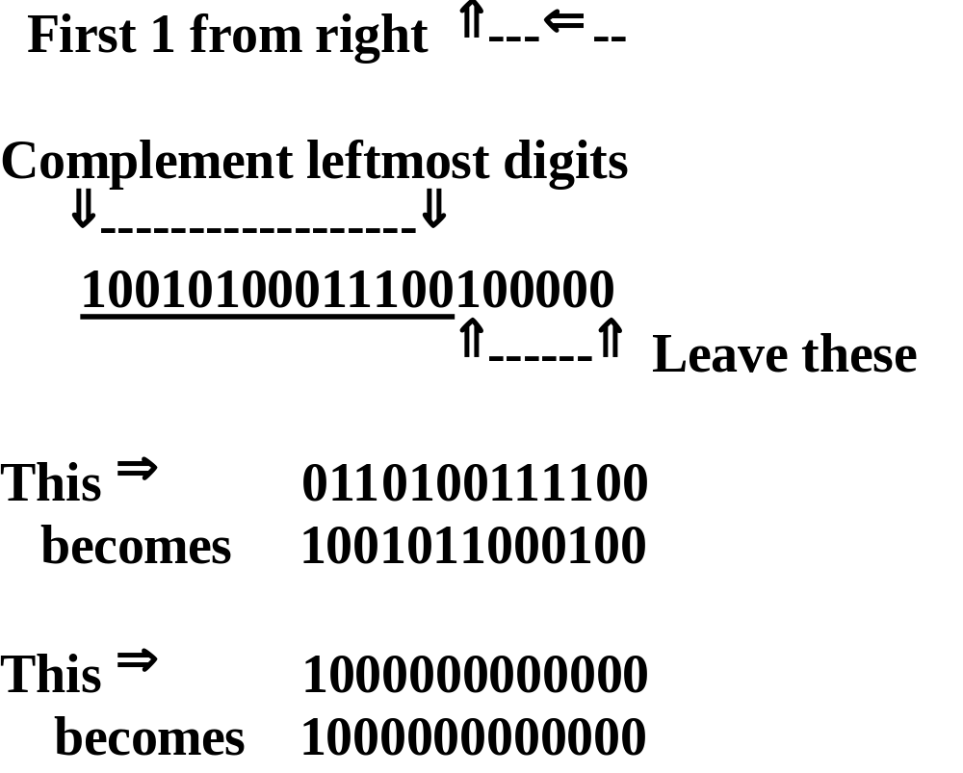
Two's Complement Example

Slide 10
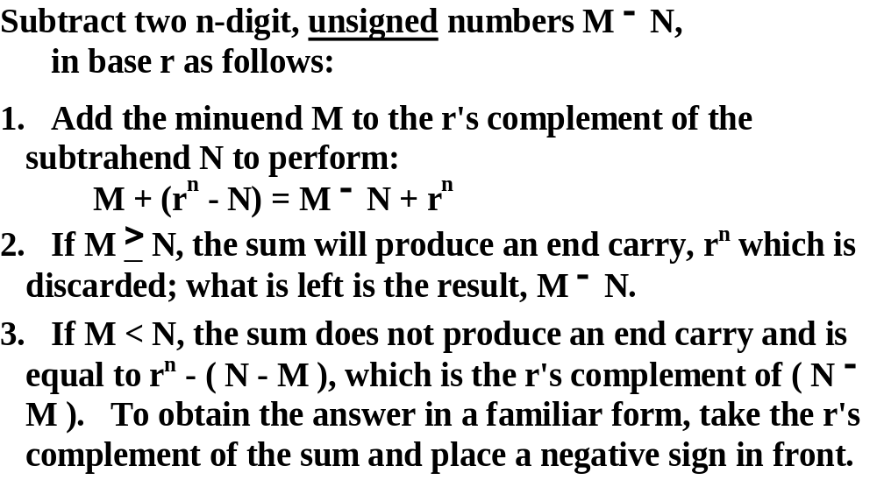
Subtraction with Radix Complements

Slide 11
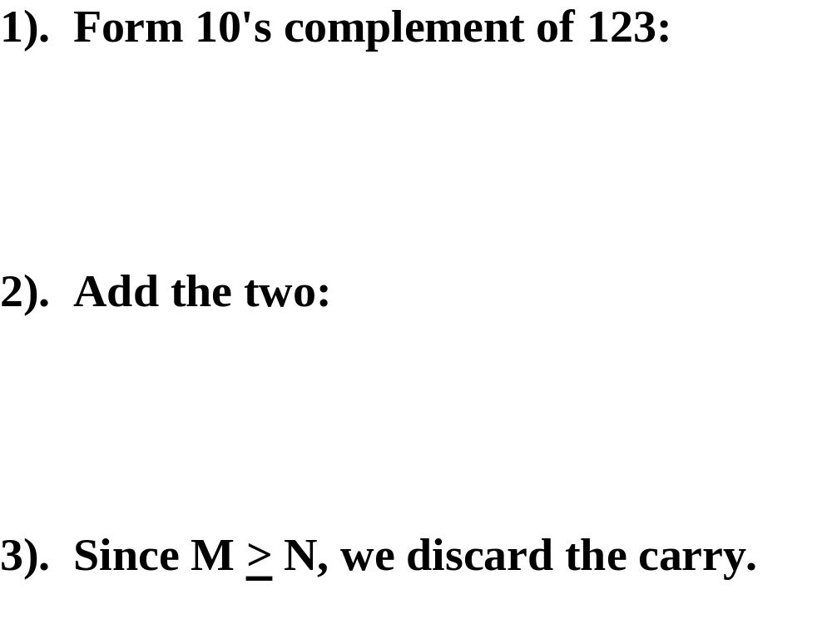
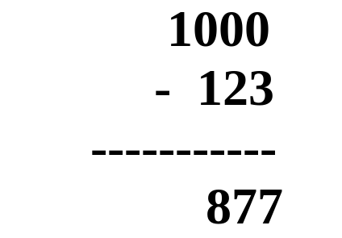
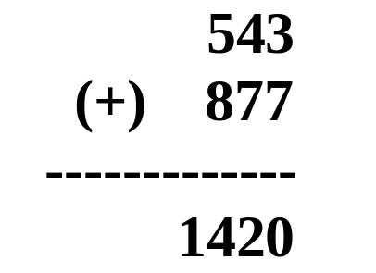

^{Example: Find 543}₁₀ ^{– 123}₁₀

Slide 12
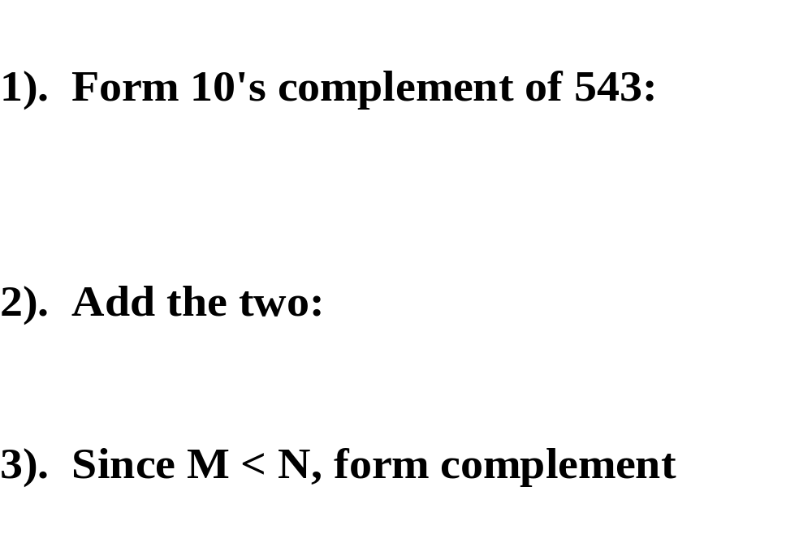
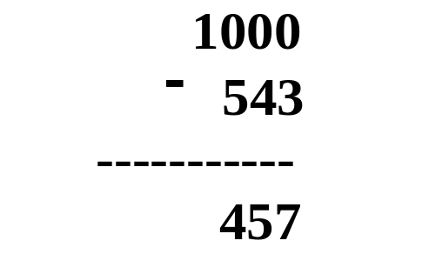
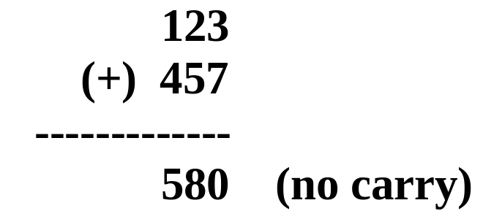
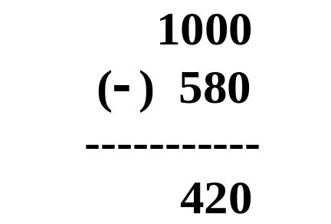

^{Example: Find 123}₁₀ ⁻ ⁵⁴³₁₀

Slide 13
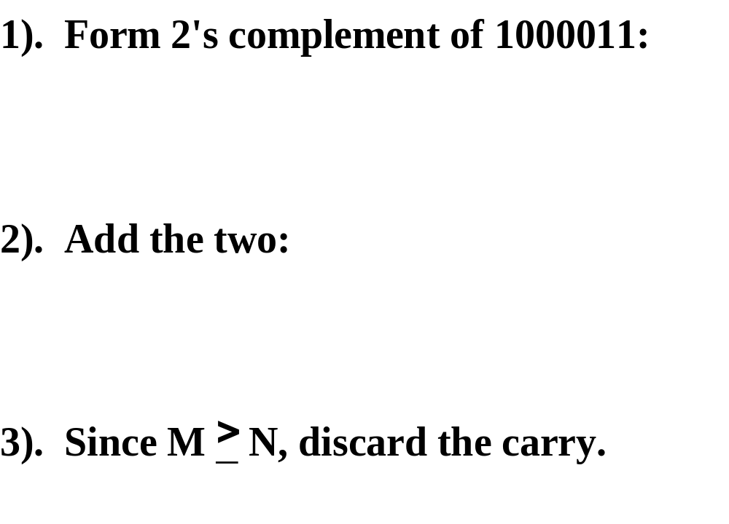
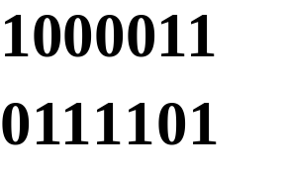
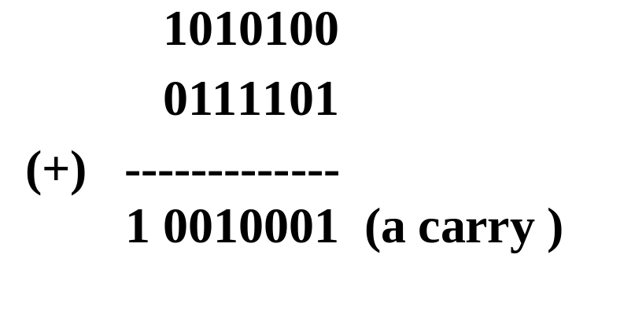

Binary Example

Slide 14
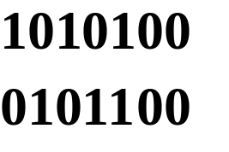
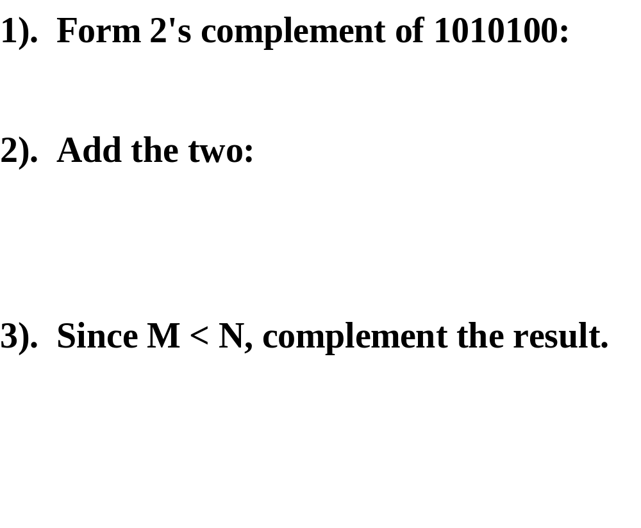
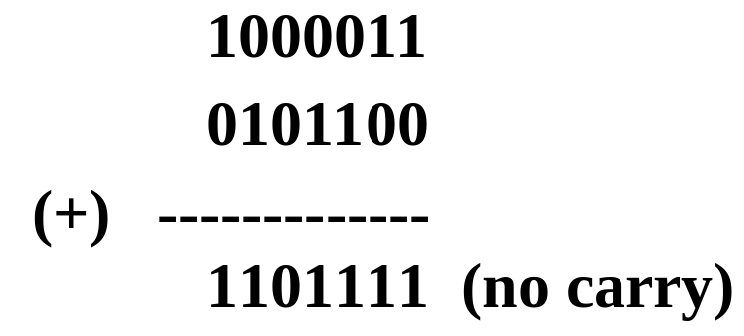

Another Binary Example

Slide 15
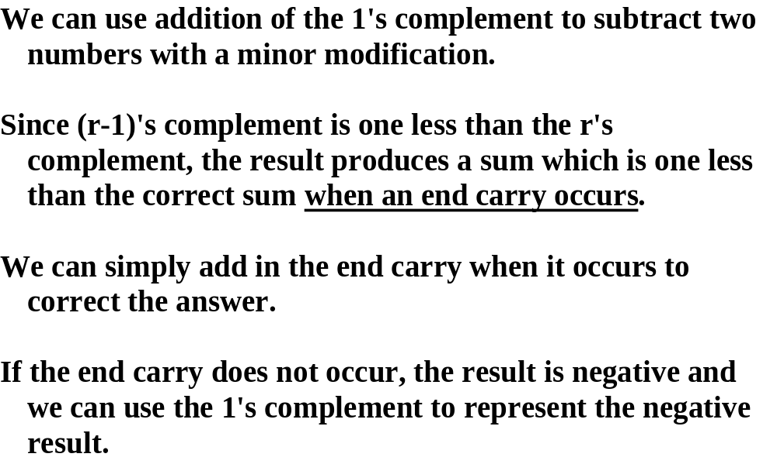
Subtract: Add 1’s Complement

Slide 16
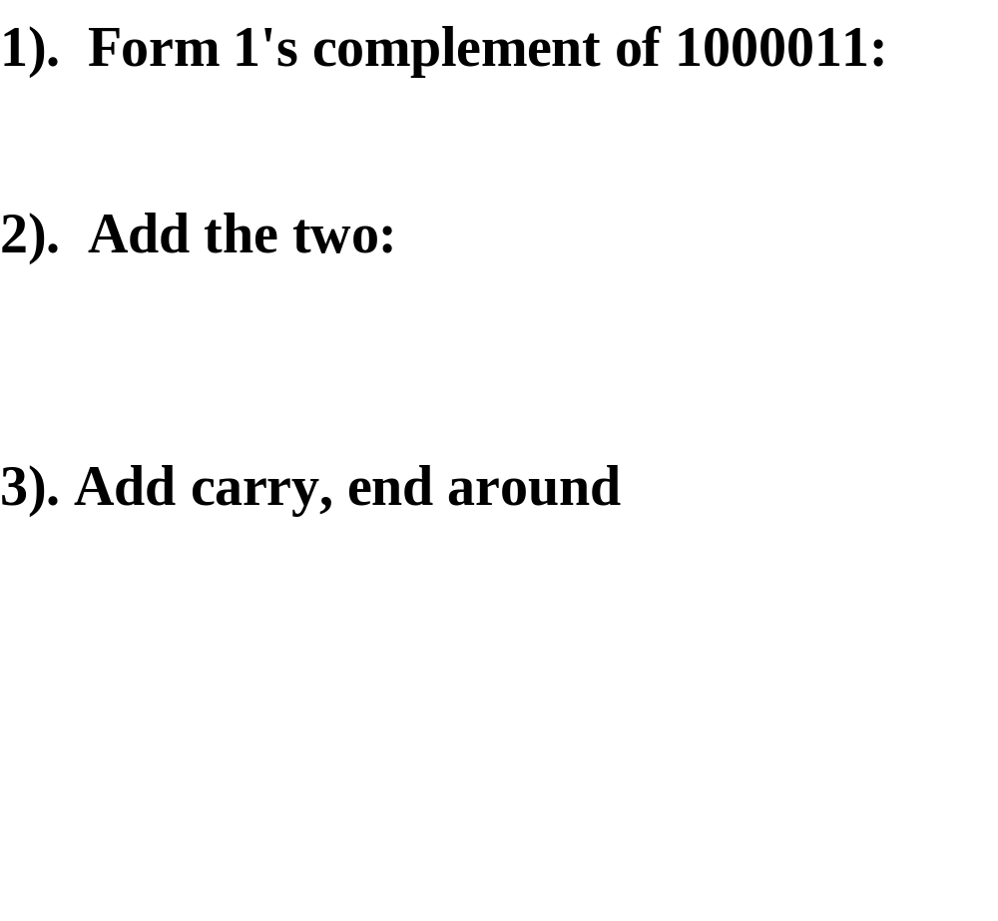

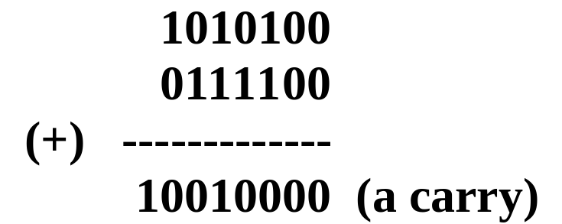
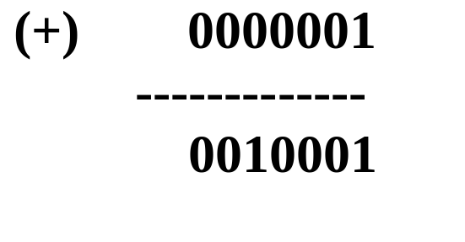

1’s Complement Subtraction

Slide 17
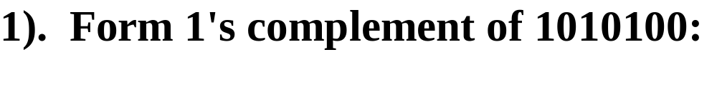
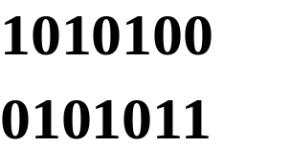
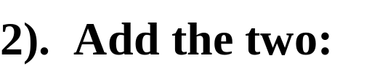
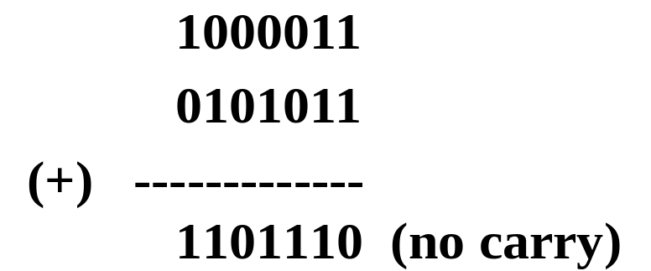


1’s Complement Subtraction

Slide 18
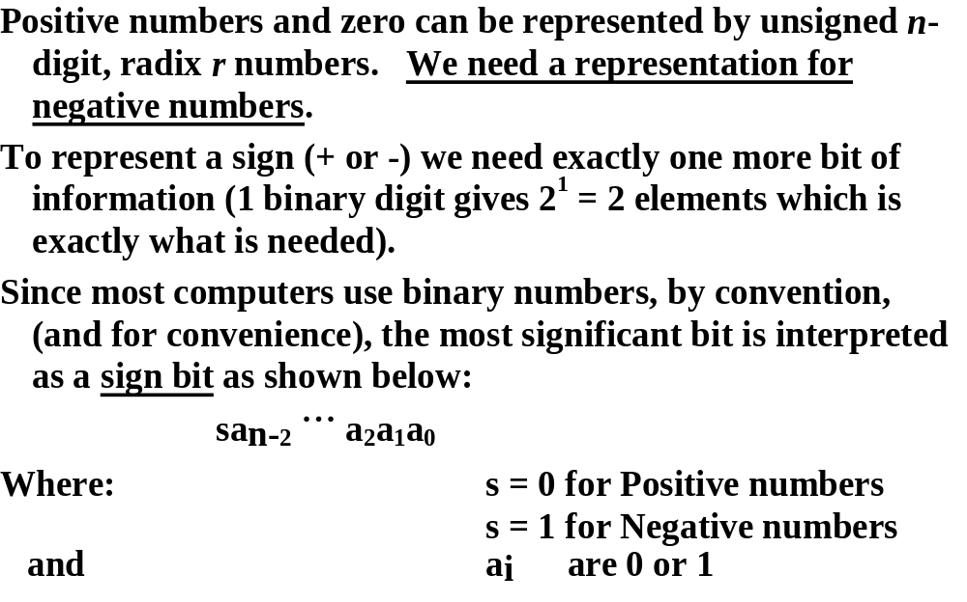
Signed Integers

Slide 19
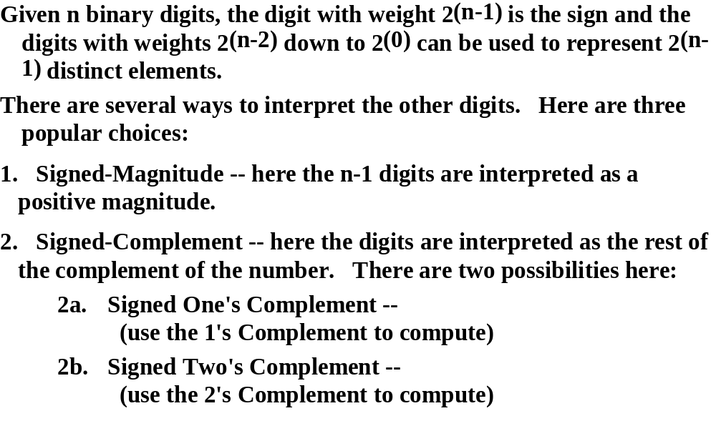
Interpreting the Other Digits

Slide 20

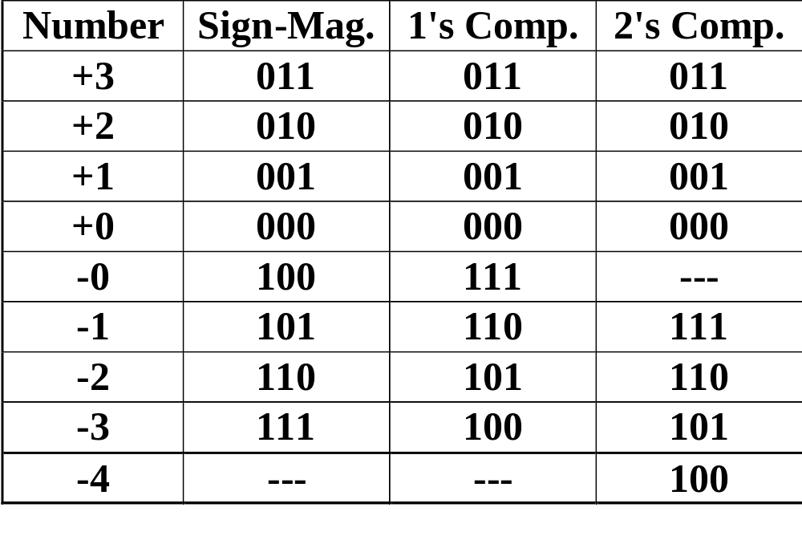
Example: Given r=2, n=3

Slide 21
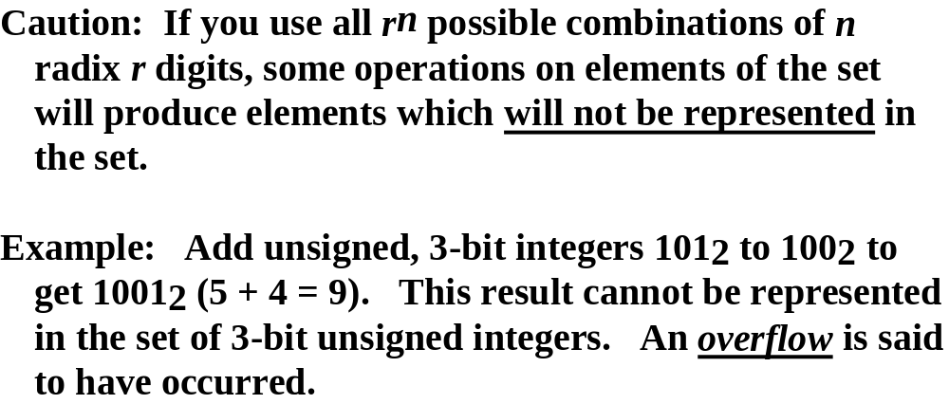
Addition with Signed Numbers

Slide 22
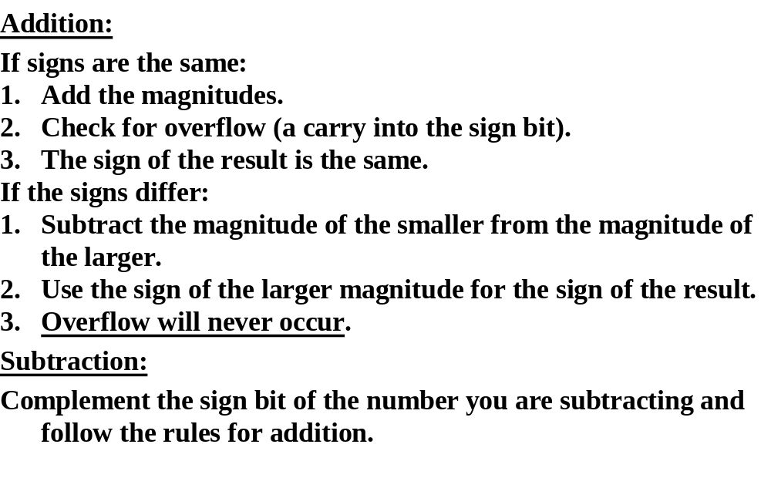
Signed-Magnitude Arithmetic

Slide 23
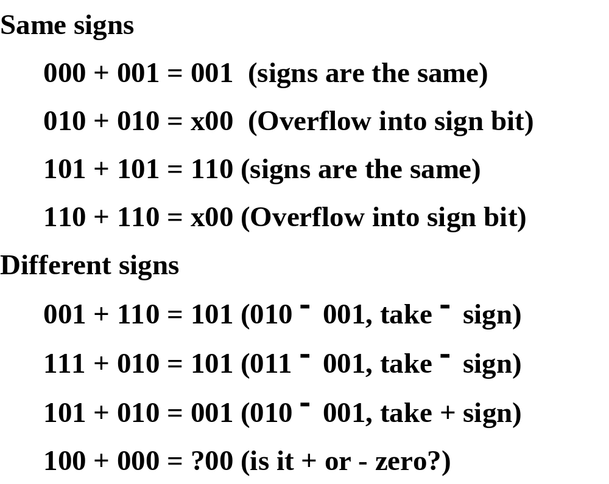
Sign-Magnitude Examples

Slide 24
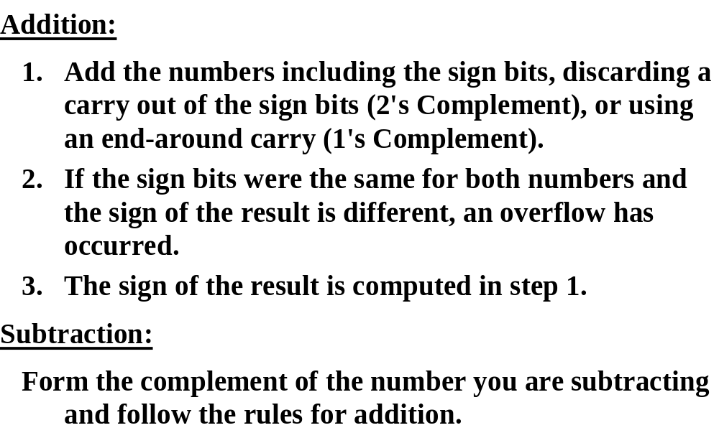
Signed-Complement Arithmetic

Slide 25
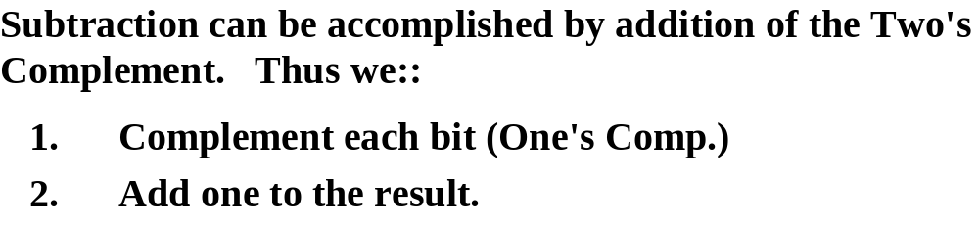
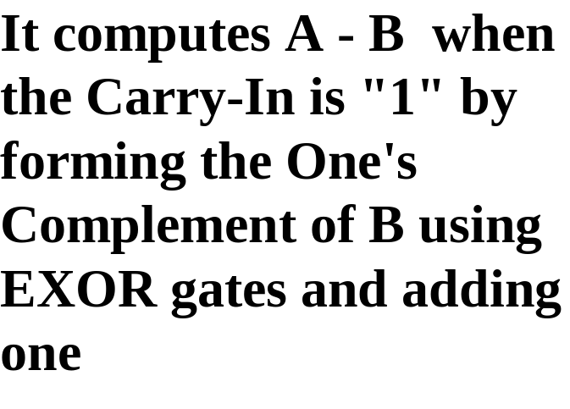
Binary Adder/Subtractor
A(3)
A(2)
A(1)
A(0)
B(3)
B(2)
B(1)
B(0)
C(0)
C(4)
x
y
C(3)
x
y
C(2)
x
y
C(1)
x
y
C_{o}
FA
C_{i}
C_{o}
FA
C_{i}
C_{o}
FA
C_{i}
C_{o}
FA
C_{i}
S
S
S
S
S(3)
S(2)
S(1)
S(0)

