Slide 1
COMBINATIONAL CIRCUITS

Slide 2
Overview
Introduction to Combinational Circuits
Adder
Ripple Carry Adder
Subtraction
Adder/Subtractor

Slide 3
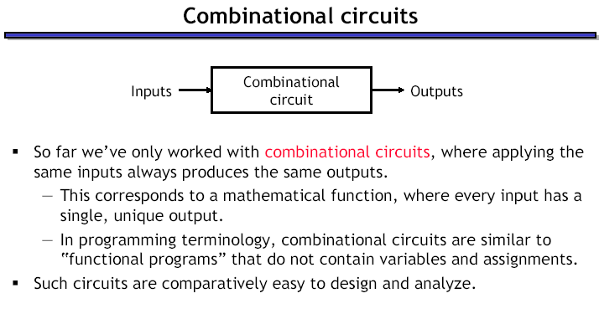

Slide 4
Adder
Design an Adder for 1-bit numbers
1. Specification: 2 inputs (X,Y) 2 outputs (C,S)

Slide 5
Adder
Design an Adder for 1-bit numbers
1. Specification: 2 inputs (X,Y) 2 outputs (C,S)
2. Formulation:
X | Y | C | S
0 | 0 | 0 | 0
0 | 1 | 0 | 1
1 | 0 | 0 | 1
1 | 1 | 1 | 0

Slide 6
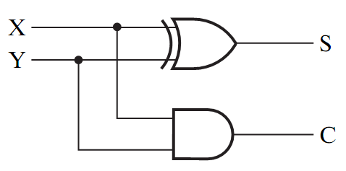
Adder
Design an Adder for 1-bit numbers?
1. Specification: 3. Optimization/Circuit 2 inputs (X,Y) 2 outputs (C,S)
2. Formulation:
X | Y | C | S
0 | 0 | 0 | 0
0 | 1 | 0 | 1
1 | 0 | 0 | 1
1 | 1 | 1 | 0

Slide 7
Half Adder
This adder is called a Half Adder
Q: Why?
X | Y | C | S
0 | 0 | 0 | 0
0 | 1 | 0 | 1
1 | 0 | 0 | 1
1 | 1 | 1 | 0

Slide 8
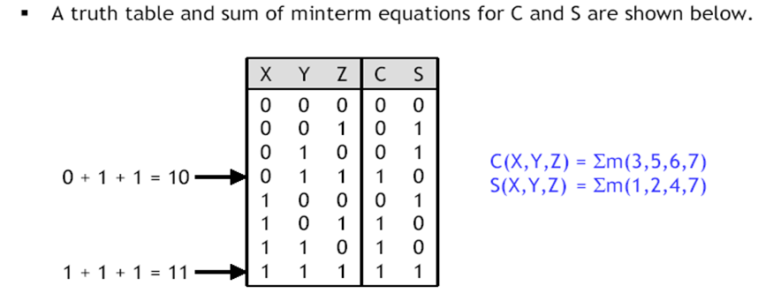
Full Adder
A combinational circuit that adds 3 input bits to generate a Sum bit and a Carry bit

Slide 9
Full Adder
A combinational circuit that adds 3 input bits to generate a Sum bit and a Carry bit
Sum
YZ
X | Y | Z | C | S
0 | 0 | 0 | 0 | 0
0 | 0 | 1 | 0 | 1
0 | 1 | 0 | 0 | 1
0 | 1 | 1 | 1 | 0
1 | 0 | 0 | 0 | 1
1 | 0 | 1 | 1 | 0
1 | 1 | 0 | 1 | 0
1 | 1 | 1 | 1 | 1
X
00 01 11 10
0
1
0 1 0 1
1 0 1 0
S = X’Y’Z + X’YZ’ + XY’Z’ +XYZ
= X ⊕ Y ⊕ Z
Carry
YZ
X
00 01 11 10
0
1
0 0 1 0
0 1 1 1
C = XY + YZ + XZ

Slide 10
Full Adder = 2 Half Adders
Manipulating the Equations:
S = X ⊕ Y ⊕ Z
C = XY + XZ + YZ

Slide 11
Full Adder = 2 Half Adders
Manipulating the Equations:
S = ( X ⊕ Y ) ⊕ Z
C = XY + XZ + YZ
= XY + XYZ + XY’Z + X’YZ + XYZ
= XY( 1 + Z) + Z(XY’ + X’Y)
= XY + Z(X ⊕ Y )
OR:
S = ( X ⊕ Y ) ⊕ Z
C = X’YZ + XY’Z + XYZ’ + XYZ
= (X’Y + XY’)Z + XY(Z+Z’)
= (X ⊕ Y )Z + XY

Slide 12
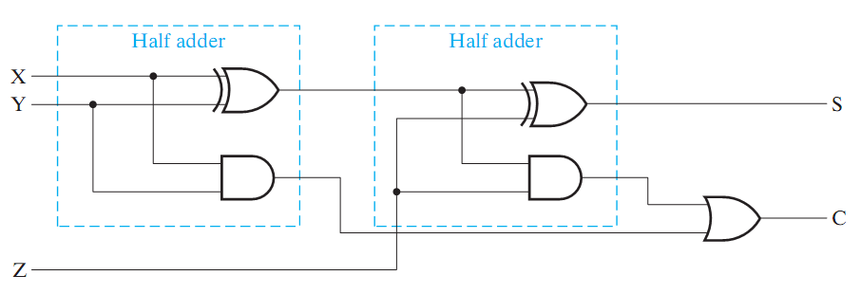
Full Adder = 2 Half Adders
Manipulating the Equations:
S = ( X ⊕ Y ) ⊕ Z
C = XY + XZ + YZ = XY + Z(X ⊕ Y )
Think of Z as a carry in
Src: Mano’s Book

Slide 13
Bigger Adders
How to build an adder for n-bit numbers?
Example: 4-Bit Adder
Inputs ?
Outputs ?
What is the size of the truth table?
How many functions to optimize?

Slide 14
Bigger Adders
How to build an adder for n-bit numbers?
Example: 4-Bit Adder
Inputs ? 9 inputs
Outputs ? 5 outputs
What is the size of the truth table? 512 rows!
How many functions to optimize? 5 functions

Slide 15
Ripple Carry Adder
To add n-bit numbers:
Use n Full-Adders in parallel
The carries propagates as in addition by hand
Use Z in the circuit as a C_{in}
1 0 0 0
0 1 0 1
0 1 1 0
1 0 1 1

Slide 16
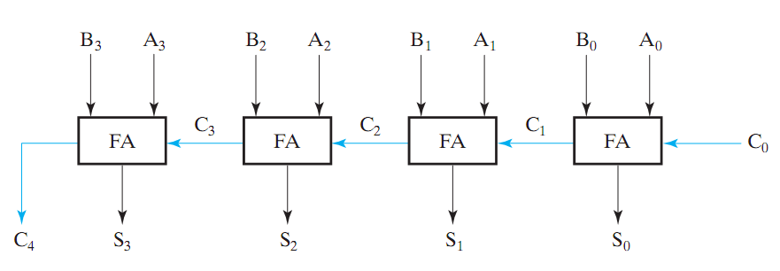
Binary Parallel Adder
To add n-bit numbers:
Use n Full-Adders in parallel
The carries propagates as in addition by hand
Src: Mano’s Book
This adder is called ripple carry adder

Slide 17
Subtractor
Design a Subtractor for 1-bit numbers
1. Specification: inputs (A, B) outputs (Diff, Borrow)

Slide 18
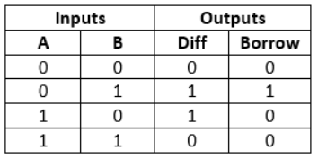
Subtractor
Design a Subtractor for 1-bit numbers
1. Specification: inputs (A, B) outputs (Diff, Borrow)
2. Formulation:

Slide 19
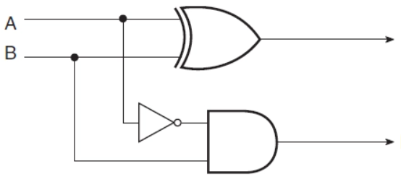
Half Subtractor
Design an Subtractor for 1-bit numbers
1. Specification: 3. Optimization/Circuit inputs (A, B) outputs (Diff, Borrow)
2. Formulation:
Diff
Borrow

Slide 20
Full Subtractor
A full subtractor is a combinational circuit that performs subtraction of two bits, one is minuend and other is subtrahend, taking into account borrow of the previous adjacent lower minuend bit. This circuit has three inputs and two outputs.

Slide 21
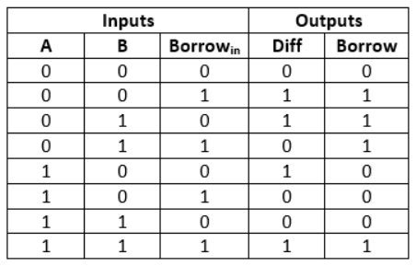
Full Subtractor
Diff
Borrow
BB_{in}
BB_{in}
A
00 01 11 10
A
00 01 11 10
0
1
0 1 0 1
1 0 1 0
0
1
0 1 1 1
0 0 1 0
Diff = A’B’B_{in} + A’BB_{in}’ + AB’B_{in}’ + ABB_{in}
= A ⊕ B ⊕ B_{in}
Borrow = A’B + BB_{in} + A’B_{in}

Slide 22
Full Subtractor = 2 Half Subtractors
Manipulating the Equations:
Diff = ( A ⊕ B ) ⊕ B_{in}
Borrow = A’B + BB_{in} + AB_{in}
=
=
= A’B + B_{in}(A ⊕ B )’
OR:
Diff = ( A ⊕ B ) ⊕ B_{in}
Borrow = A’B’B_{in} + A’BB_{in} + A’BB_{in}‘ + ABB_{in}
= (A’B’ + AB)B_{in} + A’B(B_{in} + B_{in}’)
= (A ⊕ B )’B_{in} + A’B

Slide 23
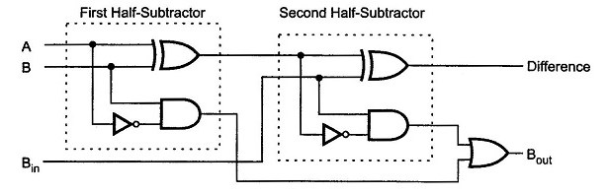
Full Subtractor = 2 Half Subtractors
Manipulating the Equations:
S = A ⊕ B ⊕ B_{in}
C = A’B + BB_{in} + A’B_{in}

Slide 24
Subtraction (2’s Complement)
How to build a subtractor using 2’s complement?

Slide 25
Subtraction (2’s Complement)
How to build a subtractor using 2’s complement?
1
Src: Mano’s Book
S = A + ( -B)

Slide 26
Adder/Subtractor
How to build a circuit that performs both addition and subtraction?

Slide 27
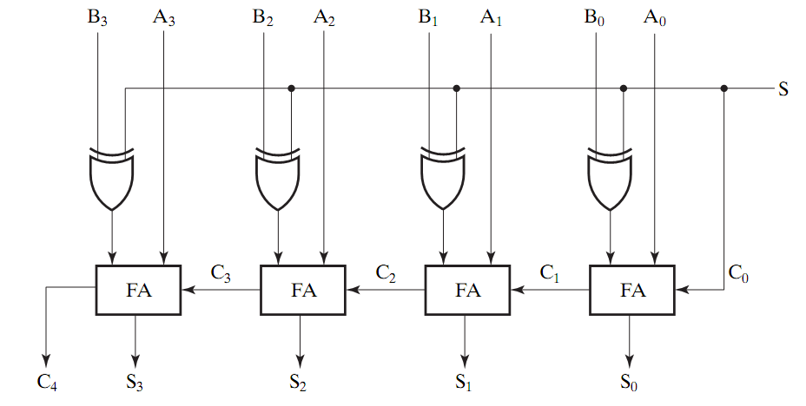
Adder/Subtractor
0 : Add
1: subtract
Src: Mano’s Book
Using full adders and XOR we can build an Adder/Subtractor!

Slide 28
Binary Parallel Adder (Again)
To add n-bit numbers:
Use n Full-Adders in parallel
The carries propagates as in addition by hand
Src: Mano’s Book
This adder is called ripple carry adder

Slide 29
Carry Look Ahead Adder
How to reduce propagation delay of ripple carry adders?
Carry look ahead adder: All carries are computed as a function of C₀ (independent of n !)
It works on the following standard principles:
A carry bit is generated when both input bits Ai and Bi are 1, or
When one of input bits is 1, and a carry in bit exists
Carry bits
Cn Cn-1…….Ci……….C2C1C0
An-1…….Ai……….A2A1A0
Bn-1…….Bi……….B2B1B0
Carry Out
Sn Sn-1…….Si……….S2S1S0

Slide 31
