Slide 1
Magnitude Comparator Decoder and Encoder

Slide 2
Comparators
Compare the magnitude of two binary numbers for the purpose of establishing whether one is greater than, equal to, or less than the other.
A comparator makes use of a cascade connection of identical subnetworks similar to the case of the parallel adder.

Slide 3
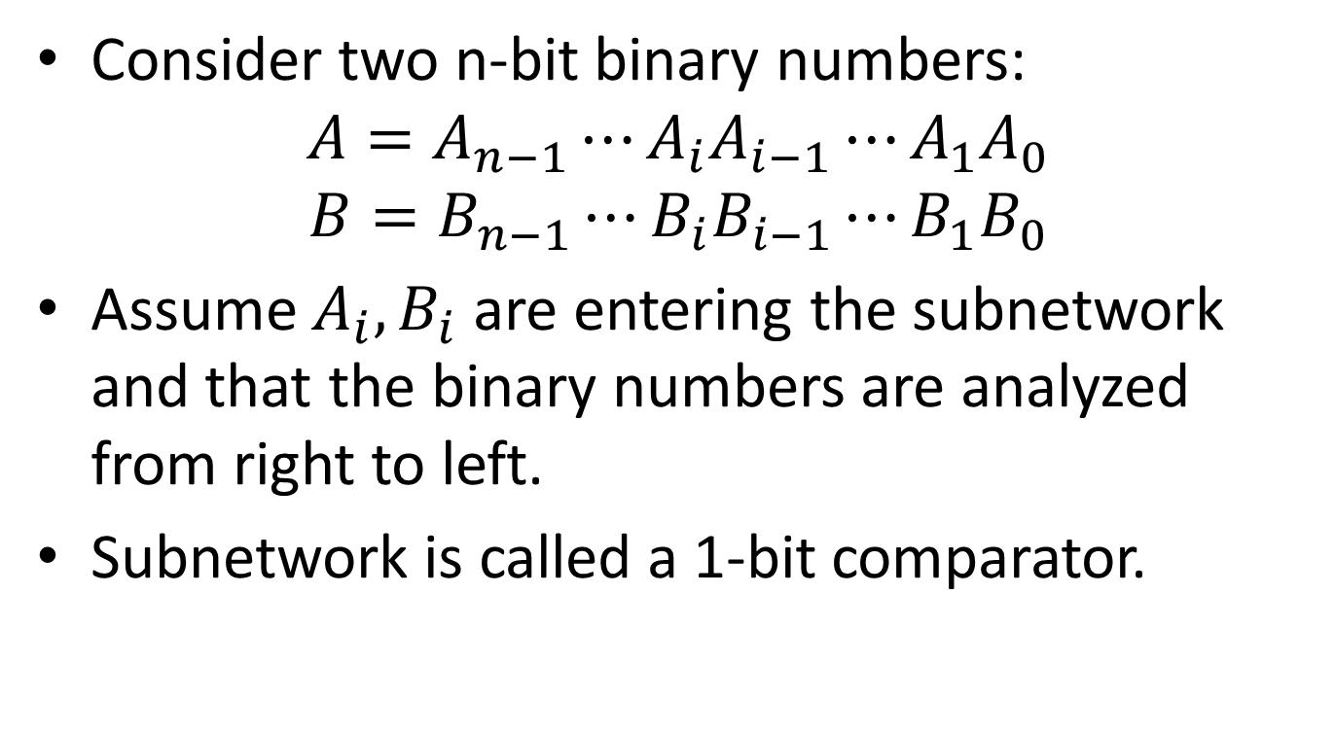
Comparators
Consider two n-bit binary numbers:
$$A=A_{n−1}⋯A_{i}A_{i−1}⋯A_{1}A_{0}$$
$$B=B_{n−1}⋯B_{i}B_{i−1}⋯B_{1}B_{0}$$
Assume $A_{i}, B_{i}$ are entering the subnetwork and that the binary numbers are analyzed from right to left.
Subnetwork is called a 1-bit comparator.

Slide 4
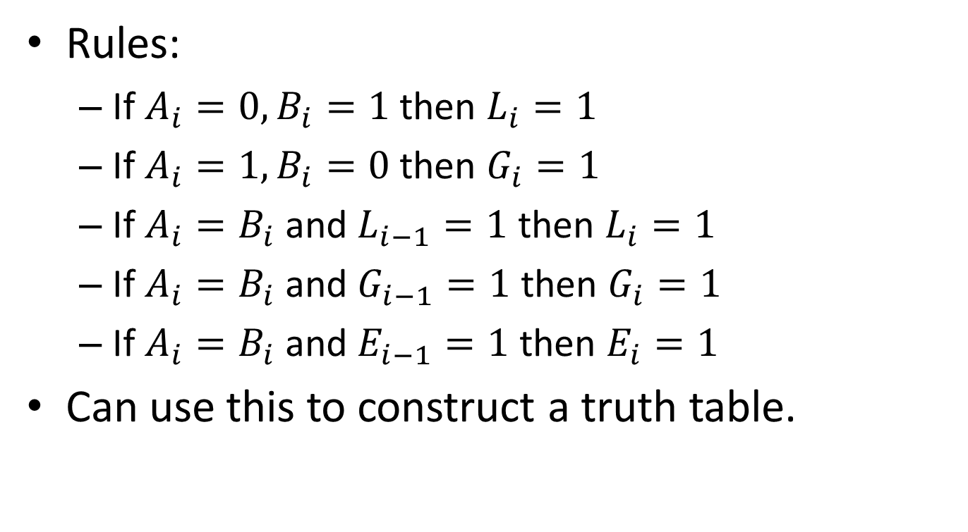
Comparators
Rules:
If $A_{i}=0, B_{i}=1$ then $L_{i}=1$
If $A_{i}=1, B_{i}=0$ then $G_{i}=1$
If $A_{i}=B_{i}$ and $L_{i−1}=1$ then $L_{i}=1$
If $A_{i}=B_{i}$ and $G_{i−1}=1$ then $G_{i}=1$
If $A_{i}=B_{i}$ and $E_{i−1}=1$ then $E_{i}=1$
Can use this to construct a truth table.

Slide 5
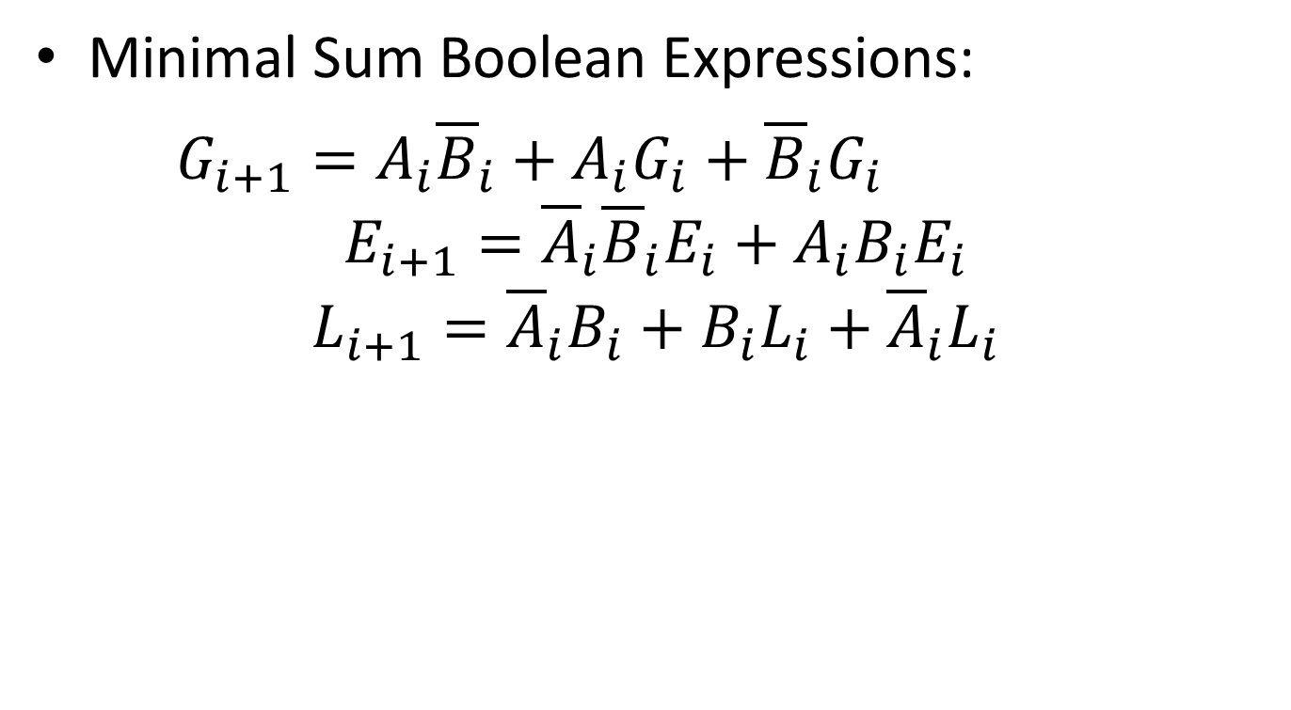
Comparators
Minimal Sum Boolean Expressions:
$G_{i+1}=A_{i}{\overline{B}}_{i}+A_{i}G_{i}+{\overline{B}}_{i}G_{i}$
$$E_{i+1}={\overline{A}}_{i}{\overline{B}}_{i}E_{i}+A_{i}B_{i}E_{i}$$
$$L_{i+1}={\overline{A}}_{i}B_{i}+B_{i}L_{i}+{\overline{A}}_{i}L_{i}$$

Slide 6
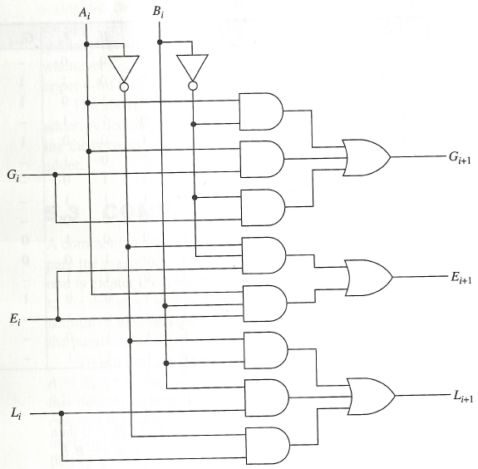
Comparators

Slide 7
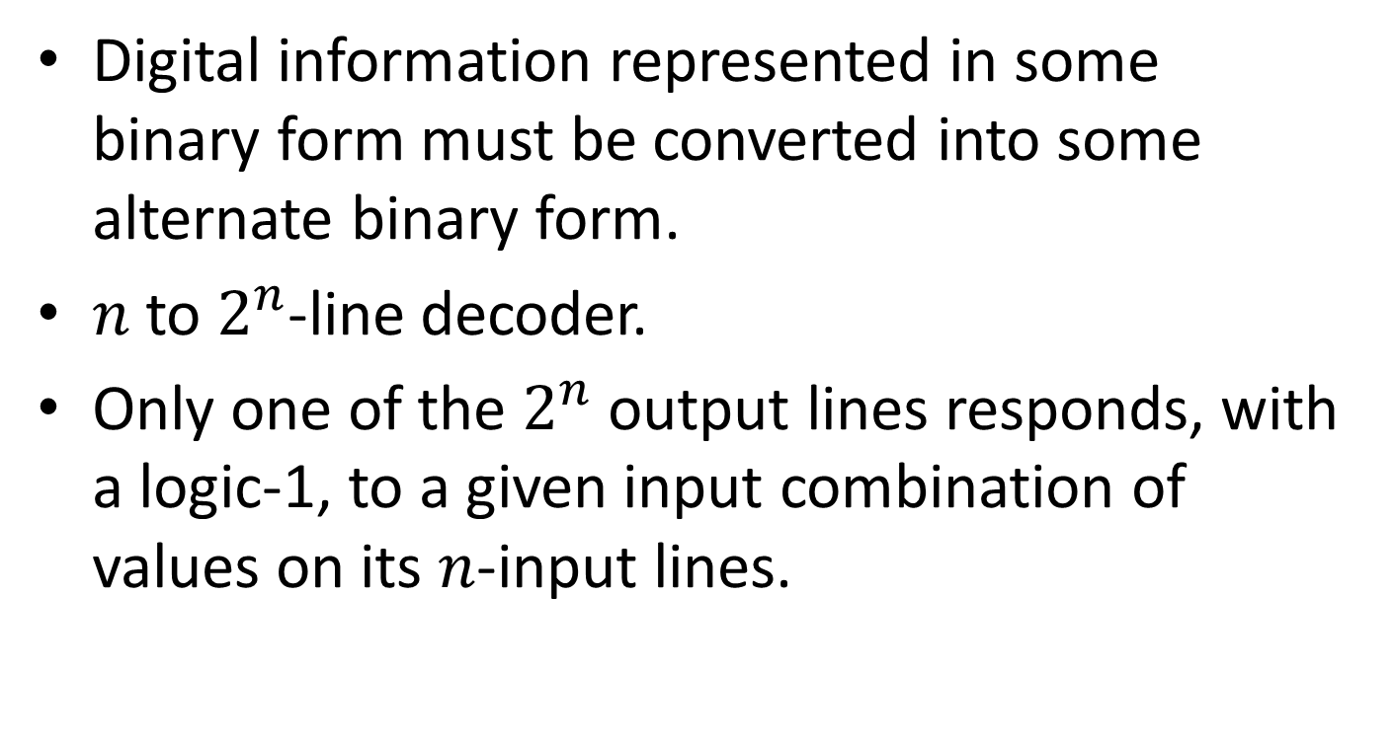
Decoder
Digital information represented in some binary form must be converted into some alternate binary form.
$n$ to $2^{n}$-line decoder.
Only one of the $2^{n}$ output lines responds, with a logic-1, to a given input combination of values on its $n$-input lines.

Slide 8
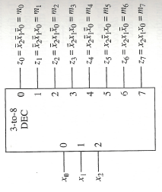
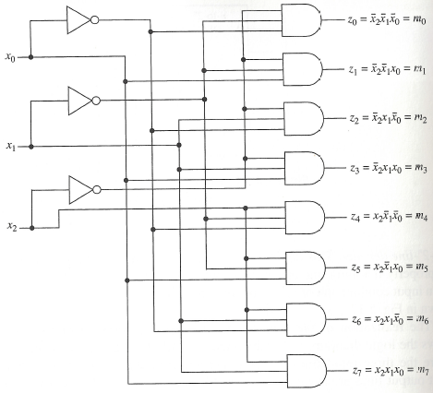
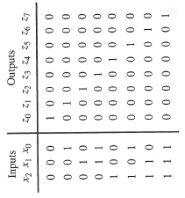
Realization
Symbol
Logic Diagram
Truth Table

Slide 9
Decoder
Input combinations can be regarded as binary numbers with the consequences that the j-th output line is at logic-1 for j = 0, 1, . . , 7 only when input combination j is applied.

Slide 10
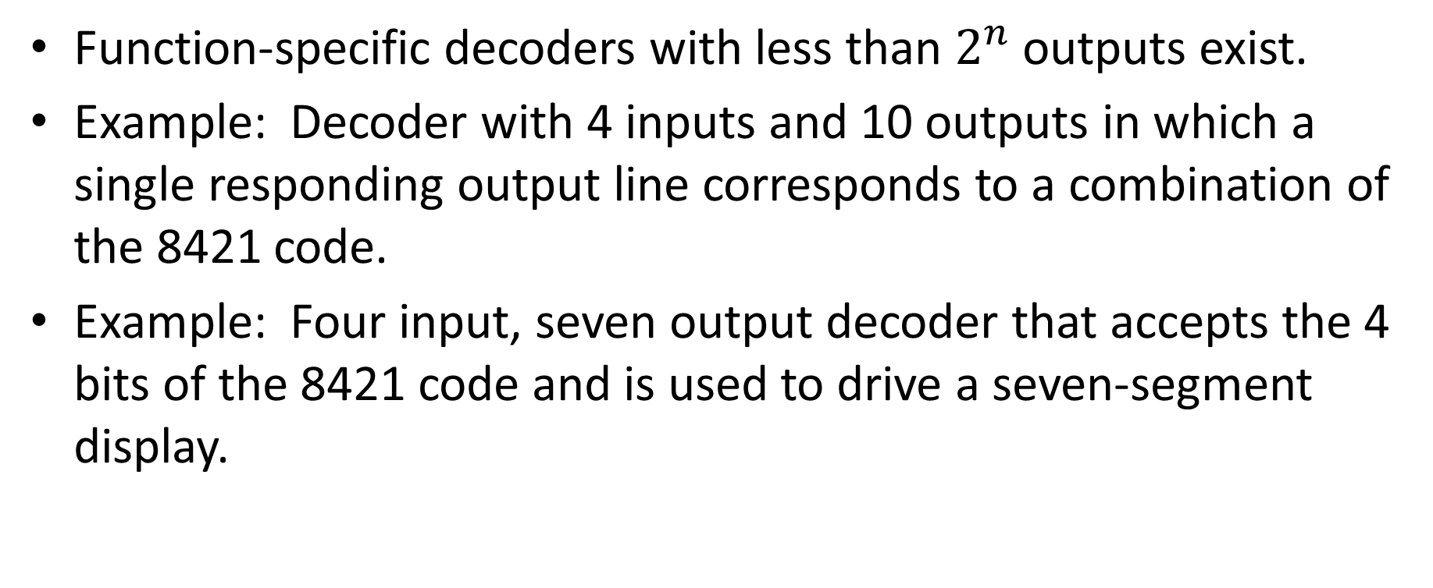
Other types of Decoders
Function-specific decoders with less than $2^{n}$ outputs exist.
Example: Decoder with 4 inputs and 10 outputs in which a single responding output line corresponds to a combination of the 8421 code.
Example: Four input, seven output decoder that accepts the 4 bits of the 8421 code and is used to drive a seven-segment display.

Slide 11
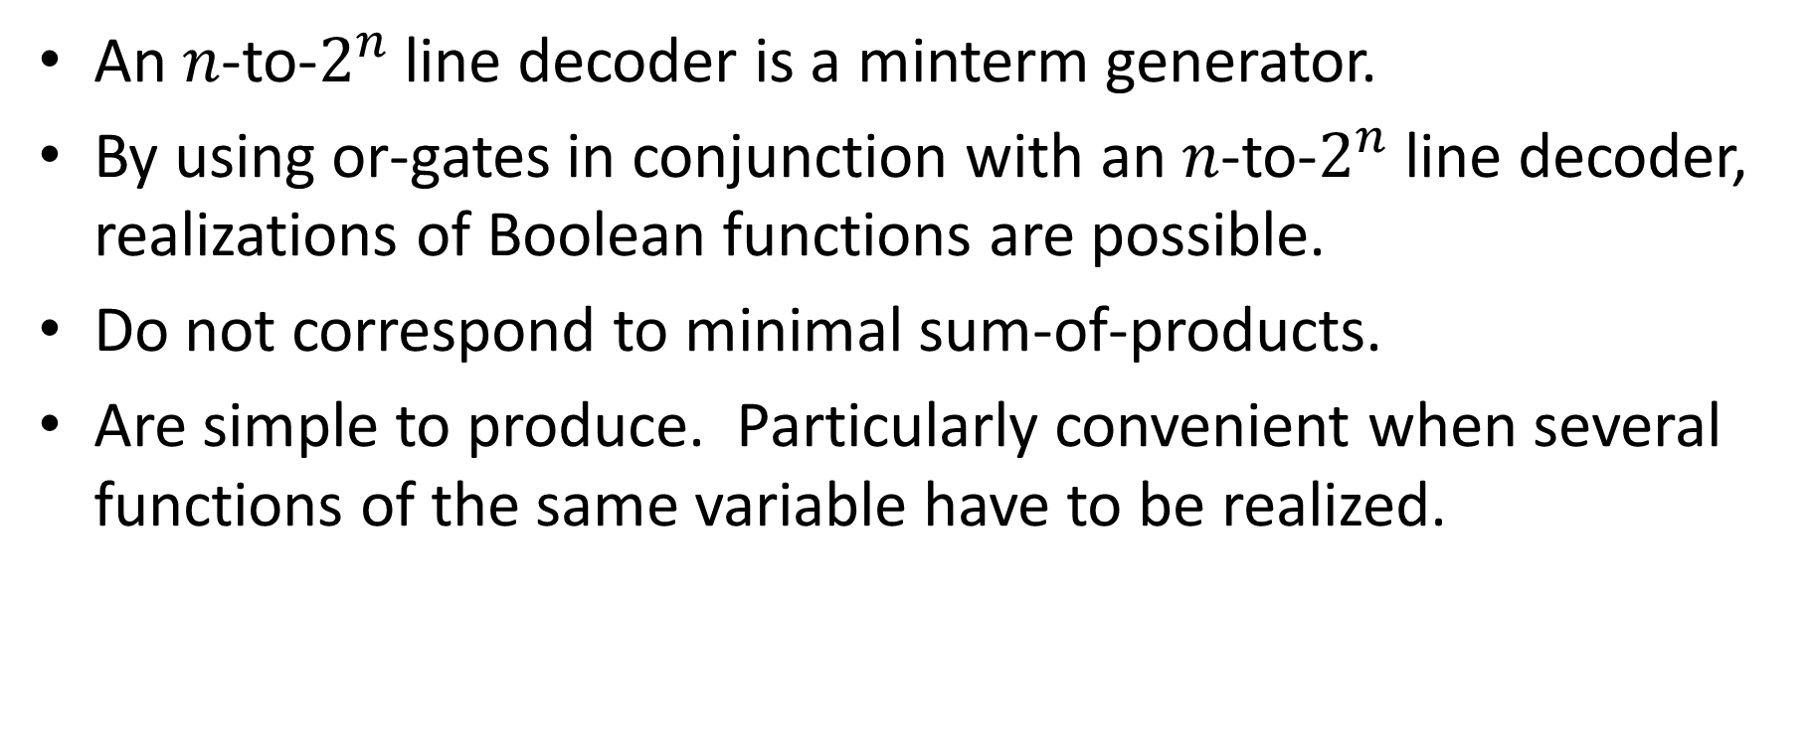
Logic Design Using Decoders
An $n$-to-$2^{n}$ line decoder is a minterm generator.
By using or-gates in conjunction with an $n$-to-$2^{n}$ line decoder, realizations of Boolean functions are possible.
Do not correspond to minimal sum-of-products.
Are simple to produce. Particularly convenient when several functions of the same variable have to be realized.

Slide 12
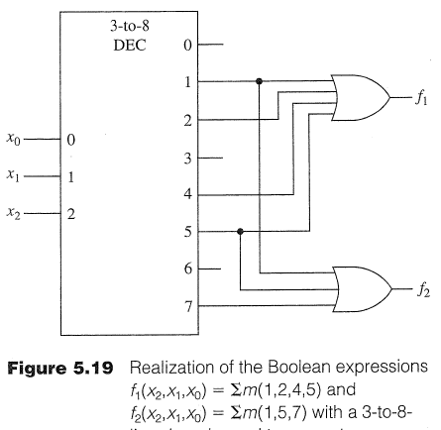
Minterms using OR Gates

Slide 13
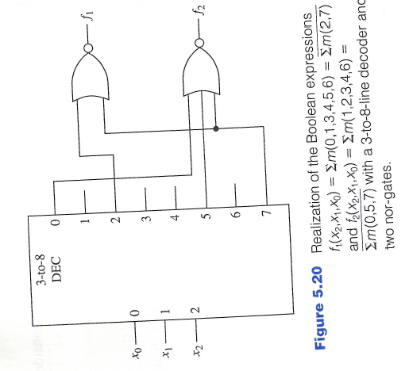
Minterms using NOR Gates

Slide 14
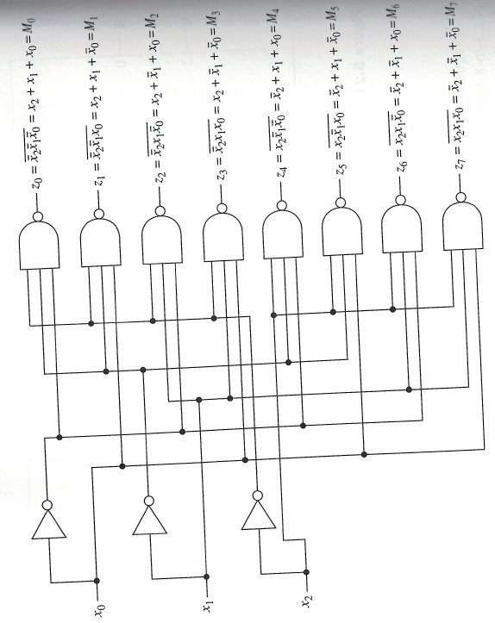
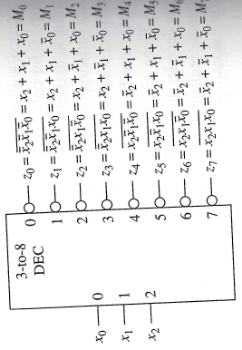
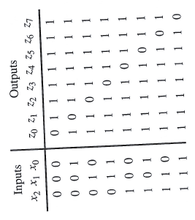
Implementing a Decoder using NAND
Symbol
Logic Diagram
Truth Table

Slide 15
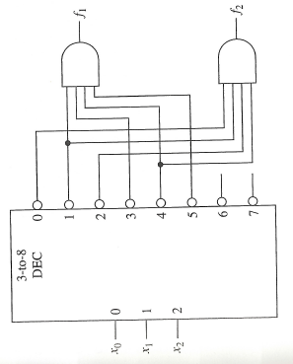
Minterms using AND gates
$$f_{1}=∑m\left(0,2,6,7\right), f_{2}=∑m(3,5,6,7)$$

Slide 16
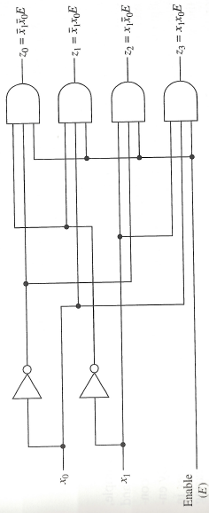
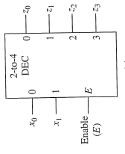
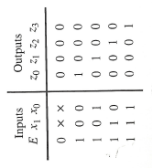
Decoders with an Enable Input
Symbol
Logic Diagram
Truth Table

Slide 17


Decoders with enable inputs
When disabled, all outputs of the decoder can either be at logic-0 or logic-1.
Enable input provides the decoder with additional flexibility. Idea: data is applied to the enable input.
Process is known as demultiplexing.
Enable inputs are useful when constructing larger decoders from smaller decoders.
$${\overline{x}}_{0}{\overline{x}}_{1}E$$
If $x_{0}=0, x_{1}=0$ then data appears on line $z_{0}$.
Data

Slide 18
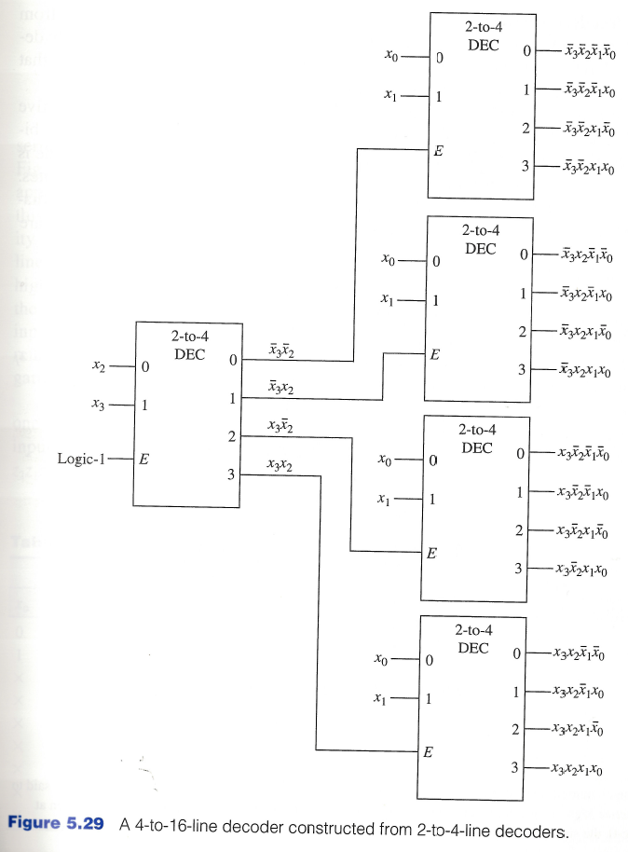
Constructing Larger Decoders

Slide 19
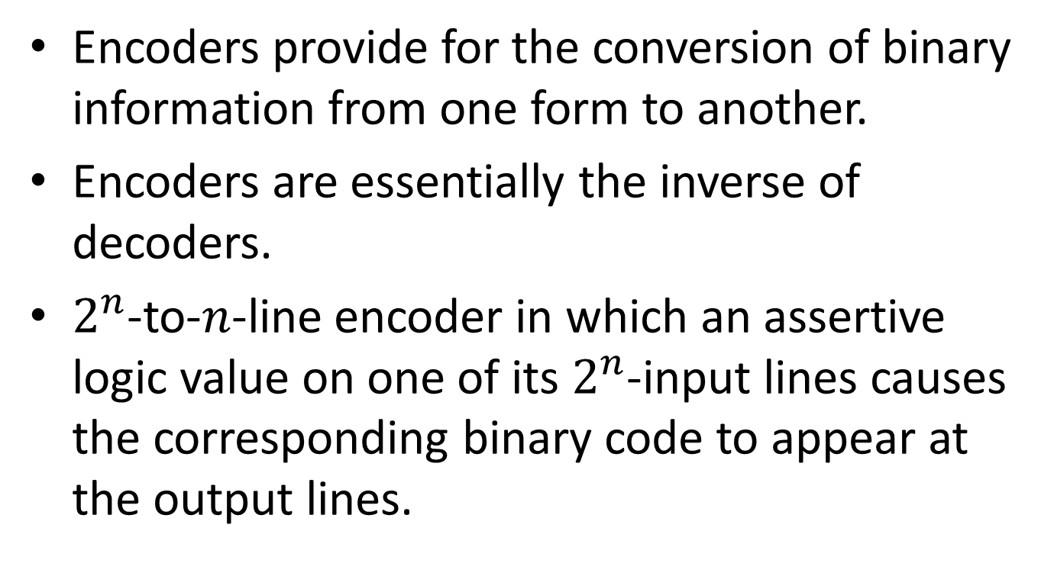
Encoders
Encoders provide for the conversion of binary information from one form to another.
Encoders are essentially the inverse of decoders.
$2^{n}$-to-$n$-line encoder in which an assertive logic value on one of its $2^{n}$-input lines causes the corresponding binary code to appear at the output lines.

Slide 20
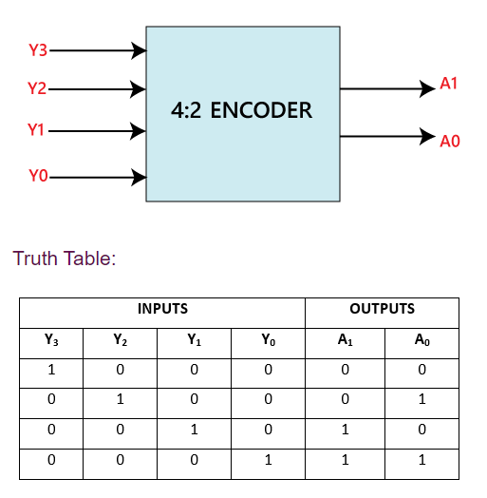
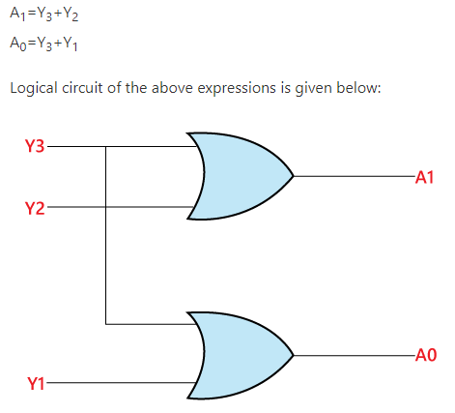
Encoders

Slide 21
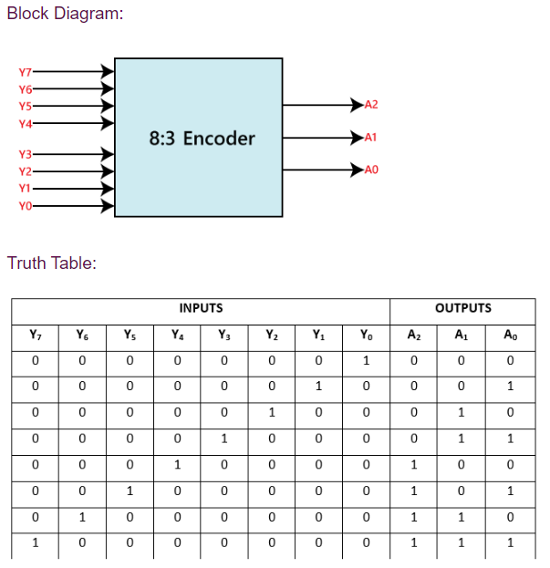
8:3 Encoder

Slide 22
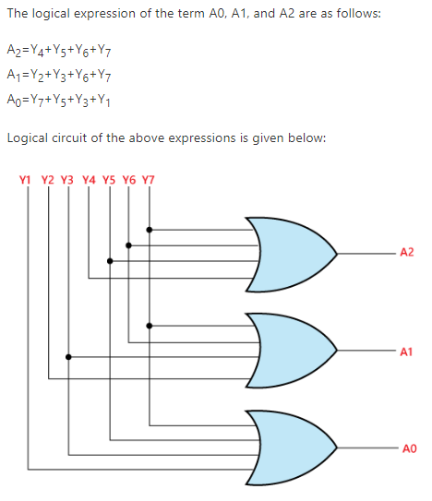
8:3 Encoder

Slide 23
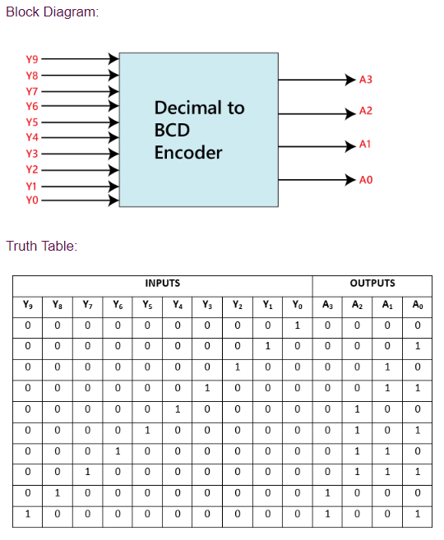
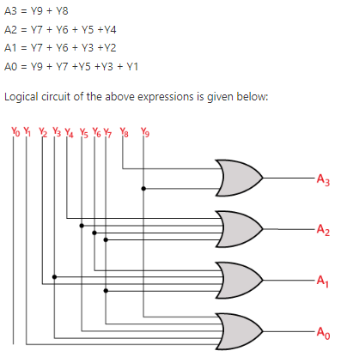
Decimal to BCD Encoder

Slide 24
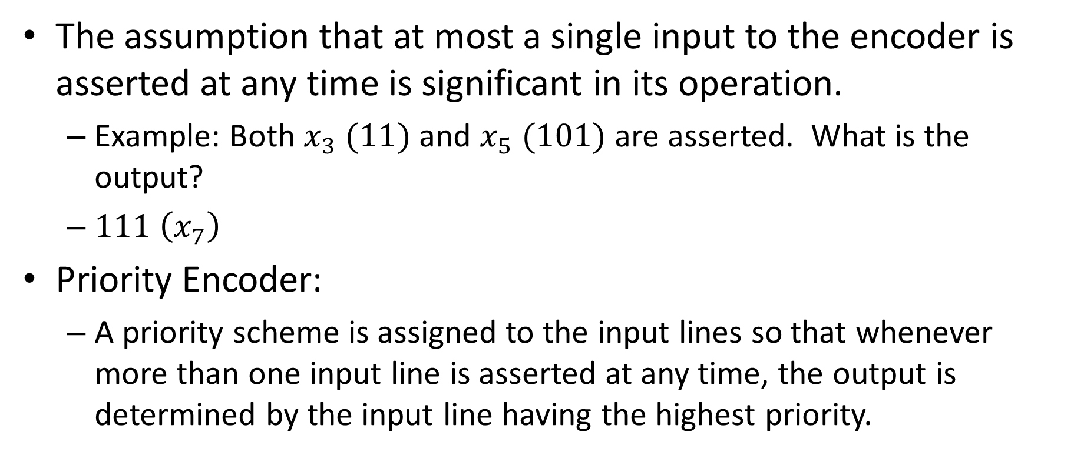
Priority Encoder
The assumption that at most a single input to the encoder is asserted at any time is significant in its operation.
Example: Both $x_{3} (11)$ and $x_{5} (101)$ are asserted. What is the output?
$111 \left(x_{7}\right)$
Priority Encoder:
A priority scheme is assigned to the input lines so that whenever more than one input line is asserted at any time, the output is determined by the input line having the highest priority.

Slide 25
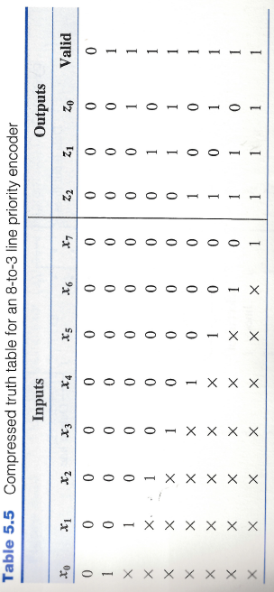
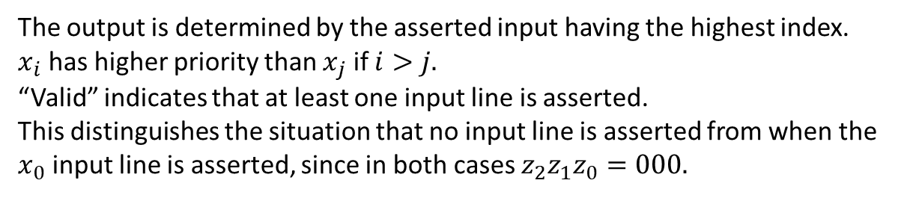
Priority Encoder
The output is determined by the asserted input having the highest index.
$x_{i}$ has higher priority than $x_{j}$ if $i>j.$
“Valid” indicates that at least one input line is asserted.
This distinguishes the situation that no input line is asserted from when the $x_{0}$ input line is asserted, since in both cases $z_{2}z_{1}z_{0}=000.$

Slide 26
ENCODERS AND DECODERS
ONLY ONE INPUT ACTIVATED AT A TIME
BINARY CODE INPUT
ONLY ONE OUTPUT ACTIVATED AT A TIME
BINARY CODE OUTPUT

Slide 27
THE 8421 BCD CODE
BCD stands for Binary-Coded Decimal.
A BCD number is a four-bit binary group that represents one of the ten decimal digits 0 through 9.
Example:
Decimal number 4926 4 9 2 6
8421 BCD coded number 0100 1001 0010 0110

Slide 28
ELECTRONIC ENCODER -
DECIMAL TO BCD
BCD output
Decimal input
0 0 0 0
0 1 0 1
0 1 1 1
0 0 1 1
7
Decimal
to
BCD
Encoder
5
3
0
Encoders are available in IC form.
This encoder translates from decimal input to BCD output.

Slide 29
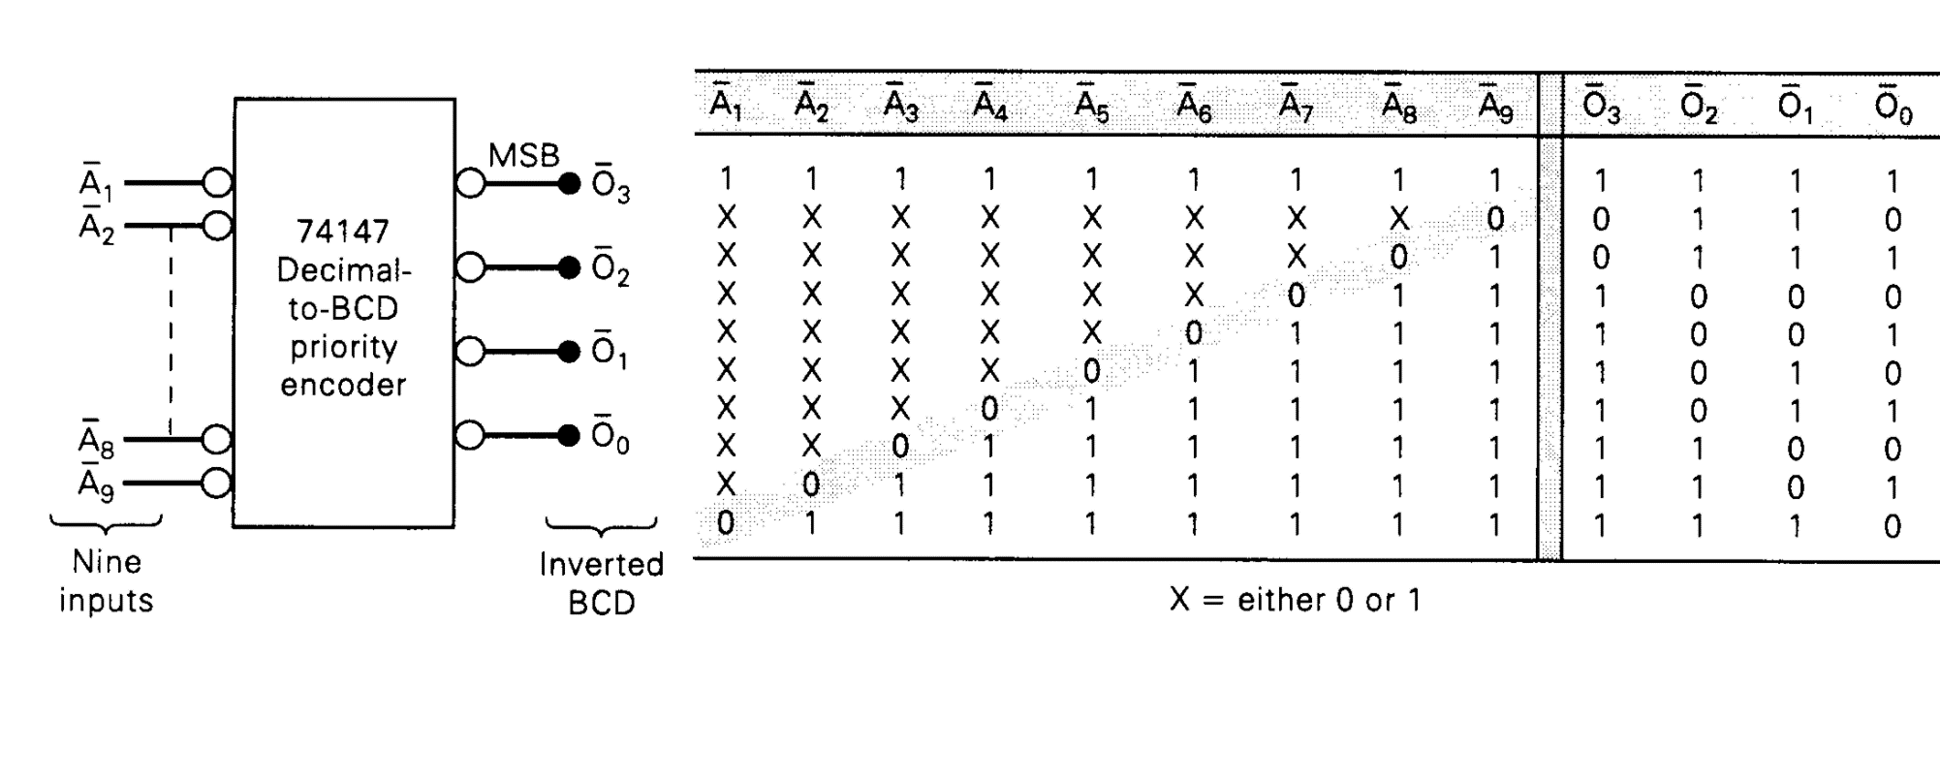
10 line to 4 line Encoder

Slide 30
4 line to 10 line Decoder

Slide 31
DECODERS: BCD TO
7-SEGMENT DECODER
BCD input
Decimal output
LED
0 0 0 0
0 0 0 1
0 0 1 0
0 0 1 1
0 1 0 0
BCD-to-
7-Segment
Decoder/
Driver
Electronic decoders are available in IC form.
This decoder translates from BCD to decimal.
Decimals are shown on an 7-segment LED display.
This IC also drives the 7-segment LED display.

Slide 32
TEST
Q #1- What is the decimal output from the decoder that
appears on the 7-segment display?
Q #2- What is the decimal output from the decoder that
appears on the 7-segment display?
Q #3- What is the decimal output from the decoder that
appears on the 7-segment display?
Q #4- What is the decimal output from the decoder that
appears on the 7-segment display?
Q #5- What is the decimal output from the decoder that
appears on the 7-segment display?
Answer: 3
Answer: 0
Answer: 9
Answer: 7
Answer: 6
BCD input
Decimal output
1 0 0 1
0 1 1 1
0 0 0 0
0 1 1 0
0 0 1 1
BCD-to-
7-Segment
Decoder/
Driver
?

Slide 33
TEST

Slide 34
TEST

Slide 35
TEST
ANSWER THE FOLLOWING QUESTIONS WITH ONE OR MORE OF THESE WORDS: MUX, DEMUX, ENCODER, DECODER.
A. Has more inputs than outputs.
ENCODER, MUX
B. Uses select inputs.
MUX, DEMUX
C. Can be used in parallel-to-serial conversion.
MUX
D. Produces a binary code at its output.
ENCODER
E. Only one of its outputs is activated at one time.
DEMUX, DECODER
F. Used to route input signals to one of several outputs.
MUX
G. Used to generate arbitrary logic functions.
MUX, DEMUX
H. 3 line-to-8 line or binary to octal.
DECODER
I. Data Selectors are also
MUX.

