Slide 1
Parity

Slide 2
Parity Generator and Parity Check
Majority of modern communication is Digital in nature i.e., it is a combination of 1’s and 0’s. The digital data is transmitted either through wires (in case of wired communication) or wireless. Even in an advanced mode of communication, there will be errors while transmitting data (due to noise).
The simplest of errors is corruption of a bit i.e., a 1 may be transmitted as a 0 or vice-versa. To confirm whether the received data is the intended data or not, we should be able to detect errors at the receiver.

Slide 3
What is Parity Bit?
The parity generating technique is one of the most widely used error detection techniques for the data transmission. In digital systems, when binary data is transmitted and processed, data may be subjected to noise so that such noise can alter 0s (of data bits) to 1s and 1s to 0s.
Hence, a Parity Bit is added to the word containing data in order to make number of 1s either even or odd. The message containing the data bits along with parity bit is transmitted from transmitter to the receiver.
At the receiving end, the number of 1s in the message is counted and if it doesn’t match with the transmitted one, it means there is an error in the data. Thus, the Parity Bit it is used to detect errors, during the transmission of binary data.

Slide 4
Parity Generator and Checker
A Parity Generator is a combinational logic circuit that generates the parity bit in the transmitter. On the other hand, a circuit that checks the parity in the receiver is called Parity Checker. A combined circuit or device of parity generators and parity checkers are commonly used in digital systems to detect the single bit errors in the transmitted data.

Slide 5
Even Parity and Odd Parity
The sum of the data bits and parity bits can be even or odd. In even parity, the added parity bit will make the total number of 1s an even number, whereas in odd parity, the added parity bit will make the total number of 1s an odd number.
The basic principle involved in the implementation of parity circuits is that sum of odd number of 1s is always 1 and sum of even number of 1s is always 0. Such error detecting and correction can be implemented by using Ex-OR gates (since Ex-OR gate produce zero output when there are even number of inputs).

Slide 6
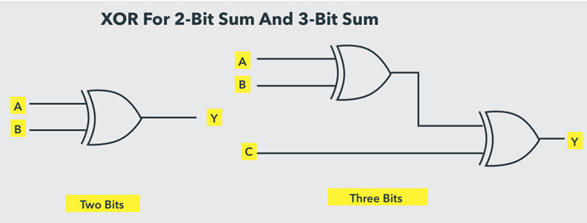
Even Parity and Odd Parity
To produce two bits sum, one Ex-OR gate is sufficient whereas for adding three bits, two Ex-OR gates are required as shown in below figure.

Slide 7
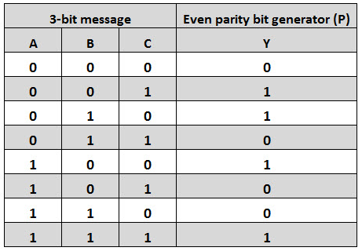
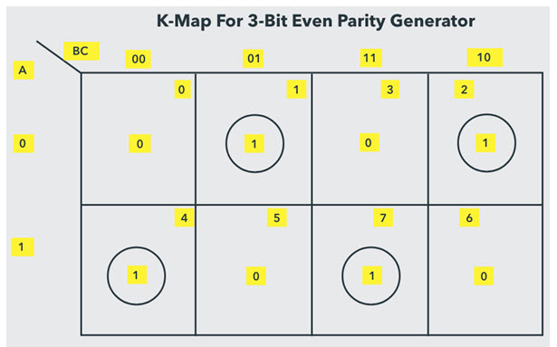
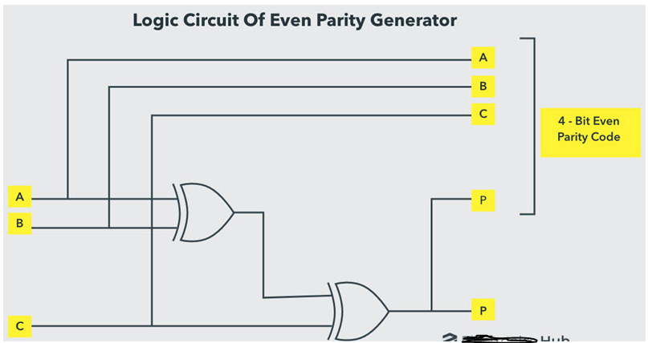
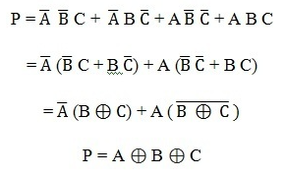
Even Parity Generator

Slide 8
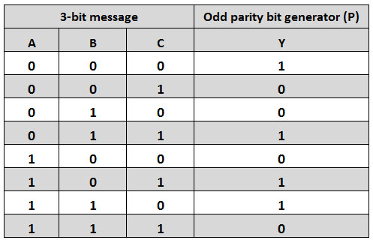
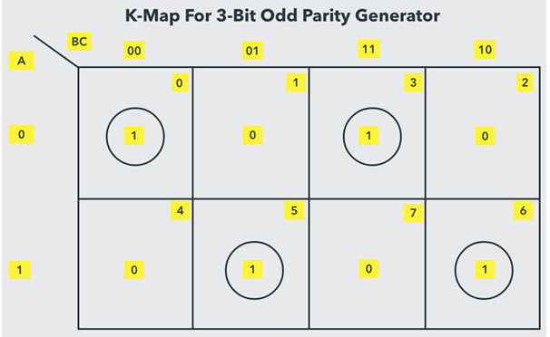

Odd Parity Generator

Slide 9
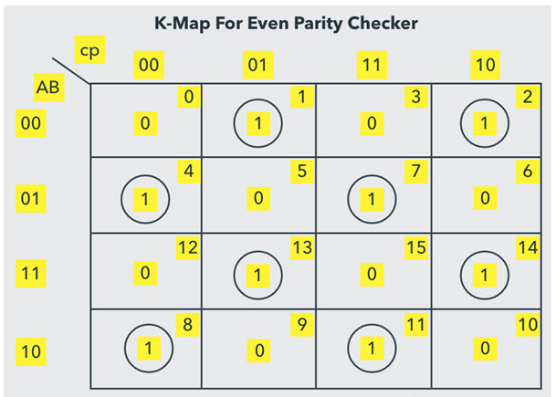
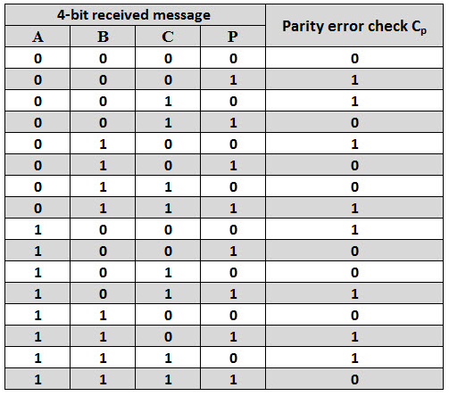
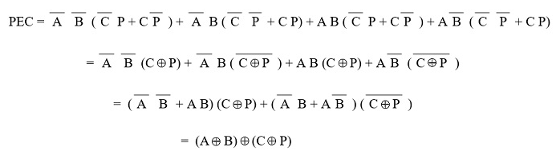
Even Parity Checker

Slide 10
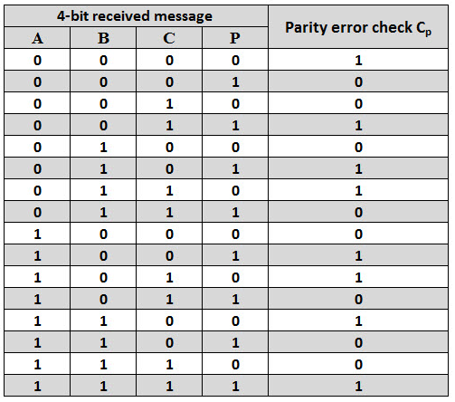
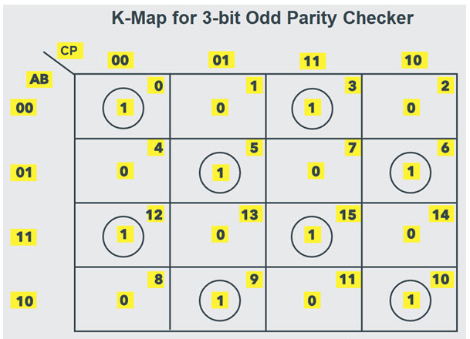
Odd Parity Checker

