Slide 1
Input / Output Organization

Slide 2
Overview
Computer has ability to exchange data with other devices.
  Human-computer communication
  Computer-computer communication
  Computer-device communication

Slide 3
Accessing I/O Devices

Slide 4
Single Bus
Processor
Memory
Bus
I/O de
vice 1
I/O de
vice
n
Figure 4.1. A single-bus structure.

Slide 5
Memory-Mapped I/O
When I/O devices and the memory share the same address space, the arrangement is called memory-mapped I/O.
Any machine instruction that can access memory can be used to transfer data to or from an I/O device.
Move DATAIN, R0
Move R0, DATAOUT
Some processors have special In and Out instructions to perform I/O transfer.

Slide 6
ISOLATED vs MEMORY MAPPED I/O
Isolated I/O
- Separate I/O read/write control lines in addition to memory read/write control lines
- Separate (isolated) memory and I/O address spaces
- Distinct input and output instructions
Memory-mapped I/O
  - A single set of read/write control lines
  (no distinction between memory and I/O transfer)
  - Memory and I/O addresses share the common address space
  -> reduces memory address range available
  - No specific input or output instruction
  -> The same memory reference instructions can
  be used for I/O transfers
  - Considerable flexibility in handling I/O operations

Slide 7
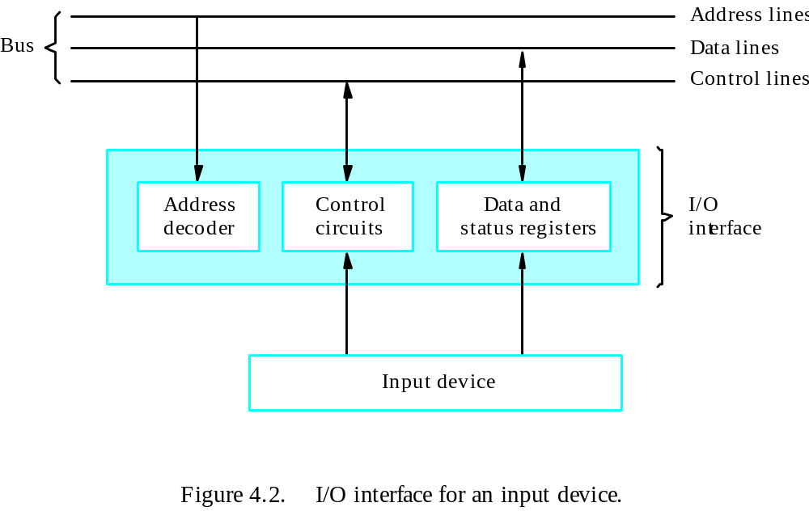
Interface

Slide 8
I/O INTERFACE
Port A
I/O data
register
Bidirectional
Bus
data bus
buffers
Port B
I/O data
register
CPU
Chip select
I/O
Device
CS
Internal bus
Register select
RS1
Timing
Control
Control
Register select
register
RS0
and
I/O read
Control
RD
Status
Status
I/O write
WR
register
CS RS1 RS0 Register selected
0 x x None - data bus in high-impedence
1 0 0 Port A register
1 0 1 Port B register
1 1 0 Control register
Programmable Interface
1 1 1 Status register
- Information in each port can be assigned a meaning
depending on the mode of operation of the I/O device
-> Port A = Data; Port B = Command; Port C = Control; Port D = Status
- CPU initializes(loads) each port by transferring a byte to the Control Register
-> Allows CPU can define the mode of operation of each port
-> Programmable Port: By changing the bits in the control register, it is possible to change the interface characteristics

Slide 9
ASYNCHRONOUS DATA TRANSFER
Synchronous and Asynchronous Operations
Asynchronous Data Transfer
Synchronous - All devices derive the timing information from common clock line
Asynchronous - No common clock
Asynchronous data transfer between two independent units requires that
control signals be transmitted between the communicating units to
indicate the time at which data is being transmitted
Two Asynchronous Data Transfer Methods
Strobe pulse
A strobe pulse is supplied by one unit to indicate the other unit when the transfer has to occur
Handshaking
A control signal is accompanied with each data being transmitted to indicate the presence of data
The receiving unit responds with another control signal to acknowledge receipt of the data

Slide 10
HANDSHAKING
Source-Initiated
The source unit that initiates the transfer has
no way of knowing whether the destination unit
has actually received data
Destination-Initiated
The destination unit that initiates the transfer
no way of knowing whether the source has
actually placed the data on the bus
To solve this problem, the HANDSHAKE method
introduces a second control signal to provide a Reply
to the unit that initiates the transfer

