Slide 1
Memory Organization

Slide 2
Outline
Introduction
Characteristics of Memory Systems
Memory Hierarchy
Memory Locations and Addresses
Semiconductor Memory

Slide 3
Introduction
Memory unit → One of the most essential component of digital computer
Memory is divided into two tiers:
Main Memory
Expensive
Small capacity
High – performance
Auxiliary Memory or Secondary Storage
Cheap
Large capacity
Slow

Slide 4
Characteristics of Memory Systems
Location Internal Processor Register Cache Memory Main Memory External Optical Disk Magnetic Disk Magnetic Tape | Capacity Number of words Number of bytes | Unit of Transfer Words Block | Access Method Sequential Direct Random Associative
Performance Access time Cycle time Transfer rate | Physical Tape Semiconductor Magnetic Optical Magneto-optical | Physical Characteristics Volatile / Non-volatile Erasable / Non-erasable | Organization Memory Modules
Table 1

Slide 5
Memory Hierarchy
CPU
Register
INCREASING STORAGE
Inboard
Memory
Cache
Memory
INCREASING SPEED
Main
Memory
Outboard
Storage
CD/DVD-ROM/RW
Blu-Ray
Magnetic Disk
Off-line
Storage
Magnetic Tape
Figure 1

Slide 6
Memory Locations and Addresses
Memory holds both instruction and data.
Memory uses ‘k’ address locations and ‘n’ bits per location to store instruction or data.
The size of ‘n’ is typically ‘8’ (represents Byte), ‘16’ (represents word), etc…
Address
Data Length
0 | n-1 | … | 1 | 0
1
2
2^{k} – 1
k | No. of locations
10 | 2¹⁰ = 1024 = 1 K
16 | 2¹⁶ = 65,536 = 64 K
20 | 2²⁰ = 1,048,576 = 1 M
Table 2
Table 3

Slide 7

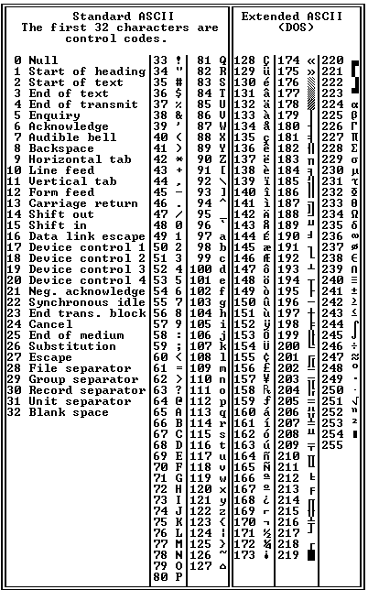
ASCII Character Set Table
A Character takes 8 bits (1 Byte) to store in memory.
That means total possible number of characters are 2⁸ = 256, which can use the ASCII value of 0 to 255.
Figure shows the list of ASCII and Extended ASCII characters along with their respective ASCII values.
Word
64 bit
16 bit
32 bit

Slide 8
RAM Chip
Chip select 1
CS1
Chip select 2
CS2
CS1 | CS2 | RD | WR | Memory Function | State of data bus
1 | 0 | 0 | 1 | Write | Input data to RAM
1 | 0 | 1 | × | Read | Output data from RAM
128 × 8
RAM
Read
RD
8 bit
data bus
Write
WR
7 bit address
AD7
Functional Table (All the other states remain in High-Impedance state)
Block Diagram
* High-Impedance: Output is not being driven to any defined logic level by the output circuit.

Slide 9
ROM Chip
Chip select 1
CS1
Chip select 2
CS2
512 × 8
ROM
8 bit
data bus
9 bit address
AD9
Block Diagram

Slide 10
Memory connection to the CPU
Address bus
CPU
16 – 11
10
9 8
7 – 1
RD
WR
Data bus
CS1
CS2
128 × 8
RAM 1
Decoder
3 2 1 0
RD
WR
AD7
CS1
CS2
128 × 8
RAM 2
RD
WR
AD7
CS1
CS2
128 × 8
RAM 3
RD
WR
AD7
CS1
CS2
128 × 8
RAM 4
RD
WR
AD7
CS1
CS2
512 × 8
ROM
AD9

Slide 11
Memory Address map
It is a tabular representation for the assigned address space for each chip in the system.
Component | Hexadecimal Address | Address bus
 |  | 10 | 9 | 8 | 7 | 6 | 5 | 4 | 3 | 2 | 1
RAM 1 | 0000 – 007F | 0 | 0 | 0 | × | × | × | × | × | × | ×
RAM 2 | 0080 – 00FF | 0 | 0 | 1 | × | × | × | × | × | × | ×
RAM 3 | 0100 – 017F | 0 | 1 | 0 | × | × | × | × | × | × | ×
RAM 4 | 0180 – 01FF | 0 | 1 | 1 | × | × | × | × | × | × | ×
ROM | 0200 – 03FF | 1 | × | × | × | × | × | × | × | × | ×

Slide 12
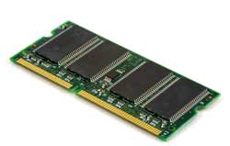
Semiconductor Memory
Essential element of today's electronics.
It is a type of semiconductor device tasked with storing data.

Slide 13
Types of Semiconductor Memory
Electronic semiconductor memory technology can be split into two main types or categories, according to the way in which the memory operates:
RAM (Random Access Memory): RAM or random access memory is a form of semiconductor memory technology that is used for reading and writing data in any order as required. It is used for such applications as the computer or processor memory where variables and other stored and are required on a random basis. Data is stored and read many times to and from this type of memory.
ROM (Read only Memory): A ROM is a form of semiconductor memory technology used where the data is written once and then not changed. In view of this it is used where data needs to be stored permanently, even when the power is removed - many memory technologies lose the data once the power is removed.

Slide 14


Slide 15
Types of Semiconductor Memory
Semiconductor Memory
Volatile Memory
Non-Volatile Memory
DRAM
PROM
EPROM (UV-PROM)
(Erasable Programmable ROM)
SRAM
SDRAM
EEPROM (Electrically Erasable PROM)
FLASH
FeRAM (Ferro Electric RAM)

Slide 16
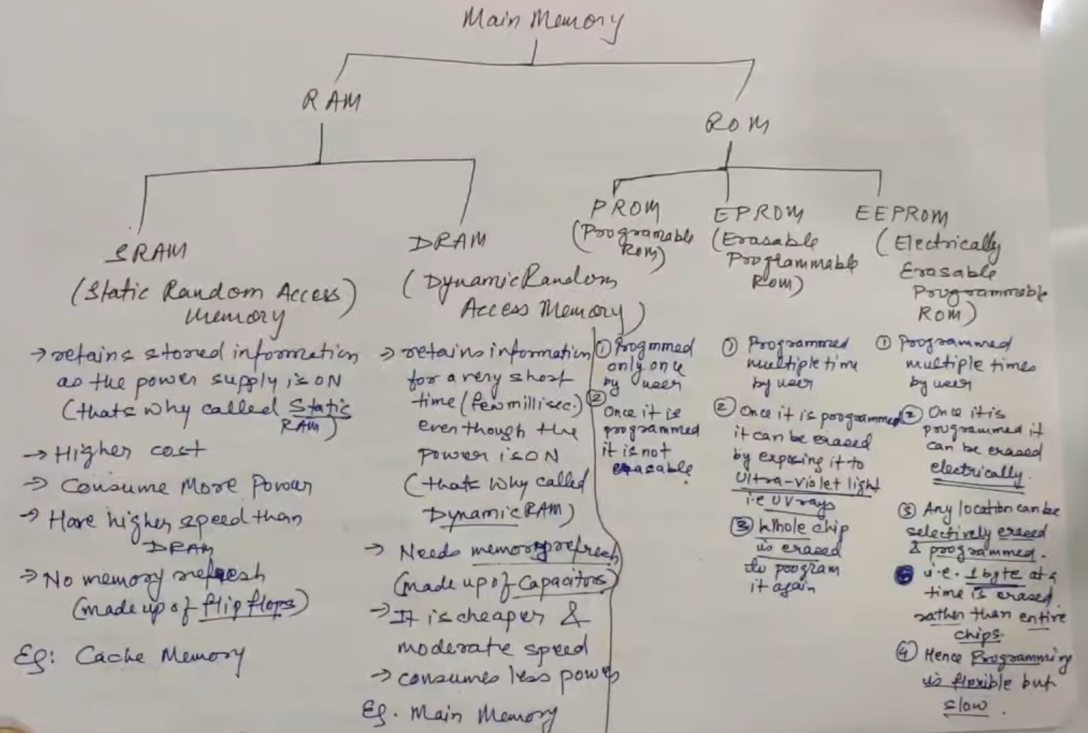

Slide 17
Semiconductor Memory Technologies
DRAM: Dynamic RAM is a form of random access memory. DRAM uses a capacitor to store each bit of data, and the level of charge on each capacitor determines whether that bit is a logical 1 or 0. However these capacitors do not hold their charge indefinitely, and therefore the data needs to be refreshed periodically. As a result of this dynamic refreshing it gains its name of being a dynamic RAM. DRAM is the form of semiconductor memory that is often used in equipment including personal computers and workstations where it forms the main RAM for the computer.

Slide 18
Semiconductor Memory Technologies
SRAM: Static Random Access Memory. This form of semiconductor memory gains its name from the fact that, unlike DRAM, the data does not need to be refreshed dynamically. It is able to support faster read and write times than DRAM (typically 10 ns against 60 ns for DRAM), and in addition its cycle time is much shorter because it does not need to pause between accesses. However it consumes more power, is less dense and more expensive than DRAM. As a result of this it is normally used for caches, while DRAM is used as the main semiconductor memory technology.

Slide 19
Semiconductor Memory Technologies
SDRAM: Synchronous DRAM. This form of semiconductor memory can run at faster speeds than conventional DRAM. It is synchronized to the clock of the processor and is capable of keeping two sets of memory addresses open simultaneously. By transferring data alternately from one set of addresses, and then the other, SDRAM cuts down on the delays associated with non-synchronous RAM, which must close one address bank before opening the next.

Slide 20
Semiconductor Memory Technologies
PROM: This stands for Programmable Read Only Memory. It is a semiconductor memory which can only have data written to it once - the data written to it is permanent. These memories are bought in a blank format and they are programmed using a special PROM programmer.

Slide 21
Semiconductor Memory Technologies
EPROM: This is an Erasable Programmable Read Only Memory. This form of semiconductor memory can be programmed and then erased at a later time. This is normally achieved by exposing the silicon to ultraviolet light.

Slide 22
Semiconductor Memory Technologies
EEPROM: This is an Electrically Erasable Programmable Read Only Memory. Data can be written to it and it can be erased using an electrical voltage. This is typically applied to an erase pin on the chip. Like other types of PROM, EEPROM retains the contents of the memory even when the power is turned off. Also like other types of ROM, EEPROM is not as fast as RAM.

Slide 23
Semiconductor Memory Technologies
Flash memory: Flash memory may be considered as a development of EEPROM technology. Data can be written to it and it can be erased, although only in blocks, but data can be read on an individual cell basis.
It is also non-volatile, and this makes it particularly useful. As a result Flash memory is widely used in many applications including memory cards for digital cameras, mobile phones, computer memory sticks and many other applications.

Slide 24
Semiconductor Memory Technologies
FeRAM: Ferroelectric RAM is a random-access memory technology that has many similarities to the standard DRAM technology. The major difference is that it incorporates a ferroelectric layer instead of the more usual dielectric layer and this provides its non-volatile capability. As it offers a non-volatile capability, F-RAM is a direct competitor to Flash.

