Slide 1
Solving General
Lattice Puzzles
April 2011
(based on faw10)
openu.ac.il

Slide 2
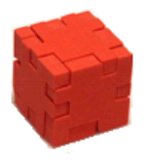
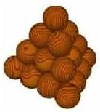
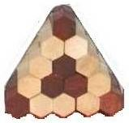
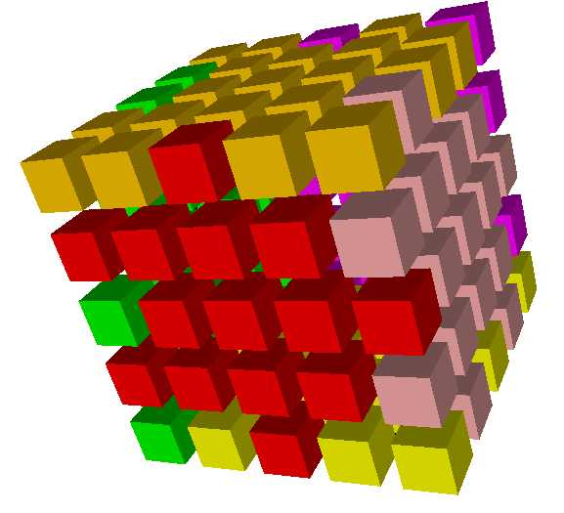
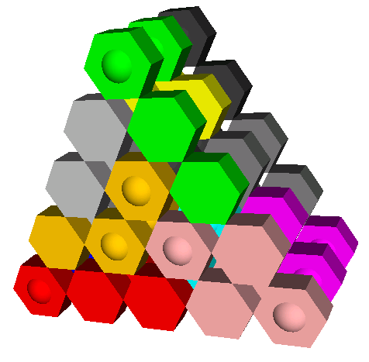
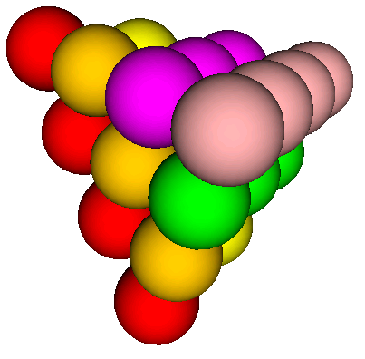
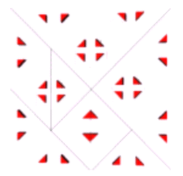
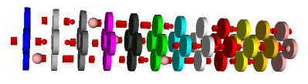
Puzzles!

Slide 3
Intro - what is all about?
De-coupling the puzzle from its algorithm impl‘.
How? Use graph, instead of
var puzzle: array [10][6] of integer;
// puzzle[x][y] = pentomino id/ 0-empty/ -1-blocked
Test: BT and DLX

Slide 4
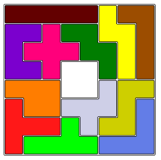
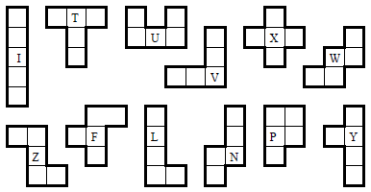
Some facts – the 12 Pento-minoes
5-ominoes = connected 5-square subsets of an infinite board.
Scott 1958 –
8x8 – 2x2 in the middle: Narrow the location of the X part
Not random, but by an order
Use the 2D presentation (Bitwise-and instr’ over MANIAC)
Fletcher 1965 (today there’s a C version)
compress the presentation
The BEST method for the 12 Pento-minoes
Again, use the 2D presentation ☹ (prevent redundant checks)
Golomb & Baumert 1965 –
Minimize the branches factor
(SZ heuristics --> variable ordering)

Slide 5
(strong) NP complete - bin-packing reduction
Both
Represent the bin-packing problem as a puzzle
Verify a solution
take P time
Heuristics for brute-force solutions
Branching “wisely” – the SZ heuristic
Code optimization – incl’ java tricks
Customized tricks

Slide 6
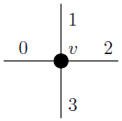
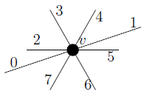
Graph Representation of Lattice
repetitive pattern!
Lattice | Pattern | Transformations
orthogonal 2-dim |  | CW-rotate: RL(i) = i +1 (mod 4)
Hexagonal Prism |  | X-flip: F(0|1|2|3|4|5|6|7) = (1|0|2|7|6|5|4|3) YZ-rotate: R(0|1|2|3|4|5|6|7) = (0|1|3|4|5|6|7|2)

Slide 7
Back track- and search
In general, 3 methods (Korf 98)
Single agent – we want the steps! (TSP, 15-tile)
2 players games – mini-Max, α-β pruning
CSP –brute force by BT (8-queens)
BT by DFS/ not BFS
Intelligent: Variable ordering (the SZ)
Back-jumping vs partial Forward Checking
The ST heuristics – do not enter dead-end paths
(work only on the current island)

Slide 8
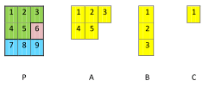
Puzzles and Solutions
Puzzle: Subgraph P of underlying lattice
Parts: Subgraphs of underlying lattice
Solution: an exact cover of P by parts, in general:
Every node of P is covered by exactly one node of a part.

Slide 9
Init’
Part orientations – auto generate
Essentially-different solutions – based on symmetries of the puzzle plus a unique part,
and more…
Rarely, there is a need to check the previous solutions (but almost a few)
Vs block the cover of the unique part on other symmetries

Slide 10
Tricks
“trick” – use an anchor – auto compute in the Init’
Lexicographically order (DFS, calc’ id based on edges’ weights)
Faster put – keep the DFS traversal output
Even by the concrete part and node
Representation- Property on the cell (color/ direction) to support more lattices , like Tangram/ cylinders…

Slide 11
Trivial algo’
On each permutation
Recursive – cover the current Part & Puzzle
While covering, remember who and where, update the Puzzle anchor…
Back-track – un-cover, the part is available now…

Slide 12
Knuth’s Dancing Links (2000)
Representing a puzzle as a Matrix Cover problem.
Clever pointer operations (Del/Undel in a linked list):
Remove x: Next[Prev[x]] ← Next[x]
Prev[Next[x]] ← Prev[x]
Unremove x: Next[Prev[x]] ← x
Prev[Next[x]] ← x
Allows to work on a global variable, instead of copy the current state at every level

Slide 13
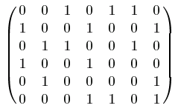
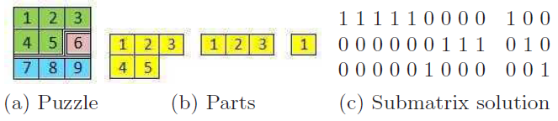
Exact cover
Input
choose a subset of rows such that
each column of the sub-matrix contains
exactly one ‘‘1’
Output {1,4,5}
Tiling- add a N columns, column per part

Slide 14
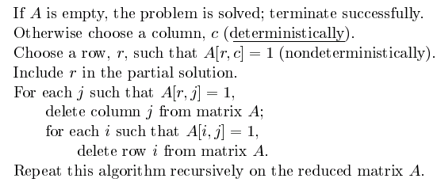
Algo’ X – trial and error
Level k = after k chosen rows
How-To Chose column?
Parts order – 2x10^12 branches by monte-carlo
Lexicographically (Value ordering) – 9M
SZ – variable ordering
= The column with the fewest 1s
Cover

Slide 15
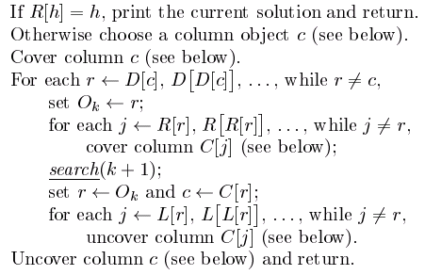
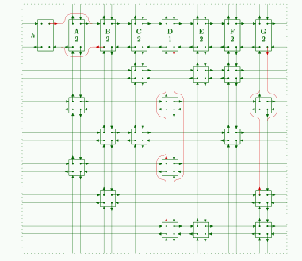
Representation
Search(k) // starts from 0
C[] points to the columns

Slide 16



How-To Chose column?
the leftmost uncovered column:
SZ

Slide 17
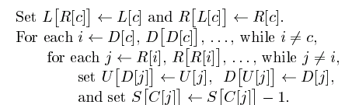
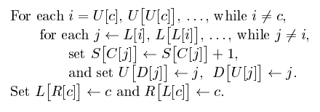
Cover – simple remove
Uncover – the Dancing Link
X + DL = DLX

Slide 18
Keys (tab) and holes (pocket)
Each edge has its matches , it also can be with no pockets
BT is trivial, there is an lexicographically order: check after each assignment
MC is not by order – manually verify the keys/holes
MC+SZ fails – no assignment is being checked at all

Slide 19
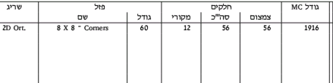
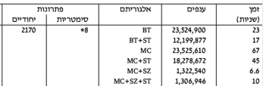
Results
On single-core

Slide 20
Do It Yourself add a lattice cook book
Edge: Enums (East/west/…), offset for graphics (always project to 3 dims), mark for anchor
Cell: Transformations (Rotate-Left/ X-flip)
Part: Nothing to do ☺
Grid: Almost nothing, except the textual way to display solutions.

Slide 21
User puzzles
Parts.script:
Part2D part;
part = new Part2D('D');
part.prepareRotations(4); // 4 nodes
part.addEdge(1, Edge1D.RIGHT, 2); …. parts.add(part); // part.specialCell(1);
Locks.script (optional)
parts.get('X').putKey(cell-Id /*1..5*/, Edge3D.UP, -1) // positive keys, negative holes
Grid.script (usually using loops)
int cell-Id = calc-Id(row, col) ;
ICellPart cell = new CellPart2D(new CellId(cell-Id));
add(new CellId(cell-Id), cell);
addAndValidate(cell, Edge2D.UP, calc-Id(row-1, col));

Slide 22

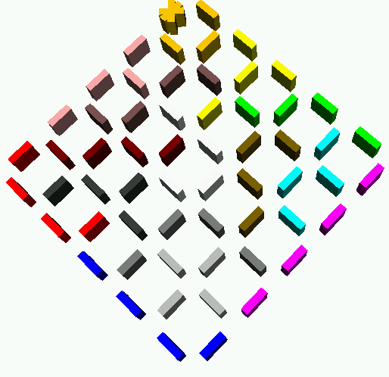
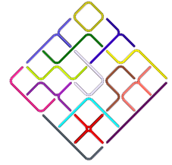
Future Work – More lattices
Poly-sticks – sqr → stick
the reduction
Main concern is the edge:
Edges are the four regular 2D, plus
Four CW by 45% (down-left, right-down…)
part = new PartPoly('A'); part.prepareRotations(4);
part.addEdge(1, EdgePoly.DOWN, 2); part.addEdge(2, EdgePoly.RIGHT_DOWN, 3);
part.addEdge(3, EdgePoly.RIGHT, 4);
part.specialCell(1); part.specialCell(4);
add(part);

Slide 23

Future Work II
More lattices: Hexi-amonds – sqr → triangle
SZ for the BT – the trade-off
Init’ only once
User friendly – draw with out program
Concurrency – split in the middle of the tree
Assembly (“Burr”)

