Slide 1
Trivia game
Project
By Shaharyar Ali

Slide 2
TABLE OF CONTENTS
01
02
03
04
Project Overview
Structure
Application Flow
Conclusion

Slide 3
Project Overview
Purpose: To create a Trivia Game (quiz) with a user-friendly interface.
Technologies Used: Dart and Flutter for mobile development and database (PHP MyAdmin SQL).
Key Features:
User can enter their name
Take a quiz with multiple questions
View the results at the end

Slide 4
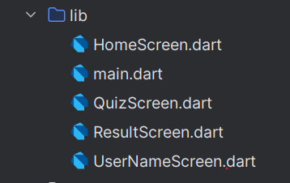
Structure
main.dart: Entry point of the application.
HomeScreen.dart: The main screen where users start the quiz.
UserNameScreen.dart: Screen for user to input their name.
QuizScreen.dart: Screen displaying quiz questions.
ResultScreen.dart: Screen showing the user's quiz results.

Slide 5
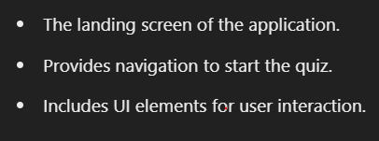
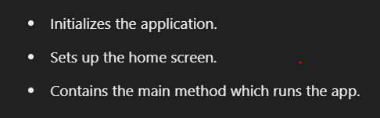
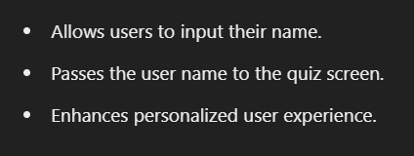
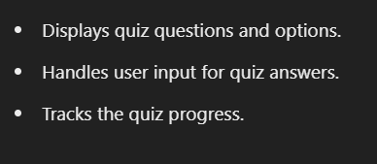
Structure
3. Home Screen
1. Main
4. Quiz Screen
2. User Name Screen

Slide 6
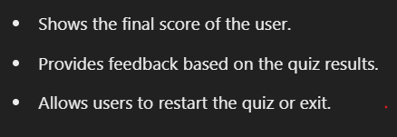
Structure
5. Result Screen

Slide 7
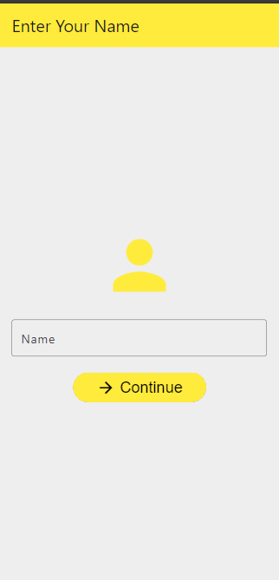
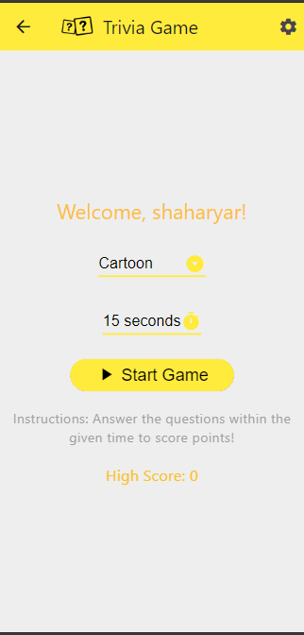
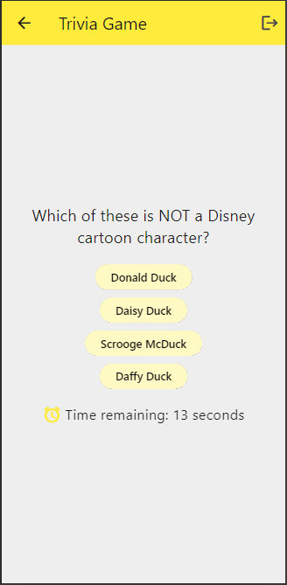
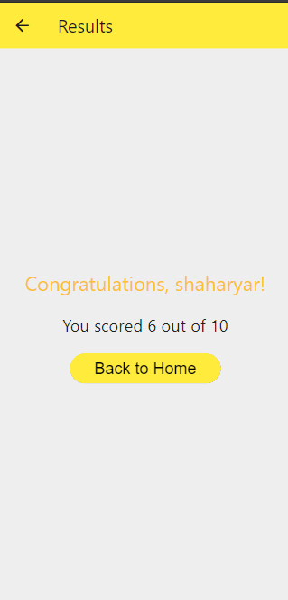

Application Flow

Slide 8
Conclusion
Summary: A quiz application built with Dart and Flutter and used database (PHP MyAdmin SQL).
Key Takeaways: User-friendly interface, personalized experience, and easy navigation.

Slide 9
Thank you…

