Slide 1
Algorithm for Suggesting Delineation Planes for Interactive Segmentation
Author: Shahar Yifrah
Supervisor: Prof. Daniel Cohen-Or
Tel Aviv University

Slide 2
Medical Imaginng
Motivation: Image guided diagnosis and therapeutic (e.g. radiation) and surgical interventions
Traditionally, 3D image is analyzed in 2D planar slices
Target is not easily delineated by a specific visible boundary
Based on clinical know-how
Requires manual expert interaction
Ill posed geometric problem

Slide 3
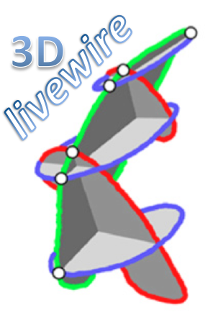
Related Work
Gray level based features
N. Ramesh, J.H. Yoo, and I.K. Sethi. 1995
Texture based features
Sharma et al., 2008
Efficient interactive 3D Livewire segmentation of objects with arbitrarily topologies
Poon, Hamarneh Abugharbieh 2008
Interactive semiautomatic contour delineation using statistical conditional random fields framework
Hu, Grossberg, Wu, Riaz, Perez, and Mageras 2012
Notes:
Poon 2008:
It is based on contours generated semi-automatically on
a selected set of slices are used as seed points on new unseen slices in different
orientations. The seed points are calculated from intersections of user-based livewire
techniques with new slices. The technique reduces significantly the number of
slices the user has to delineate, however the result strongly depends on the use selecting
the best slices to achieve an effective delineation
Hu 2012:
A promising statistical analysis with user interaction, [HGW+12] supports user strokes on the images to identify the
characteristics of the organ to be delineated and its surroundings. Based on user
input from sample slices the boundary is estimated on nearby slices.

Slide 4
Related Work
3D object recognition in robotics: Next Best View
Next-best-scan planning for autonomous 3d modeling
Kriegel, Rink, Bodenm?ller, Narr, Suppa, Hirzinger 2012
Spotlight: Active learning for interactive 3d image segmentation
Top, Hamarneh, Abugharbieh 2011

Slide 5
Pipeline
Create the segmentation from delineations on existing planes using RBF
Assess the uncertainty over the segmented surface based on distances to image edges
Suggesting a new plane by clustering the high-uncertainty regions

Slide 6
RBF

Slide 7
RBF Interpolation from contours
Sample contours
For each point:
Outside point with value -1
Inside with value 1
Center reduction
Solve linear system for coeffs

Slide 8
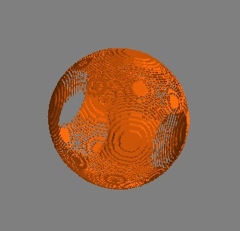
Assessing Uncertainty
Uncertainty at a surface point = its distance to the nearest edge
Extract edges by discrete Laplacian operator to each voxel
Take those voxels (called edge voxels) whose Laplacian is at least 3 standard deviations away from the mean over all voxels
Why Laplacian
sensitive to thin edges
works in all directions

Slide 9
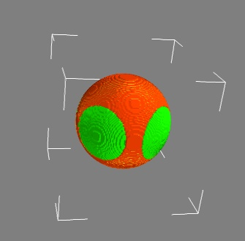
Clustering the Low-Grade Voxels
First rule out surface voxels whose uncertainty is lower than the average among all surface voxels
Find clusters of densely connected uncertain voxels, using a variant of the density-based clustering algorithm DBSCAN

Slide 10
DBSCAN
Points at A are core points.
Points B and C are density-reachable from A and thus density-connected and belong to the same cluster.
Point N is a noise point that is neither a core point nor density-reachable.
(MinPts=3 or MinPts=4)

Slide 11
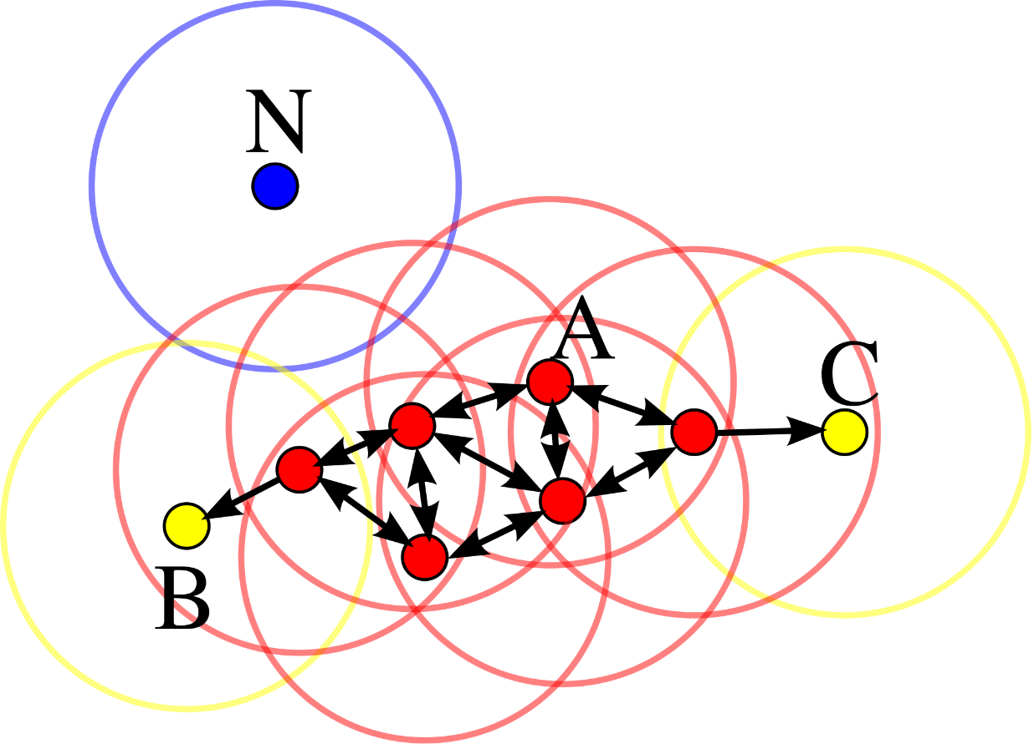
DBSCAN
Pick an un-clustered voxel
If #(uncertain neighbors)>MinPts in 26-neighborhood, create a cluster for it
A cluster is expanded as long as its density is maintained

Slide 12
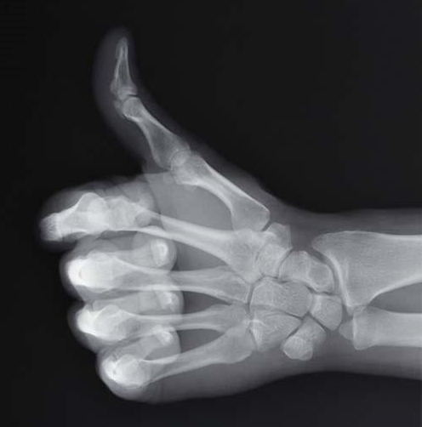
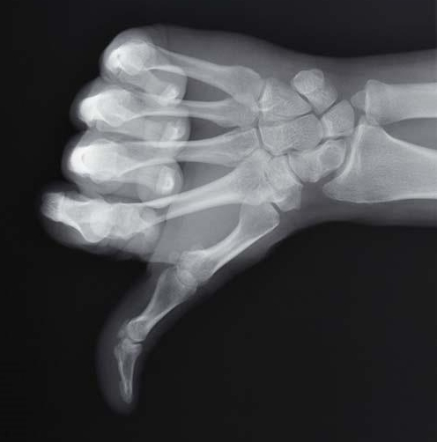
DBSCAN
Pros
Does not require the number of clusters in prior
Not sensitive to the ordering of voxels
Can handle arbitrary shape of the clusters
Use 9-ring of the voxel to reduce memory complexity
Cons
Needs parameters: MinPts and Ɛ

Slide 13
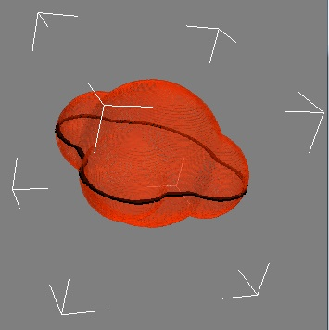
Finding the Next Plane
Seek a plane that will pass through the clusters with the greatest size
Case 1: cluster-size drops by half after 1st or 2nd cluster - Use Principal Component Analysis of them
Case 2: Use 3 largest cluster centroids
Extract oblique slice by 3 points

Slide 14
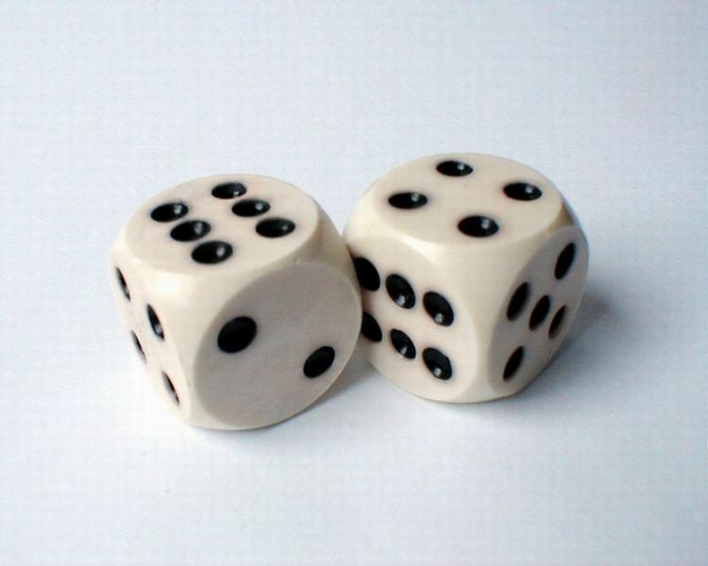
Results and Evaluation
Assessing Interpolation Quality
Dice Coefficient
Compare to Random Slice approach

Slide 15
Synthetic Shapes

Slide 16
Synthetic Shapes – Trefoil Knot
7 Slices Algo
7 Slices Random

Slide 17
Anatomical Shapes

Slide 18
Real Medical Images
98x113x171
Brain ventricle from MRI Image size: 98x113x171

Slide 19
Real Medical Images
Humeral bone part from CT Image size: 120x110x155

Slide 20
Special thanks to:
Thank You.
Prof. Danny Cohen-Or (TAU)
Prof. Tao Ju (WUSTL)
Mr. Eyal Zadicario (TAU)
..and my beloved wife and family.

Slide 21
Addendum: Oblique Slice Extraction
Find intersections of the plane with the data box edges.
For these points, find a rectangle bounding-box.
Find the affine transformation T(x) = Ax+t from R² to R³.
For each axes-pair:
Calculate the corners targets.
Use them to calculate the transformation and the target dimensions.
Take the axes-pair that yields the rectangle with minimum area.
Use the transformation and do trilinear interpolation for every value in the2D target image.

