Slide 1
Study Link https://studylink.dryft.ca/
Group members:
Jay Patel
Mehir Kumar
Mantaj Singh
Shivam Sangwan

Slide 2
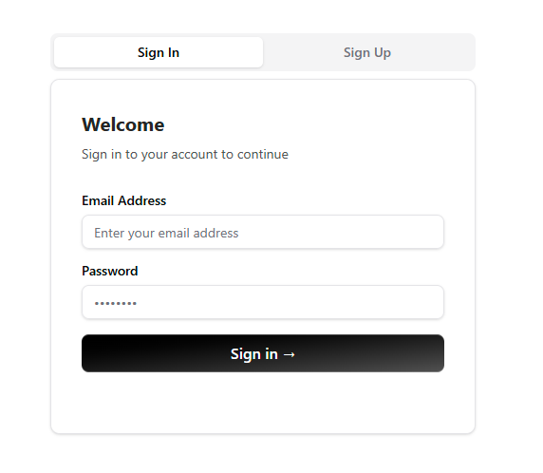
Project Overview
A great platform designed to make group study easier.
The application allows users to create and join study groups, share files, participate in discussions, and manage learning resources.

Slide 3
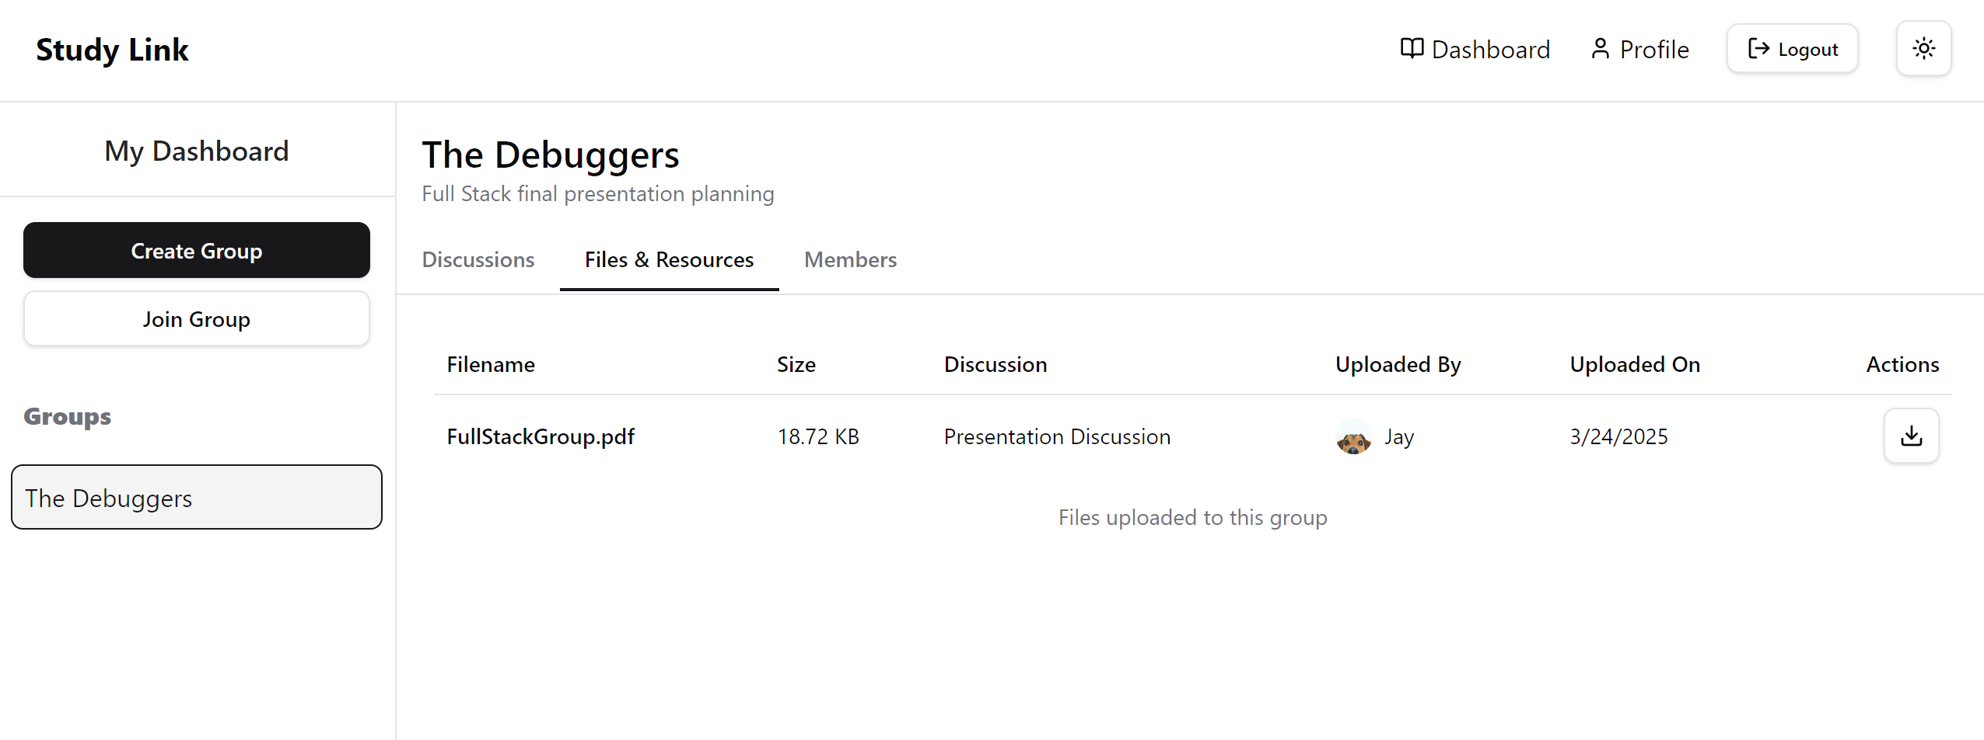
How it works
User registers/logs in.
Lands on dashboard showing their groups
Can create/join study groups
Within groups, can: Start discussion, comment on discussion, upload and download files, manage group settings(if admin)

Slide 4
Architecture
Frontend architecture:
The Frontend is built as a Single Page Application(SPA) using React with TypeScript, utilizing Vite as a build tool and shadcn for UI components.
React + TypeScript + Vite

Slide 5
Architecture
Backend architecture:
The backend follows a RESTful API design pattern using Express.js.
Express + TypeScript + Node.js

Slide 6
Architecture
Database Architecture:
PostgreSQL database with the following core data tables: User, Group, GroupMember, Discussion, Comment(Chat Message), File, Authentication models.

Slide 7
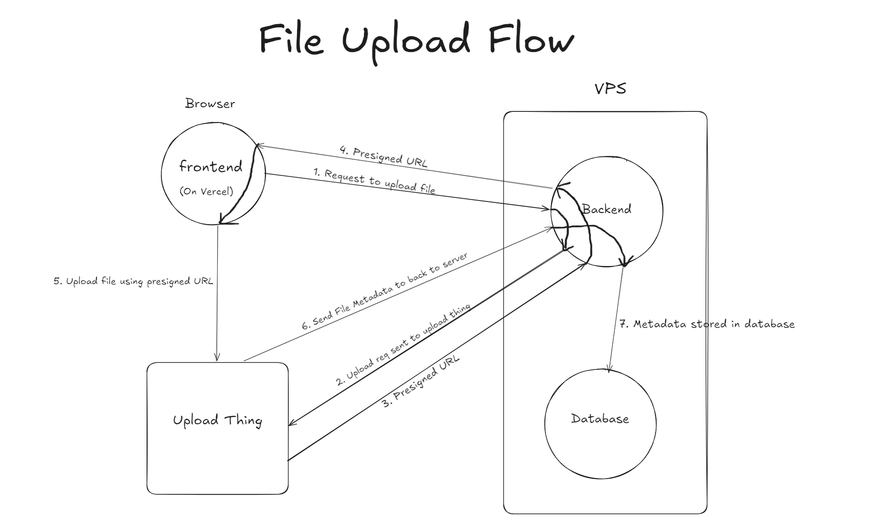

Slide 8
Core Features:
User Management: Authentication (login/signup), Profile customization, Session management
Study Groups: Create/Join study groups, Public and private groups, Role-based permissions(admin/member)
Discussions: Create threads within groups, Comment system, Content organization
File Sharing: Upload and share study materials, Organize file within groups/ discussions, Secure access control

Slide 9
Technical Flow
Authentication:
Backend verifies sessions using tokens.
Protected routes redirect unauthenticated users to login page.
Data Management:
API calls from frontend to fetch/update data.
Backend processes requests, queries database and returns response.
File Handling:
Files uploaded via UploadThing integration.
Metadata stored in database.
Access control based on group membership.

Slide 10

Deployment
Frontend deployed on Vercel.
Backend containerized with Docker.
PostgreSQL database self hosted on VPS(Virtual Private Server).

Slide 11
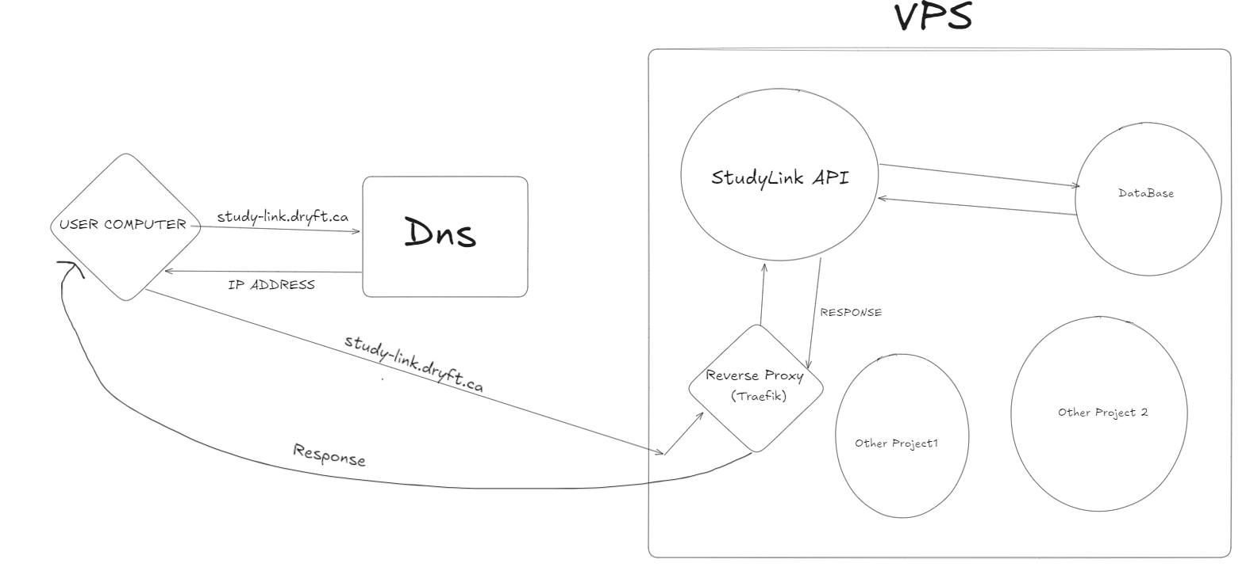
Life Cycle of Backend Request
Notes:
Life Cycle of Backend Request

Slide 12
Key Libraries
Frontend:
React, React Router
ShadCN
TailwindCSS
Axios
Backend:
Express
Node.js
Better Auth
UploadThing
TypeScript

Slide 13
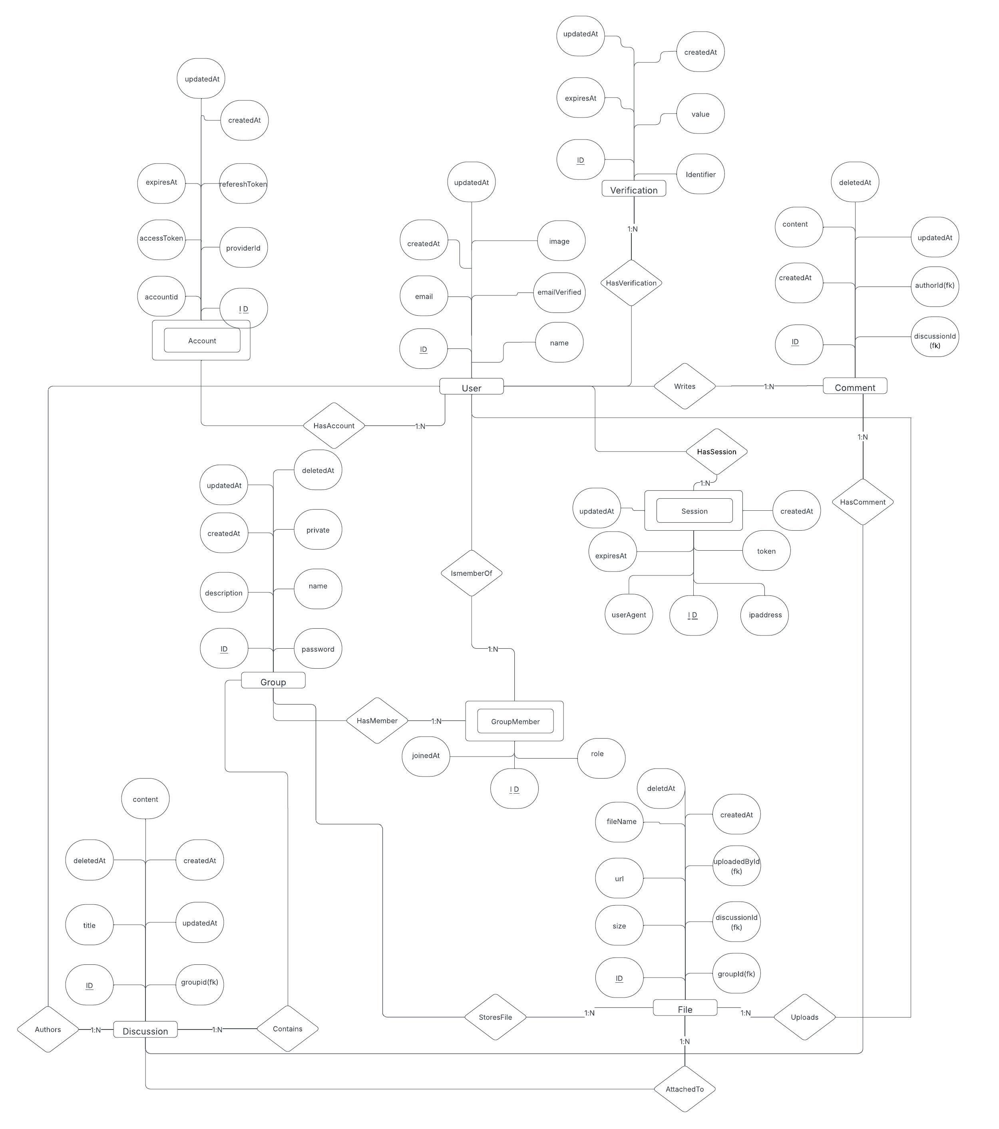
ER Diagram

Slide 14
Future advancements:
Forgot Password Feature: Currently Missing– users are locked out if they forgot their password.
Private Group Password Bug
AI Integration for moderator & more.

Slide 15
Any Questions?

