Slide 1


^THIN GOLD BORDER AROUND THE ABOVE 2 BOXES ^

Slide 2


^ ABOVE TITLE CENTERED ^

Slide 3

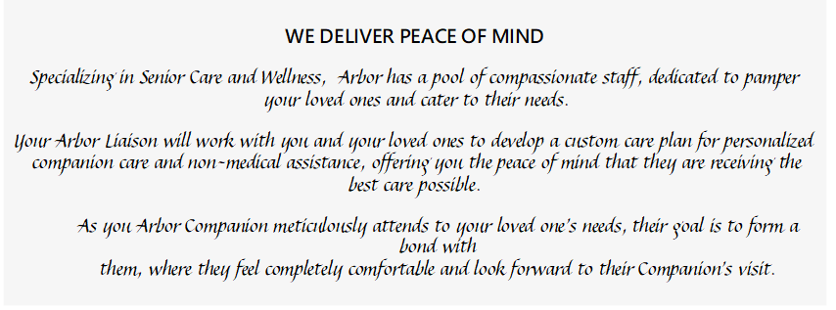

Change “Cambridge Home Care” – to– Arbor Care
Change “Cambridge Home Care” – to– Arbor Care
^THIN GOLD BORDER AROUND THE ABOVE 2 BOXES ^

Slide 4

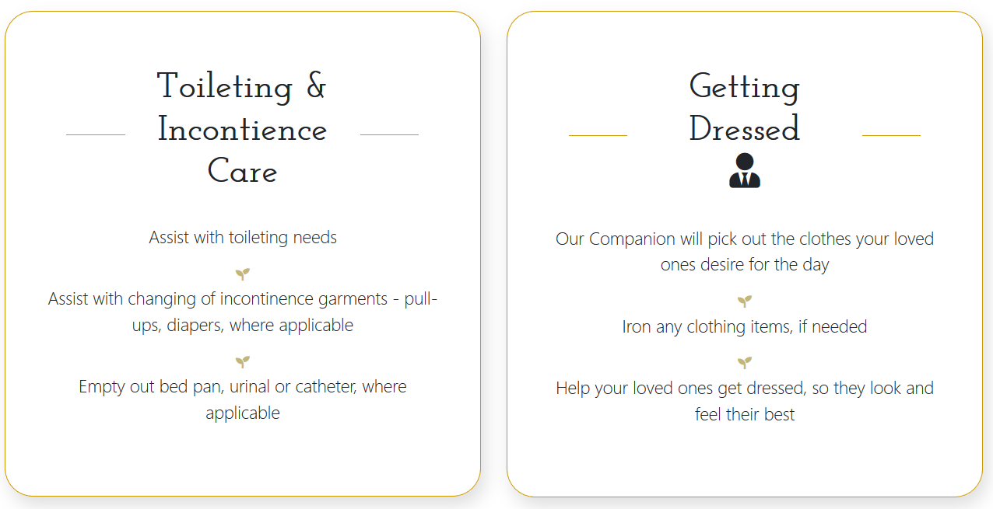
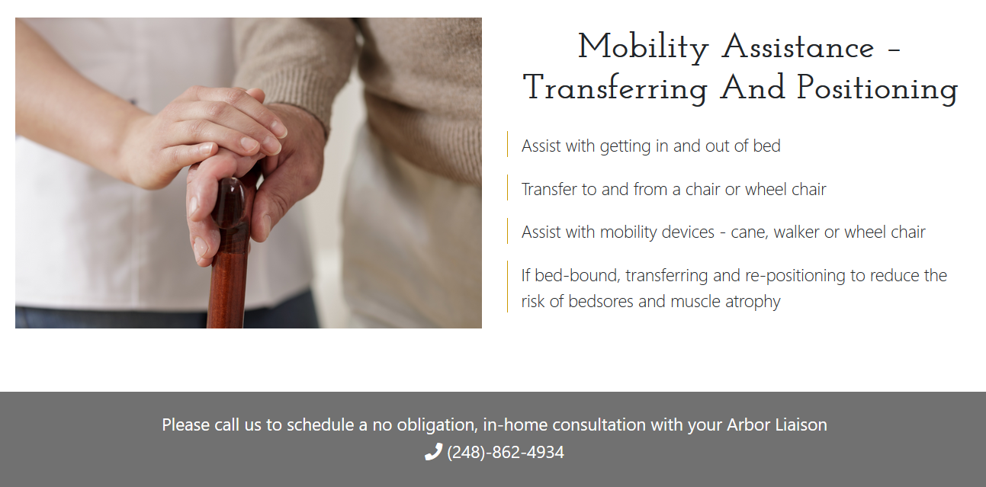
<< REMOVE ICON

