Slide 1
Choose location for Vet Clinic
IBM Data SCIENCE CAPSTONE
Shahbaz Masood
Feb 2019

Slide 2
Introduction
The location of any consumer-oriented retail business is a key factor in its success. Same is true for a pet clinic.
An ideal location should consist of many factors like pet friendliness of area, number of dog parks, number of pet food and service shops etc.
The following analysis helps solve veterinarians to pick a spot where the clinic would have the most customers while considering the above mentioned factors.

Slide 3
Data
The analysis uses the data set Bay_Area_cities.json which was downloaded from the github repository of FrankBowers43.
This json is used to get the names of all the neighborhoods in the bay area.
The names are located in the features.properties.NAME10 node

Slide 4
Methodology
Extract the names of the Bay Area Neighborhoods JSON
Feed names to the geocoder API to get the latitude and longitudes
Feed the location coordinates to the FourSquare Search query and process the result to store the in a workable data frame
Cleaned data
OneHot Encode the venue type.
Deciding metric = MAX (Sum of counts of Dog Run, Pet Café, Pet Service and Pet Stores in each neighborhood and subtract the result from the count of Veterinarians in the neighborhood)
Kmeans on the metric
Analyze the data

Slide 5
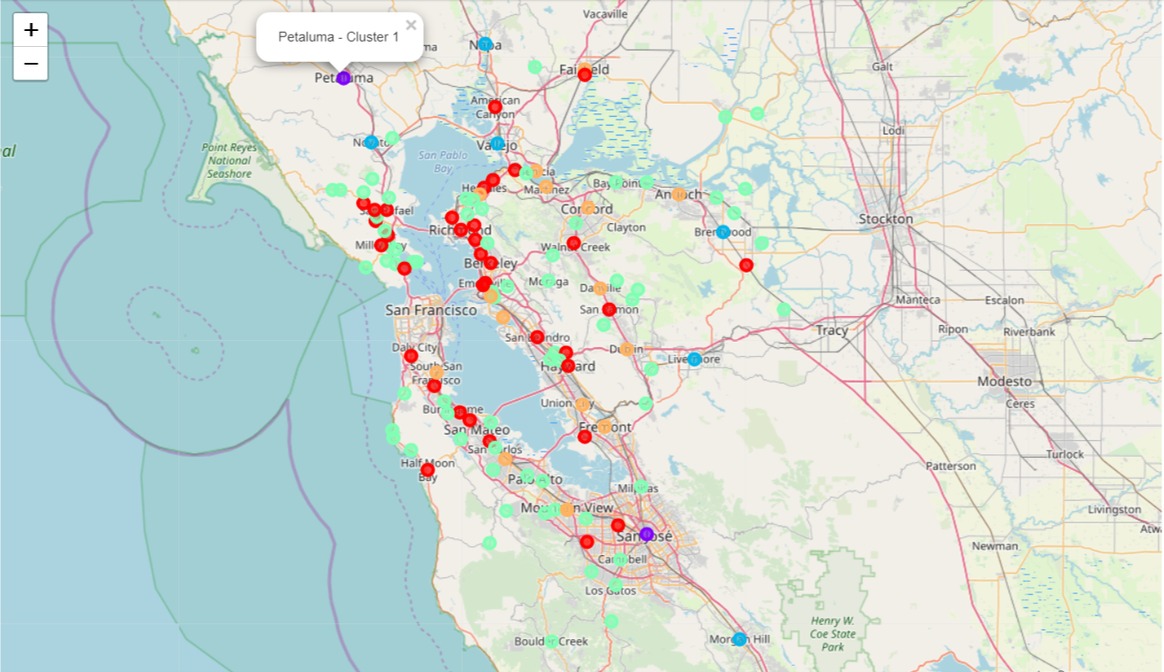
Results – San Jose & Petaluma is the best choice

Slide 6
Conclusion
The analysis provides a starting point for doing a physical survey of a good choice of starting and establishing vet clinic.
The population of the two districts should also be considered in making the decision along with commercial rents etc.

Slide 7
THANK YOU!

