Slide 1


Slide 2

Web Based Gardening Care Application

Slide 3
Group Members Introduction
Name :Shahbaz Hussain
VuID :Bc210401251

Slide 4

INTRODUCTION OF PROJECT
The Gardening Care Application is a comprehensive web-based platform designed specifically for domestic users (homeowners) and gardening enthusiasts of all experience levels. It aims to promote sustainable gardening practices and simplify the plant care process through intelligent, interactive, and user-friendly tools.

Slide 5
INTRODUCTION OF PROJECT
Key Objectives:
To assist users in effectively managing their home gardens.
To provide personalized plant care recommendations based on real-time data.
To foster an online gardening community for shared knowledge and experience.
To integrate technology with nature to enhance gardening productivity and joy.

Slide 6

Process Model Diagram

Slide 7
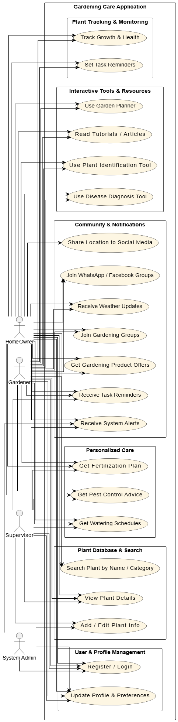
Use Case Diagram

Slide 8
Business Rules Catalog
Core Business Rules
Role-Based Access Control
User Location Dependency
Unique User Registration
Plant Identification Accuracy
Notification Timeliness
Data Consistency for Plant Tracking

Slide 9
Functional Requirements
User Registration and Login
Plant Database Management
Personalized Plant Care Recommendations
Plant Tracking and Monitoring
Interactive Tools
Community Engagement Alert and Reminder
System Admin Controls

Slide 10
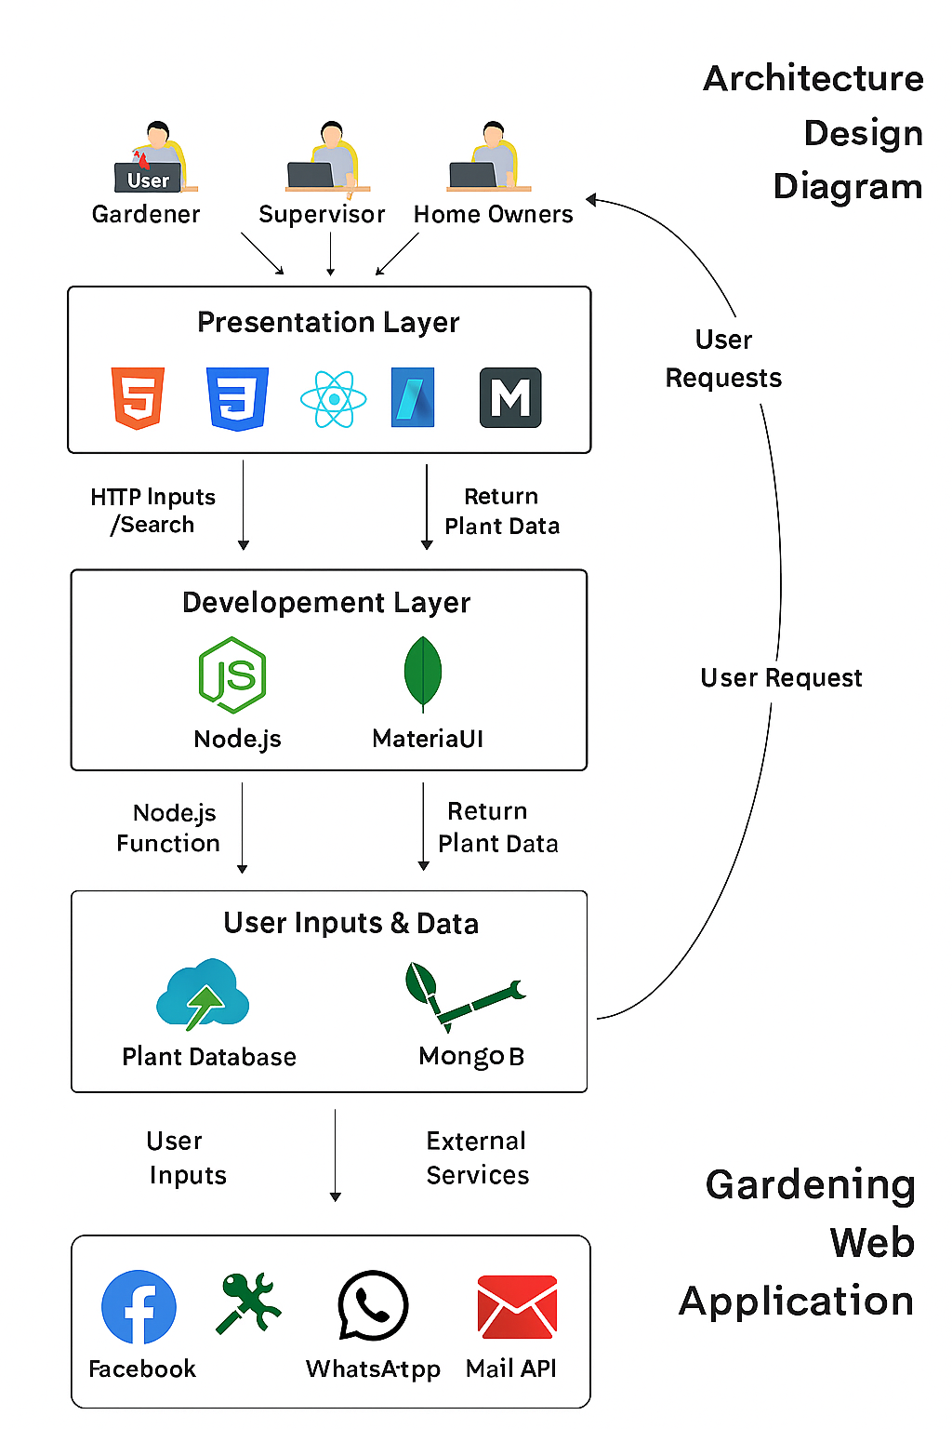
Architectural Design

Slide 11
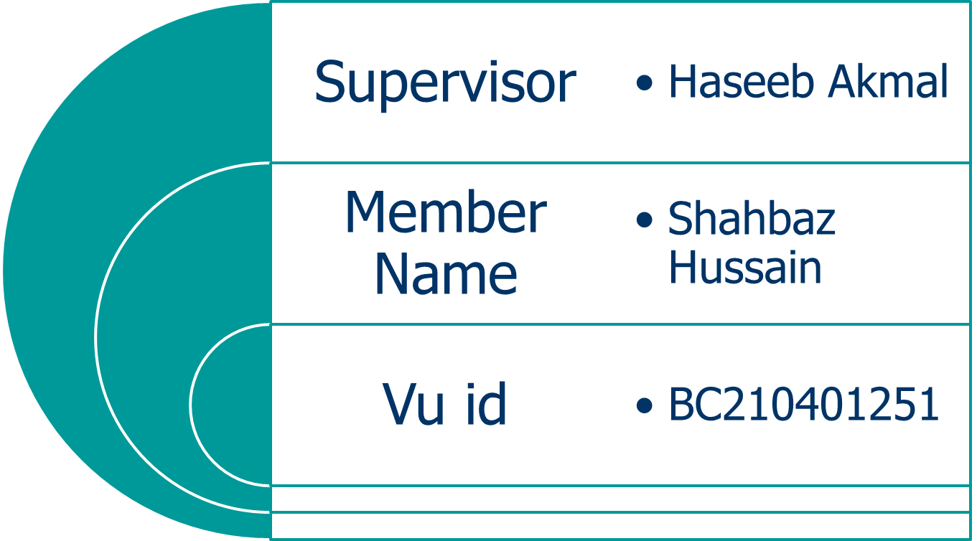
Team Structure

Slide 12
Project Schedule

Slide 13
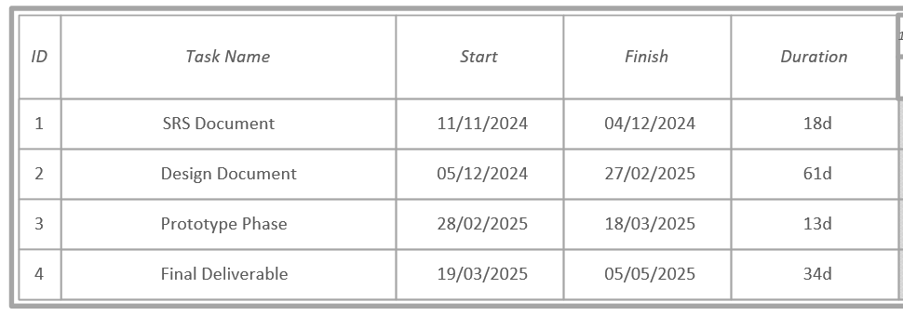
Project Schedule

Slide 14
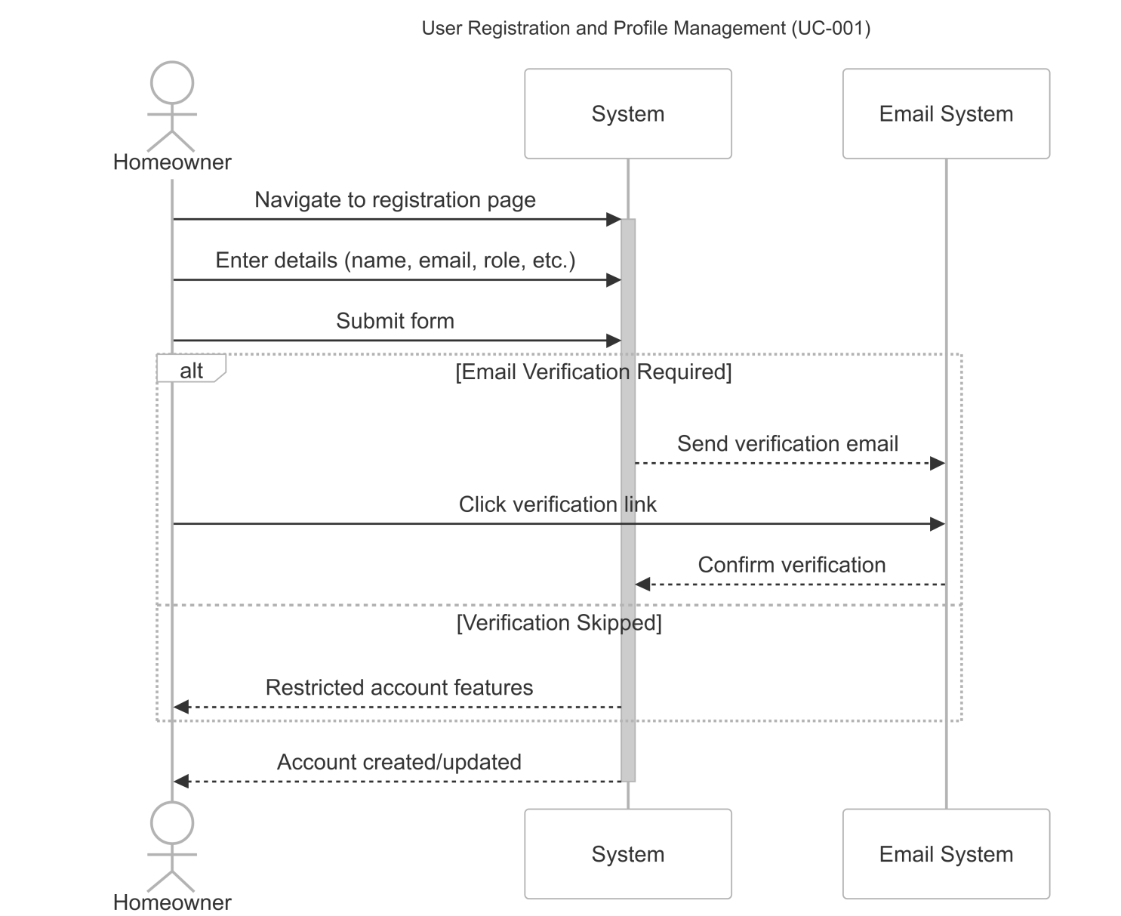
Sequence Diagrams

Slide 15
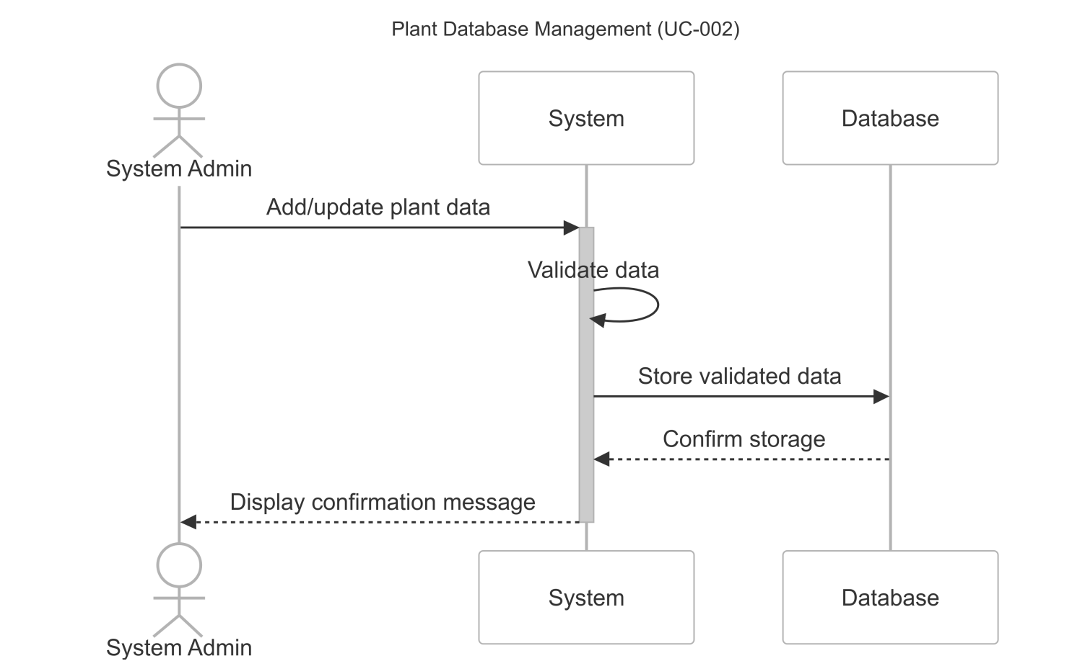
Sequence Diagrams

Slide 16
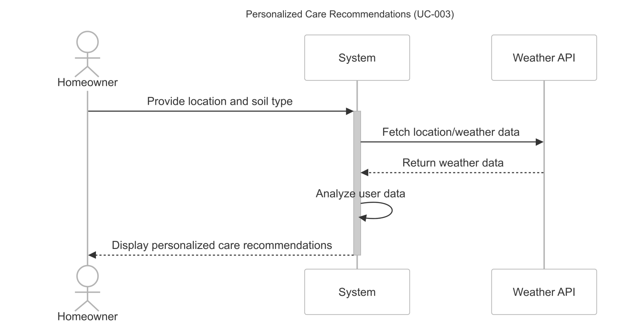
Sequence Diagrams

Slide 17
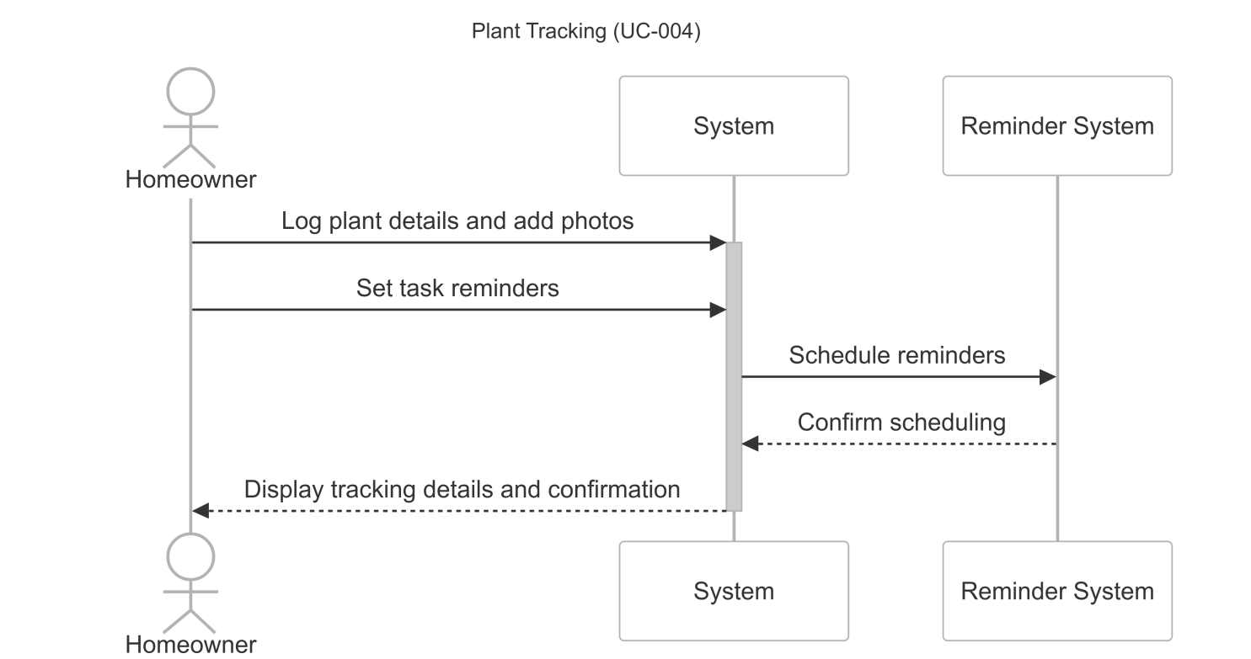
Sequence Diagrams

Slide 18
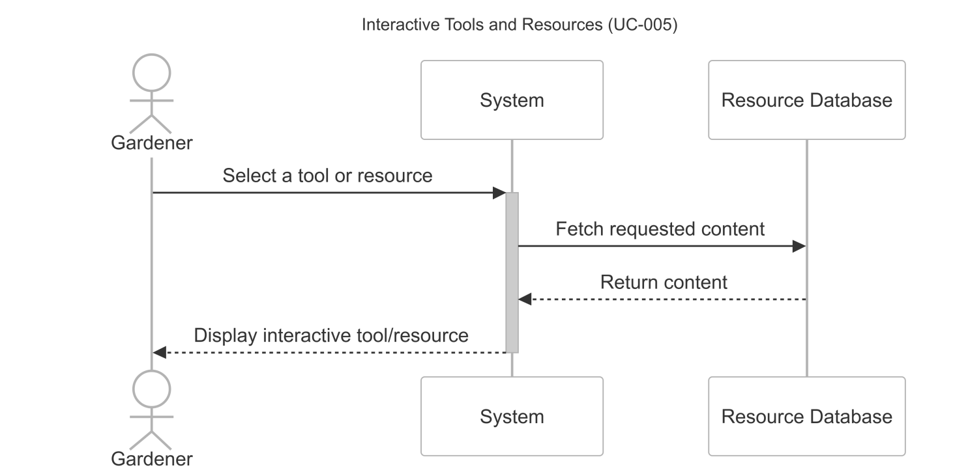
Sequence Diagrams

Slide 19
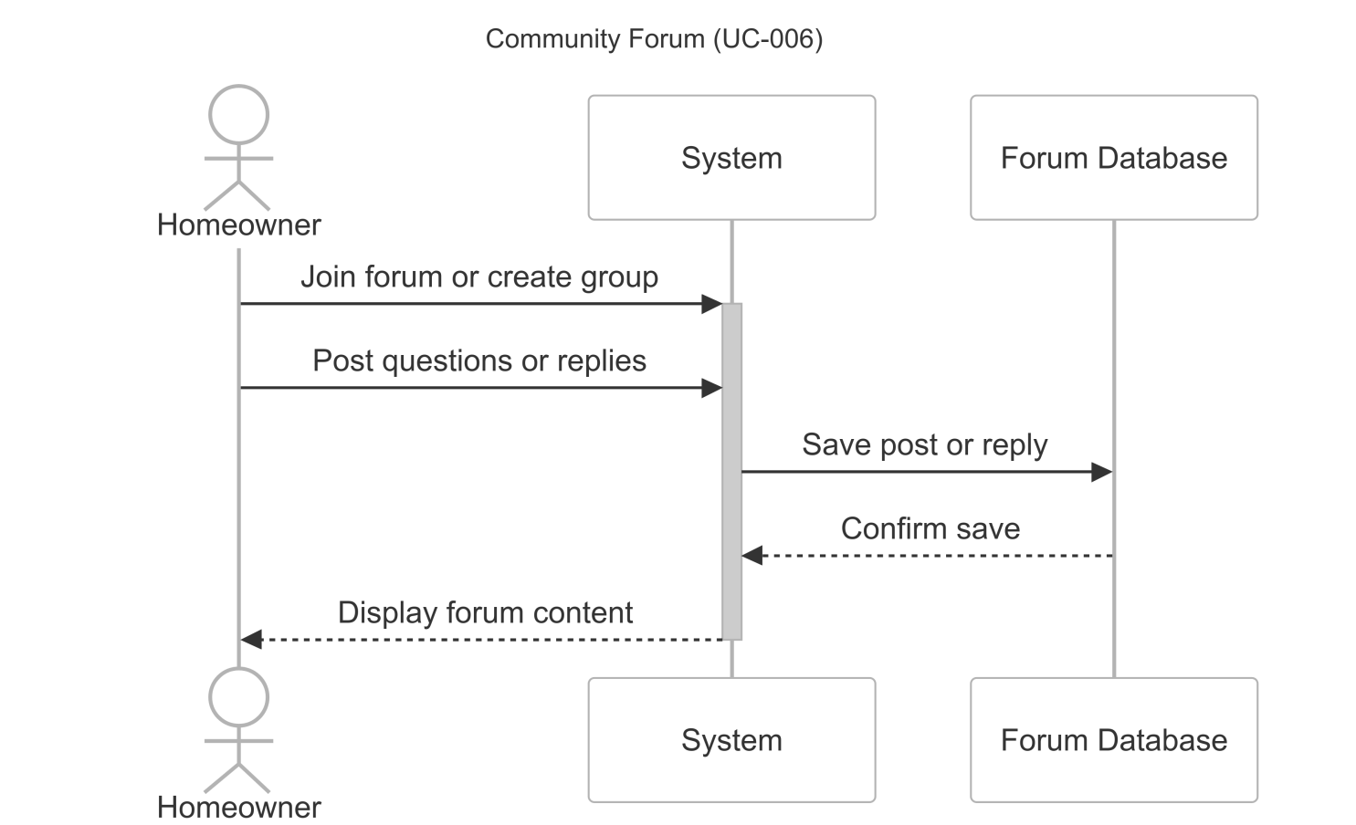
Sequence Diagrams

Slide 20
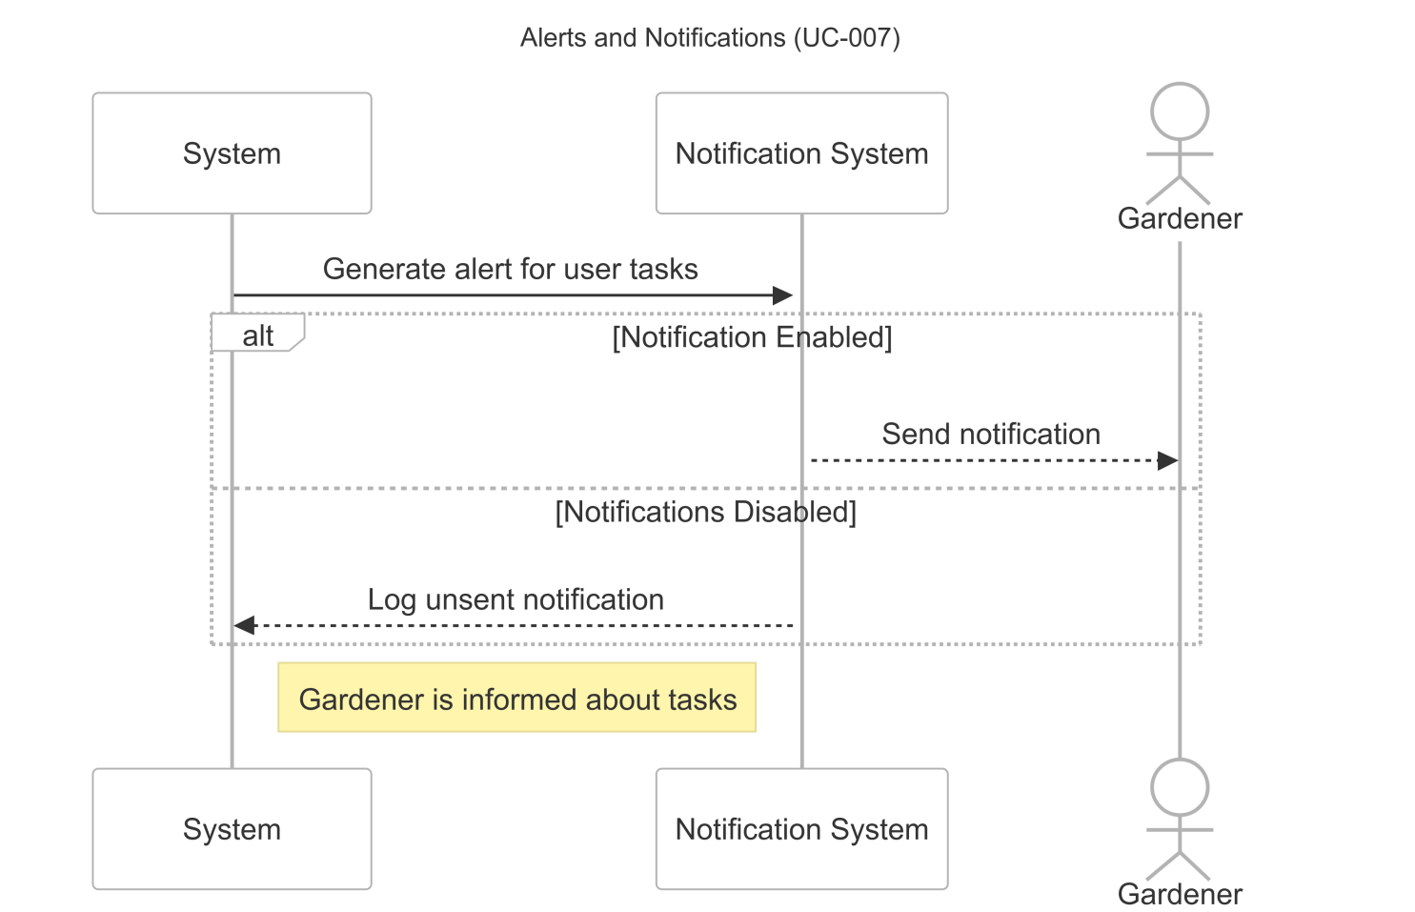
Sequence Diagrams

Slide 21
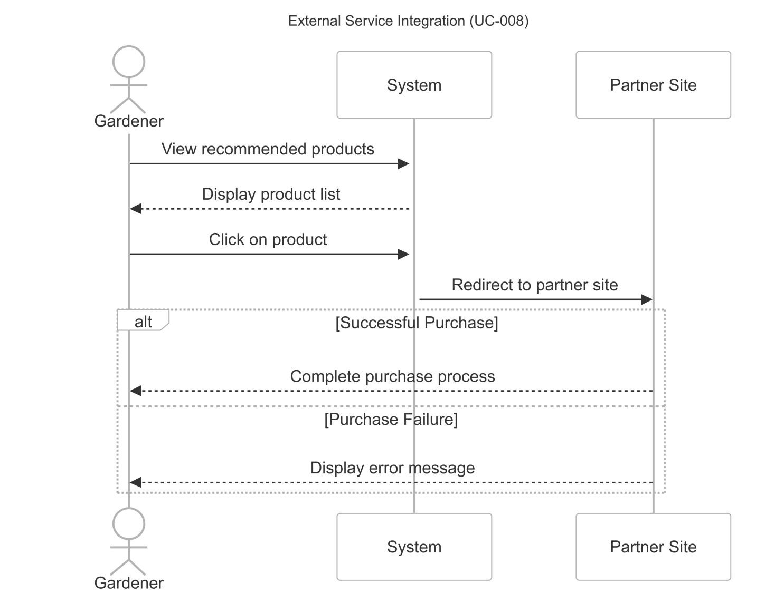
Sequence Diagrams

Slide 22
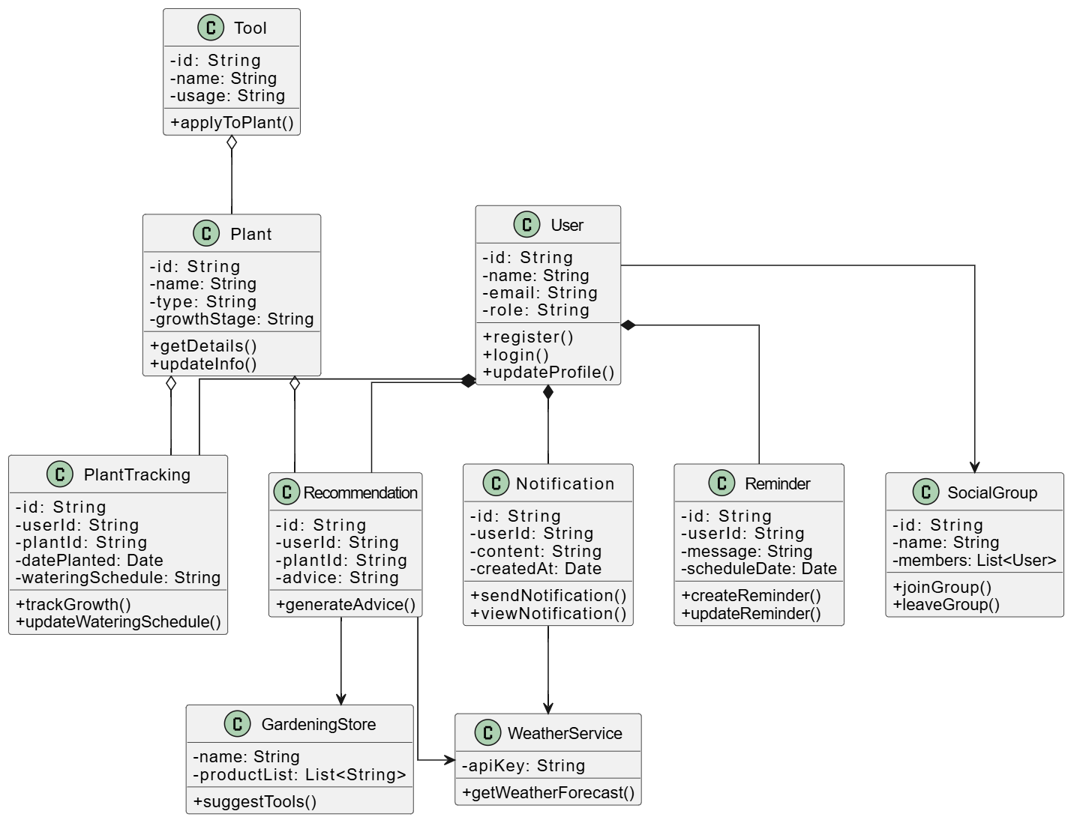
Logical Model/Class Diagram

Slide 23
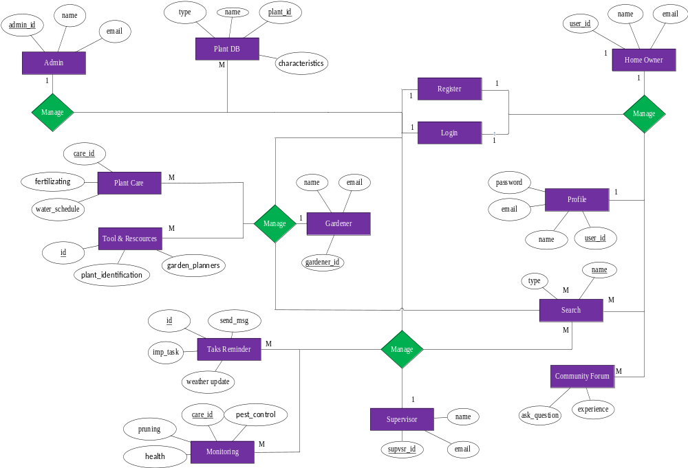
Entity-Relationship Diagram

Slide 24
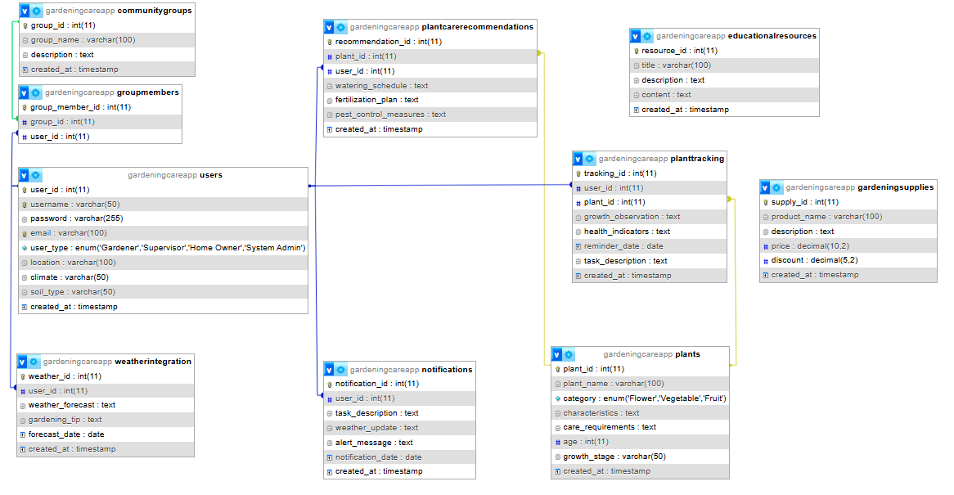
Database Diagram

Slide 25
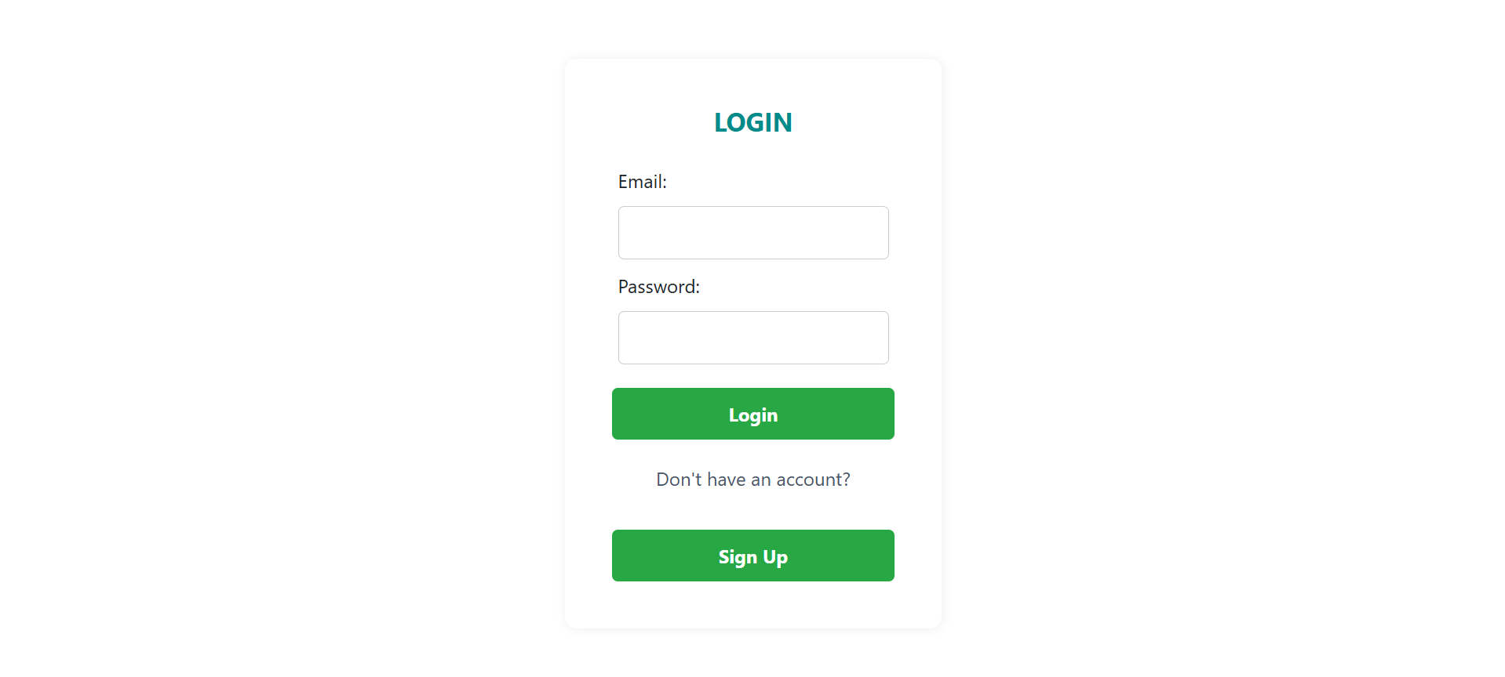
User Interfaces

Slide 26
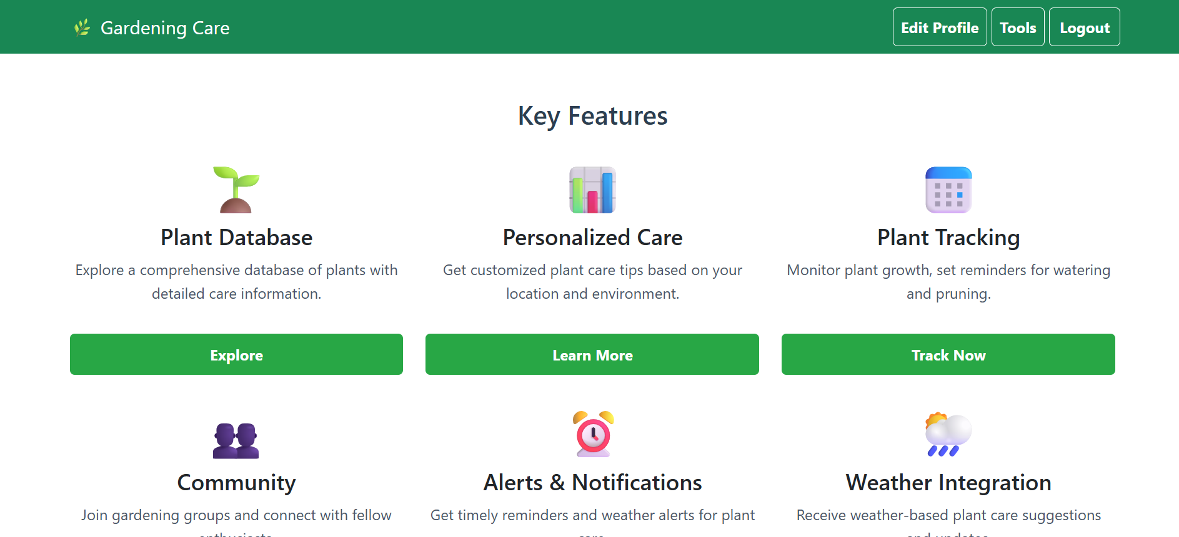
Main Interface

Slide 27
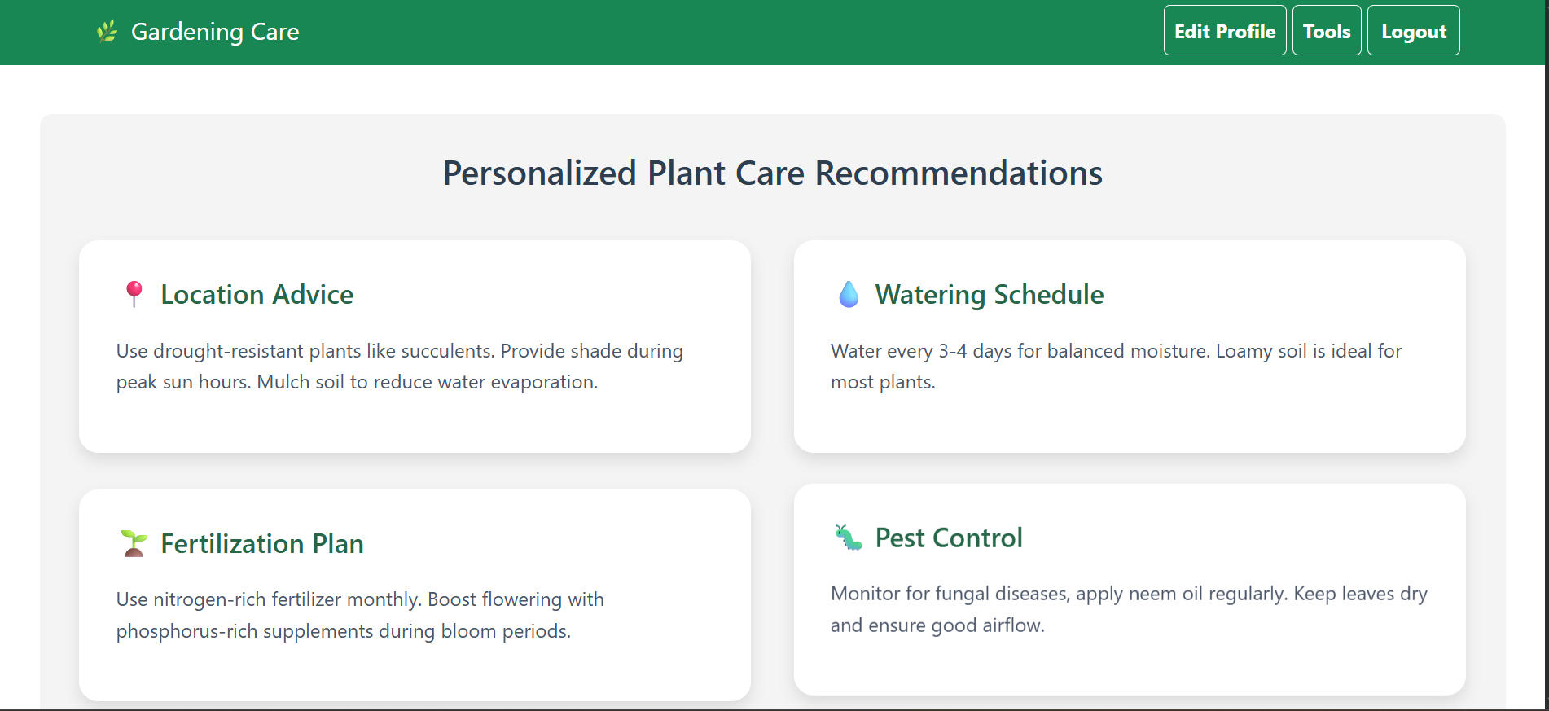
Recommendations

Slide 28
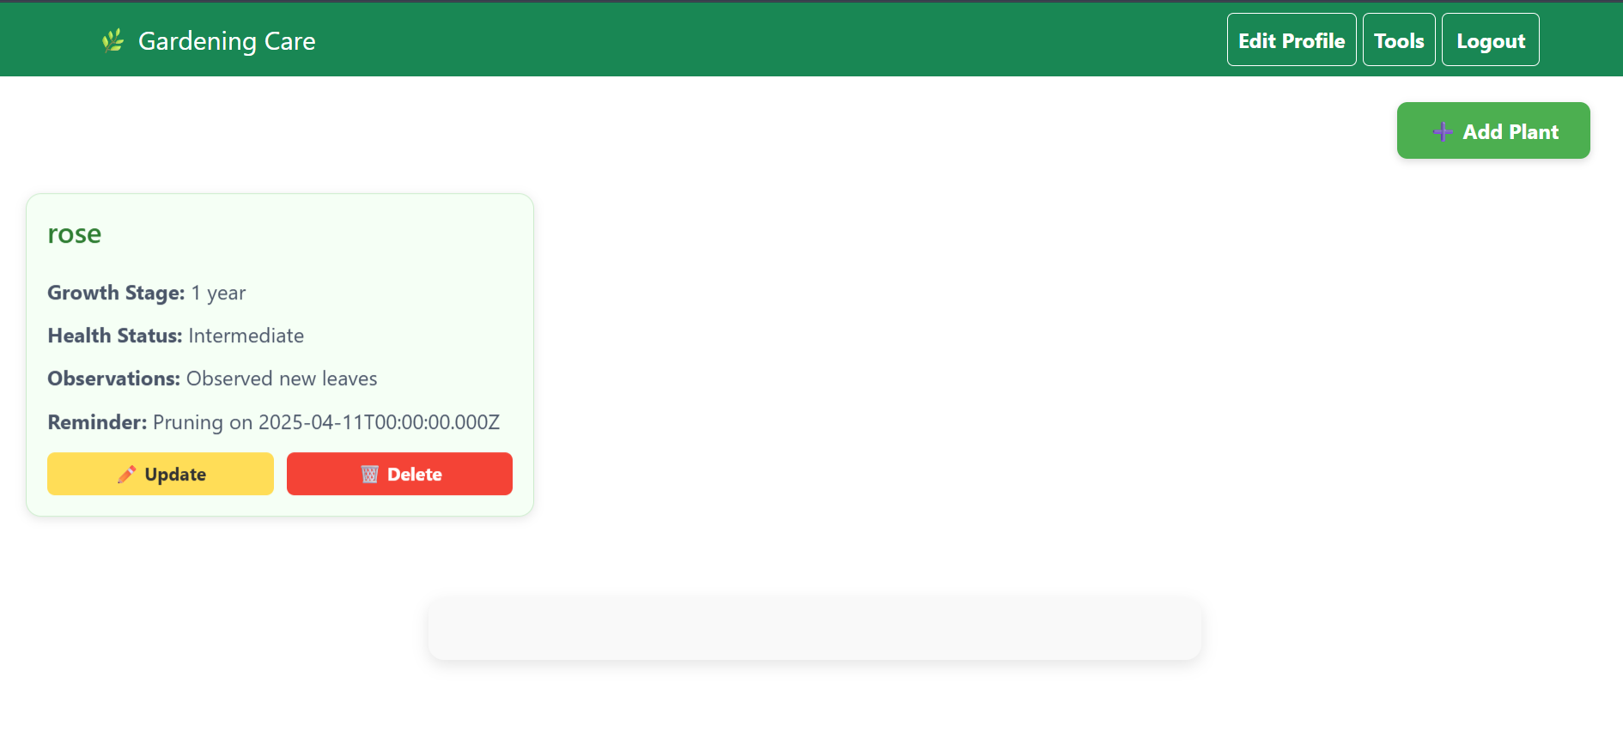
Plant Tracking

Slide 29
Technologies
Frontend Development:
HTML, CSS, JavaScript
React
Bootstrap
Backend Development:
Node.js
MongoDB
Express.js

Slide 30
Tools
Vs Studio Code
Postman
MongoDB
Microsoft Visio
MS Office

