Slide 1
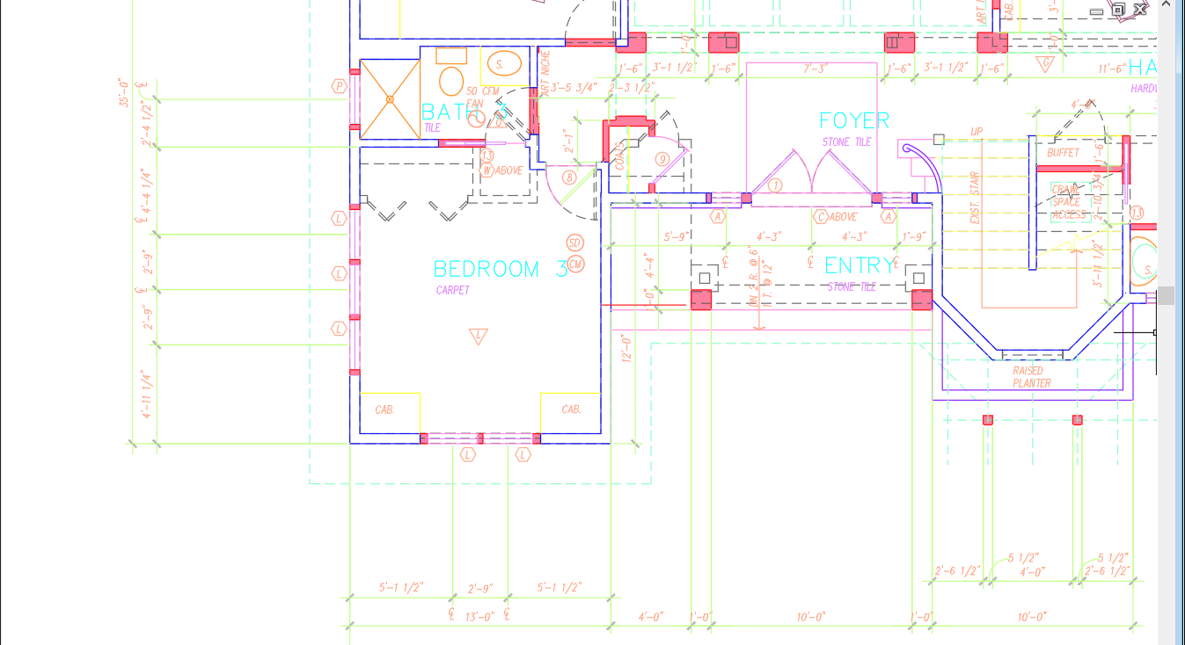
Michelle Phillips

