Slide 1
DEPI | Digital Egypt Pioneers Initiative
Data Lens
Country Data Comparison Dashboard – World Development Indicators
Track: Junior Data Analysis
Team: Shahd Mahmoud Abdelmagid (Team Leader) · Eman Ali Mostafa · Malak Hassan Mahmoud · Farah Khaled Fathy · Menna Abdelnasser Ramadan · Mariam Baher Mohsen
Instructor: Noran El Zeky
Notes:
Introduce the team and the project. Draft: update status and results before the final discussion (Week 21).

Slide 2
The Problem and Our Objective
DEPI | Junior Data Analysis
The problem
Our objective
The WDI workbook has 22 countries × 74 indicators × 25 years, but cannot be compared directly
The same country appears under different spellings (44 variants for 22 countries)
About 20% of year cells are empty ("..") and some numbers are stored as text
Duplicate and empty rows; the year 2009 is missing
Clean and standardize the data in a repeatable way
Build a star-schema data model with DAX measures
Deliver an interactive dashboard: overview, comparison, trends, map, drill-through
Document, test, and deliver everything through GitHub on time
Data Lens | 2
Notes:
Numbers come from profiling WDI_Data.xlsx: 7,521 of 37,675 year cells hold "..", 6 duplicate rows, 100 empty rows.

Slide 3
Data and Cleaning: Challenges and Solutions
DEPI | Junior Data Analysis
22
74
25
20%
countries
indicators
years (2009 missing)
cells empty
Challenge | Solution
Inconsistent country names (USA, United States of America…) | Trim and map to 22 standard names
".." and "-" placeholders; text numbers like "295,282.00" | Convert to null / numeric; show "No data", never zero
6 duplicate rows, 100 empty rows, 4 non-data rows | Remove by key; log in data quality log
Year columns named "2000 [YR2000]" | Extract year and unpivot to rows
6 indicators without metadata, 1 without values | Flag and exclude from comparison
Data Lens | 3

Slide 4
Solution and Architecture
DEPI | Junior Data Analysis
WDI_Data.xlsx
Source
Power Query
Clean & standardize
Data Model
Star schema
DAX
Measures
Power BI Dashboard
3+ pages, map, drill-through
GitHub
Delivery
Data model (star schema)
Key measures
DimCountry, DimIndicator, DimYear
FactIndicatorValue: one value per country, indicator, year
ExcludedEntities: countries/indicators lacking data
Indicator value, latest value with data
Year-over-year change, country rank
Country A vs. Country B difference
Data coverage %
Data Lens | 4

Slide 5
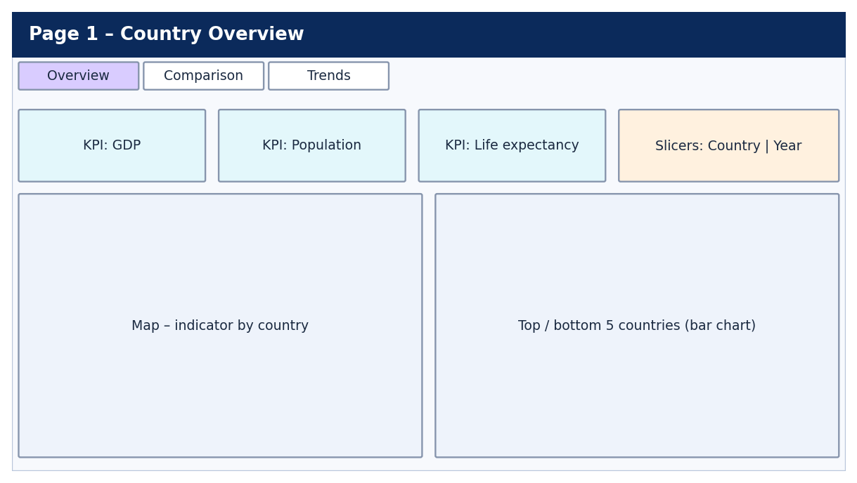
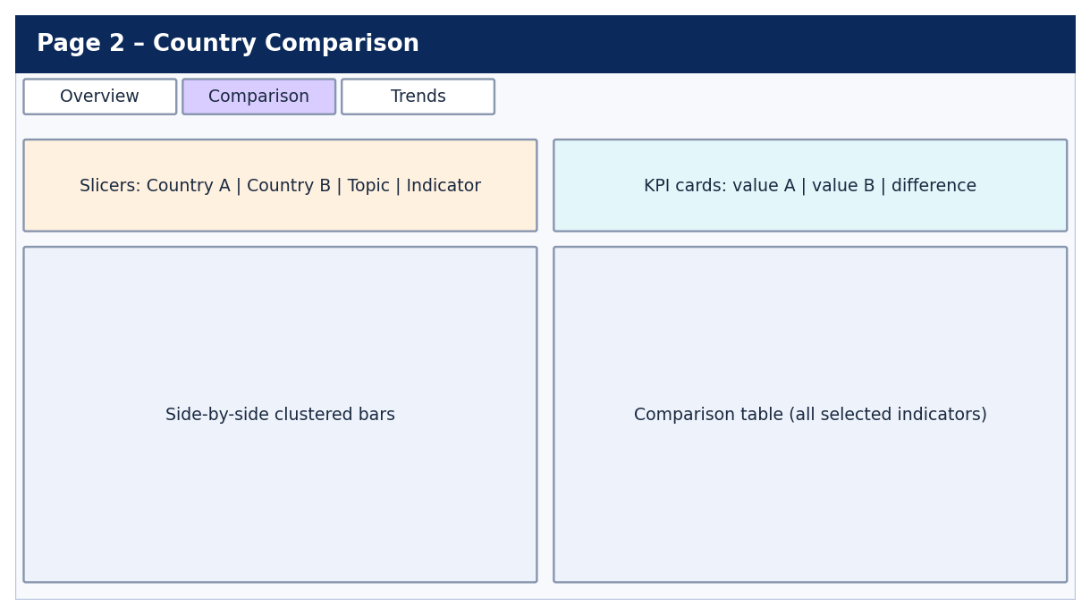
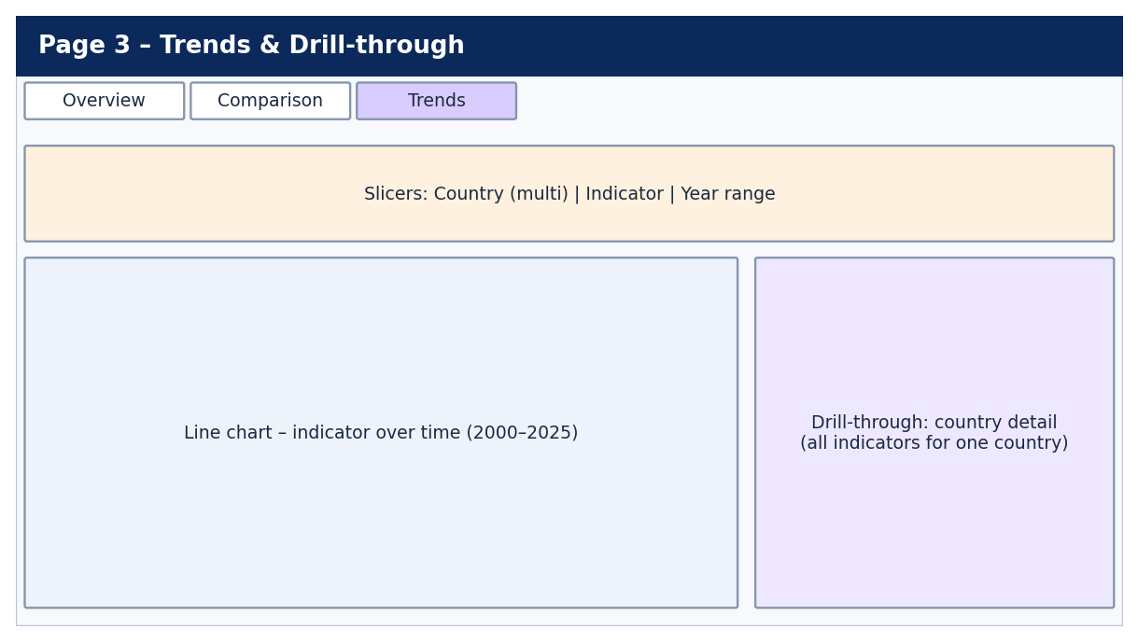
Dashboard Design (Wireframes)
DEPI | Junior Data Analysis
Overview: KPIs, map, top/bottom countries
Comparison: Country A vs. Country B
Trends: 2000–2025 + drill-through
Consistent header, navigation and slicers on every page; 16:9 layout that fits 1920 × 1080
Missing data is shown as "No data", never as zero; units appear in every title
High contrast, alt text and tooltips for accessibility
Data Lens | 5
Notes:
Wireframes are the approved design. Replace with screenshots of the final dashboard after implementation.

Slide 6
Team and Responsibilities
DEPI | Junior Data Analysis
Member | Role | Responsibilities
Shahd Mahmoud Abdelmagid | Team Leader | Coordination, GitHub, final presentation
Eman Ali Mostafa | Data Cleaning Lead | Power Query cleaning, data quality log
Malak Hassan Mahmoud | Data Modeling & DAX | Star schema, relationships, measures
Farah Khaled Fathy | Dashboard Developer | Overview and Comparison pages
Menna Abdelnasser Ramadan | Dashboard / UI-UX | Trends page, map, drill-through, theme
Mariam Baher Mohsen | QA & Documentation | Test cases, user manual, technical docs, infographic
Data Lens | 6
Notes:
Each member explains the work they delivered during the final discussion.

Slide 7
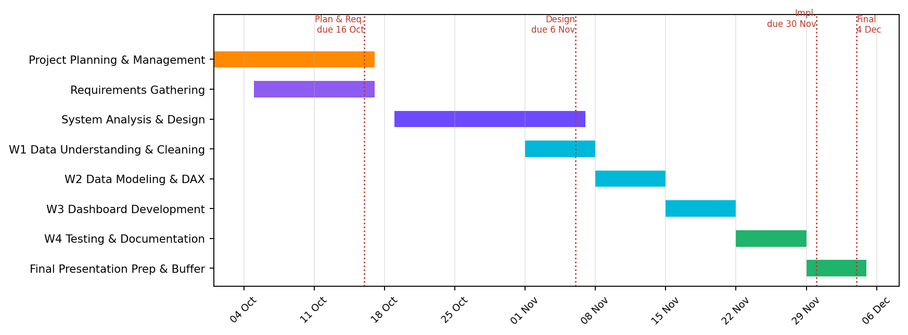
Plan, Status and Next Steps
DEPI | Junior Data Analysis
Status (update before presenting)
Documents ready: proposal, plan, requirements, analysis & design, test plan, user manual and technical docs (drafts)
Implementation: in progress
Testing: test cases written, not yet run
Next steps
Finish cleaning, model and dashboard pages
Run test cases and log bugs
Add dashboard screenshots and final results
Upload all files to GitHub
Data Lens | 7

Slide 8
Deliverables and Outcomes
DEPI | Junior Data Analysis
Clean dataset + data quality log
Power BI dashboard (.pbix)
Test cases and bug report
User manual
Technical documentation
Project infographic
Final presentation
GitHub repository + README
Live demo
Open the dashboard: select countries, compare two countries, view the trend, use the map, and drill through to a country.
Data Lens | 8
Notes:
Add final results and lessons learned after testing.

