Slide 1

DEPI · Digital Egypt Pioneers Initiative
Track: Data Analysis
DevCompare
Comparing the development of Egypt, Nigeria, India, Brazil and Türkiye (2000–2025)
Team Leader: Shahd Mahmoud Abdelmagid
Malak Hassan Mahmoud · Eman Ali Mostafa · Farah Khaled Fathy
Mariam Baher Mohsen · Menna AbdelNasser Ramadan
Instructor: Nouran Elzeky

Slide 2
Problem & objectives
Why this project?
The problem
The solution
Objectives
Development data lives in large Excel files with text markers for missing values and missing years (2009 is absent everywhere; Egypt lacks 2009–2015). Comparing countries by hand is slow and gaps can distort conclusions.
A repeatable Python pipeline cleans and merges the data, analyses it, and publishes one interactive dashboard that clearly shows what is observed, interpolated and forecast.
• 5 countries, 19 indicators, 26 years
• Rankings, growth, correlation
• Relative Development Score
• Trend forecast to 2030
• One command, ≈ 4 seconds
5
19
5
26
countries
indicators (18 + 1 derived)
themes
years of data
DEPI · Data Analysis · DevCompare | 2

Slide 3
Data & quality
World Bank WDI – two Excel extracts, last updated 07/13/2026
Year 2009 missing
Absent for every country in both files.
Egypt gap 2009–2015
Only in the Egypt/Nigeria file → 26.9 % interpolated.
Our rule
Interpolate internal gaps ≤ 7 years, flag them, never use them for rankings or forecasts.
DEPI · Data Analysis · DevCompare | 3

Slide 4
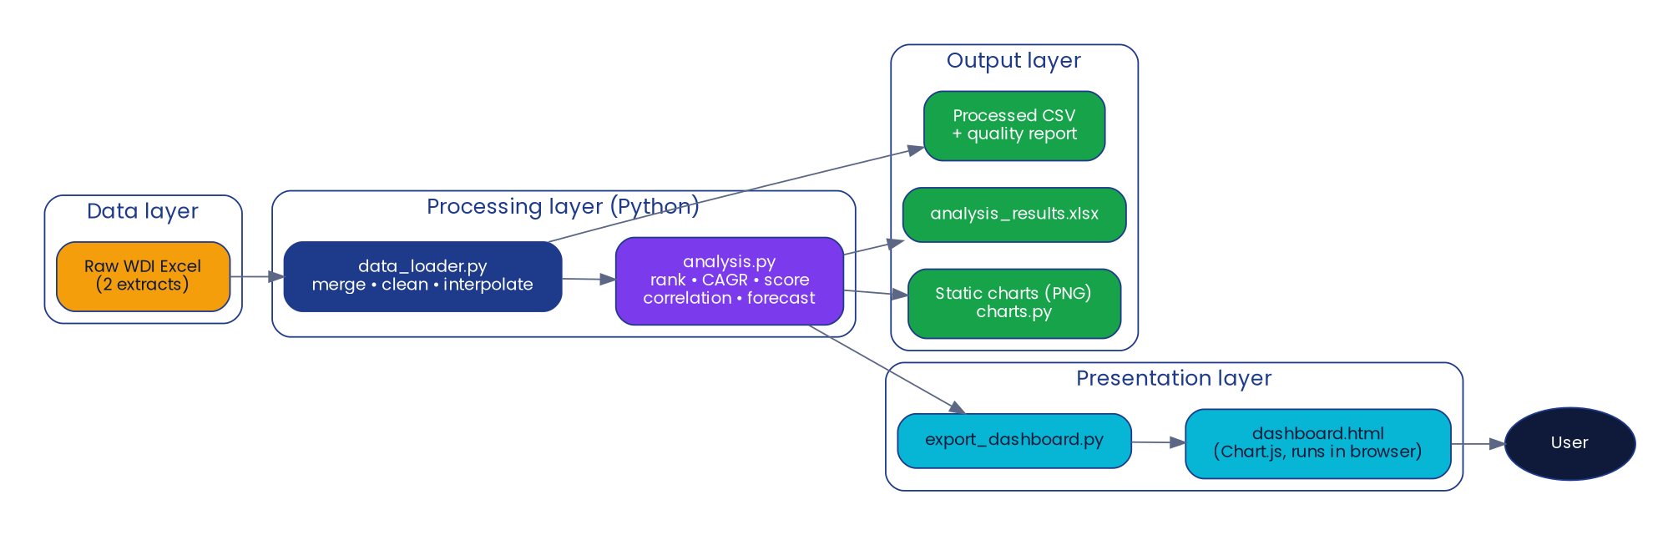
Architecture
Layered pipeline feeding a static dashboard
No server, no database, no paid services · Python · pandas · NumPy · scikit-learn · matplotlib · openpyxl · Chart.js · GitHub
DEPI · Data Analysis · DevCompare | 4

Slide 5
Methods
How the numbers are produced
Clean & merge
Interpolate
Rank & grow
Replace “..”, merge files with priority, keep 5 countries and 18 indicators.
Linear, internal gaps ≤ 7 years, flagged as not observed.
Rank 1 = best (direction-aware); CAGR for GDP, GDP per capita, population.
Development Score
Forecast
Correlation
Min-max normalise 6 indicators across the 5 countries; mean × 100 (relative).
Linear trend on observed points to 2030; hold-out MAE; never below zero.
Pearson matrix with a caution against causal claims.
DEPI · Data Analysis · DevCompare | 5

Slide 6
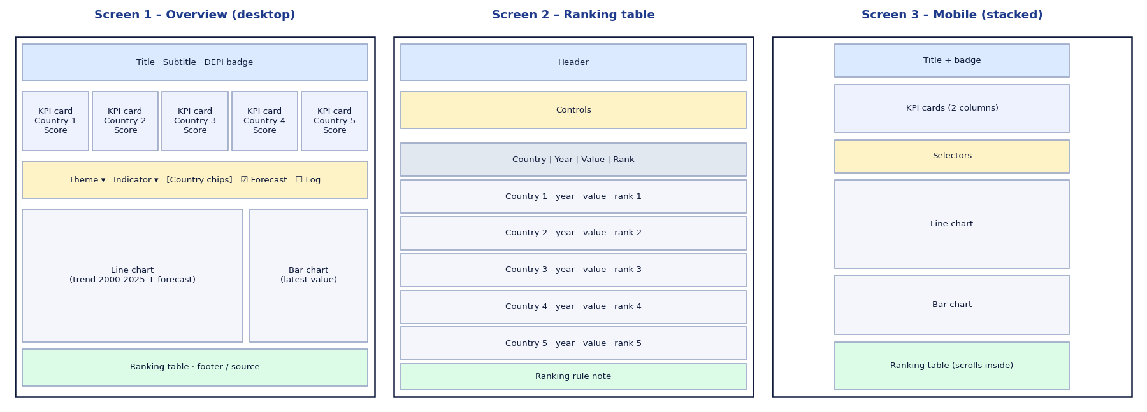
Interactive dashboard
One HTML file · Chart.js · light/dark mode · responsive
What you can do
• Pick theme and indicator
• Show or hide countries
• Trend line + forecast
• Latest value bar chart
• Ranking table with rule
• Score cards
Layout (wireframes)
Honest by design
Hollow markers = interpolated points · dashed lines = forecast · source, units and the ranking rule are always shown beside the results.
DEPI · Data Analysis · DevCompare | 6

Slide 7
Results
Relative Development Score and long-run growth
DEPI · Data Analysis · DevCompare | 7

Slide 8
Key insights
Latest observed values; ranking among the five countries
Türkiye leads, Nigeria trails
India grows fastest
Türkiye 83.3 · Brazil 76.1 · Egypt 52.4 · India 50.1 · Nigeria 16.7. Nigeria is last on five of the six score indicators.
GDP CAGR 8.9 % and the largest GDP (≈ US$ 4.0 T), but GDP per capita (≈ US$ 2,700) and mobile subscriptions stay low.
Egypt
Nigeria
Highest industry share of GDP (32 %); GDP deflator inflation about 25 %, second to Türkiye (36 %); life expectancy 71.8 years.
Fastest population growth (2.1 %) with the lowest life expectancy (54.6 years) and the highest under-5 mortality (115.6 per 1,000).
DEPI · Data Analysis · DevCompare | 8

Slide 9
Testing & quality assurance
Automated tests, defects found and how they were handled
18 / 18
≈ 3.7 s
≈ 83 KB
unit tests pass
full pipeline
dashboard file
Defect | Resolution
Year 2009 missing for all countries | Interpolated and flagged
Egypt missing 2009–2015 | Interpolated and flagged; re-export recommended
Duplicate Nigeria rows in both files | Priority merge + duplicate test
Negative forecast (Türkiye mortality) | Clipped at 0 + test added
Excel export TypeError | Fixed (sheet_name keyword)
Browser acceptance tests (UAT-01 … UAT-09) are defined in the Test Report and must be executed by the team.
DEPI · Data Analysis · DevCompare | 9

Slide 10
Team & responsibilities
Each member explains the part they delivered
Member | Role | Delivered
Shahd Mahmoud Abdelmagid | Team Leader | Planning, GitHub, integration, final presentation
Malak Hassan Mahmoud | Data Engineer | Data loader, cleaning, quality report
Eman Ali Mostafa | Data Analyst | Ranking, CAGR, score, forecast, insights
Farah Khaled Fathy | Dashboard Developer | Interactive dashboard and static charts
Mariam Baher Mohsen | Systems Analyst | Requirements, UML, ERD, wireframes
Menna AbdelNasser Ramadan | QA & Documentation | Tests, bug reports, manual, technical doc
Instructor: Nouran Elzeky
DEPI · Data Analysis · DevCompare | 10

Slide 11
Challenges, limitations & next steps
Challenges & limitations
Next steps
• Missing years in the supplied extracts (2009; Egypt 2009–2015)
• Some indicators empty for some countries (excluded)
• Linear forecasts are indicative only
• The score is relative to these five countries
• Latest year differs by indicator
• Re-export complete Egypt data
• Add more countries and indicators
• Try better time-series models
• Run the tests automatically on every pull request (GitHub Actions)
• Arabic / English dashboard
Thank you · Questions?
DEPI · Data Analysis · DevCompare | 11

