Slide 1
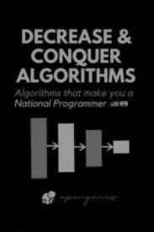
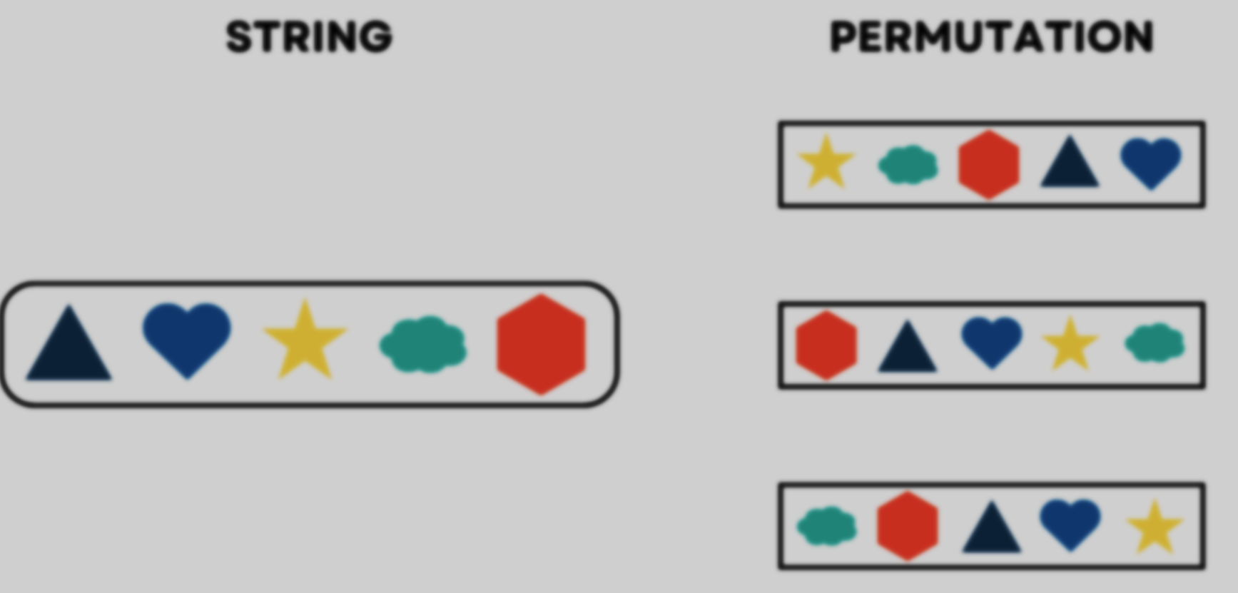
SHAHD AHMED SULTAN
223439

Slide 2
SOLVE
USING
Permutations
Decrease and Conquer
strategy

Slide 3
01
02
Permuations
Algorithm
Decrease and Conquer
CONTENTS OF THIS TEMPLATE
03
04
05
Implementation
Analysis

Slide 4
DECREASE AND CONQUER
It breaks a problem into smaller parts,
solving them progressively until a manageable base case is reached. The strategy simplifies complex problems by addressing smaller instances, eventually combining solutions to derive the overall solution.
01

Slide 5
Types of Decrease and Conquer
Decrease by Constant
(usually one)
Topological sort
Algorithms for generating permutations
Euclid’s algorithm
Selection by partition
Exponential by squaring
Variable Size Decrease
Insertion sort
Decrease by constant factor
(usually half)
Binary search and bisection methods
Multiplication a la russe
Nim-like games

Slide 6

02
Algorithms for generating permutations
A permutation of a set of distinct elements is an ordered arrangement of those elements.
the choice to decrease by one is context-dependent. It's a common technique in various algorithms and mathematical analyses where reducing the size of the set by one is relevant

Slide 7
Purpose of permutation
Counting Arrangements
Game Theory
Data Encryption
Sorting Algorithms
Puzzle Solving

Slide 8
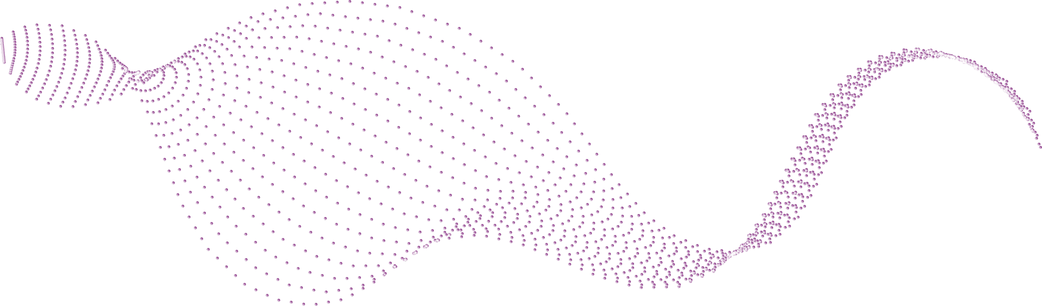


03 ALGORITHM
List of all permutations
INPUT
NUMBER

Slide 9
N=1
A
N=2
BA
AB
N=3
CBA
BCA
BAC
ABC
ACB
CAB
N=4
BACD
CBAD
BCAD
DACB
CABD
ABCD
ADCB
CBDA
BCDA
BADC
CADB
ABDC
ADBC
ACDB
CDAB
CDBA
BDCA
BDAC
DABC
ACBD
DCAB
DCBA
DBCA
DBAC

Slide 10
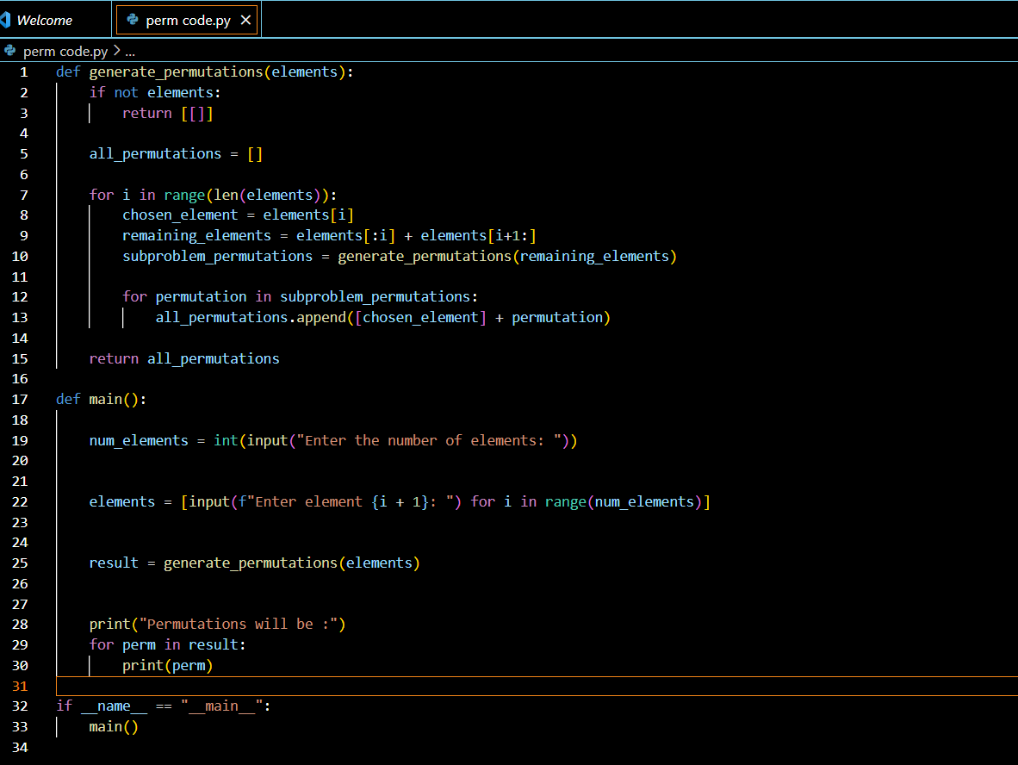
04 IMPLEMENTATION

Slide 11
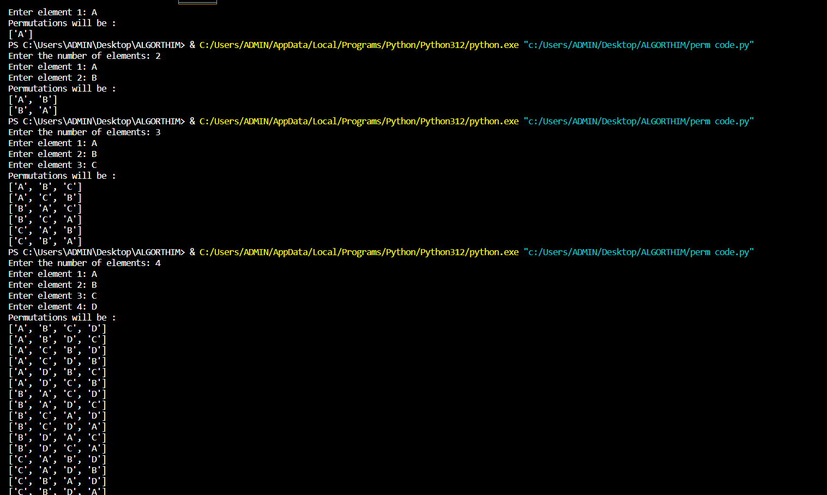
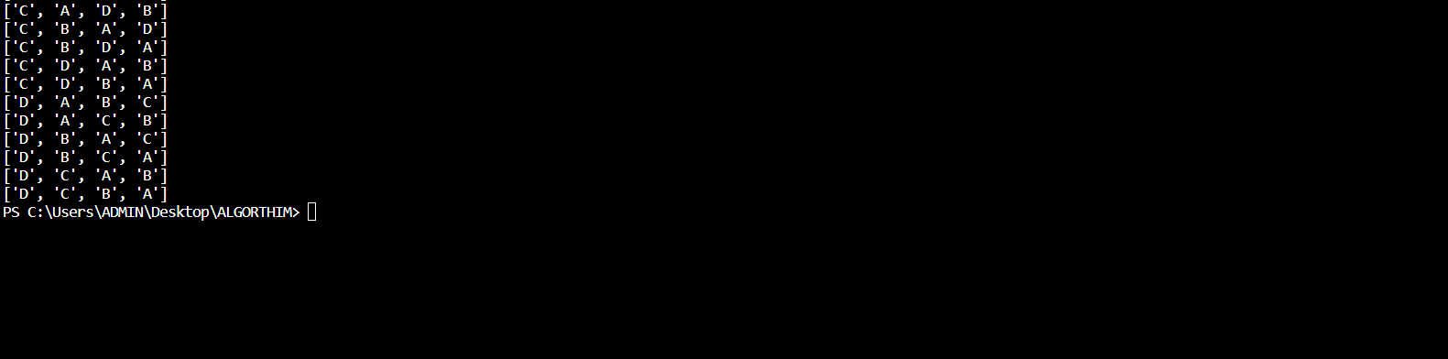

Slide 12
05
ANALYSIS

Slide 13
USING RECURRENCE
In each loop there is an element that will be neglected and for each n substitute it with n-1
T(n)=T(n-1)+n!, T(0)=1
T(n-1)=T(n-2)+T(n-1)!, T(0)=1

Slide 14
Let’s subsist in one equation to reach base case
T(n)=T(n-1)+T(n)!, T(0)=1
=T(n-2)+T(n-1)!+T(n)!
=T(n-3)+ T(n-2)+T(n-1)!+T(n)!
ASSUME k=n
=T(n-k)+ T(n-(k-1))!+T(n-1)!+T(n)!
=T(n-k)+ T(n-(k-1))!+T(n-(K-2)!+………..+n!

Slide 15
=T(n-k)+ T(n-(k-1))!+T(n-(K-2)!+………..+n!
T(0)=1 SO T(n-k)=1
1+1!+2!+3!+………….+n!
Then this algorithm will be O(n!)

Slide 16
THANKYOU

