Slide 2

Problem Statement
The store has a loyalty programme and it wants to
Provide offers on products during non – sale period
On certain categories of interest.
Based on the Black Friday Sales data, we need to recommend the top 100 products it must prioritize for loyalty rewards to customers
We also need to back this up with a business and statistical
reasoning
2

Slide 3

What is a Black Friday Sale?
Black Friday is an informal name for the Friday
Following Thanksgiving Day in the United States which is celebrated on the fourth Thursday of November
This also has been regarded as the beginning of America’s Christmas shopping season since 1952
This term is more commonly used now as compared to the past
It is undoubtedly considered the biggest shopping day in America
It is known as black Friday since at this day in Philadelphia there were heavy and disruptive vehicle and pedestrian traffic
Hence because of this chaotic behaviour this day had been branded as Black Friday
3

Slide 4
Dataset and Features Descriptions
1. We had three datasets out of which only product dataset had null values
2. We have 21 types of occupation, 5891 unique customers and 3 categories of city
3. In product category 1 we have 18 unique entries, product category 2 we have 17 unique entries and in product category 3 we have 15 unique entries
4. We have outliers in the purchase column
5. We plotted the basic graphs in each dataset which will be explained later
6. We merged the three datasets but before that we changed the size of the features so that the merger wont crash
7. We plotted graphs again after merging the dataset
Customer Dataset
1. User ID
2. Gender
3. Age
4. Occupation
4. Occupation
Location Dataset
1. User ID
2. City Category
3. Stay in Current City Years
4. Occupation
Product Dataset
1. User ID
2. Product ID
3. Product Category _1, Product Category _2, Product Category _3
4. Purchase
Feature Creation
Two new features have been created
User ID count
Product ID count
4

Slide 5

Challenges Faced
The data consists of features such as Product Category in multiple columns which were difficult to interpret.
There are 19% of missing values in Product Category 2 and 70% of missing values in Product Category 3, making the imputation impractical.
Apart from Revenue/Sales almost all the variables are categorical in nature. Limiting the scope directly applicable techniques involving calculations.
Data is available in different worksheets which requires joining by the common key.
Observations are of the order of 0.5 million making the pattern recognition and interpretation complex.
5

Slide 6
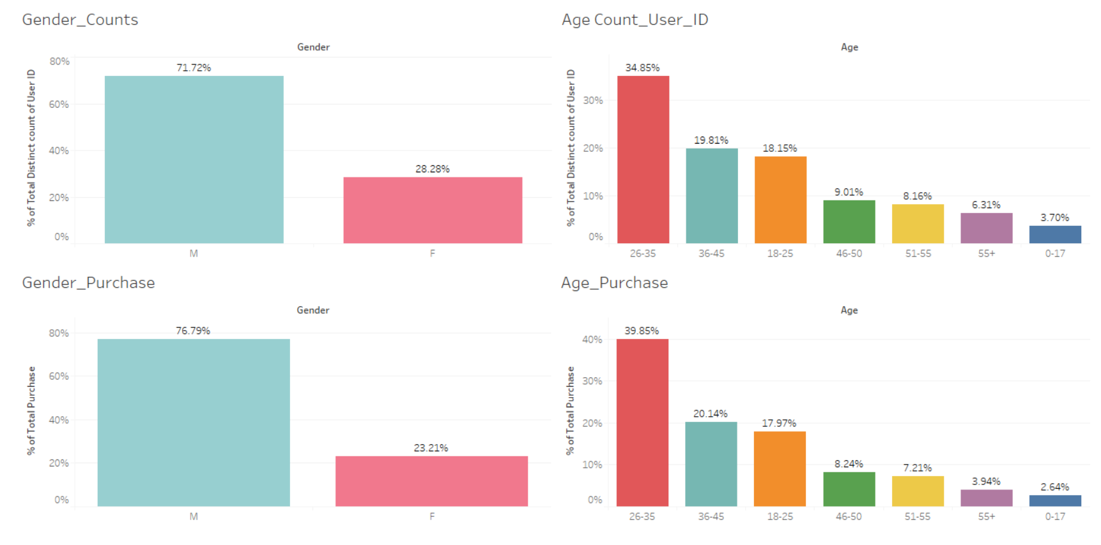
Gender and Age Analysis
We can see male forms 2/3 rd. of the population, and female 1/3rd of the population.
Hence, as a decision maker one should concentrate more on the male population and recommend products to target them
We can see the age group of 26 -35, 36-45 and 18-25 forms the highest count.
So, one should come up with a business scenario where the mentioned age groups are pitched with orders that may intrigue them
Gender wise if we see male
spend many times more than women. They constitute 2/3rd of the revenue generated. Hence, we should follow the above business plan
Age wise 26-35, 36-45 and 18-25 contribute the highest towards revenue.
So, one shoiuld come up with a business plan where they target the three age groups, and provide according aspects
6

Slide 7
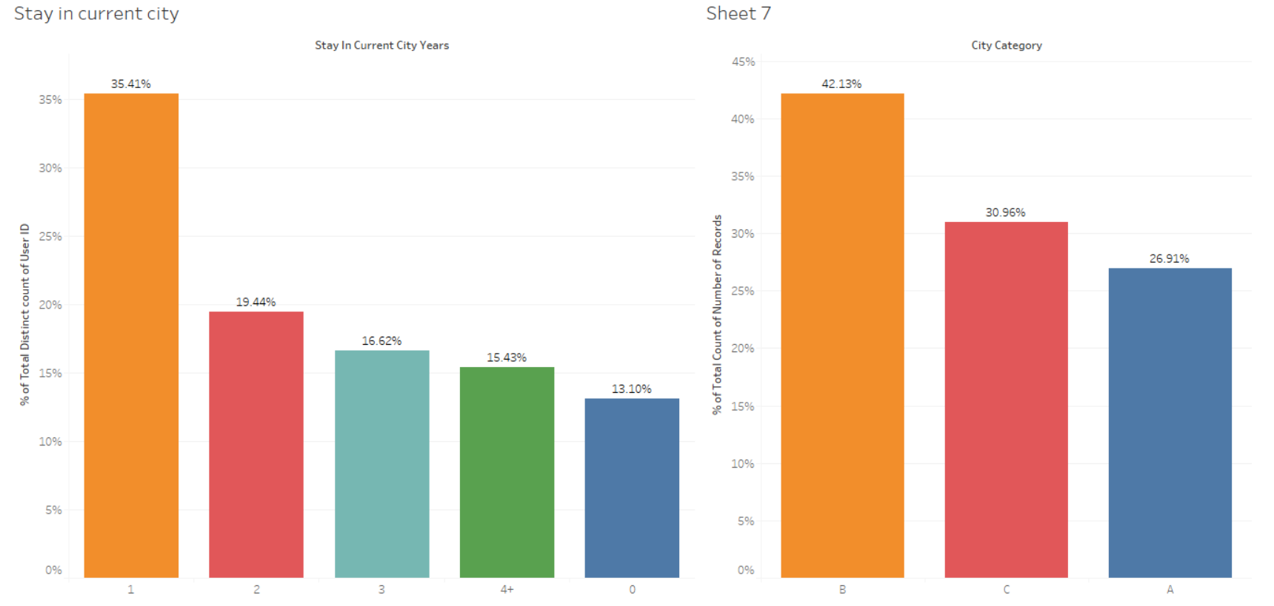
City Category and Stay in Current City Years
People hailing from cities B and C form the highest count, it could infer that age group 18 - 45 years could reside in these cities. Hence,
as a decision maker, one should concentrate more on these cities providing time to time discounts, offers and prospects to boost sales and revenue
People staying for 1, 2 and 3 years form the highest count. So, one could infer that people from age group 18 - 45 years could most probably form these group
7

Slide 8
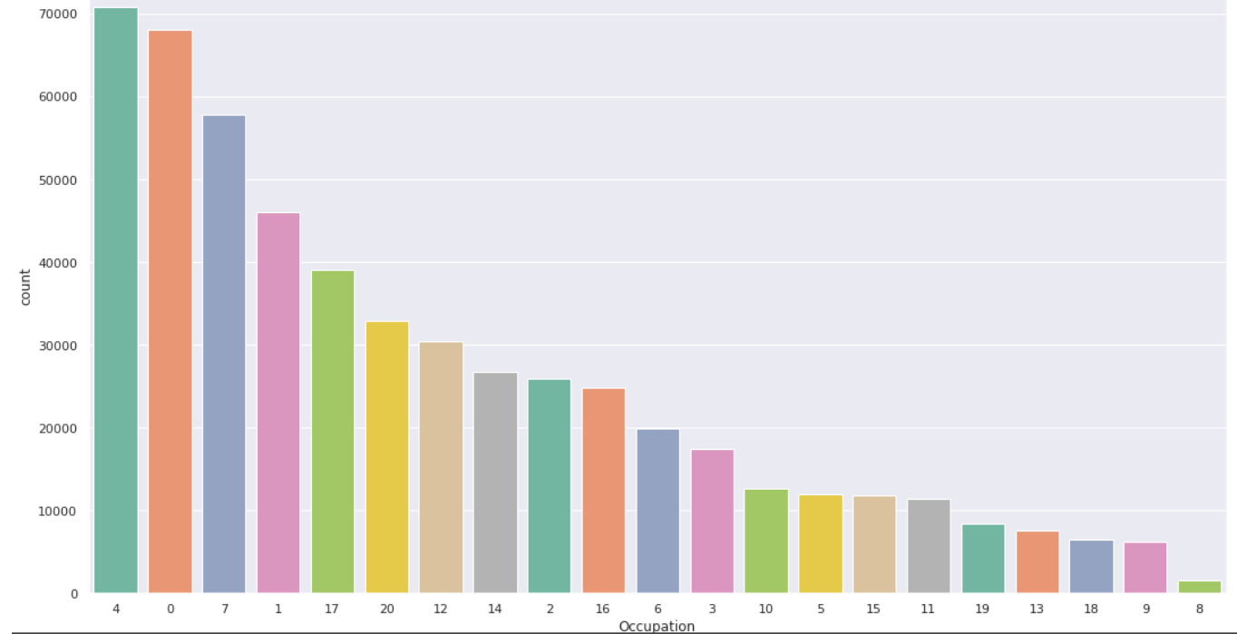
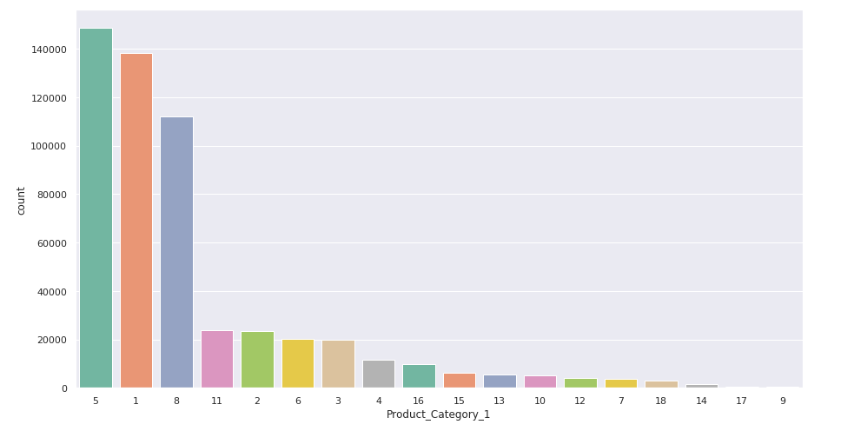
Occupation And Product Category Analysis
Occupation type 4, 0, 7 and 1 form the highest count.
Hence, it could be inferred that these could be average, above average or high income group.
Hence, as a decision maker one should bring about more prospects and offers specific to these occupation types, as it would be a boon to improving customer relation and in the long run could also improve sales and revenue
For analysis, we concentrated more on category 1, and in this category 5,1 and 8 form the highest count
.
So, it could mean that these are the popular products in this category.
Hence, as a decision maker one could concentrate more on the sales and revenue of these products mentioned
8

Slide 9
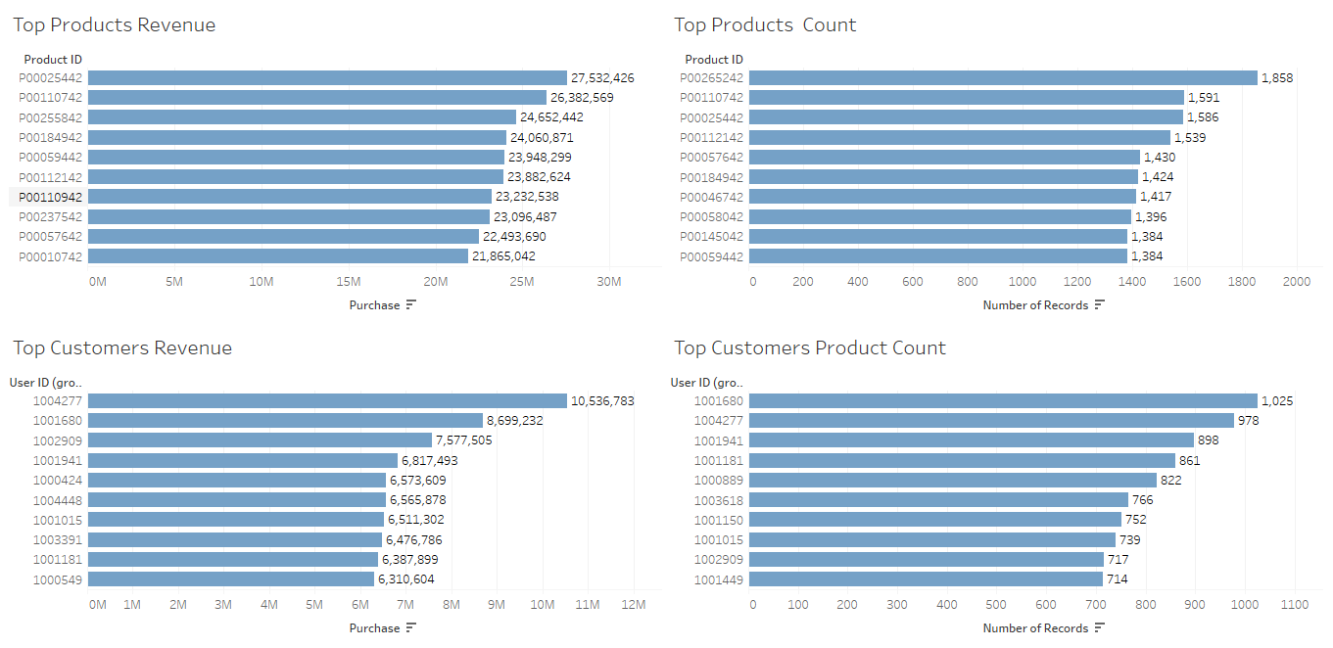
Product And Customer Analysis
Top Products and Customers which give us the maximum revenue ,the maximum quantity sold and customer who bought the maximum product are shown
9

Slide 10
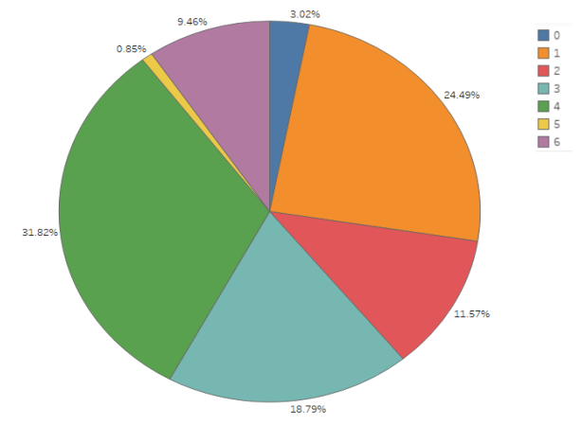
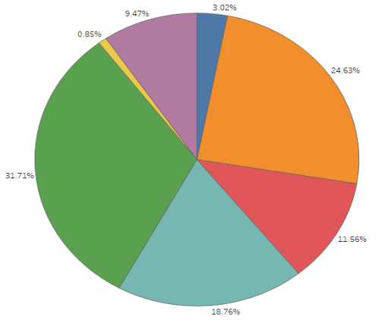
Clustering Analysis
1. We decided to do clustering on this model and to find the number of different clusters or groups that exist in the structure.
2. So we applied K-Means algorithm on the dataset.
3. We plotted the elbow graph.
4. As the size of the dataset was huge, we decided to settle with 7 clusters.
5. The first pie chart gives us the percentage of count of different users.
6. The second pie chart is showing which clusters contribute most towards the revenue.
10

Slide 11
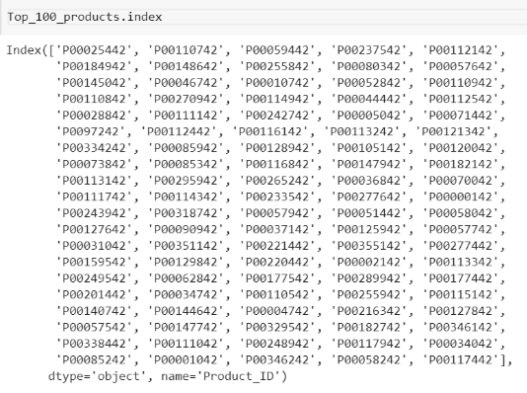
Top Products
Our main objective is to determine the top 100 products
This is a list of top 100 products based on their purchase.
Assumptions:-
1. Percentage profit of all products are same
2. Even with the best discount the products are not in loss
Insights:-
1. Number of quantity sold ranges from (P00117442) to (P0025442)
11

Slide 12
Classification
After grouping the users into 7 clusters,we applied classification model.
We performed the above, so that any new user coming in could be classified in any one of those clusters and products belonging to that cluster could be recommended
To execute the required, we performed different classification techniques, such as Random Forest, Logistic Regression, KNN, Decision Tree and Naive Bayes
We used F1 score to evaluate our model, whose score is depicted in the report
Models | Accuracy (%)
1. Random Forest | 83
2. Logistic Regression | 65
3. KNN | 57
4. Decision Tree | 45
5. Naive Bayes | 35
Limitations:- Due to the massie size of the dataset we resolved to take sample from the original dataset, so that we could overcome the computational and memory constraint faced.
12

Slide 13

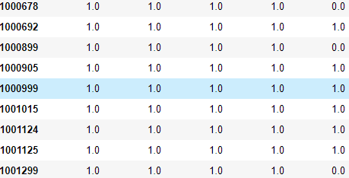
Market Basket Suggestion
Market Basket Analysis
How it works?
Major customers who purchased first 4 products also purchased the 5th one
Model will do a simple rule according to the purchase pattern
For the three who haven't purchased that product it will suggest
13

Slide 14
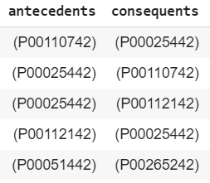
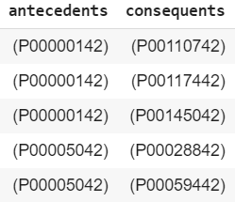
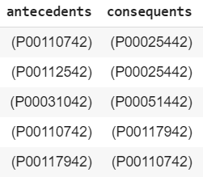
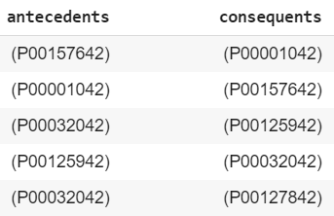
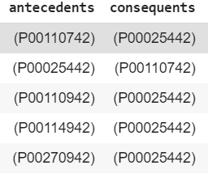
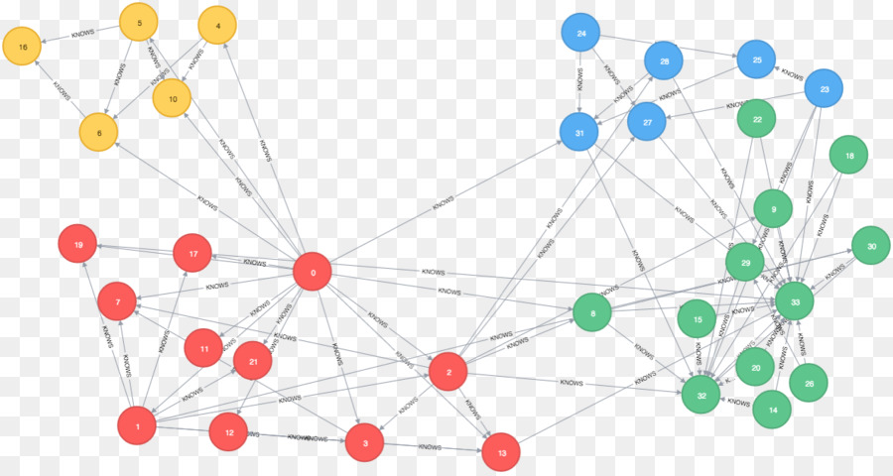
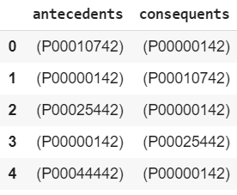
Cluster wise Suggestion
Cluster 1
Cluster 2
Cluster 3
Cluster 4
Cluster 5
Cluster 6
14

Slide 15


