Slide 1
FACULTY OF ARTIFICIAL INTELLIGENCE ENGINEERING | SYRIAN PRIVATE UNIVERSITY
Next-Day Athlete Readiness Prediction from Wearable, Training-Load and Lifestyle Data
Seminar 1: problem framing, literature review and dataset description
Student: [Name] Supervisor: [Name] October 2026
Notes:
Introduce the project in one sentence: an interpretable model that predicts whether an athlete will have a low-readiness day tomorrow, using PMData.

Slide 2
Problem and goal
Research questions
Scientific problem
Training load, sleep and stress interact, and coaches mostly rely on feel or closed tools.
Self-reported readiness is noisy and differs from athlete to athlete.
Public data are small (16 athletes), so models must be tested on unseen people.
1
Which model is most accurate on unseen athletes?
2
Does personalization beat one population model?
3
What do sleep, load and nutrition each add?
Goal
Predict tomorrow's low-readiness day with a lightweight, explainable model and compare population vs personalized models.
4
How many days of data does a new user need?
Notes:
Users: coaches, athletes and gyms. Affected: the 16 anonymised PMData participants. Decision support only, not a medical diagnosis.

Slide 3
State of the art
Work | Data | Method | Relevance to us
PMData (2020) | 16 athletes: Fitbit, PMSys, logs | Dataset paper | Our data source and its limits
Health-LLM (2024) | Wearable data incl. PMData | Large language models | Strong reference; heavy models
PerSQ (2022) | PMData lifelogs | Personalized sleep quality | Supports personalization
HealthSLM-Bench (2025) | PMData tasks | Small language models | Task definition, 14-day window
HybridSense-LLM (2026) | PMData | Statistical features + LLM | Latest PMData result to compare
PAIR | Athlete wearable data | Personalized neural model | Injury risk; personalization helps
Also reviewed in the report: soccer-readiness time-series study (2022), LSTM + attention for athlete injury (2026), PART multimodal tennis framework.
Notes:
Recent PMData work leans toward language models. Personalization has been studied mostly for sleep or injury, not readiness.

Slide 4
Coverage and research gap
Work | PMData | Readiness | Personal. | Multi-source | Unseen athletes | Light + explainable
PMData (2020) | ● | ● | – | ◐ | – | –
Health-LLM | ● | ● | – | ◐ | – | –
PerSQ | ● | – | ● | ◐ | – | –
HealthSLM-Bench | ● | ● | – | ◐ | – | ◐
HybridSense-LLM | ● | ● | – | ◐ | – | –
PAIR | – | – | ● | ◐ | – | –
LSTM + attention | – | – | – | ◐ | – | ◐
This project | ● | ● | ● | ● | ● | ●
● addressed ◐ partly – not reported (from abstracts; to verify in full texts)
Gap: no reviewed work compares population, personal and fine-tuned models for next-day readiness on PMData, combining sleep, load and nutrition, tested on unseen athletes with calibration and cold-start analysis.
Notes:
The matrix is built from abstracts and will be verified against the full texts during the literature review.

Slide 5
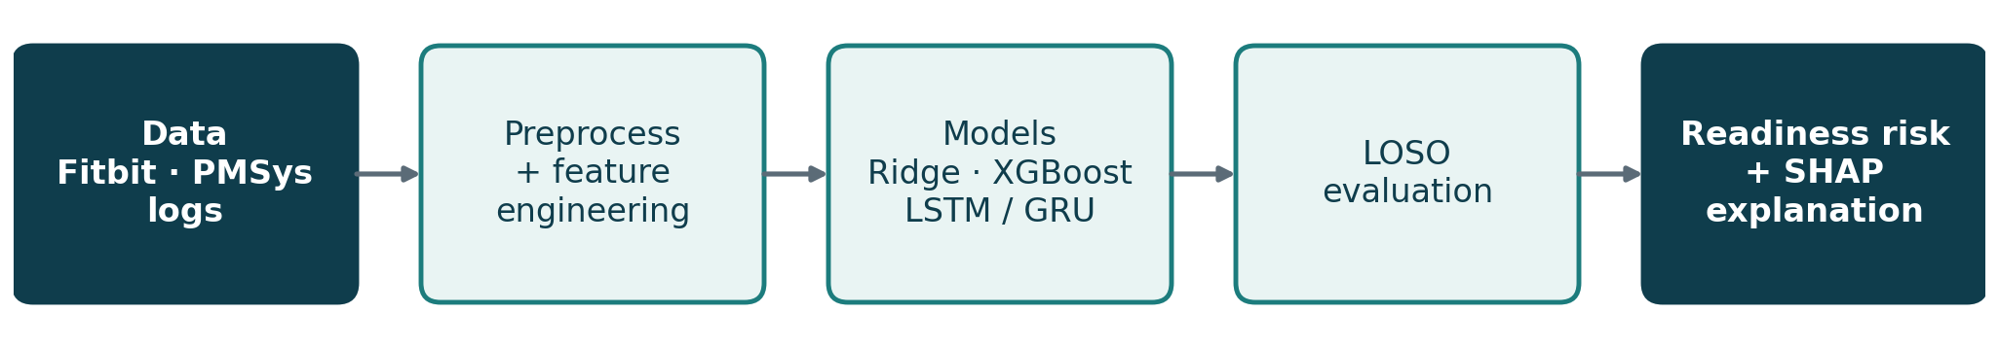
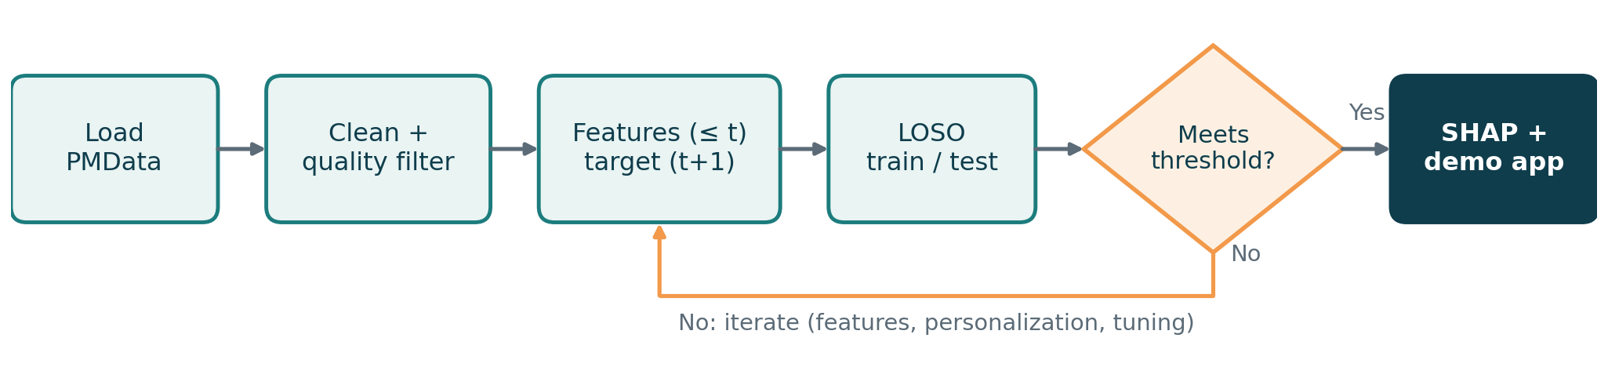
Proposed solution
Block diagram
Flowchart
Notes:
Pipeline: aggregate to daily rows, build features from past days only, evaluate with leave-one-subject-out, then explain with SHAP.

Slide 6
Dataset and EDA
16
2,211
1,729
1,423
participants
participant-days
readiness reports
valid day-pairs
Data quality decisions
Low readiness (≤ 4.5) = 35% of days.
p03: 95% identical values; p05: zeros then fives (46-day run). Rule: exclude runs > 30 days from the main analysis, keep in a sensitivity analysis.
Completeness: sleep 80%, steps 94%, nutrition logs 52-64%.
Notes:
The EDA notebook reproduces these numbers from daily.csv. Sources: Fitbit Versa 2, PMSys app, Google Forms logs, Nov 2019 to Mar 2020.

Slide 7
Framing card
Task type | Binary classification: low readiness tomorrow (secondary: 3-class, regression)
Input → output | Past 7-14 days of sleep, load, wellness, logs → low-readiness day at t+1
Users & affected | Coaches, athletes, gyms; 16 anonymised PMData participants
Costlier error | FN: a missed low day means full load on a tired athlete
Metric + threshold | Recall ≥ 0.70 at precision ≥ 0.50 (provisional)
Baseline | Persistence, majority class, 7-day mean; published PMData results
Test-set size | LOSO over ~14 athletes, ≈1,250 pairs, ≈440 positives → recall ± 4 pts
Success: threshold met, or a documented gain over persistence (macro-F1 +0.05, lower MAE). Counts marked ≈ are estimates, confirmed after the baseline run.
Notes:
The costlier error is the false negative. Test-set figures are provisional and will be refined in W03.

Slide 8
Tools, theory and plan
1
Tools
2
Theory (Chapter 1)
3
Plan (8 weeks)
Python, pandas, NumPy
scikit-learn, XGBoost
PyTorch (LSTM / GRU)
SHAP, Matplotlib
Streamlit, Jupyter, Git
Readiness, sRPE, ACWR
Time-series features, leakage
Gradient boosting, LSTM
LOSO, recall, calibration
SHAP, personalization
W1-2 review, EDA
W3-4 baselines, XGBoost
W5-6 LSTM, personalization
W7 SHAP, Streamlit demo
W8 report, final defense
Notes:
The first seminar needs no results. Next step: baselines under leave-one-subject-out evaluation.

