Slide 1

Property Price Prediction
By- Darpan SHah
Prof. Mahmoud Daneshmand
MIS 637 Data Analytics and Machine learning
Department of Information Systems
Stevens Institute of Technology

Slide 2
Outline
Introduction (Research Understanding phase)
Data (Data understanding & data preparation phases)
ANN Model (Modeling phase)
Results (Evaluation phase)
Conclusion

Slide 3
Introduction
Buying a house is a crucial moment for every individual as it involves large sum of money and happens once in a lifetime.
Numerous factors affect the price of a house thus must be analyzed with high level of precision.
Given the non-linear relation between different factors and the price, artificial neural network model proves to be the best.
This project intends to predict price of properties in India based on factors that play a key role in decision making of buying a property.

Slide 4
DATA
Input variables Description:
Posted By – Who has posted the advertisement in search for a buyer for the property. Under Construction – Is the property still not ready RERA – whether the property is approved by Real Estate Regulatory Authority or not. BHK No. – number of bedrooms in the property. BHK or RK - whether it consist of bedrooms or not. Square Ft. – The total area of the property Ready to Move – Is the property ready to move in or not. Resale – Is it the fresh property or resale of old property. Address – the address of the property Longitude – Longitudinal location of the property Latitude – Latitudinal location of the property

Slide 5
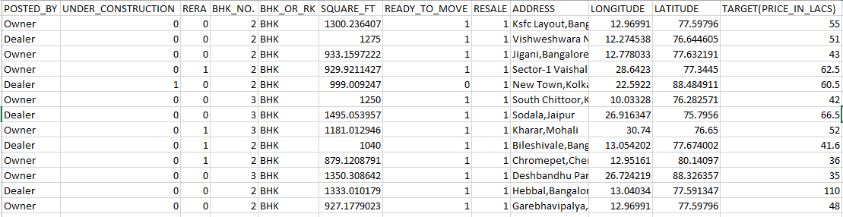
DATA
Output data
Output of the model is the prediction of the price of Property in India
Sample data ( Source: Kaggle)
There are 29,451 data points each representing a property in India.

Slide 6
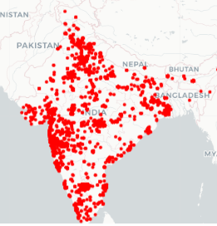
Graphical representation
In the graph red dotes represent data points, and can see that our dataset is not biased as it has values from all over India.
6

Slide 7
Data Processing
Operations performed before being used for modeling:
Transformation performed on variables
Check the missing values – found no missing values
Check for outliers
Check correlation with Target (Y) variable
Normalizing the dataset as requirement for ANN
7

Slide 8
Data Processing
Transformations performed on variables:
Address
Using the variable we created a new variable Zone having 5 distinct values:
Western
Central
Southern
Northern
Eastern
Posted By
There are three distinct values which were converted to different variables having 0 and 1 values. New variables are:
Posted by Builder
Posted by Owner
Posted by Dealer
8

Slide 9
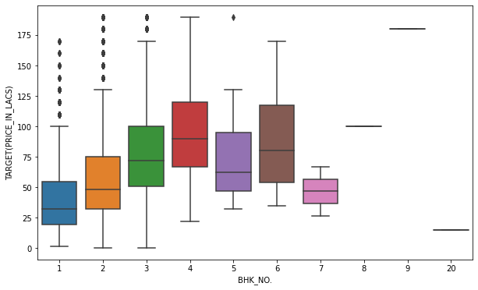
Data Processing
Check for Outliers:
We can see in the below graph that there are some extreme values in the variable named BHK No.:
Outliers with single values hence removed
9

Slide 10
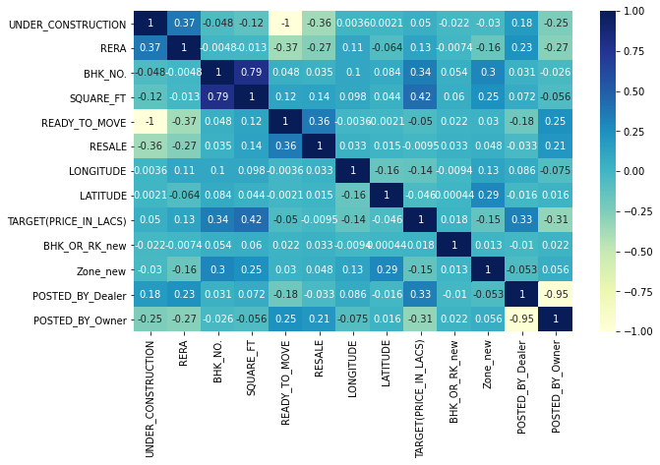
Data processing
Correlation with Target Variable:
Variables having high correlation with Target variable are:
BHK No.
Square Ft.
Posted by Dealer
10

Slide 11
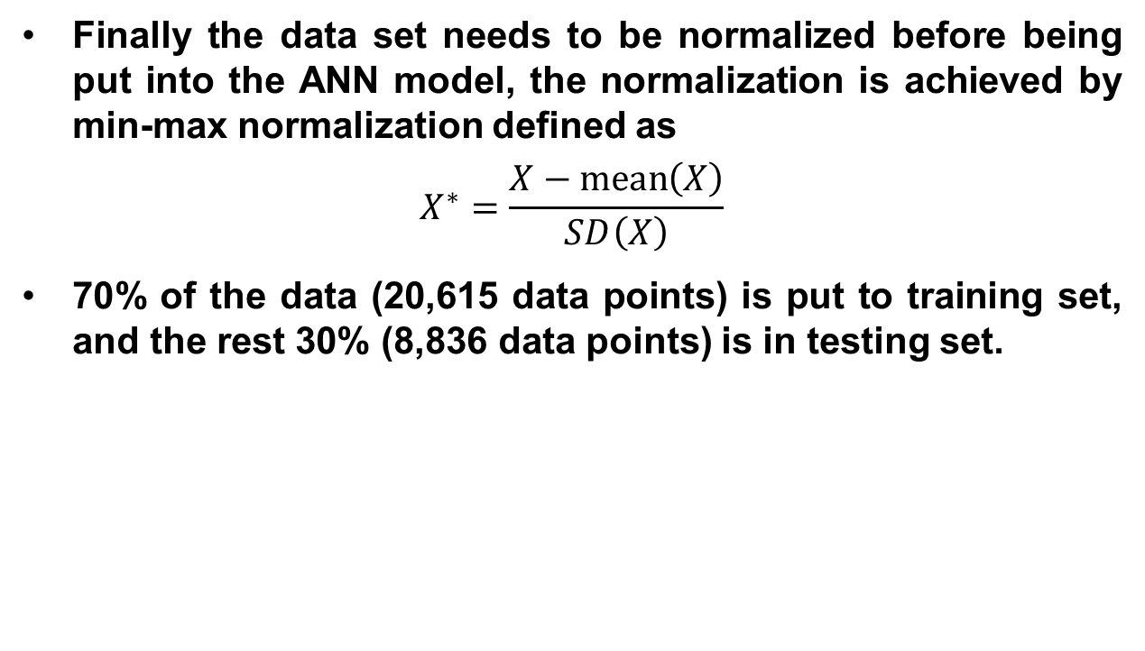
Data Processing
Finally the data set needs to be normalized before being put into the ANN model, the normalization is achieved by min-max normalization defined as
$$X^{∗}=\frac{X−\operatorname{mean}\left(X\right)}{SD\left(X\right)}$$
70% of the data (20,615 data points) is put to training set, and the rest 30% (8,836 data points) is in testing set.

Slide 12
Data Processing
Final variables chosen to be considered in model are:
Input Variables Output Variable
Under construction 1. Target (Price in lacks)
Rera
Bhk no.
Square ft.
Ready to move
Resale
Longitude
Latitude
Bhk or Rk
Zone
Posted by dealer
Posted by owner
12

Slide 13
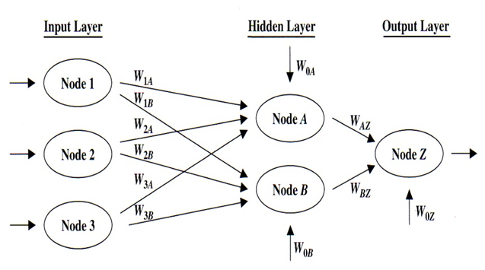
ANN Model

Slide 14
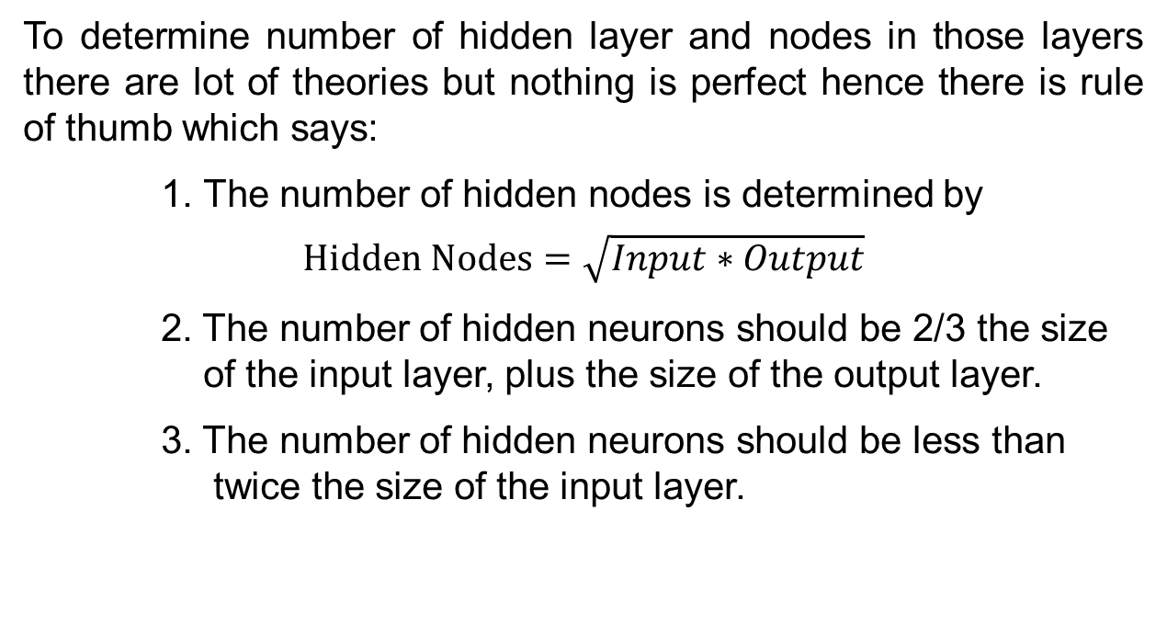
ANN Model
To determine number of hidden layer and nodes in those layers there are lot of theories but nothing is perfect hence there is rule of thumb which says:
1. The number of hidden nodes is determined by
$$Hidden Nodes=\sqrt{Input∗Output}$$
2. The number of hidden neurons should be 2/3 the size of the input layer, plus the size of the output layer.
3. The number of hidden neurons should be less than twice the size of the input layer.

Slide 15
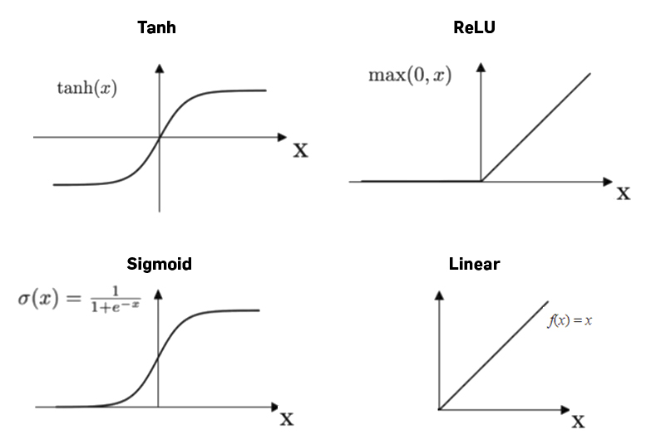
ANN MODEL
Activation Function:
It defines how the weighted sum of the input is transformed into an output.
Types:
1. Rectified Linear Activation (ReLU)
2. Hyperbolic Tangent (Tanh)
3. Logistic (Sigmoid)
4. Linear

Slide 16
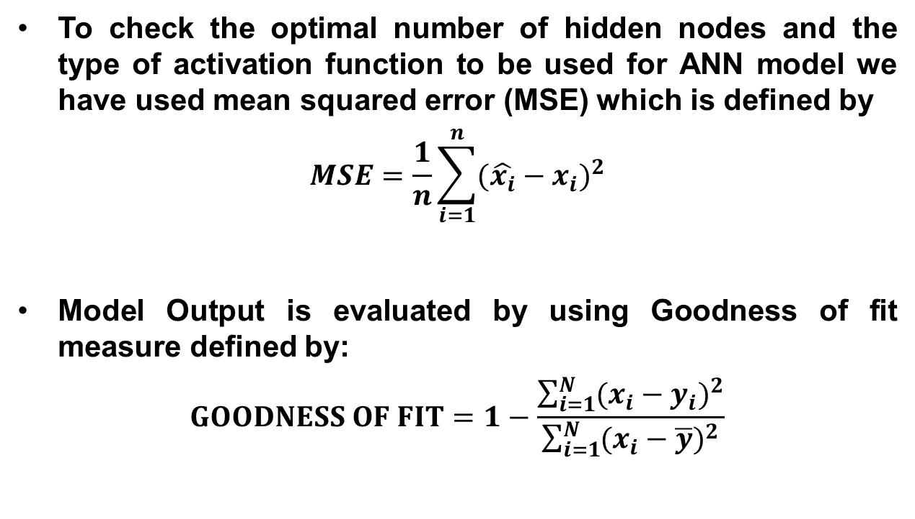
ANN Model
To check the optimal number of hidden nodes and the type of activation function to be used for ANN model we have used mean squared error (MSE) which is defined by
$$MSE=\frac{1}{n}\sum_{i=1}^{n}{(\hat{x_{i}}−x_{i}})^{2}$$
Model Output is evaluated by using Goodness of fit measure defined by:
$$GOODNESS OF FIT=1−\frac{\sum_{i=1}^{N}{(x_{i}−y_{i})^{2}}}{\sum_{i=1}^{N}{(x_{i}−\overline{y})^{2}}}$$

Slide 17
Result
The table below shows the result of the model calculated in Python:
Activation Function | Hidden Layers | Hidden Nodes | Learning Rate | MSE | Goodness of Fit
ReLU | 1 | 8 | 0.01 | 86.18 | 0.4521
Tanh | 1 | 8 | 0.01 | 44.40 | 0.9430
Sigmoid | 1 | 8 | 0.01 | 58.51 | 0.8002
It is shown in the above table that the ANN model with activation function as Hyperbolic Tangent (Tanh) and 8 hidden nodes has the smallest MSE and largest goodness of fit among all the models with different activation function hence it is the optimal model for this study.

Slide 18
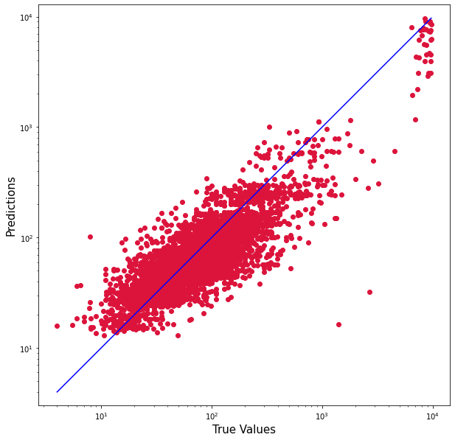
result
The plot of ANN model output shows a good fit.

Slide 19
Conclusion
When choosing the number of hidden layers and hidden nodes properly, ANN shows a fairly well ability to model target series with certain inputs.
If the input is highly correlated to the target, both ANN and traditional multivariate regression could generate satisfying results.
When the input and target are less correlated, ANN displays a much better accuracy in prediction than traditional multivariate regression.

Slide 20
Reference
Peng, T.M., Hubele, N.F. and Karady, G.G., 1992. Advancement in the application of neural networks for short-term load forecasting. IEEE Transactions on Power Systems, 7(1), pp.250-257.
Ostafe, D., 2005, May. Neural network hidden layer number determination using pattern recognition techniques. In 2nd Romanian-Hungarian Joint Symposium on Applied Computational Intelligence, SACI.
Selim, H., 2009. Determinants of house prices in Turkey: Hedonic regression versus artificial neural network. Expert systems with Applications, 36(2), pp.2843-2852.

Slide 21
Thank you

