Slide 1


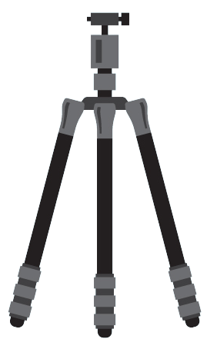
Camera2
By: Shahd Belhaj

Slide 2


Slide 3
Camera2 Package
Camera Manager
Camera Devices
Camera Characteristics
Camera CaptureSession
Camera Metadata
CaptureResult
The android.hardware.camera2 package provides an interface to individual camera devices connected to an Android device, introduced in Android 5.0 Lollipop.
It provides developers with a comprehensive way for interacting with camera devices on Android devices.
With Camera2 Package, developers can build advanced camera applications that take advantage of features such as RAW image capture, manual focus control, and more.

Slide 4
Camera2 Package
Camera Manager
Camera Devices
Camera Characteristics
Camera CaptureSession
Camera Metadata
CaptureResult
System Service Manager with Information/Access for Cameras
Detects, characterizes and connects to CameraDevcies
Provides a list of Available Cameras with getCameraIdList()
Allows us to use open and close camera by passing in CameraId and CameraDevice.StateCallback
Provides us with Camera Characteristics

Slide 5
Camera2 Package
Camera Manager
Camera Devices
Camera Characteristics
Camera CaptureSession
Camera Metadata
CaptureResult
Representation of a single camera connected to an Android device
Creating a CaptureRequest.Builder for Capture Requests
Create a new camera capture session by providing the target output set of Surfaces to the camera device.
setRepeatingRequest() is used to start a repeating capture request for the camera device.

Slide 6
Camera2 Package
Camera Manager
Camera Devices
Camera Characteristics
Camera CaptureSession
Camera Metadata
CaptureResult
Querying Supported Camera Resolutions
CameraManager cameraManager = (CameraManager) getSystemService(Context.CAMERA_SERVICE);
String cameraId = cameraManager.getCameraIdList()[0];
CameraCharacteristics cameraCharacteristics = cameraManager.getCameraCharacteristics(cameraId);
StreamConfigurationMap streamConfigMap = cameraCharacteristics.get(CameraCharacteristics.SCALER_STREAM_CONFIGURATION_MAP);
Size[] outputSizes = streamConfigMap.getOutputSizes(ImageFormat.JPEG);

Slide 7
Camera2 Package
Camera Manager
Camera Devices
Camera Characteristics
Camera CaptureSession
Camera Metadata
CaptureResult
Provides a way to capture images or video from a camera device on an Android device.
capture() is used to capture a single image
setRepeatingRequest() will start a repeating capture request for the capture session until stopRepeating() is called
captureBurst() used to capture a burst of images in a single request for a camera capture session
Captures a set number of images instead of a continuous stream.

Slide 8
Camera2 Package
Camera Manager
Camera Devices
Camera Characteristics
Camera CaptureSession
Camera Metadata
CaptureResult
Unlike Camera Characteristics, Camera Metadata provides dynamic information
getKeys() returns a list of keys that are present in the metadata.
Each key represents a specific metadata item, such as the camera's supported resolutions, or the current exposure settings.
isAvailable() is used to determine if a specific metadata item is available for the current camera device.

Slide 9
Camera2 Package
Camera Manager
Camera Devices
Camera Characteristics
Camera CaptureSession
Camera Metadata
CaptureResult
CameraPreviews
Represents the result of a single image capture from a camera device
Used to analyze the settings and state of the camera device during the capture for improvement
getTimestamp(), getFrameNumber(): , getSequenceId()

Slide 10
Camera2 Package
Camera Manager
Camera Devices
Camera Characteristics
Camera CaptureSession
Camera Metadata
CaptureResult
Camera Previews
SurfaceView
TextureView
Typically used for displaying camera preview or live stream
Less efficient because it involves more overhead for rendering graphics
Supports transparency and overlap
Typically used for video playback
Updated independently of the rest of the UI
Does not support transparency and overlap

Slide 11
CameraManager
get CameraIdList()
get CameraCharacteristics()
openCamera();
CameraDevice
create CaptureRequest();

Slide 12
CameraManager
get CameraIdList()
get CameraCharacteristics()
openCamera();
CameraDevice
create CaptureRequest();
Preview
CaptureRequest
SurfaceView
TextureView
MediaEncoder
ImageReader
Builder needs
CameraID
Target Surface
create CaptureSession()
CameraSession
Capture()
Captureburst()
Setrepeatingburst()
Requests to
Hardware

Slide 13
CameraManager
get CameraIdList()
get CameraCharacteristics()
openCamera();
CameraDevice
create CaptureRequest();
Preview
CaptureRequest
SurfaceView
TextureView
MediaRecoder
ImageReader
Builder needs
CameraID
Target Surface
create CaptureSession()
CameraSession
Capture()
Captureburst()
Setrepeatingburst()
Requests to
Hardware
Output
Image Buffers
CaptureResult
Retrieve Image Metadata
CameraCaptureSession.CaptureCallback

Slide 14
Preview
CaptureRequest
SurfaceView
TextureView
MediaEncoder
ImageReader
Builder needs
CameraID
Target Surface
create CaptureSession()
CameraSession
Capture()
Captureburst()
Setrepeatingburst()
Requests to
Hardware
Output
Image Buffers
CaptureResult
Retrieve Image Metadata
CameraCaptureSession.CaptureCallback

Slide 15








JULY
3
SUNNY
Photos
Videos
Phone
Music
Settings
Camera

Slide 16
JULY
3
SUNNY
Videos
Phone
Music
Settings
Camera

Slide 17

Saving Photos
JULY
3
SUNNY
Using ImageReader from android.media
Videos
Phone
ImageReader imageReader = ImageReader.newInstance(1920, 1080, ImageFormat.JPEG, 1);
imageReader.setOnImageAvailableListener(new ImageReader.OnImageAvailableListener() {
@Override
public void onImageAvailable(ImageReader reader) {
Image image = reader.acquireLatestImage();
File file = new File(Environment.getExternalStoragePublicDirectory(Environment.DIRECTORY_DCIM), "photo.jpg");
Music
Settings
Camera

Slide 18
Saving Videos
Using MediaRecorder from android.media
Must pass frame rate in Capture Request, Uses setRepeatingRequest
MediaRecorder mediaRecorder = new MediaRecorder();
mediaRecorder.setVideoSource(MediaRecorder.VideoSource.SURFACE);
mediaRecorder.setOutputFormat(MediaRecorder.OutputFormat.MPEG_4);
mediaRecorder.setVideoEncoder(MediaRecorder.VideoEncoder.H264);
mediaRecorder.setVideoSize(1920, 1080);
mediaRecorder.setVideoFrameRate(30);
File outputFile = new File(getExternalFilesDir(null), "video.mp4");

Slide 19

OBJECT DETECTION APP
Using Camera2 Package

Slide 20
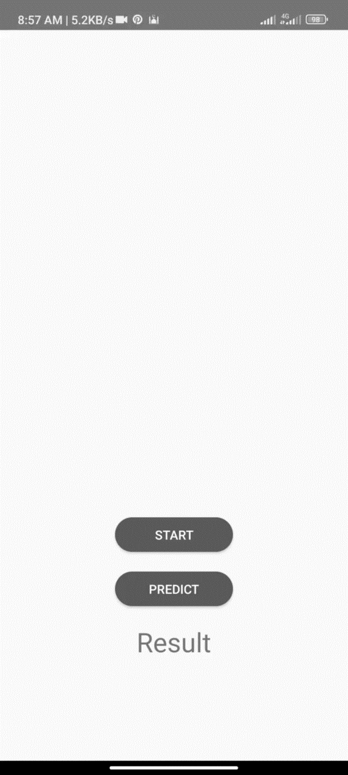
The app captures an image with the device's camera displays it on the screen
and then predicts the object in the image using a pre-trained machine learning model.

Slide 22
private void startCameraPreview() { try { cameraManager = (CameraManager) getSystemService(Context.CAMERA_SERVICE); cameraId = getBackFacingCameraId(cameraManager); if (ActivityCompat.checkSelfPermission(this, Manifest.permission.CAMERA) != PackageManager.PERMISSION_GRANTED) { ActivityCompat.requestPermissions(MainActivity.this, new String[]{Manifest.permission.CAMERA}, REQUEST_CAMERA_PERMISSION); return; }
How Camera2 was used for this app

Slide 23
private String getBackFacingCameraId(CameraManager cameraManager) {
try {
for (String cameraId : cameraManager.getCameraIdList()) {
CameraCharacteristics cameraCharacteristics = cameraManager.getCameraCharacteristics(cameraId);
if (cameraCharacteristics.get(CameraCharacteristics.LENS_FACING) == CameraCharacteristics.LENS_FACING_BACK) {
return cameraId;
}
}
} catch (CameraAccessException e) {
e.printStackTrace();
}
return null;
}

Slide 24
cameraManager.openCamera(cameraId, new CameraDevice.StateCallback() {
@Override
public void onOpened(@NonNull CameraDevice camera) {
cameraDevice = camera;
try {
Surface surface = imageReader.getSurface();
captureRequestBuilder = cameraDevice.createCaptureRequest(CameraDevice.TEMPLATE_PREVIEW);
captureRequestBuilder.addTarget(surface);
cameraDevice.createCaptureSession(Collections.singletonList(surface), new CameraCaptureSession.StateCallback() {
@Override
public void onConfigured(@NonNull CameraCaptureSession session) {
captureSession = session;
try {
captureRequestBuilder.set(CaptureRequest.CONTROL_MODE, CameraMetadata.CONTROL_MODE_AUTO);
captureSession.setRepeatingRequest(captureRequestBuilder.build(), null, backgroundHandler);
} catch (CameraAccessException e) {
e.printStackTrace();
}
}

Slide 25
@Override
public void onDisconnected(@NonNull CameraDevice camera) {
cameraDevice.close();
cameraDevice = null;
}
@Override
public void onError(@NonNull CameraDevice camera, int error) {
Toast.makeText(MainActivity.this, "Camera error: " + error, Toast.LENGTH_SHORT).show();
cameraDevice.close();
cameraDevice = null;
}

Slide 26
THANK YOU
ANY QUESTIONS

