Slide 1
Etbaly
From digital ideas to physical products

Slide 2
Table of contents
01
Introduction
05
System Architecture
02
Problem Statement
06
System Design
03
Proposed Solution
07
User Interface
04
Related Works
08
Conclusion

Slide 3
Introduction
There is a significant gap between digital ideas and physical products. Many individuals and small businesses struggle to turn their ideas into real, customized items due to complex design tools, unreliable manufacturing services, and high costs.
Etbaly aims to bridge this gap by providing an all-in-one digital manufacturing platform that integrates design, customization, and production into a single, user-friendly ecosystem.

Slide 4
Problem Statement
Hard to find products that can be customized
Design software is too difficult for most people
Manufacturing services are not always reliable
Custom and small
Scale production is expensive

Slide 5
Related Works
SeekMake
Shape-E
Generate 3D objects conditioned on text or images
Instant quotes
Fab Lab Egypt
Zoo AI
Offers access to machines
Generate 3D objects conditioned on text

Slide 6
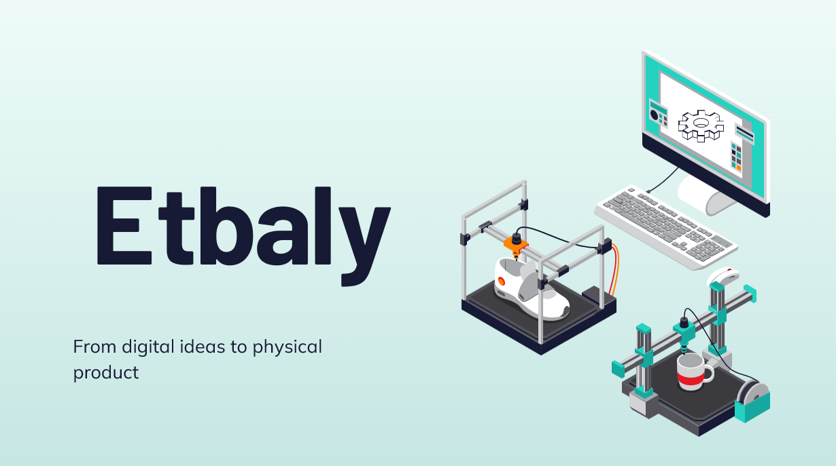
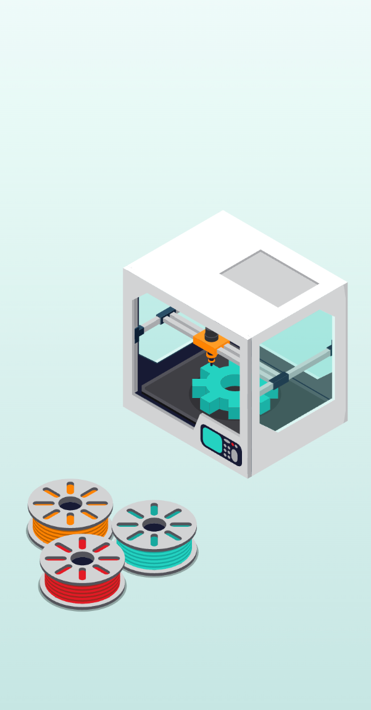
Proposed Solution
Etbaly offers a digital production platform that allows users to design, customize, and order physical products online.
The platform use AI-powered design tools and professional manufacturing to make product creation accessible, flexible, and affordable for individuals, creators, and businesses.

Slide 7
Main Features
AI-Driven Design: Generate unique 3D models from simple text prompts.
Parametric Customization: Easily modify dimensions of existing designs using simple sliders.
Professional File Upload: Upload standard STL/OBJ files for manufacturing.
Automated Analysis & Quote: Instant cost estimation and automatic checks for printability errors (e.g., thin walls).
Interactive 3D Viewer: Visually inspect designs in real-time before ordering.

Slide 8
Uploud-to Quote Flow
First
Next
Next
User uploads STL file to the platform
Node.js server routes to Processing Engine
Blender Script checks for geometric errors
Next
Last
PrusaSlicer CLI calculates exact weight and print time
Instant price is displayed to the user

Slide 9
AI-to-Print Flow
First
Next
Next
User enters text prompt describing desired object
AI Engine generates 3D model from description
Blender Script checks for geometric errors
Next
Last
Decision Gate: Valid models proceed to print queue
Complex models are flagged for professional review

Slide 10
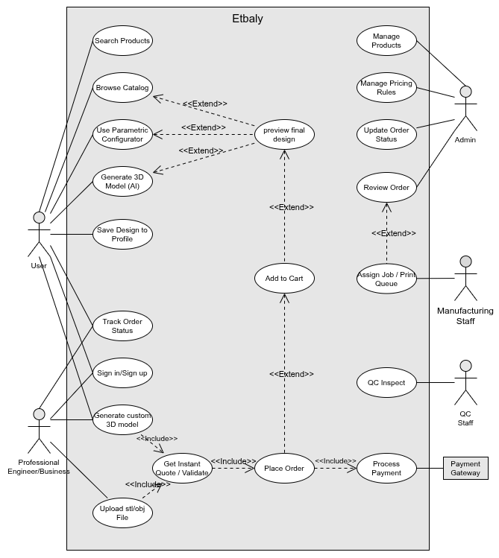
Use Case Diagram
Customers: Browse catalog, use AI tools, preview designs, and track orders.
Professionals: Upload CAD files, validate models, and get instant quotes.
Admins: Manage products, pricing, and oversee order workflows.
Production & QC: Manage print queues and perform quality inspections.
Payment Gateway: Processes secure transactions to finalize the order.

Slide 11
Class Diagram

Slide 12
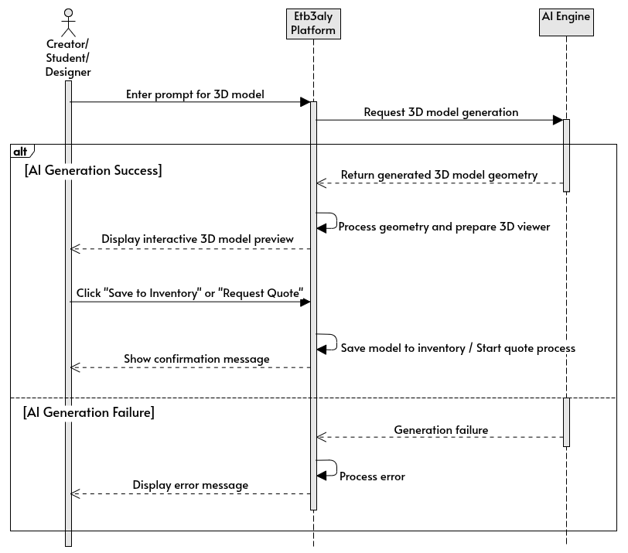
AI 3D Model Generation
User enters a text prompt and selects generation options (style, size, complexity).
System sends the generation request to the backend AI Engine.
AI Engine processes the prompt and generates a 3D representation
Engine converts the generated output into a 3D mesh (STL/OBJ).
System returns the generated model to the platform and displays a 3D preview to the user.
User can save the model, request a quote, or proceed to order.

Slide 13
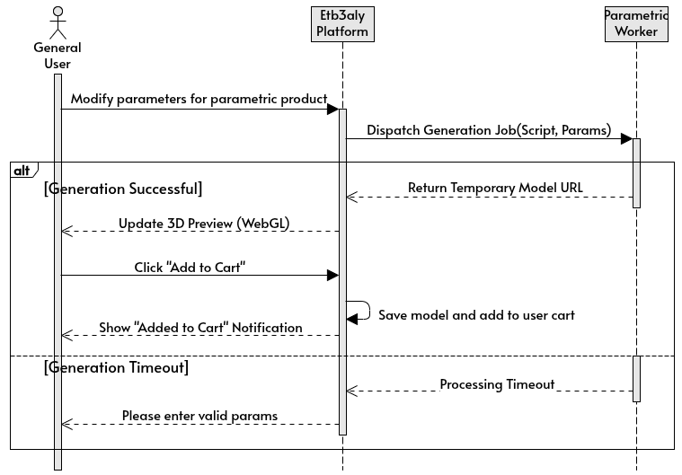
Parametric Modification
User selects a customizable product or 3D model from the platform.
System displays available parameters (e.g., size, height, thickness, color, text).
User modifies the parameters using sliders or input fields.
System sends the new values to the Parametric Engine / Model Processor.
Engine updates the 3D model geometry
System displays an updated real-time 3D preview and recalculates the price.
User confirms changes and proceeds to save, quote, or order.

Slide 14
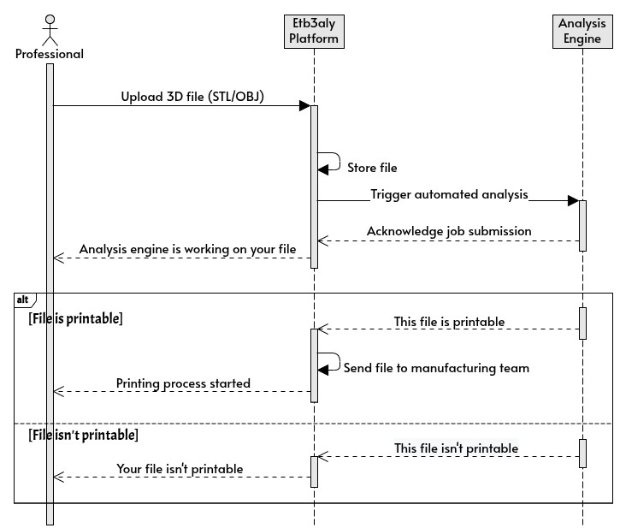
Upload 3D File
User uploads a 3D file (STL/OBJ) through the platform.
System validates the file type and size.
System securely stores the file in the database / object storage.
System triggers an analysis job and sends the file to the backend Analysis Engine.
System notifies the user that the file is being processed.
After analysis, the system updates the file status (printable or not printable).

Slide 15
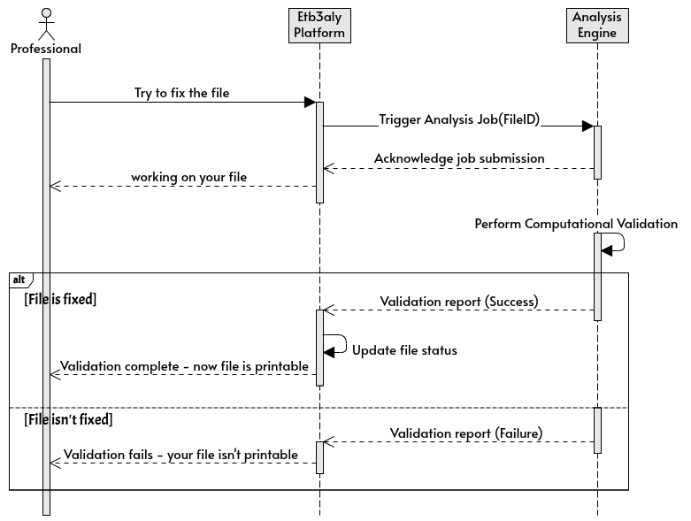
File Analysis
User uploads or tries to fix a 3D file.
System triggers analysis job to the backend engine.
Engine checks geometry for errors: non-manifold edges, holes, inverted normals.
Computes bounding box and minimum wall thickness.
Generates JSON validation report with pass/fail status and repair suggestions.
Alternative Path: Critical topology issues flagged as REQUIRES REPAIR, with automated healing suggestions

Slide 16
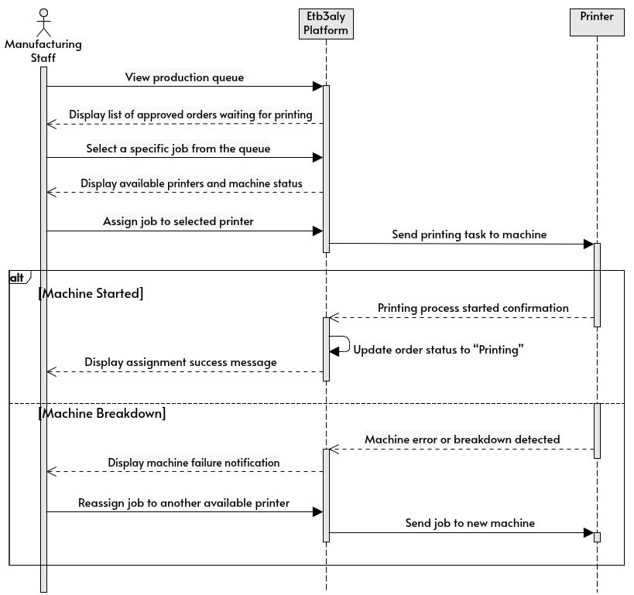
Manage Print Jobs
Manager views the manufacturing queue.
System filters printers based on material and volume constraints.
Manager assigns job to printer.
System sends G-Code to the printer.
Alternative Paths: Hardware exception → Job rolled back to queue with HIGH PRIORITY

Slide 17
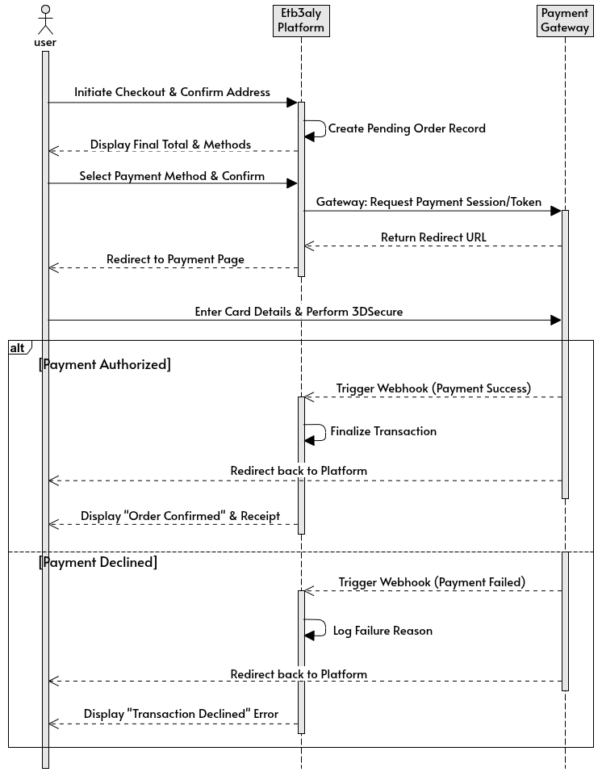
Place Order & Pay
User confirms details, starts checkout.
System calculates total
User selects payment method
System redirects the user to the payment gateway.
User completes authentication and payment.
The Gateway notifies our system instantly (via Webhook) of success.
System updates the Order Status to PAID.
Alternative Scenario: If Payment fails, the transaction rolls back. The order remains in PENDING PAYMENT status

Slide 18
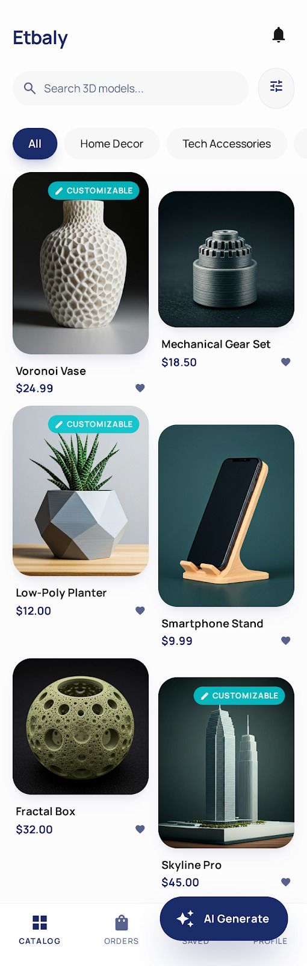
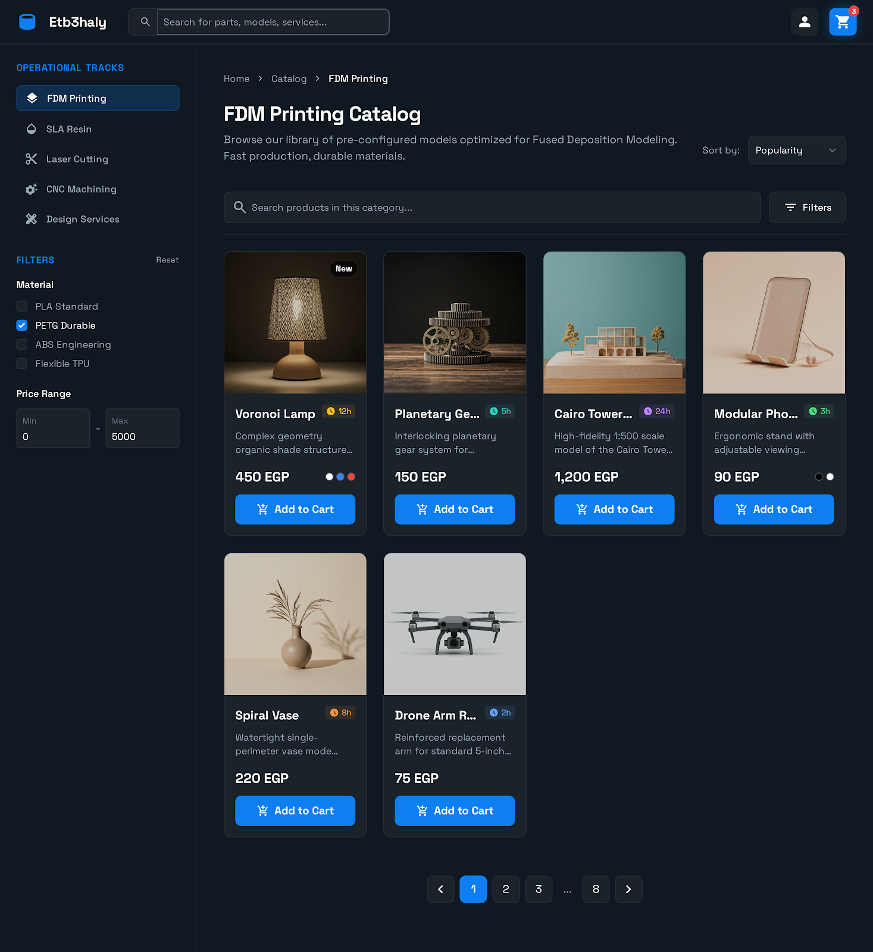
Product Catalog & Marketplace

Slide 19
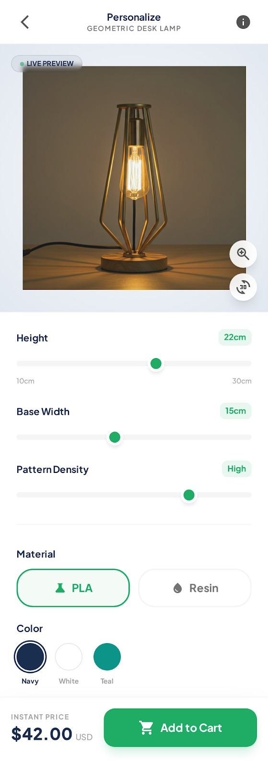
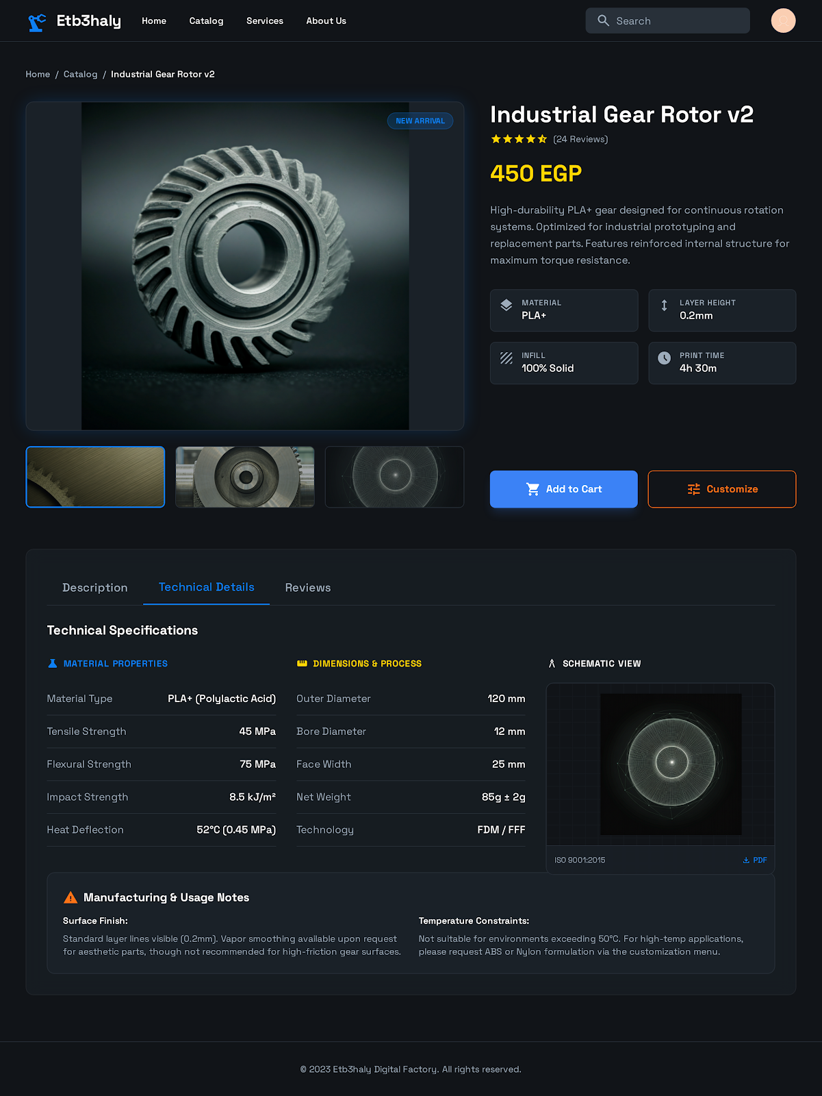
Product Details

Slide 20
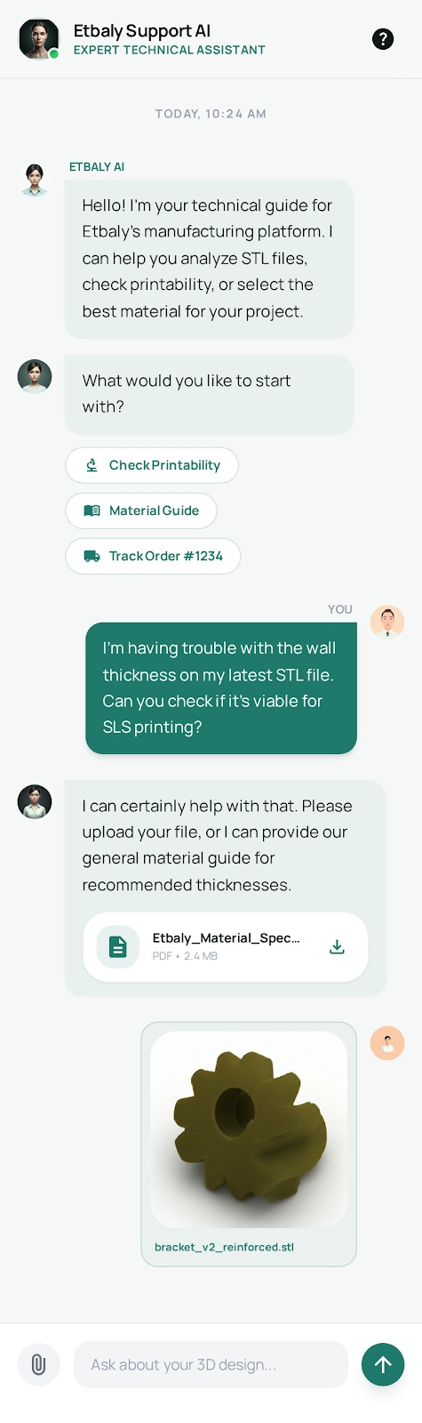
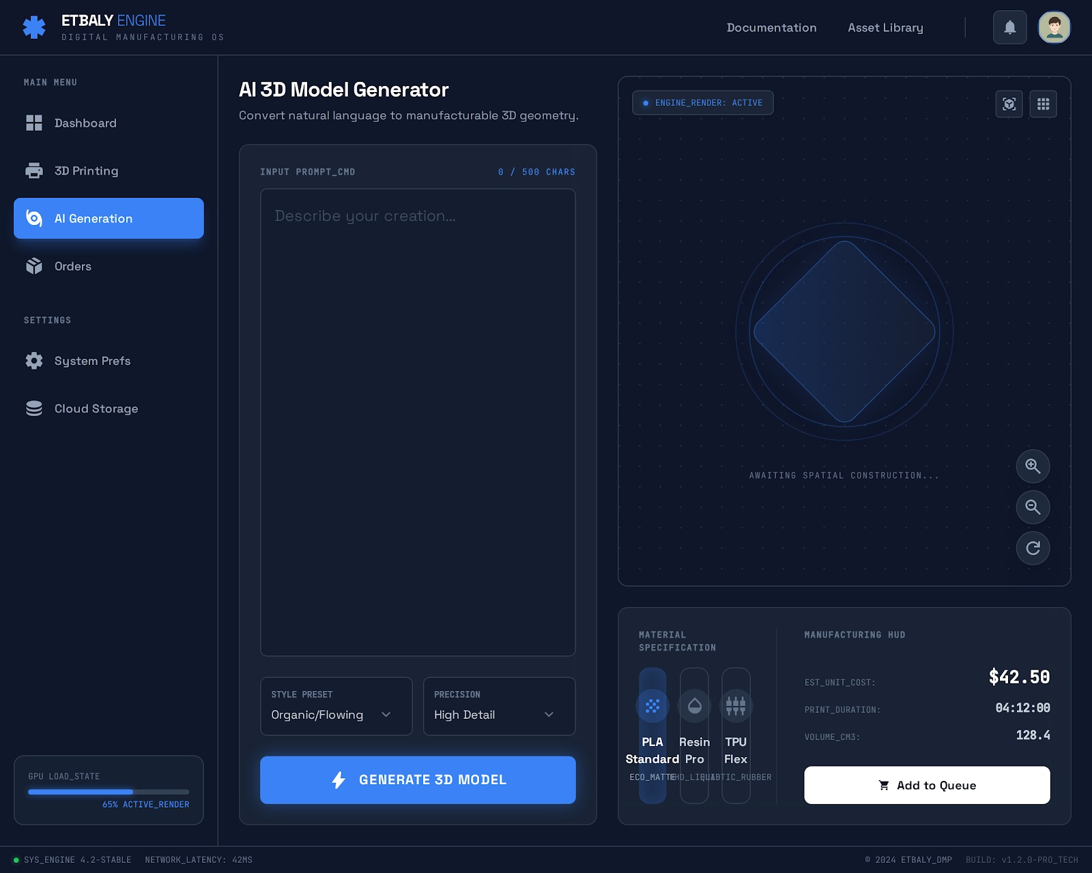
AI Generative Design Lab

Slide 21
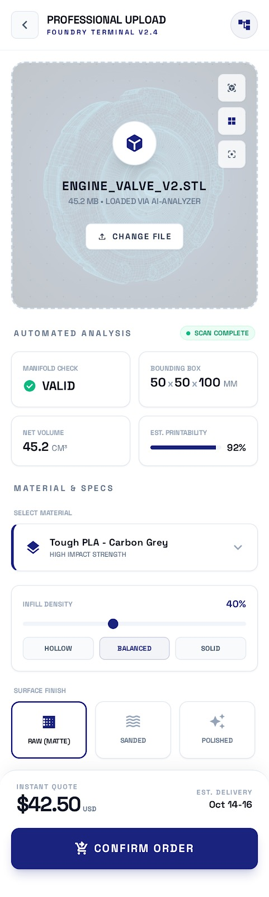
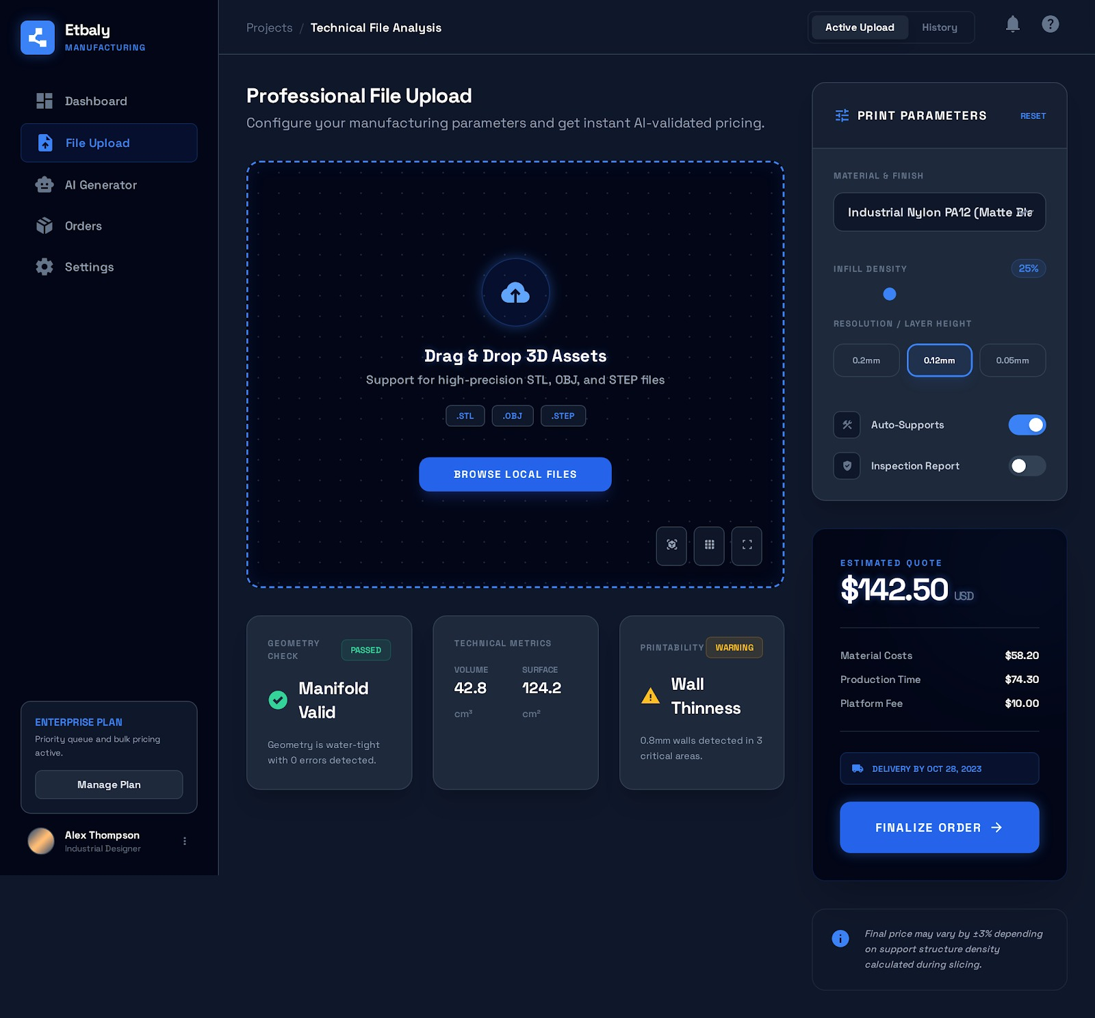
Professional Upload & Instant Quote

Slide 22
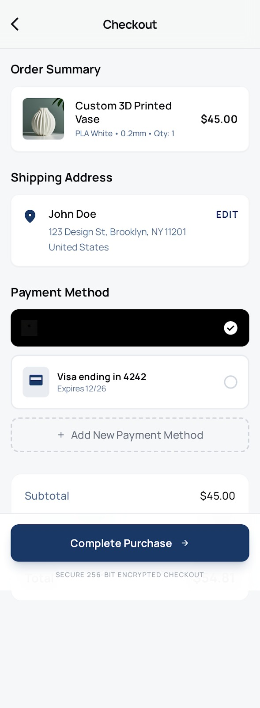
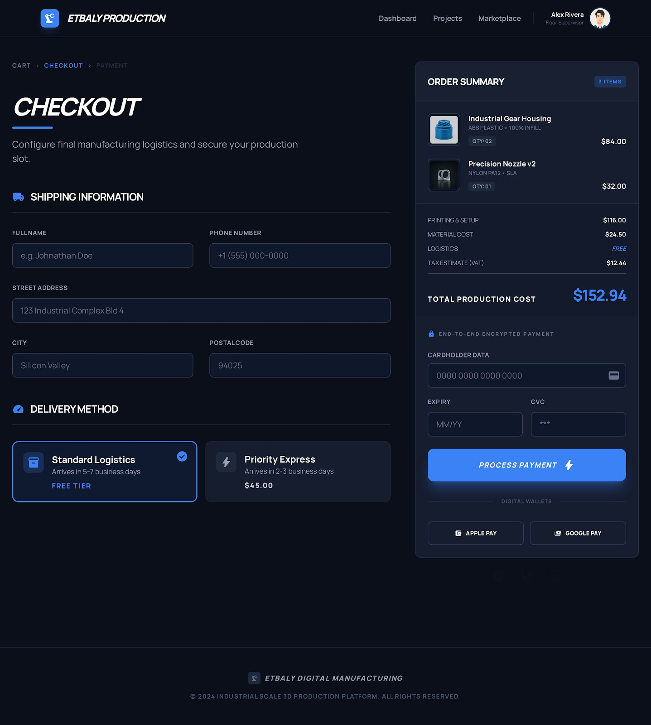
Checkout and Payment

Slide 23









Technical Stack

Slide 24
Conclusion
Etbaly successfully bridges the gap between digital design and physical products
Provides an integrated solution reducing cost, time, and technical barriers
Demonstrates high technical and economic feasibility
Opens new possibilities for accessible digital manufacturing

Slide 25
Thank You!
Presented by:
Yussef Yasser Shaher Mohamed
Basmala Emad Abdelhameed
Nada Azmy Gamal Mostafa
Basmala Hesham Yehia Radwan
Shahd Alaa Fathy Mahmoud
Supervised By:
Dr. Hamada Ibrahim
Eng. Amir Mostafa

