Slide 1


Bresenham's circle algorithm in computer graphics
Circle drawing is a fundamental problem in computer graphics. Let's explore one of the most efficient methods, Bresenham's algorithm.
Presenter By :Dhiraj Kumar Shah

Slide 2
Introduction to Bresenham's Algorithm
Bresenham's algorithm is an incremental method of drawing circles.
Digital Differential Analyzer (DDA)
Midpoint Circle Algorithm
Why Bresenham's Algorithm?
A similar algorithm that uses integer operations.
Another popular circle algorithm that scans for pixel coordinates along the circle.
Bresenham's algorithm has a simpler logic and computational speed advantages over other methods.

Slide 3
Concept and working of Bresenham's circle drawing algorithm
Bresenham's algorithm draws a circle one pixel at a time by choosing the best pixel option for each step. It takes into account the symmetry of the circle.
Decision Variable
Picking the Next Pixel
Coloring the Pixels
A decision variable tracks the error in the estimation of the circle's radius at each step.
The algorithm computes the coordinates of all possible pixels and chooses the one that best approximates the circle at the current step.
The pixels are colored in the process of choosing the best-fit pixel.

Slide 4
Deriving the algorithm with examples
Let's explore the algorithm with an example of drawing a circle from (0, 0) with a radius of 5.
Step 2
x=1, y=5
1
2
3
Step 1
Step 3
x=0, y=5
x=2, y=4

Slide 5

Advantages of using Bresenham's algorithm over other methods
Bresenham's algorithm is the fastest method for drawing circles.
1
Efficient Computation
2
No Floating-Point Division
With incremental calculations and integer-only operations, Bresenham's algorithm is incredibly fast.
Without division operations, which are typically slow on most processors, Bresenham's algorithm is even more efficient.
3
Minimal Memory Storage
Bresenham's algorithm only needs to store a few variables, making it memory-efficient.

Slide 6
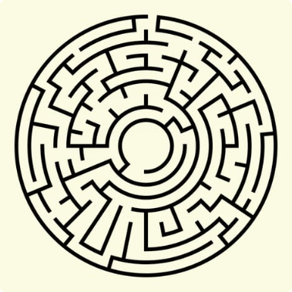
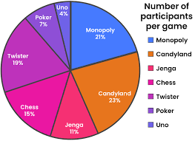

Real-world applications of Bresenham's algorithm in computer graphics
Bresenham's algorithm is used in many applications that need fast and efficient circle drawing.
Games
Machine Learning
Charts and Graphs
Bresenham's algorithm is used extensively in game development, particularly for rendering visual elements like circular bullet trajectories and circular particles.
Bresenham's algorithm can create fan-shaped wedges used in pie charts and graphs.
Bresenham's algorithm is used in image recognition and processing, and 3D graphics modeling.

Slide 7
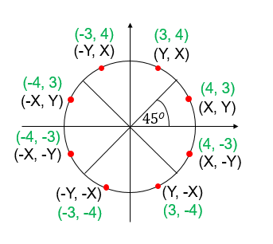



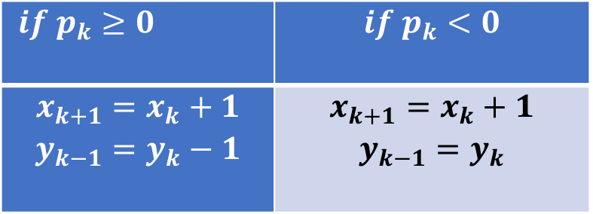
Bresenham's Circle algorithm:
A circle is a symmetrical figure which follows 8-way symmetry
True circle
$$for initial decision parametor at \left(0,r\right)=$$
$if p_{k}≥0$ | $$if p_{k}<0$$
$$x_{k+1}=x_{k}+1$$ $$y_{k−1}=y_{k}−1$$ | $$x_{k+1}=x_{k}+1$$ $$y_{k−1}=y_{k}$$
$$p_{k} =3−2r$$
$${ p}_{k+1}={ p}_{k}+4x_{k}+6 when p_{k}<0$$
${ p}_{k+1}={ p}_{k}+4{(x}_{k}−y_{k})+10 when p_{k}≥0$

Slide 8
Q.N : 1
Find circle Co-ordinates using Bresemhan’s Circle Algorithm Where r = 5 and Plot into Graph.
Finally <Co-ordinates of Circle are
(0, 5) (1, 5) (2, 4) (3, 3)
(0, -5) (1, -5) (2, -4) (3, -3)
(-0, -5) (-1, -5) (-2, -4) (-3, -3)
(-0, 5) (-1, 5) (-2, 4) (-3, 3)
Solution :
Given radius of Circle is r=5,
Let us Suppose Circle from origin (0,0) and y-axis(0, r)
Now,
We calculate Next Point decision Parameter P_{K}
P_{K} = 3-2r = 3-2*5= -7
P1=P_{K+1} = P_{K} +4*x+6= -7+4*1+6= 3
P3=P_{K+1} = P_{K} +4*( x_{k} – y_{k} )+10= 3+4*(2-4)+10= 5
Now, We Compute decision Table
X Y P_{k}
0 5 -7<0
1 5 3>0
2 4 5>0
3 3

Slide 9

Conclusion and future scope
Bresenham's algorithm helps us draw circles efficiently and has many applications in the field of computer graphics. This algorithm's future scope opens up possibilities for more efficient circle-drawing methods and faster computing.

Slide 10



Thanks!
Do you have any questions? dtisp2020@gmail.com
Project link on git
Personal details

