Slide 1

Artificial Intelligence
By: John McCormack, Brian Padilla, and Dharmin Shah

Slide 2

Quality and Important factors in AI
A quality artificial intelligence program should complete its tasks in a timely manner
Reliability means that the software should rarely produce the wrong answer.
Next is the durability of the program, which entails minimizing the chance of the program crashing.

Slide 3

Quality Assurance Processes currently used
Dynamic testing:
Sensitivity analysis
Statistical analysis & measures
Regression and automated testing
Static testing:
Anomaly detection
Structured walk-throughs

Slide 4
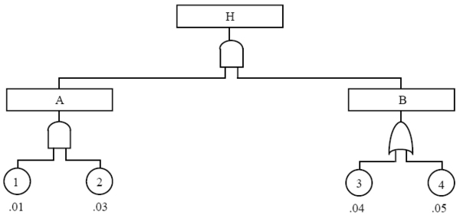
Suggested Quality Assurance processes
Symbolic Testing: The idea is to allow program variables to take symbolic values and to evaluate the functions computed by program statements symbolically also.
Fault-Tree Analysis: The goal of fault-tree analysis is to show that the logic contained in the software design will not produce system safety failures, and to determine environmental conditions which could lead to the software causing a safety failure.

Slide 5
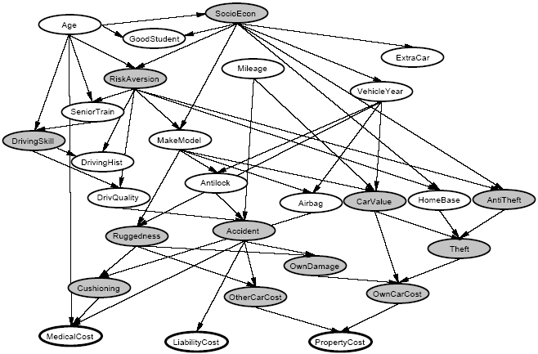
Regulation/Standards in AI
Bayesian Regulation/Networks: Bayesian networks (BNs), also known as belief networks (or Bayes nets for short), belong to the family of probabilistic graphical models (GMs).
BN’s are primarily used for building Artificial Neural Networks (ANN). ANNs are used in the financial sector to predict the performance of stock market, and they are also used in medical field to perform diagnosis and analysis on reports.

Slide 6

Successes in AI
DXplain is an example of one of these clinical decision support systems, developed at the Massachusetts General Hospital.
The PUFF system for automatic interpretation of pulmonary function tests has been sold in its commercial form to hundreds of sites world-wide.
Watson is an artificial intelligence computer system capable of answering questions posed in natural language, developed in IBM's DeepQA.

Slide 7

Failures in AI
The United States government's Strategic Computing Initiative.
The fall of expert systems: By the early 90s, the earliest successful expert systems, such as XCON, proved too expensive to maintain.
The fizzle of the fifth generation: In 1981, the Japanese Ministry of International Trade and Industry set aside $850 million for the Fifth generation computer project.

Slide 8

Problems with Quality Assurance in AI
The problem with requirements and specifications for AI software is that generally there aren't any—so failures in fielded AI systems may go unnoticed because those using them have no idea what the “correct" behavior should be.
The problems of dynamic testing for AI software are similar: it may not be clear whether or not the outcome of a particular test is satisfactory.

Slide 9
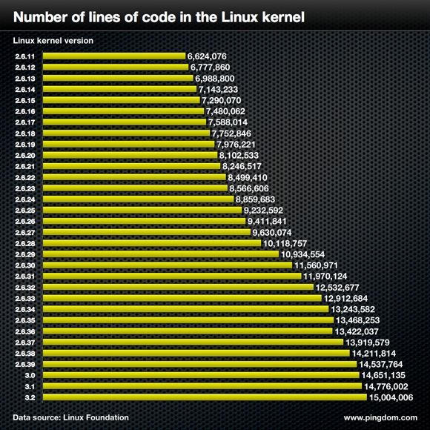
Metrics Used in AI
Size Metrics: It seems eminently plausible that the effort required to construct a piece of software is strongly influenced, if not fully determined, by its final size, and that its reliability will be similarly influenced.
Cost and Effort Metrics: Cost and effort metrics attempt to measure, or predict, the eventual size of a program, the cost required to construct it, the “effort" needed to understand it.
Complexity Metrics: Complexity metrics attempt to quantify the “difficulty” of a program. The simplest complexity metric is the decision count, denoted DC which can be defined as the number of “diamonds" in a program's flow chart.

Slide 10
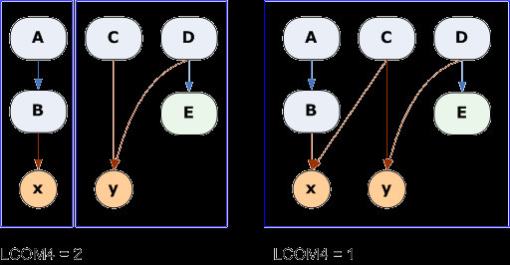
Metrics Suggested
Cohesion Metric: For a cohesion metric, construct a flow graph for the module. Each vertex in the graph is an executable statement, and for each node in the graph record the variables referenced in statement.

