Slide 1

Artificial Intelligence
By: John McCormack, Brian Padilla, and Dharmin Shah

Slide 2

Quality and Important factors in AI
A quality artificial intelligence program should its tasks in a timely manner
Another factor is reliability. Reliability means that the software should rarely produce the wrong answer. The higher the probability of AI software to produce correct results, the more reliable it is.
Next is the durability of the program, which entails minimizing the chance of the program crashing.

Slide 3

Quality Assurance Processes currently used
Dynamic testing:
1. Sensitivity analysis: Used to determine whether very similar inputs can produce wildly different outputs.
2. Statistical analysis & measures: When an AI system is evaluated against human experts the outcome may not be clear cut and it may be desirable to use statistical techniques to provide quantitative measures of relative performance.
3. Regression and automated testing: It is important to perform regression tests in order to ensure that modifications do not adversely change the system's behavior on examples encountered previously.
Static testing:
1. Anomaly detection: Anomaly detection depends crucially on the presence of redundancy in programs. An anomaly in a program is nothing more than an apparent conflict between one indication of intent or purpose and another: for example, a programmer declares a variable as an integer, but assigns a string value to it
2. Structured walk-throughs: Structured walk-throughs entail an informal, but highly detailed, manual examination of program code, specifications or requirements.

Slide 4
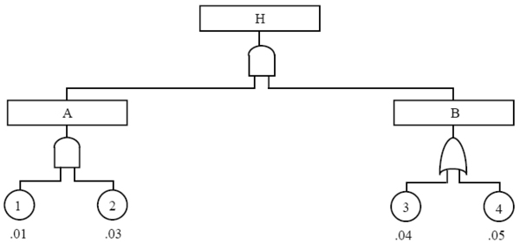
Suggested Quality Assurance processes
Symbolic Testing: It constitutes a systemic technique for generating information about the inner workings of a program. The idea is to allow program variables to take symbolic values and to evaluate the functions computed by program statements symbolically also. The output produced by a symbolic execution system consists of the symbolic values accumulated in its variables through execution of a selected path. The programmer can compare these values with those expected.
Fault-Tree Analysis: The goal of fault-tree analysis is to show that the logic contained in the software design will not produce system safety failures, and to determine environmental conditions which could lead to the software causing a safety failure.

Slide 5
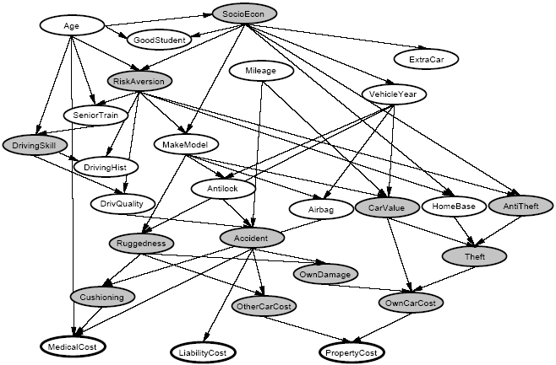
Regulation/Standards in AI
Bayesian Regulation/Networks: Bayesian networks (BNs), also known as belief networks (or Bayes nets for short), belong to the family of probabilistic graphical models (GMs). These graphical structures are used to represent knowledge about an uncertain domain. In particular, each node in the graph represents a random variable, while the edges between the nodes represent probabilistic dependencies among the corresponding random variables.
BN’s are primarily used for building Artificial Neural Networks (ANN). ANNs are used in the financial sector to predict the performance of stock market, and they are also used in medical field to perform diagnosis and analysis on reports.

Slide 6

Successes in AI
DXplain is an example of one of these clinical decision support systems, developed at the Massachusetts General Hospital. It is used to assist in the process of diagnosis, taking a set of clinical findings including signs, symptoms, laboratory data and then produces a ranked list of diagnoses. It provides justification for each of differential diagnosis, and suggests further investigations.
The PUFF system for automatic interpretation of pulmonary function tests has been sold in its commercial form to hundreds of sites world-wide.
Watson is an artificial intelligence computer system capable of answering questions posed in natural language, developed in IBM's DeepQA project by a research team led by principal investigator David Ferrucci. Watson was named after IBM's first president, Thomas J. Watson. Watson received the first prize of $1 million.

Slide 7

Failures in AI
The United States government's Strategic Computing Initiative funded research into advanced computer hardware and artificial intelligence from 1983 to 1993. The initiative was designed to support various projects that were required to develop machine intelligence in a prescribed ten-year time frame, from chip design and manufacture, computer architecture to artificial intelligence software.
The fall of expert systems: By the early 90s, the earliest successful expert systems, such as XCON, proved too expensive to maintain. Another problem dealt with the computational hardness of truth maintenance efforts for general knowledge.
The fizzle of the fifth generation: In 1981, the Japanese Ministry of International Trade and Industry set aside $850 million for the Fifth generation computer project. Their objectives were to write programs and build machines that could carry on conversations, translate languages, interpret pictures, and reason like human beings. By 1991, the impressive list of goals penned in 1981 had not been met. Indeed, some of them had not been met in 2001, or 2011. As with other AI projects, expectations had run much higher than what was actually possible.

Slide 8

Problems with Quality Assurance in AI
All the techniques for software reliability estimation and for dynamic testing (and, for that matter, mathematical verification) depend on the availability of requirements and specification documents at least to the extent that it is possible to determine whether a program has experienced a failure.
The problem with requirements and specifications for AI software is that generally there aren't any—so failures in fielded AI systems may go unnoticed because those using them have no idea what the “correct" behavior should be.
The problems of dynamic testing for AI software are similar: it may not be clear whether or not the outcome of a particular test is satisfactory.

Slide 9
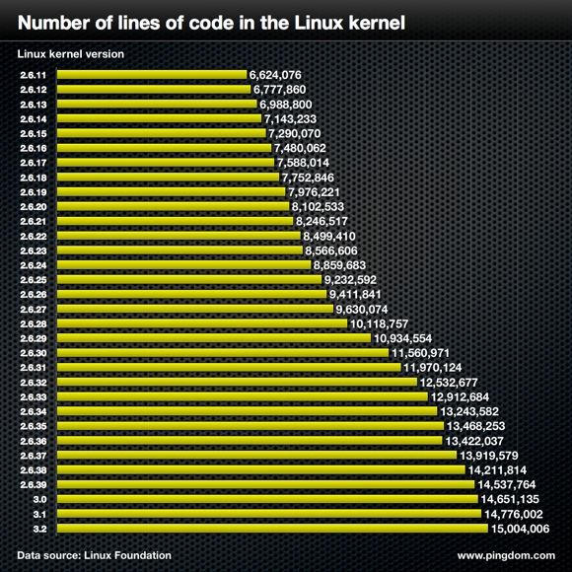
Metrics Used in AI
Size Metrics: It seems eminently plausible that the effort required to construct a piece of software is strongly influenced, if not fully determined, by its final size, and that its reliability will be similarly influenced. A line of code is counted as any non-blank, non-comment line, regardless of the number of statements or fragments of statements on the line. The basic unit of program length is the “SLOC," a single “Source Line of Code."
Cost and Effort Metrics: Cost and effort metrics attempt to measure, or predict, the eventual size of a program, the cost required to construct it, the “effort" needed to understand it, and other such interesting and important attributes.
Complexity Metrics: Complexity metrics attempt to quantify the “difficulty” of a program. The simplest complexity metric is the decision count, denoted DC which can be defined as the number of “diamonds" in a program's flow chart. A good approximation to DC can be obtained by counting the number of conditional and loop constructs in a program.

Slide 10
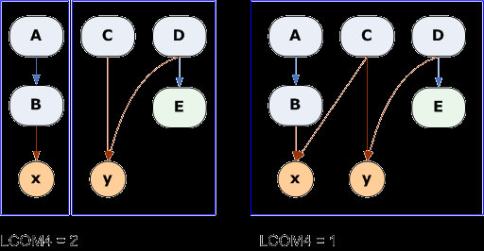
Metrics Suggested
Cohesion Metric: For a cohesion metric, construct a flow graph for the module. Each vertex in the graph is an executable statement, and for each node in the graph record the variables referenced in statement. Then determine how many independent paths of the module go through the different statements. If a module has high cohesion, most of the variables will be used by the statements in most paths. Highest cohesion is when all the independent paths use all the variables in the module.

