Slide 1



Social Media Usage Data Analysis
Names
Maya Hesham
Salma Gamal
Ahmed Alaa
Shahd Abdelmoamen
Mahmoud Kossay
Supervised By
DR Amal Mahmoud

Slide 2
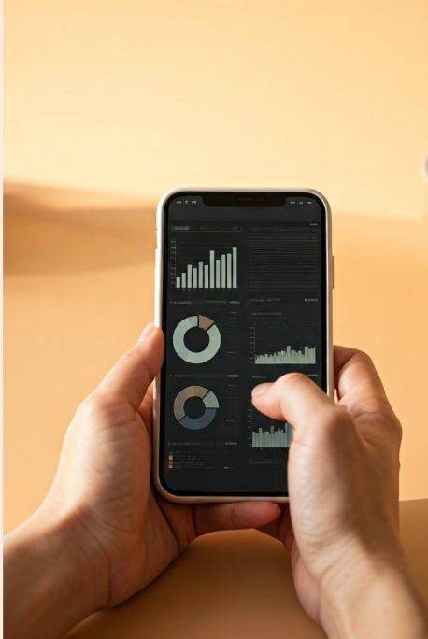
Introduction
Our project focuses on analyzing social media usage patterns using data from platforms like TikTok, Instagram, YouTube, and Facebook. As a team of five, each member used a different data analysis tool: SQL, R, Excel, Tableau, and Python. The goal was to understand user behavior, platform usage, and provide actionable insights for content strategy and healthier social media practices.

Slide 3
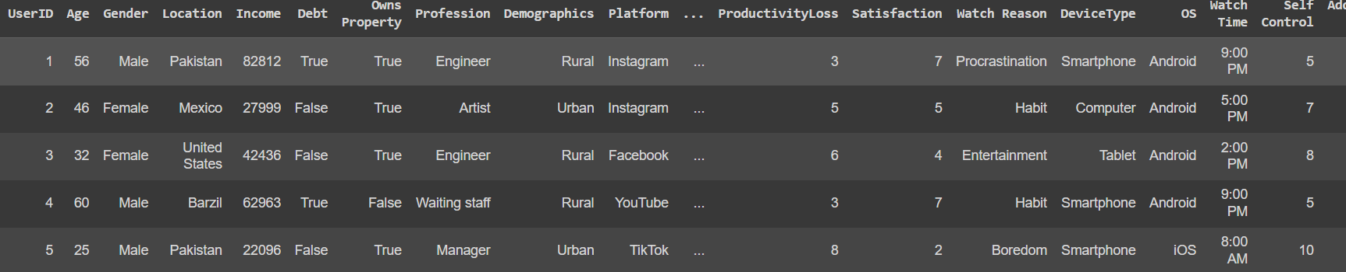
Overview of the Project
Dataset Overview:
We analyzed social media usage data including watch times, viewing habits, user demographics, and satisfaction levels across platforms.
The dataset covered key user activities, including time spent on platforms, device preferences, and content types.

Slide 4
Overview of the Project
Dataset Overview:
Demographics
Behavioral Metrics
Device Usage
User Engagement
Age, gender, location, income, and debt provide insights into user demographics, allowing for targeted marketing and content personalization.
Productivity loss, satisfaction, and addiction level reveal user engagement patterns, helping understand the impact of social media on users' lives.
DeviceType, operating system, and watch time provide information about how users access social media, enabling platform optimization and targeted advertising.
Watch reason, current activity, connection type, platform, and total time spent highlight user preferences and engagement levels, informing content strategies and platform features.

Slide 5
Overview of the Project
Dataset Overview:
Demographics
Age
Gender
Location
Income and Debt
Understanding user age distribution helps target specific age groups with relevant content and advertising.
Gender analysis reveals preferences and engagement patterns, allowing for tailored marketing strategies.
Analyzing user locations helps identify regional trends, tailor content to local interests, and optimize advertising campaigns.
Understanding user income and debt levels helps tailor product offerings and marketing messages to different socioeconomic groups.

Slide 6
Overview of the Project
Dataset Overview:
Device Usage
1
DeviceType
This data reveals how users access social media, whether on phones, tablets, or computers.
2
OS
Knowing the operating system helps tailor content and advertising to different platforms.

Slide 7




Overview of the Project
Dataset Overview:
Watching Details
Watch Reason
Current Activity
Understanding why users watch content helps personalize recommendations and optimize content creation.
Knowing what users are doing while watching helps understand
Connection Type
Platform
Analyzing connection type provides insights into user location and device usage.
Platform usage data informs content distribution strategies and platform optimization.

Slide 8
Overview of the Project
Dataset Overview:
Behavioural Metrics
Productivity Loss
Satisfaction
Track time spent on social media to understand how it impacts users' work or studies.
Measure user satisfaction with social media experiences, gauging positive and negative feelings.
Addiction Level
Self Control
Analyze user behavior patterns to identify signs of excessive social media usage
Analyze Key Characteristics of users of higher self Control

Slide 9

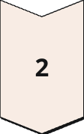

Overview of the Project
Process Overview:
Data Collection and ETL Process
Gather social media data from Kaggle then perform Extraction ,transformation then loading
Data Understanding
understand the data that we will analyze and its key features
Data Cleaning and Data Analysis
Apply statistical methods and visualization tools to uncover insights, patterns, and trends.

Slide 10
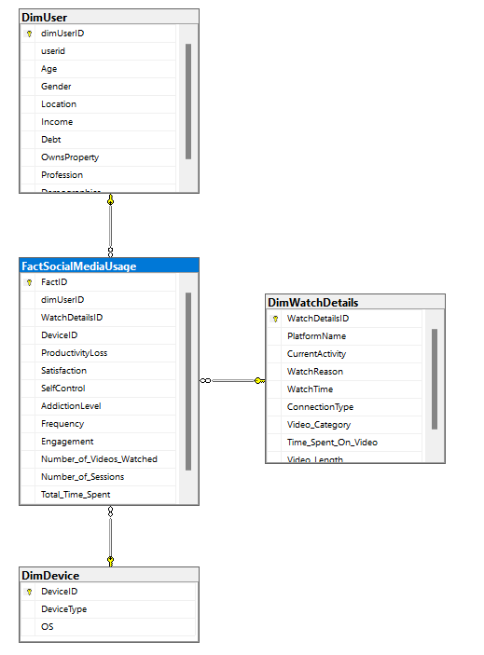
Overview of the Project
Database Schema(Star Schema):

Slide 11

Data Analytics Tools Overview
SQL
R
Python
We used SQL for extracting,
transforming,and analyzing
structured data loaded in fact and dimensions.
R was used for performing statistical analyses and visualizations to gain insights into social media usage patterns
Used for data cleaning, EDA, analyzing user behavior, and visualizing patterns to uncover
social media wasted time.
Tableau
Excel
Tableau was used to create interactive dashboards with slicers for deeper insights and dynamic data visualization.
Excel was used to analyze data and create interactive dashboards to visualize key metrics and insights from the data.
.
.

Slide 12
Analysis Details
Apply Statistical Methods
Objective: Analyze The Data Statistically
Techniques:
Identify Outliers: Detect and analyze outliers to understand their impact on the dataset.
Assess Correlation: Evaluate the relationships between variables to uncover significant correlations.
Examine Data Distribution: Analyze the distribution of data to determine its characteristics (e.g., normality, skewness) and inform further modeling decision.
Insights: Present significant statistical findings and deal with it

Slide 13
Analysis Details
Data Cleaning
Objective: Ensure data quality for accurate analysis.
Techniques:
Removing Duplicates:Check and eliminate if found.
Handling Missing Values: Apply strategies like imputation or removal.
Standardizing Data Formats: Ensure consistency in data types and formats.
Outcome: A clean dataset ready for analysis, improving reliability and validity of results.

Slide 14
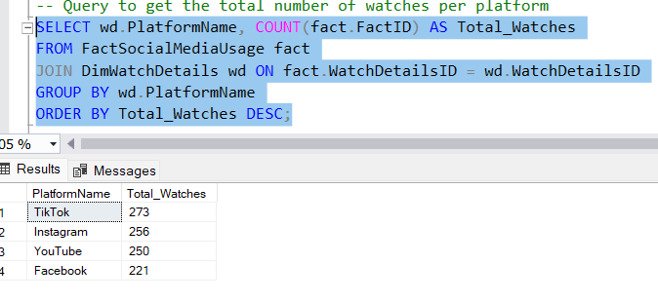
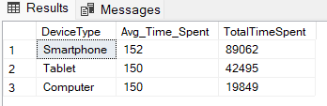
Analysis Details
Insights
Platform & Device Usage Insights
Platform Usage: TikTok leads as the most popular platform.
Device Usage: Smartphones dominate as the primary device for content consumption, with the highest session count.

Slide 15
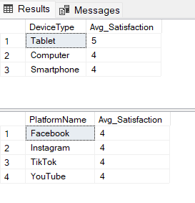
Analysis Details
Insights
Satisfaction Levels
Device Satisfaction: Tablets have higher user satisfaction due to larger screen size.
Platform Satisfaction: Average satisfaction across platforms is 4, indicating room for improvement.

Slide 16
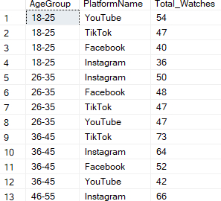
Analysis Details
Insights
Age Group Preferences
Younger (18-25): YouTube is the top platform, followed by TikTok.
Mid-Age (26-45): Instagram leads for 26-35; TikTok and Instagram dominate for 36-45.
Older (46-65): Instagram is most popular for 46-55, while YouTube tops the 56-65 group.

Slide 17
Analysis Details
Insights
Age Group Preferences
Younger (18-25): YouTube is the top platform, followed by TikTok.
Mid-Age (26-45): Instagram leads for 26-35; TikTok and Instagram dominate for 36-45.
Older (46-65): Instagram is most popular for 46-55, while YouTube tops the 56-65 group.

Slide 18
Any
Questions?

Slide 19
ETL Process
Extract
Transform
Load
DataSet is extracted From CSV into The sql Server Database to Perform the Complete ETL
Made changes or transformation needed to be done in the data
built the Schema Structure and loaded the data into three dimension
user,watch details and device then loaded the fact table
Reference: https://www.kaggle.com/datasets/muhammadroshaanriaz/time-wasters-on-social-media

Slide 20
Process in analyzing Data: Turn the number to valuable insights
Data Collection and ETL Process
Gather social media data from Kaggle then perform Extraction ,transformation then loading
Data Understanding
understand the data that we will analyze and its key features
Data Cleaning and Data Analysis
Apply statistical methods and visualization tools to uncover insights, patterns, and trends.

Slide 21
Data Analysis Focus
Data Analysis Focus
3. Content Preferences & Watch Habits:
Evaluating video categories, reasons for watching, and time spent
Identify trends in user behavior across different platforms.

Slide 22
Data Analysis Focus
2. User Demographics:
Explored user behaviors segmented by age groups, income levels, and gender.
Assessed productivity loss, addiction levels, and satisfaction across different demographics.

Slide 23
Data Analysis Focus
Data Analysis Focus
Data Analysis Focus
4. Productivity & Well-being:
Measuring productivity loss, self-control, and addiction levels to assess the impact of social media on user well-being.
Help identify the negative effects of excessive social media use on mental health and personal development.

Slide 24
Process in analyzing Data: Turn the number to valuable insights
Data Collection and ETL Process
Gather social media data from Kaggle then perform Extraction ,transformation then loading
Data Understanding
understand the data that we will analyze and its key features
Data Cleaning and Data Analysis
Apply statistical methods and visualization tools to uncover insights, patterns, and trends.

Slide 25
Process in analyzing Data: Turn the number to valuable insights
Data Collection and ETL Process
Gather social media data from Kaggle then perform Extraction ,transformation then loading
Data Understanding
understand the data that we will analyze and its key features
Data Cleaning and Data Analysis
Apply statistical methods and visualization tools to uncover insights, patterns, and trends.

Slide 26
Data Analysis Focus
Platform and Device Usage
Analyzed user engagement across various platforms (TikTok, Instagram, YouTube, Facebook).
Identified device preferences (Smartphones, Tablets, Computers) and their impact on user experience and satisfaction levels.

Slide 27


Behavioral Metrics: Productivity Loss, Satisfaction, Addiction Level,Self Control
Productivity Loss
Satisfaction
Track time spent on social media to understand how it impacts users' work or studies.
Measure user satisfaction with social media experiences, gauging positive and negative feelings.
Addiction Level
Self Control
Analyze user behavior patterns to identify signs of excessive social media usage
Analyze Key Characteristics of users of higher self Control

Slide 28
Analysis Details
Data Exploration
Objective: Understand data structure and identify patterns or trends.
Techniques:
Visualization: Use graphs (histograms, scatter plots) to illustrate distributions and relationships.
Reports: Use SQL Queries to discover trends
Pivot Tables: Use Excel Pivots to discover patterns in data
Insights: Highlight any initial findings that inform further analysis.

