Slide 1
UART Protocol
Presented by:
Shahd Mohamed.

Slide 2
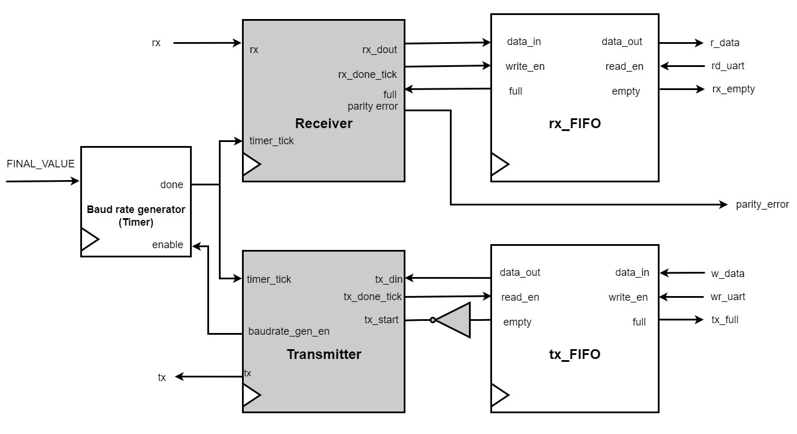
UART Design

Slide 3
timer_tick_counter < STOP_BIT_TICKS-1
tx_start =0
Transmitter FSM Diagram
IDLE
tx_start = 0
STOP
tx_start = 1
timer_tick_counter < TICKS_PER_DATABIT-1
tx_start = 1
START
DATA
PARITY
timer_tick_counter < TICKS_PER_DATABIT-1
sent_bits_counter < DATA_BITS-1

Slide 4
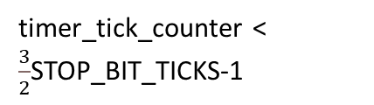
timer_tick_counter < $\frac{3}{2}$STOP_BIT_TICKS-1
rx = 1
IDLE
rx = 1
STOP
Receiver
FSM Diagram
rx = 0
rx = 0
timer_tick_counter < TICKS_PER_DATABIT-1
START
DATA
PARITY
timer_tick_counter < (TICKS_PER_DATABIT-1)/2
received_bits_counter < DATA_BITS -1

Slide 5
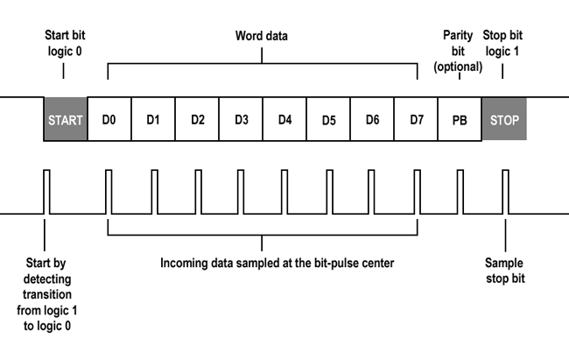
Oversampling Technique
UART is implemented using the oversampling technique to ensure that each data is read at the pulse center.
This technique enhances the reliability and accuracy of data reception.
This is achieved by using the baud rate generator block, where the receiver block counts the number of ticks it requires to reach the middle of every bit then sample the data.

Slide 6
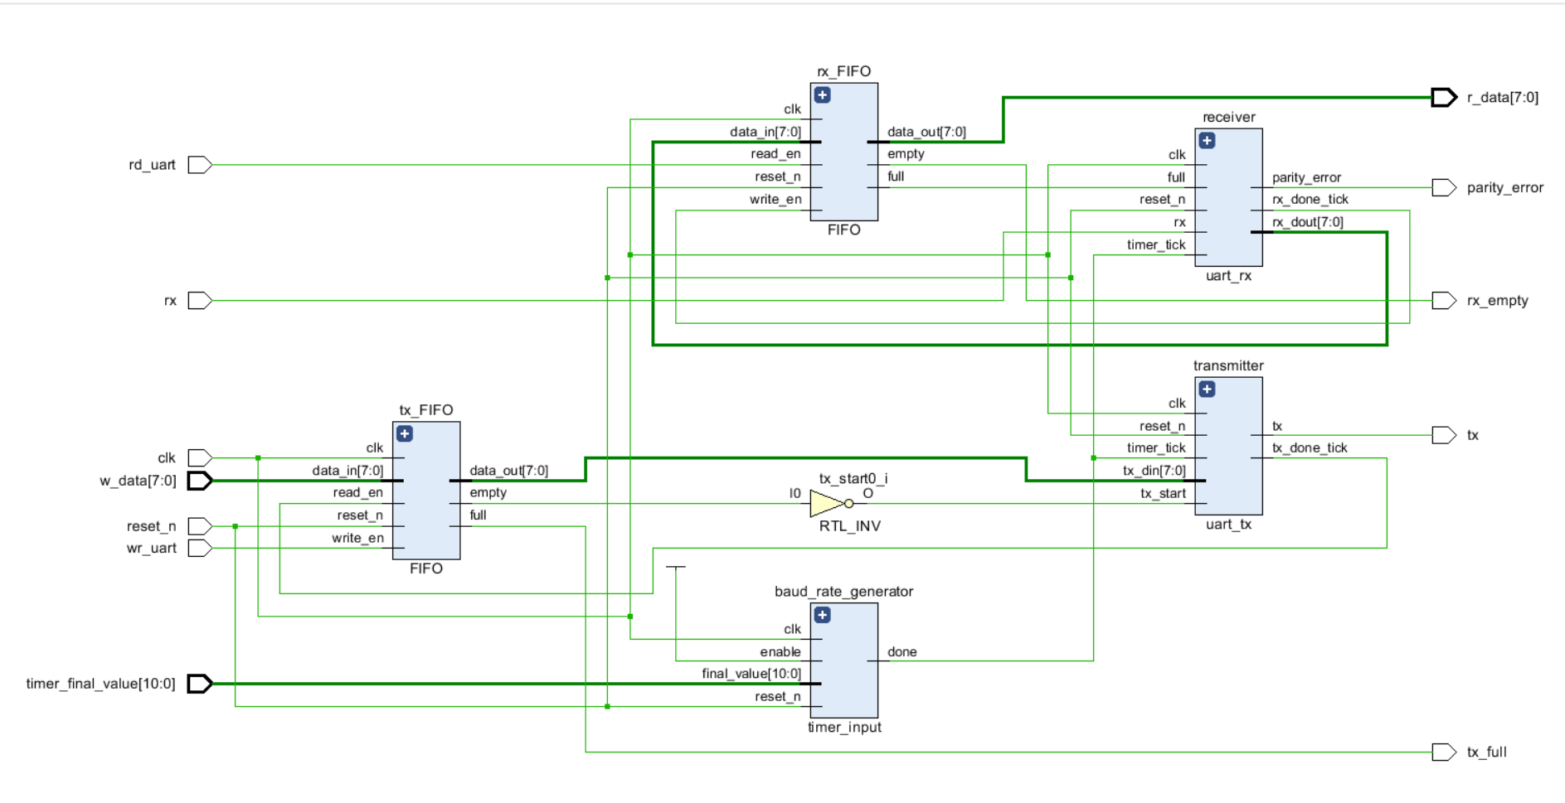
Elaborated Design Using Vivado

