Slide 1
Python

Slide 2
Intro
What is Programming: Instructions have given to machine to do some tasks using Programming languages.
.
Programming languages: It is a way of communication that humans understand because it is close to human language converted inside the machine into 0 , 1

Slide 3
Types of Programming languages
Low level , High level
Interpreted , Compiled
Programming ,Scripted
Open source , not open source
Support OOP , not supporting OOP

Slide 4
What’s Python?
Python has a simple, easy to learn syntax, which emphasizes readability. Applications written in Python can run on almost any computer, including those running Windows, macOS, and popular distributions of Linux. Furthermore, the ecosystem contains a rich set of development tools for writing, debugging, and publishing Python applications.
Python is one of the most popular and fastest growing programming languages in the world. It's used for all sorts of tasks, including web programming and data analysis, and it has emerged as the language to learn for machine learning.

Slide 5
Con.
Python is one of the most popular programming languages in the world. Created in the early 1990s, Python can be employed for a wide range of uses, from automating repetitive tasks and writing web apps to building machine learning models and implementing neural networks. Researchers, mathematicians, and data scientists in particular like Python because of its rich and easy to understand syntax and the wide range of open-source packages available..
An easy programming language, with powerful programming capabilities.

Slide 6
Con.
Interpreted language
Not Compiled to a binary form of machine language.
Interpreter converts the code to binary ‘on the fly’ at each time it is run. (Slower)

Slide 7
Why Python?
Easier syntax, more readable, shorter programs.
Has large libraries of various built-in functions.
Portable, runs on Unix, Mac, and windows.
Scalable, used for small and large programs.
Interactive, can write and test programs from terminal.

Slide 8
Indentation (very important)
Indentation is one of the greatest future in python.
It’s free(open source)
Downloading and installing Python is free and easy Source code is easily accessible.
Python is object-oriented
Structure supports four concepts

Slide 9
It’s powerful
Library utilities
Third party utilities(Numeric,Numpy,Pandas)
It’s easy to use
It’s easy to learn

Slide 10
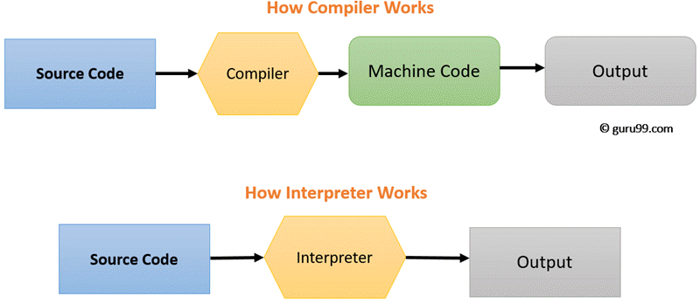
Compiler vs Interpreter

Slide 11
Compiler vs Interpreter
Compiler transforms code written in a high-level programming language into the machine code, at once, before program runs, whereas an Interpreter coverts each high-level program statement, one by one, into the machine code, during program run.
Compiled code runs faster while interpreted code runs slower.
Compiler displays all errors after compilation, on the other hand, the Interpreter displays errors of each line one by one.
Compiler takes an entire program whereas the Interpreter takes a single line of code

Slide 12
Installing Python
https://www.python.org/downloads/
PyCharm
https://www.jetbrains.com/pycharm/download/#section=windows
OR->>> Anaconda
https://www.anaconda.com/products/distribution/start-coding-immediately

Slide 13
Interactive Programming
_{>>> print(“Hello world!”)}
_{Hello world!}
Python as Calculator
_{>>> 5+5}
₁₀
_{>>> 10.5-2*3}
_{4.5}
_{>>> 10**2}
100 ** is used to calculate powers
_{>>> 17.0 // 3}
5.0 floor division discards the fractional part
_{>>> 17 % 3}
2 the % operator returns the remainder
_{>>> 5 * 3 + 2}
17 * takes precedence over +, -

Slide 14
Variables
Variables are containers that store numbers, strings, and other data types and structures.
Variables are names given to values that can be changed.
Variables are assigned values using the equal sign (=).
_{>>> first_name = ’Ali'}
>>> dna_sequence = "gtcgcctaaccgtatatttttcccgt"
A variable cannot be used if not assigned a value, an error occurs.
_{>>> dna}
NameError: name 'dna' is not defined

Slide 15
Variables
Naming
Select meaningful names: _{first_name} , is better than x.
Follow naming rules:
Case-sensitive :
one = 1
oNe = 1
One= 1
Consists of letters and numbers combinations, and underscore.
One1, one_1, one.
Numbers should not be the first letter.
Invalid: 1one
No special characters.
one#, one@1

Slide 16
Variables
Assigning values to variables
_{>>> a=3}
_{>>> a}
₃
_{>>> b=a}
_{>>> b}
₃
_{>>> b=b+3}
_{>>> b}
₆
_{>>> a}
₃

Slide 17
Data Types: Number Types
int, float, complex
1. Integer numbers:
_{>>> type(4)}
_{<type 'int’>}
2. Real numbers:
_{>>> type(4.5)}
_{<type ’float’>}
_{>>> 17/5}
₃
_{>>> float(17)/5}
_{3.4}
_{>>> 17.0/5}
_{3.4}
3. Complex numbers:
_{>>> type(3+2j)}
_{<type ’complex'>}
_{>>> (2+1j)**2}
_{(3+4j)}

Slide 18
Data Types: Strings
Single quote:
_{>>> ’atg’}
_{’atg’}
Double quote:
_{>>> ”atg”}
_{’atg’}
>>> ’This is a codon, isn’t it?’
_{Invalid Syntax}
>>> ” This is a codon, isn’t it?” # Or >>> _{’This is a codon, isn\’t it?’}
_{This is a codon, isn’t it?}

Slide 19
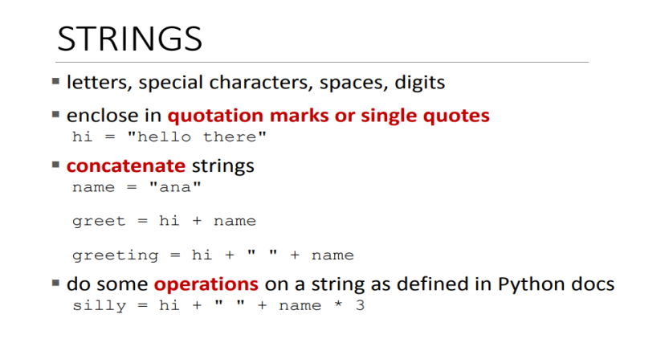

Slide 20
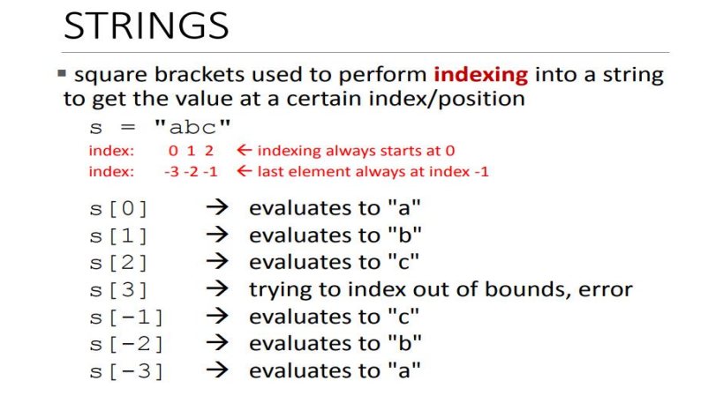

Slide 21
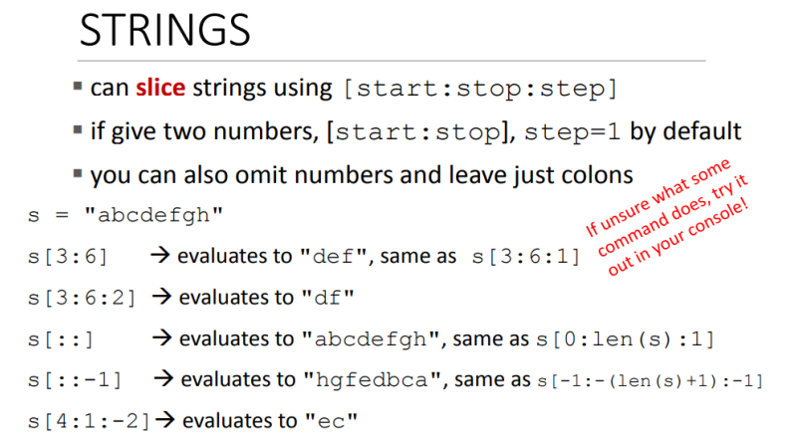

Slide 22
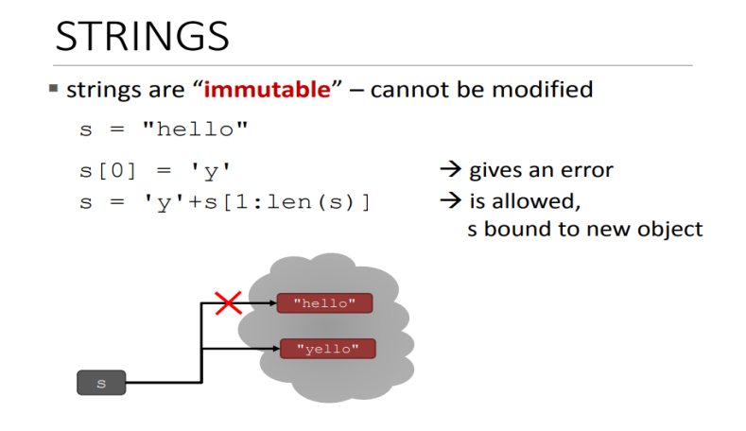

Slide 23
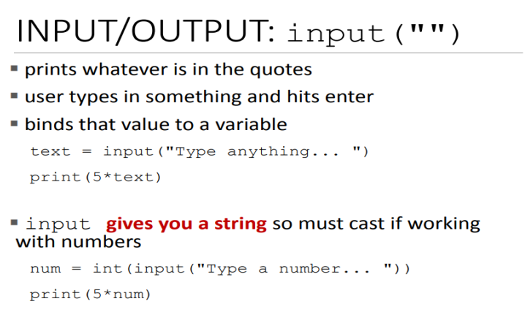

Slide 24
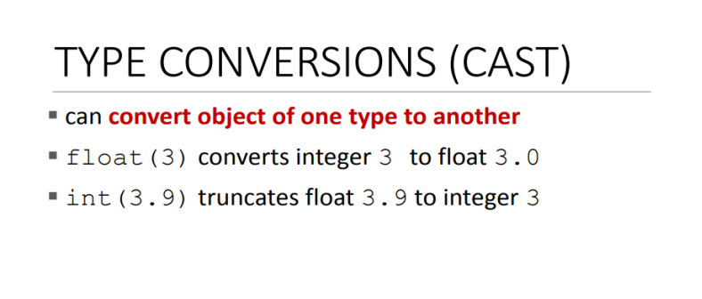

Slide 25
Type Conversions
Function | Description
int(x) | Converts x to an integer
float(x) | Converts x to a floating point number
str(x) | Converts x to a string
chr(x) | Converts an integer to a character

Slide 26
Comments
>>> name = “ahmed“ # Single line comment
'''
Multi Line
comment
'''

Slide 27
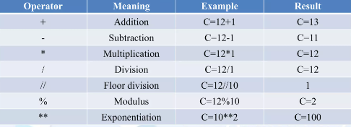
Arithmetic Operators
Arithmetic operators are used with numeric values to perform common mathematical operations

