Slide 1
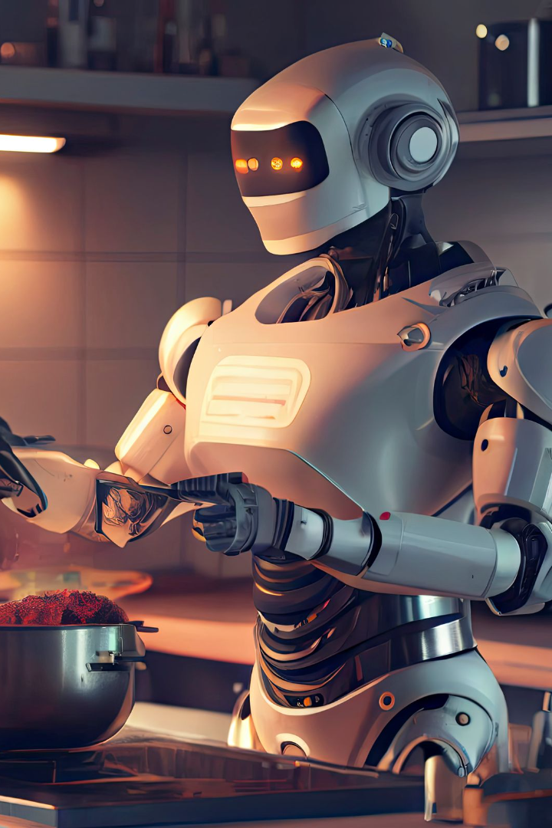
MealMaster
Welcome to our Recipe Chatbot!
Our project aims to develop a chatbot that provides personalized recipe recommendations.

Slide 2
MealMaster Features
Personalized Recipe Recommendations
Cuisine-Based Recommendations
Ingredient-Based Recommendations
The chatbot will provide recipe recommendations that align with the specified cuisine.
The chatbot will be able to recommend based on the information about the ingredients they have available.

Slide 3
Data and Data Preprocessing
1
Data Collection
Our project uses a dataset from Kaggle, which has over 8,000 recipes, most of them being Indian dishes.
Data Cleaning
2
We had some missing information in our data. To handle this, we removed the parts of the data that had missing info.
3
Merging Cuisines
To make things easier and to have better predictions, we put cuisines into bigger groups.

Slide 4
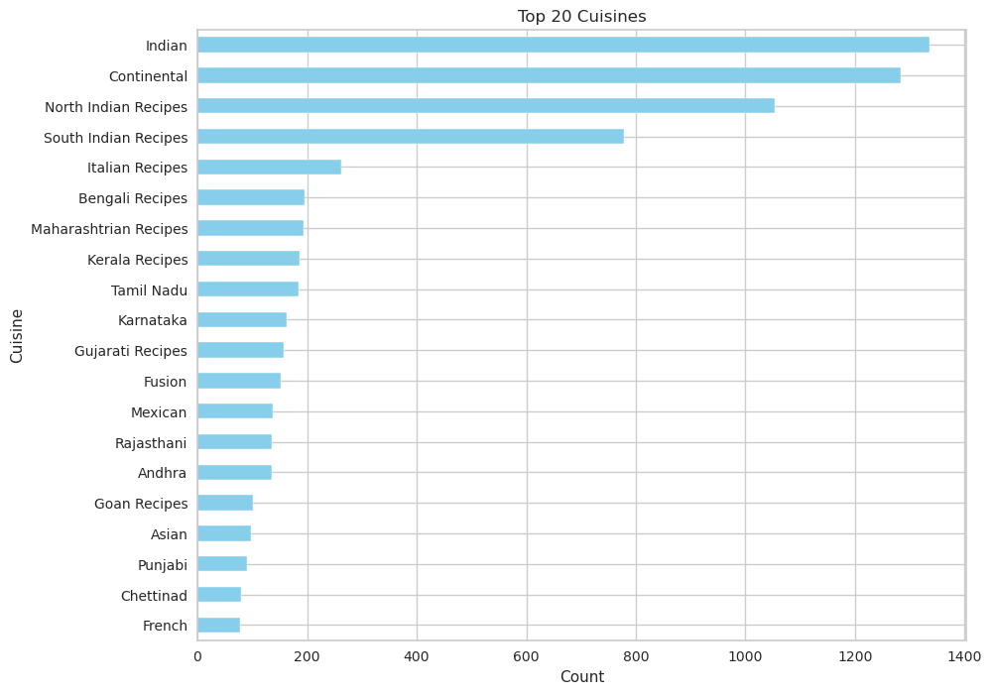
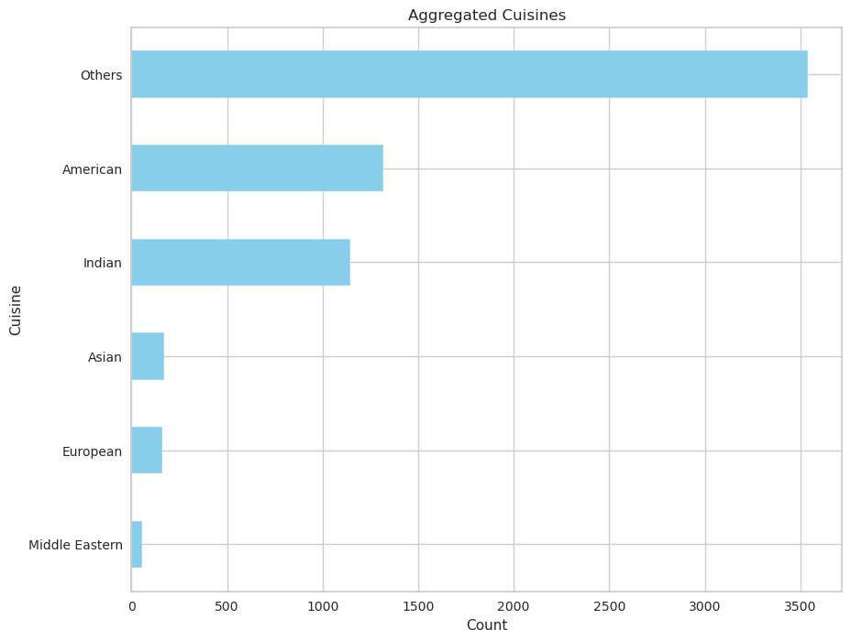
Merging Cuisines
Original
Aggregated

Slide 5
Feature Engineering
1
TF-IDF
2
Word2Vec
This is a statistical measure used to evaluate the importance of a word in a document, which is part of a larger collection (corpus).
This is a more complex model which learns to convert words into vectors of numbers, or "word embeddings", by analyzing the context in which words appear in sentences.

Slide 6
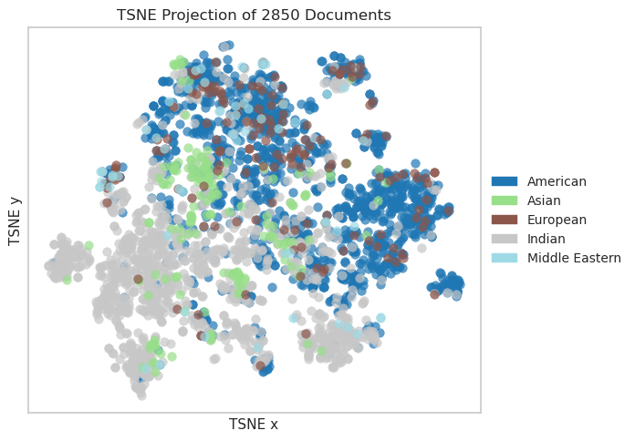
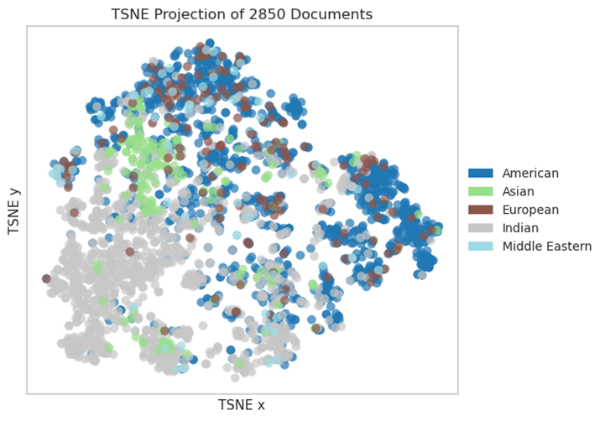
TSNE plots on TF-IDF and Word2Vec
TF-IDF
Word2Vec

Slide 7
Modeling and Model Evaluation
1
Classification
2
Clustering
Logistic Regression
Using K-means and determine the best number of clusters using the elbow method.
Support Vector Machine
Random Forrest

Slide 8
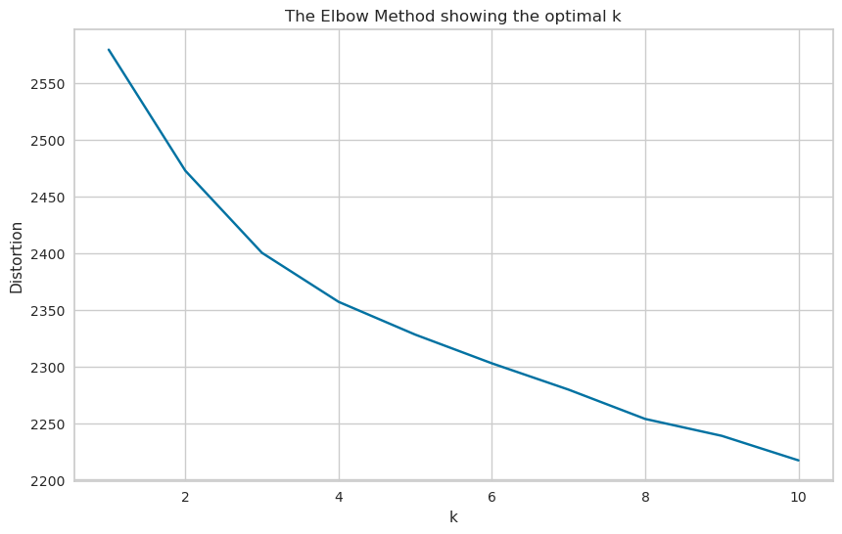
Elbow method on K-means
The optimal number of clusters is four

Slide 9
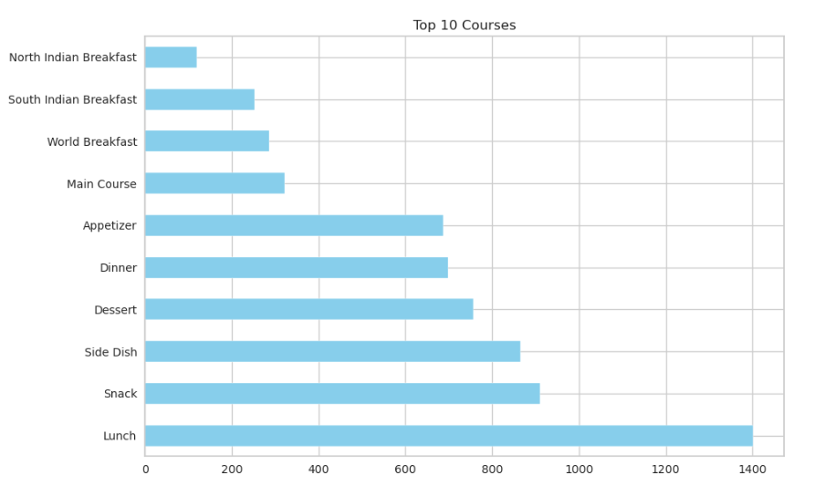
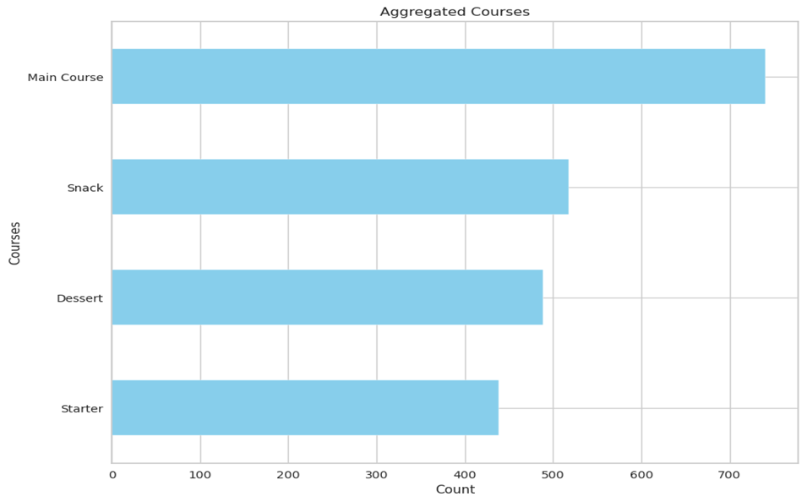
Merging Courses

Slide 10
Classification

Slide 11
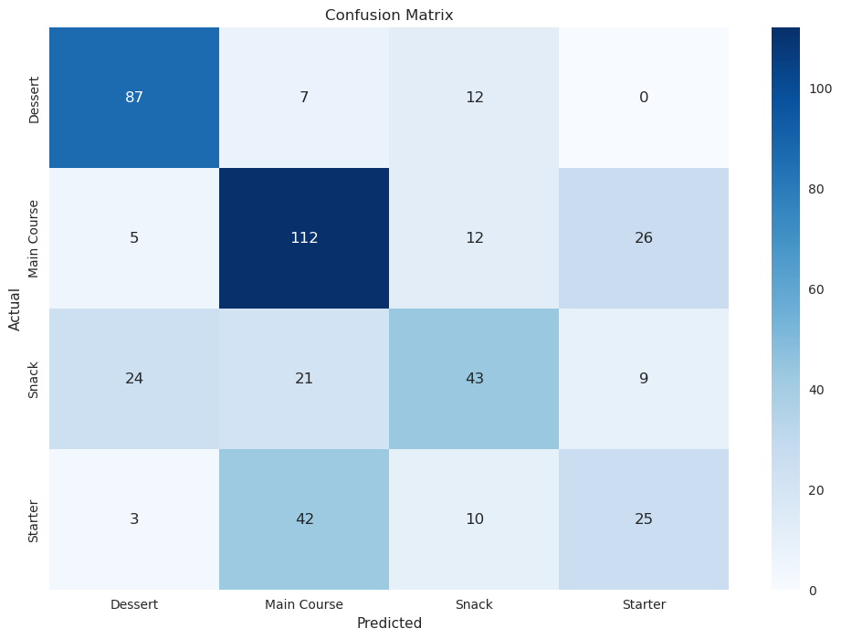
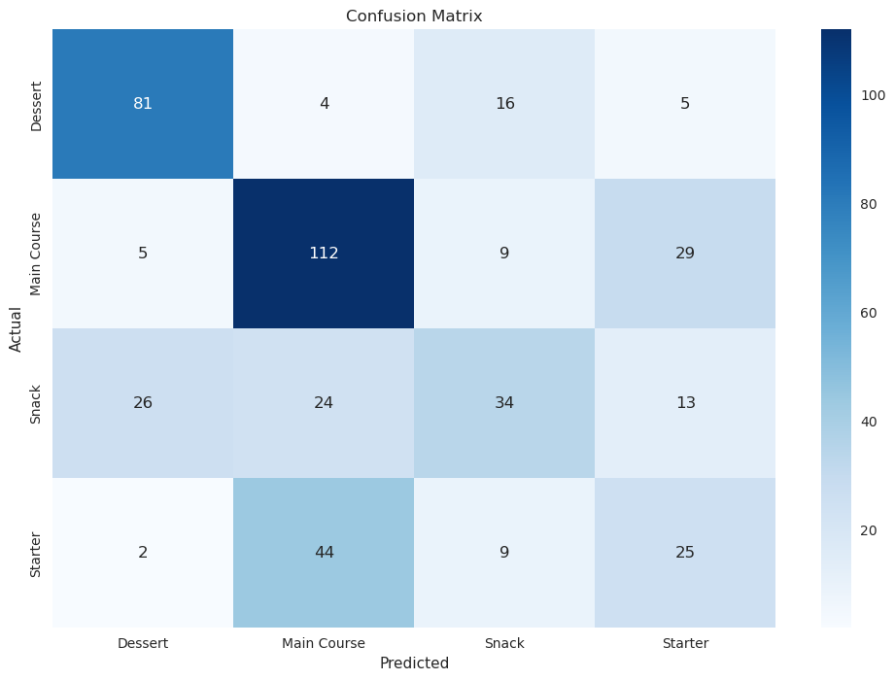
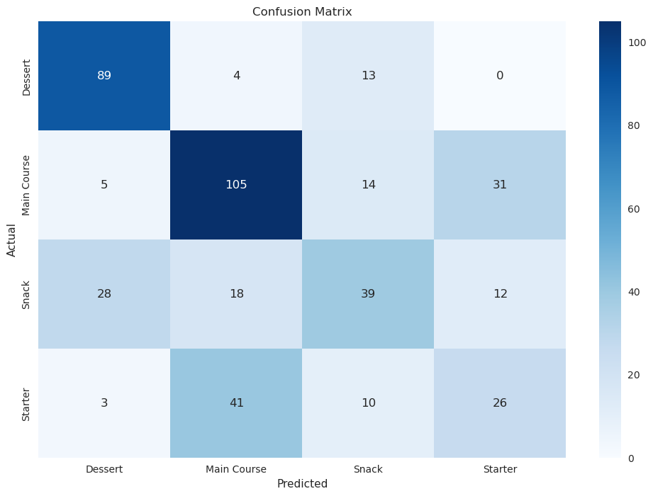
Error Analysis
Random Forest
SVM
Logistic Regression

Slide 12
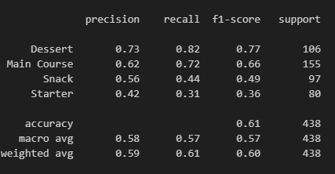
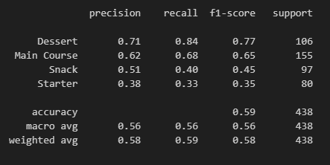
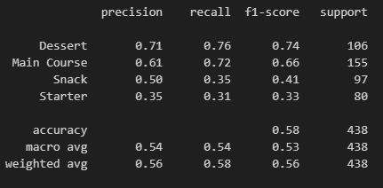
Error Analysis
Logistic Regression
SVM
Random Forrest

Slide 13
Error Analysis
1. Challenges with Class 3
2. Class Imbalance Impact
3. Suboptimal Recall for Certain Classes
The varying 'support' values (number of instances) for each class is because of an imbalanced dataset.
All three models struggled to accurately predict Class 3
Besides Class 3, some models also had difficulty with Class 2.
4. Precision Challenges
While some classes had decent recall, their precision was lacking.

Slide 14
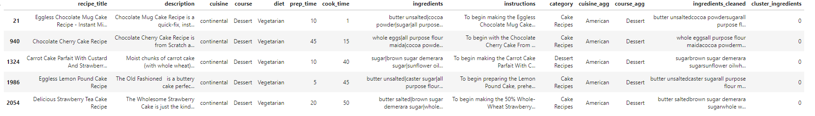
Recommendation System
Example Usage: Recommend 5 recipes similar to "Pineapple Upside Down Cake Recipe".

Slide 15
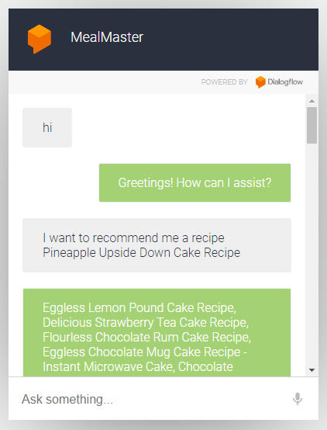
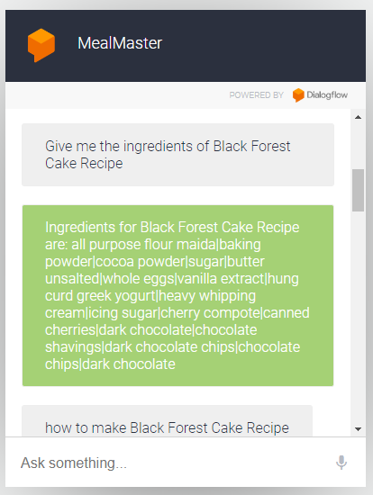
Chatbot

Slide 16
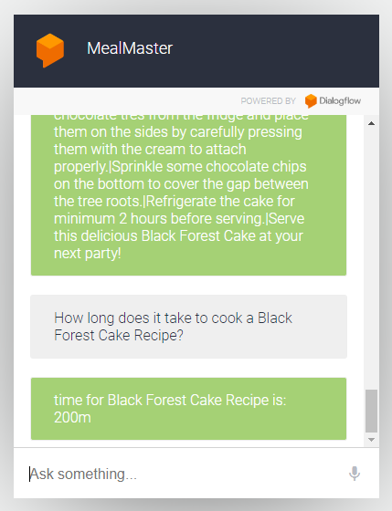
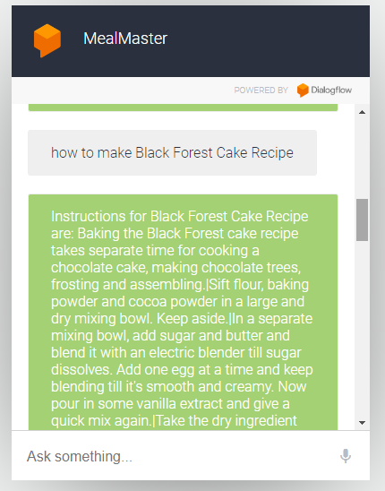

Slide 17

Thank You!

