Slide 1

WELCOME
TO
PRESENTATION

Slide 2
As a requirement of
On
Autonomous driving LEGO Car follower
Advanced Real-Time Systems

Slide 3
Presented By:
RTS Project Group-18
Mohammed Shahed Adnan (Mat. Nr. : 1179273)
Md Towfic Aziz (Mat. Nr. : 1205859)
Project Supervisor:
Prof. Dr. Jens Liebehenschel

Slide 4
Abstraction of Project
We have two LEGO Mindstorm EV3 cars. First one is controlled by an android app via bluetooth. Second car follows the first car automatically.

Slide 5
Three parts of the project
Part –A : Mechanical Design & Construction
Part – B : Controlling the 1st Car
Part – C : Lego Car Follower(2nd Car)
Presented by: Mohammed Shahed Adnan(1179273)

Slide 6
Part-A: Mechanical design and construction
We used Lego toy tools to construct the cars. LEGO EV3 device is used as the robot kit which is placed at the top of the car. Each car is run by one big motor on four wheels.
Ultrasonic sensor is placed in front of the cars
to detect the distance between cars smoothly.
Presented by: Mohammed Shahed Adnan(1179273)

Slide 7
Part-A: Mechanical design and construction
LEGO EV3 device has four input port named as 1, 2, 3, 4
And four output port named as A, B, C, D
The Ultrasonic sensor acts as input device and connected to input port 1.
Motor is working as output device and connected to output port D.
Presented by: Mohammed Shahed Adnan(1179273)

Slide 8
Part-A: Mechanical design and construction
To get better reflection for ultra sonic sensor we added a white board at the end of 1st car.
Presented by: Mohammed Shahed Adnan(1179273)

Slide 9
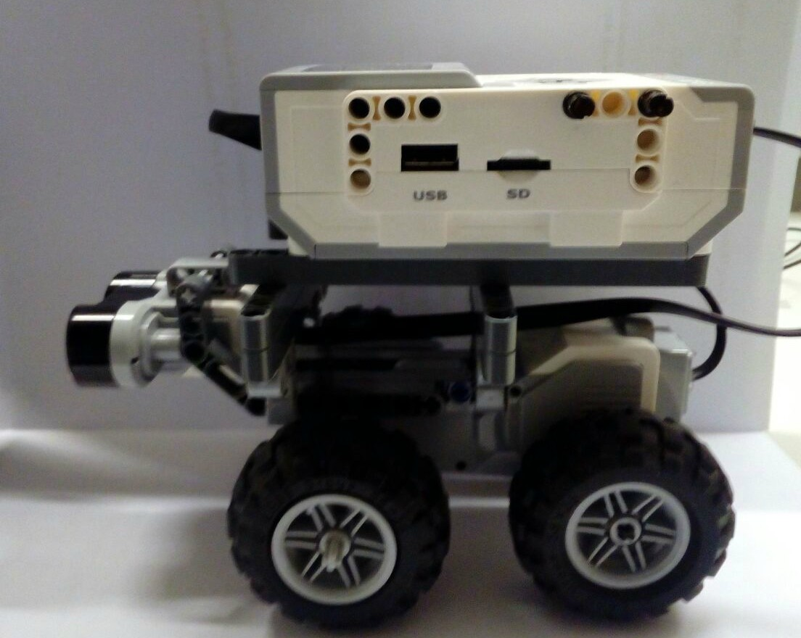
Presented by: Mohammed Shahed Adnan(1179273)

Slide 10
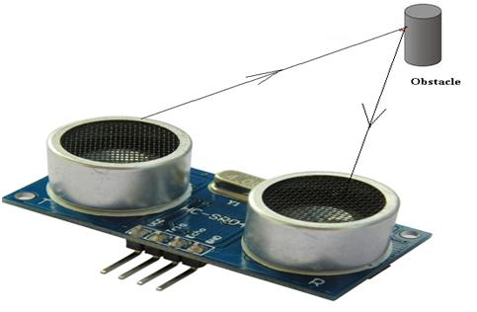
What is Autonomous Vehicle?
Autonomous Vehicle An autonomous car is a vehicle that can guide itself without human conduction.
Detecting object
Presented by: Md Towfic Aziz (Mat. Nr. : 1205859)

Slide 11
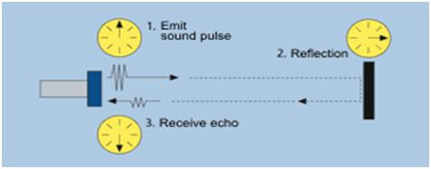
Working Principle of Ut. Sensor:
The ultrasonic sensor emits the short and high frequency signal. These propagate in the air at the velocity of sound. If they hit any object, then they reflect back echo signal to the sensor. The ultrasonic sensor consists of a multi vibrator, fixed to the base. The multi vibrator is combination of a resonator and vibrator. The resonator delivers ultrasonic wave generated by the vibration. The ultrasonic sensor actually consists of two parts; the emitter which produces a 40 kHz sound wave and detector detects 40 kHz sound wave and sends electrical signal back to the microcontroller.
Ultrasonic Working Principle

Slide 12
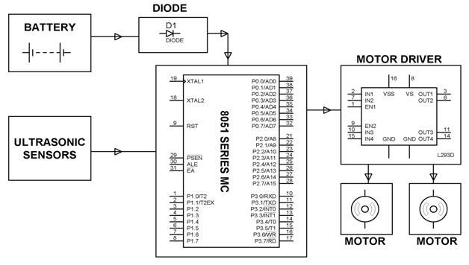
How the sensor is integrated
For detecting obstacle the robot car uses ultrasonic sensors for its movements. A microcontroller of 8051 family is used to achieve the desired operation. The motors are connected through motor IC port to microcontroller.
Ultrasonic Working Principle

Slide 13
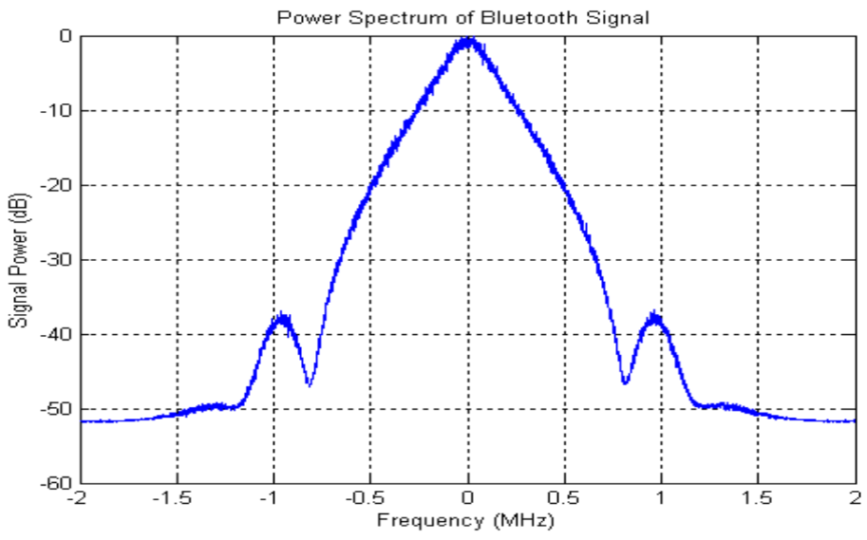
Working Principle of Bluetooth:
Bluetooth is a standard warless technology establishes communication while exchange data within a short distance. Bluetooth use ultra-high frequency wavelength for Industrial Scientific and Medical radio band or ISM radio band from the frequency 2.4 to 2.485 GHz.
Bluetooth Working Principle

Slide 14
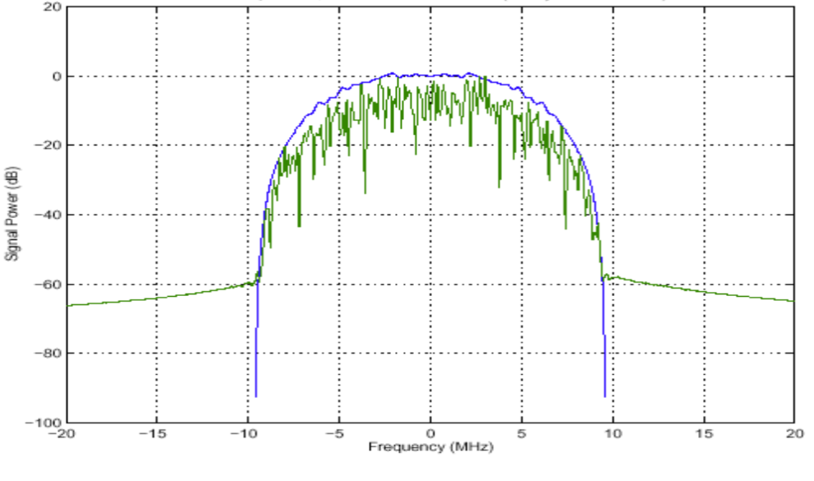
Working Principle of Bluetooth:
Wi-Fi is one types of warless and costly network solution which we use instead of wire communication. Wi-Fi is not available like Bluetooth. Different IEEE standard Wi-Fi frequencies like IEE 802.11a, IEE 802.11b, IEE 802.11g and IEE 802.11n which are provide 2.4 to 5.0GHz of frequency level.
Wi-Fi Working Principle

Slide 15
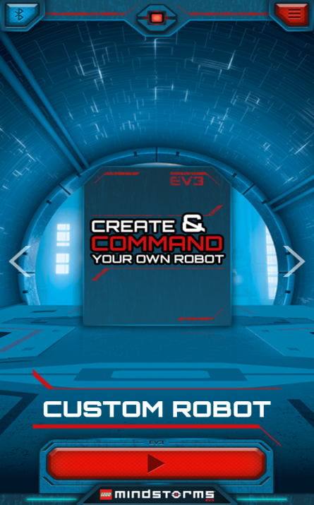
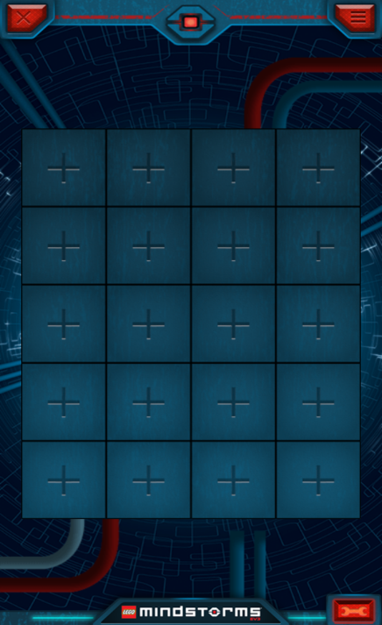
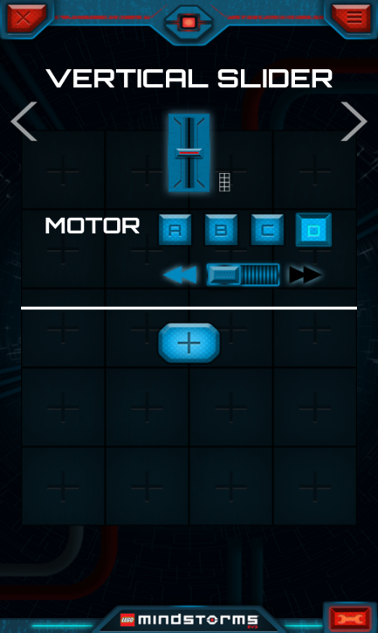
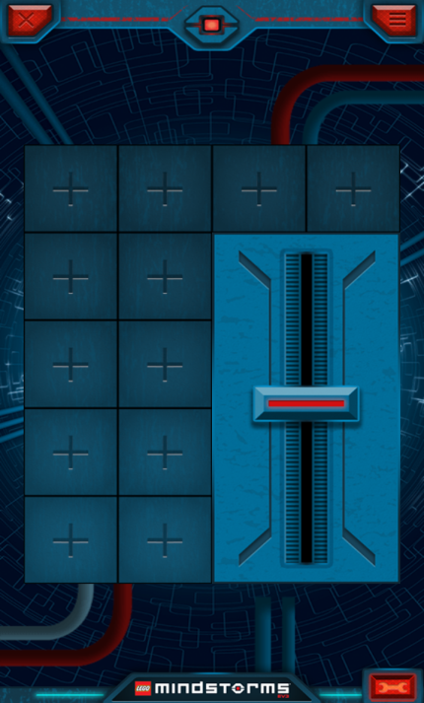
Lego Application & How to use it:
Graphical view of Lego Mindstorms application step by step
Presented by: Md Towfic Aziz (Mat. Nr. : 1205859)

Slide 16
PART –C: LEGO CAR FOLLOWER
Algorithm:
Step 1: set constant_distance cd, transition_distance td, critical_value
Step 2: turn on Ultrasonic sensor and measure distance
dist= getDistance();
Step 3:
while(flag!=false) {
dist= getDistance();
if(dist>cd+ td) {
while(dist>cd+ td) {
move the car forward;
dist= getDistance();
}
}
else if (cd+ td > dist &&dist>cd) {
while(cd+ td > dist && dist>cd) {
move the car forward slowly;
dist= getDistance();
}
}
Presented by: Mohammed Shahed Adnan(1179273)

Slide 17
PART –C: LEGO CAR FOLLOWER
else if (dist== cd) {
while(dist==cd) {
move the car forward in certain distance;
dist= getDistance();
}
}
else if(cd>dist && dist>critical_value) {
while(cd>dist && dist>critical_value) {
move the car forward very slowly;
dist= getDistance();
}
}
else if(dist<critical_value) {
while(dist<critical_value) {
stop the car and wait for next action;
dist= getDistance();
}
}
if(dist<.05) {flag=false;break;} // to avoid collision
}
Presented by: Mohammed Shahed Adnan(1179273)

Slide 18
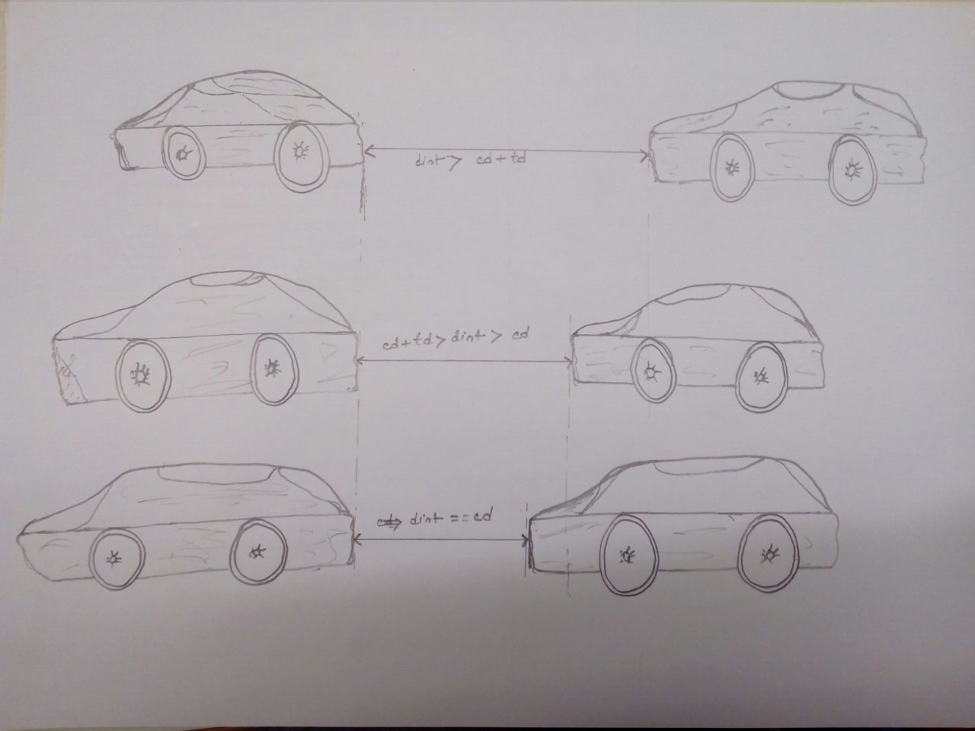
Presented by: Mohammed Shahed Adnan(1179273)

Slide 19
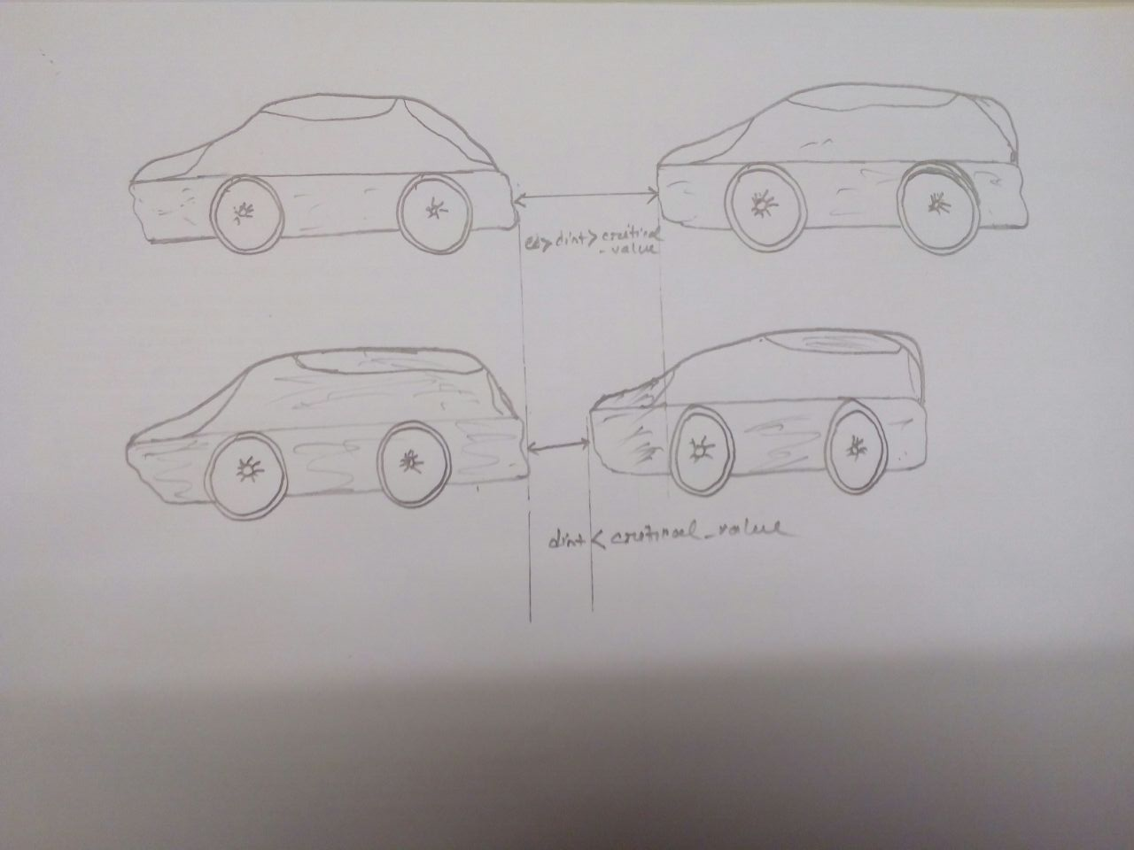
Presented by: Mohammed Shahed Adnan(1179273)

Slide 20
Programming Tools and Language
lejos EV3 based on JAVA
Eclipse IDE
External SD Card: 32 GB
Presented by: Mohammed Shahed Adnan(1179273)

Slide 21
References:
[1] Wi-Fi (IEEE 802.11b) and Bluetooth http://www.ti.com/pdfs/vf/bband/coexistence.pdf
[2] LEGO Mindstorms EV3 Programming Basics
https://www.sos.wa.gov/_assets/library/libraries/projects/youthservices/legomindstormsev3programmingbasics.pdf
[3] LEGO Mindstorms EV3 Programming Basics https://www.elprocus.com/obstacle-avoidance-robotic-vehicle/

