Slide 1
Predicting Titanic Passenger Survival
Research Design & Experiment
Research Question: Can passenger characteristics be used to predict Titanic survival?
1

Slide 2
1. Problem
Why predict passenger survival?
Goal: predict whether a Titanic passenger survived using demographic and travel-related characteristics.
Target variable: Survived (0 = did not survive, 1 = survived).
Research question: How effectively can Linear Regression and Logistic Regression predict passenger survival?
The dataset contains 889 observations and 13 variables.
2

Slide 3
2. Dataset & Method
Data preparation and experimental procedure
Main features: Pclass, Sex, Age, SibSp, Parch, Fare, and Embarked.
Engineered features: FamilySize = SibSp + Parch + 1; IsAlone indicates whether a passenger travelled alone.
Preprocessing: median imputation and standardization for numerical variables; most-frequent imputation and one-hot encoding for categorical variables.
Train/test split: 80% training (711 rows) and 20% testing (178 rows), using random_state=42 and stratification.
Models: Linear Regression baseline and Logistic Regression classification model.
3

Slide 4
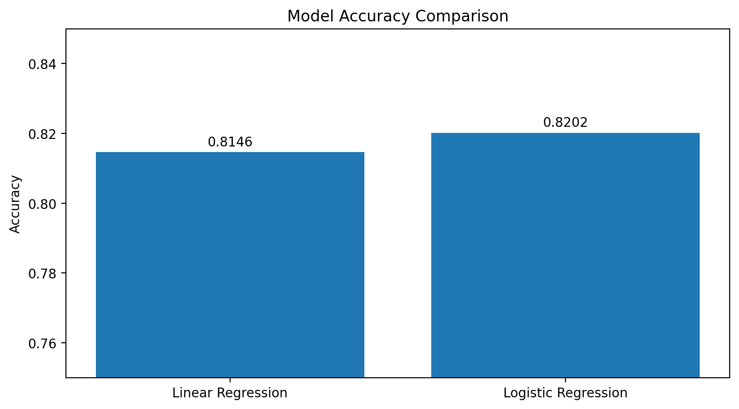
3. Results
Model performance on the test set
Model | Accuracy | MAE | MSE | R²
Linear Regression | 0.8146 | 0.2988 | 0.1426 | 0.3961
Logistic Regression | 0.8202 | — | — | —
Key result
Logistic Regression achieved the higher test accuracy: 82.02%.
4

Slide 5
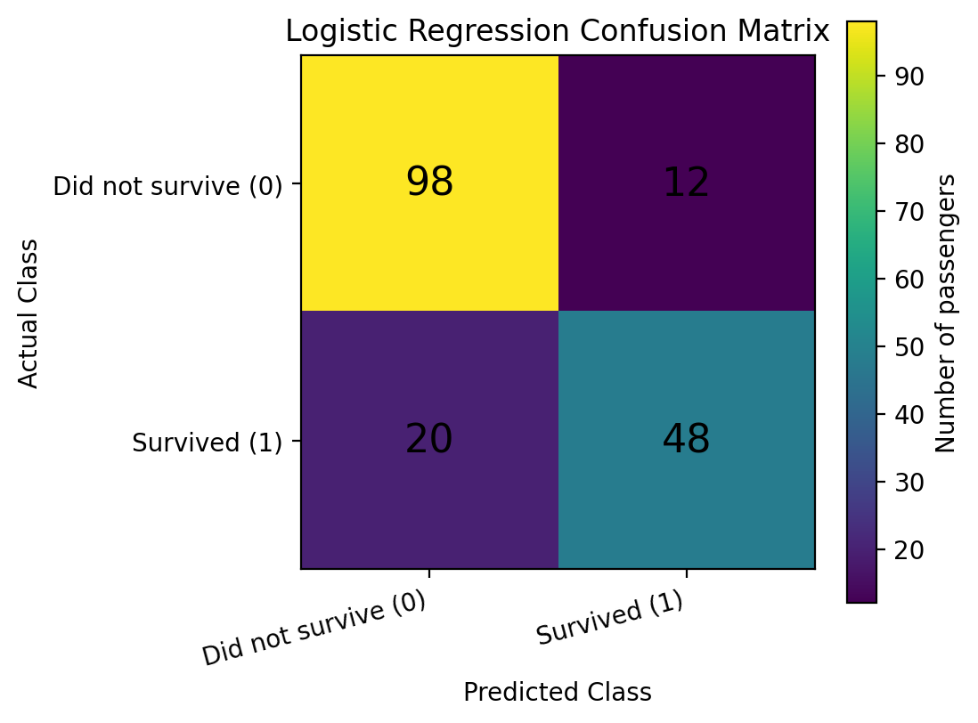
4. Findings
Logistic Regression classification results
Accuracy: 0.8202 (82.02%)
Precision: 0.8000
Recall: 0.7059
F1-score: 0.7500
Confusion matrix: 98 true negatives, 12 false positives, 20 false negatives, and 48 true positives.
5

Slide 6
5. Takeaway
What the experiment tells us
Passenger characteristics can be used to predict Titanic survival.
Logistic Regression performed slightly better than Linear Regression for the binary survival target.
Linear Regression provided a useful baseline, but it is not naturally designed for binary classification.
Limitations: the dataset may not represent all passenger populations, and the results should not be generalized without further investigation.
Future work: compare Random Forest, Gradient Boosting, and SVM; use cross-validation and hyperparameter tuning; explore additional features such as passenger titles.
6

