Slide 1
Bismillahir Rahmanir Rahin
Wel Come To Al-Amin Software
It’s a Leading IT Solution Company
Go Ahead
Make the way easy and plain

Slide 2
PROFILE OF ALAMIN SOFT
ALAMIN SOFTWARE brings the talents and market potentials of a group of dedicated Bangladeshi professionals having the dream of glorifying the image of the country in the world market through quality software solutions. This company is organized under the leadership of internationally experienced specialists in the fields of corporate finance and Information Technology.

Slide 3
ALAMIN SOFTWARE Vision:
INFOWORLD Vision :
  Better Customer Satisfaction through Quality Innovation.
ALAMIN SOFTWARE Mission:
  To be the Software Development Center of Excellence in Asia ranking among top ten fastest growing companies by 2020.
ALAMIN SOFTWARE Objectives:
  Implement QMS (Quality Management System) in all functions.
Human Resource Skills :
  ALAMIN SOFTWARE has a solid team of qualified project managers, software architects, and Software Engineers. They all are adept in the latest tools and technologies in Software, Web, Multimedia, development.

Slide 4
Skill Matrix (Software)
  LanguageTechnologyMiddlewareToolsFrameworks / PatternsOperating SystemsDBMSUML, Java, C, C++, Objective-C, VBJ2SE, J2EE, J2ME, XML, COM+Apache, Tomcat, IIS, IASJBuilder, JDeveloper Visual C++, Rational Rose, Developer 2000GoF Patterns, J2EE Patterns, JUnit, log4j, Enhydra EnterpriseSolaris, Slackware RedHat Linux, Windows NT Oracle, MS Access, MS SQL Server, mySQL
Skill Matrix (Web) :
Skill Matrix (Network Solution):
Skill Matrix (Multimedia):

Slide 5
Our clients are important to us and therefore we are always looking to improve the quality of our services in order to maximize client satisfaction.
OUR HONORABLE CLIENT
Some Of Our Honorable Clients
AL-Jameatul Falahia Kamil Madrasah Feni
Elife Solutions Technologies
Feni IT Center
Alrahma Online Org, Chittagong

Slide 6
Software Development Process
When we make an application or web site development we design it from the top down. We talk in depth with the client to find out their needs and what *look and feel* they want to achieve.
PHASE 1:
  System Analysis and Network Design
  Soft ware Design (look and feel )
  Database Design/Creation

Slide 7
PHASE 2:
Implementation of System Analysis:
Programming and Web Site Development :

Slide 8
PHASE 3:
Final Debugging
Testing
Deployment

Slide 9
School Management System
Developed by:
ALAMIN SOFTWARE A Leading It Solution Company
Address :
  141, Anower Ullah Sadak,
  Nazir Road Feni
  Tel. : 01558430172, 01829616787

Slide 10
MODULE OF SCHOOL MANAGEMENT SYSTEM
 Module # Admission Processing
Applicant’s Information
 Student Management
Student’s Information
Parent’s Information
 Academic Information
Class and Section Entry
Session Information
Subject Entry
 Examination Processing
Exam Mark Entry
Result Sheet

Slide 11
 School Accounts
Fund Creation
Class wise Fee defining
Debit Voucher Entry
Credit Voucher Entry
Fund Details
Tuition Fees
Debit Voucher
Credit Voucher
List of Vouchers
Balance Sheet
 Payroll
Defining Allowance and Cutting
Contribution
Department Entry
Designation Entry
Employee Information
Academic Qualification
Family Information
Provident Fund
Salary Increment
Provident Fund Loan
Monthly Salary Calculation
Salary Sheet

Slide 12
 School Inventory
Item Entry
Purchase Entry
Issues Entry
View Balance
Date wise purchase information
Item Wise Purchase Information
Ledger of Balance
 Library Management
Member’s Information
Library Card (For the Teacher)
Book Issue
Book Return
Purchase Information
Book Details
Supplier Information
 Club Administrator
Club Information
Administrative Information
Members’ Information
Club Fund Entry
Club Progress Monitor
Club Members List
Club Progress

Slide 13
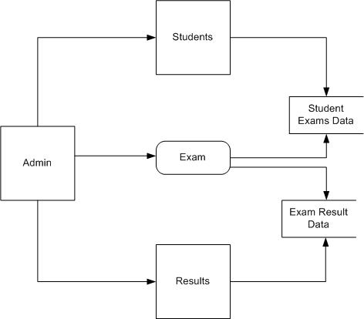
Data Flow Diagram

Slide 14
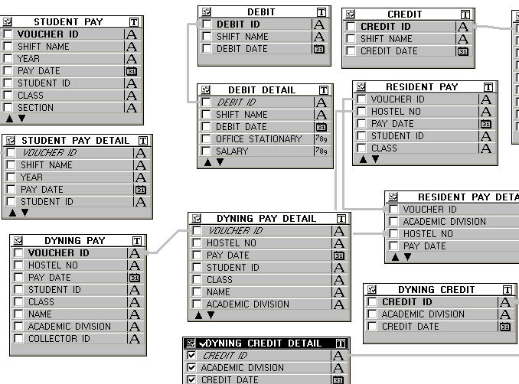
Entity Relationship Diagram

Slide 15
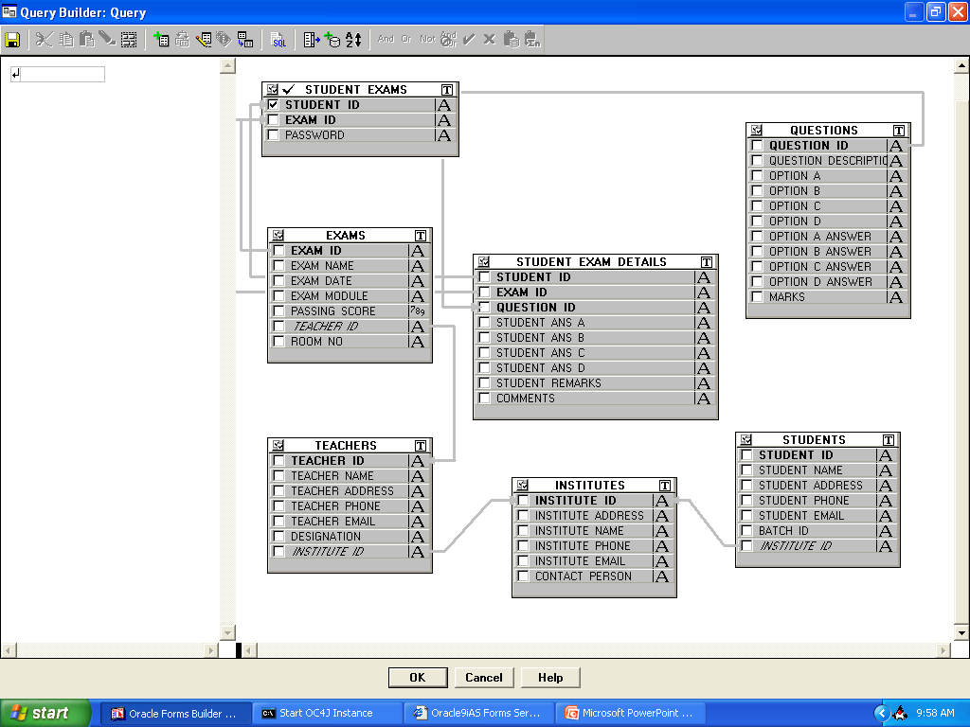
Entity Relationship Diagram

Slide 16
Introducing Forms
Login Form
Main Form
Students Form
Institutes Form
Teachers Form
Exam & Exam Details Form
Questions Form

Slide 17
Accounts Automation
Department Wise Collection
Department Wise Expenditure
Automatic Debit Voucher Entry
Automatic Credit Voucher Entry
Daily Balance Per Department
Monthly Balance Per Department
Monthly Balance Per Department
Auto sum Per Item.
And So On

Slide 18
Module Of REAL ESTATE MANAGEMENT SOFTWART
NEED OF REAL ESTATE MANAGEMENT SOFTWARE DEVELOPMENT
ADVANTAGES OF REAL ESTATE MANAGEMENT SOFTWARE DEVELOPMENT
The many advantages that accompany our rental real estate rental software include real time access to your property database, an all-inclusive suite of web-based real estate rental software tools that simplify the day-to-day process of property administration.
Collecting rent is a breeze with our electronic payment options that save your time and money.
We help to cut out data reconciliation and organize a clutter-free and database so that everyone seeing it through our real estate rental software will view the same information.
Most regular users of popular websites like eBay, Yahoo, etc find our tools and features familiar and easy-to-use. Thus they do not require much training in order to master our real estate rental software.
And the best part is, we are constantly on the lookout for ways to improve our performance and troubleshoot any problems. We also conduct surveys among our users in order to determine ways to evolve a more responsive and intuitive real estate rental software.

Slide 19
Admin Section
Phase Of a Real Estate Management
Property Type/Features
Properties
Member / Subscriptions
City / State
Payment Gateway / Others
Newsletter
Package Design
Advertise Generation
News Publishing
Feature Publishing
Maintain

Slide 20
User Section
Management Creation
Accounts Creation
Marketing Department Creation
HR Department Creation
Property Listing
My Account / Find a broker

Slide 21
Module Of REAL ESTATE MANAGEMENT SOFTWARE
Real Estate Accounts (Salary & Voucher) Managements System
Real Estate HR Management System
Real Estate Market Management System
Real Estate Market Department Performance Management System
Real Estate Sales Management System
Real Estate Customer Management System
Real Estate Contact Management System
Real Estate LAND Management System
Real Estate Project Wise Cost Management System

Slide 22
Software Feature
Alerts
Batch Processing
Billing & Invoicing
Budgeting & Forecasting
Cash Management
Commercial Leases
Contact Management
Custom User Interface
Customizable Fields
Customizable Functionality
And So ON

Slide 23
Market Management System
HR Department
Procurement
IT
Accounts
Customer Relation
Marketing

Slide 24
Module of the Market Management system Softwarte
Administration
  Infrastructure of system
  Employees Information
  Include or Exclude policy
  Create users
  Giving Permission
Market Information :
Shop Information :

Slide 25
Customers/Clint's Information :
Rent Information :
Accounts
  All Transactions are issued here
  Automatic Balance Calculation
  Monthly Rent are Automatic Added
  Collection the rent of shop for every market

Slide 26
MODULE OF HOSPITAL MANAGEMENT SYSTEM
  Patient Registration
  Appointment Scheduling
  Admission Discharge Transfer
  Bed Management
  Wards Management Module
  Patient Relations
  Doctors Workbench
  Nursing Workbench
  Operation Theater
  Electronic Medical Record
  Clinic Specialties

Slide 27
  Laboratory Information System
  Radiology Information System
  Pharmacy
  Central Sterilized Supply Department
  Blood Bank
  Dietary (F&B)
  Housekeeping/Laundry
  Equipment Maintenance System (EMS)
  Healthcare Packages

Slide 28
  Patient Billing
  Insurance and Contracts Management
  Management Information System (MIS)
  Hospital Administration
  Roster Management
  HRMS
  Financial Accounting

Slide 29
Supper Shop Management System
DAGON Supper Shop
        Represent By
ALAMIN SOFTWARE
A Leading It Solution Company

Slide 30
Methodologies of the project
Feasibility study
Corrections
Implementation
Requirement
Analysis & Specification
Corrections
Logical
Testing & Evaluation
Corrections
Logical
Design
System Development
Physical
Design
FIG -The V Lifecycle Model

Slide 31
DATA FLOW DIAGRAM (DFD)
OF Supper Shop Management System
Suppliers
Sales
Category
&
Subcategory
Supper Shop
Management
System
Emp_info
Product_info
Stock
Purchases

Slide 32
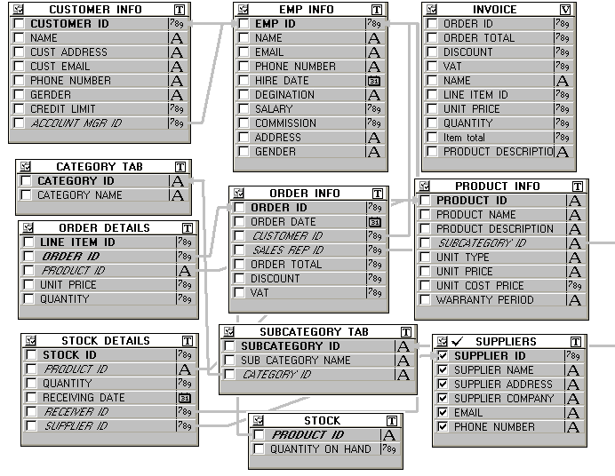
Entity Relation Diagram

Slide 33
Module of Shop management
Order_info
Order_details
Customer_info
Emp_info
Purchases
Stock
Suppliers
Category
Subcategory
Product_info
Users
Invoice (View)

Slide 34
Interfaces of the system
Home Page
Main Form
Sales
Employees Information
Product Information
Category & Subcategory
Suppliers Information
User Create Form
Change Password form
Purchases Information
Customers Information

Slide 35
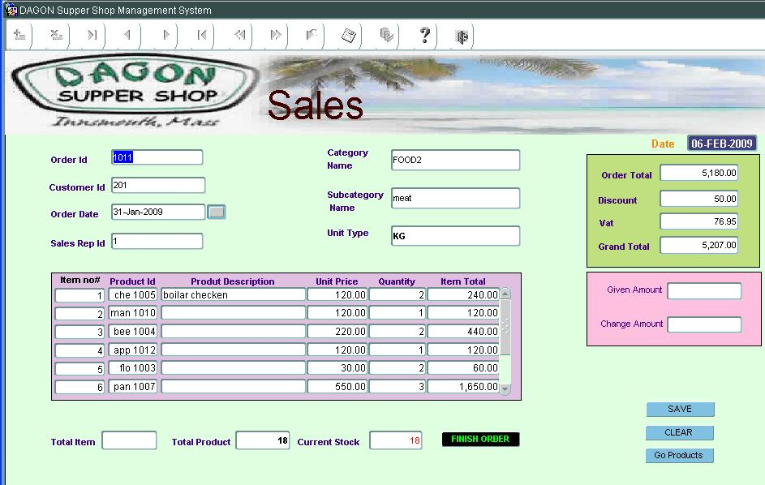
Sales form
Salesman always perform his task using it

Slide 36
Restaurant Management Systems
Developed by:
ALAMIN SOFTWARE
A Leading It Solution Company

Slide 37
Data Flow Diagram
Items
Orders
Order Items

Slide 38
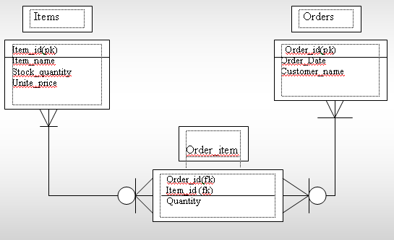
Entity Relationship Diagram

Slide 39
Introducing Interfaces
Login Form
Main Form
Items Form
Orders Form
Order Items Form
Users Form
Report Call Form

Slide 40
Project Name:
Computerized Pharmaceutical
Marketing System

Slide 41
Prepared by:
ALAMIN SOFTWARE
A Leading It Soution Company
Address
141 ANOWAR ULLAH SADAK,
NAZIR ROAD, FENI
Tel. : 01558430172, 01829616787

Slide 42
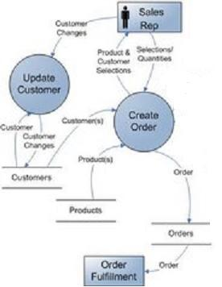
Data Flow Diagram

Slide 43
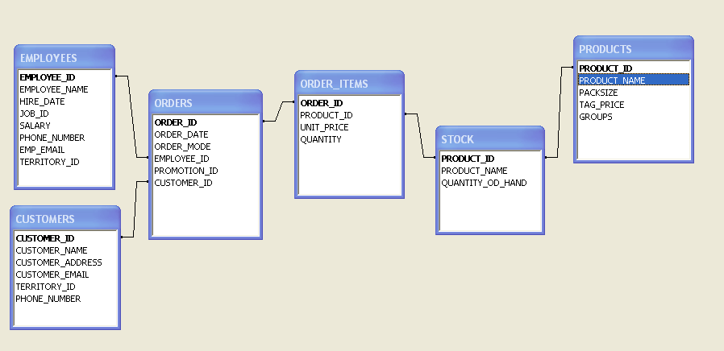
Entity Relationship Diagram

Slide 44
Introducing Interfaces
Login Form
Main Form
Customers Form
Employees Form
Orders Form
Products Form
Stock Form

Slide 45
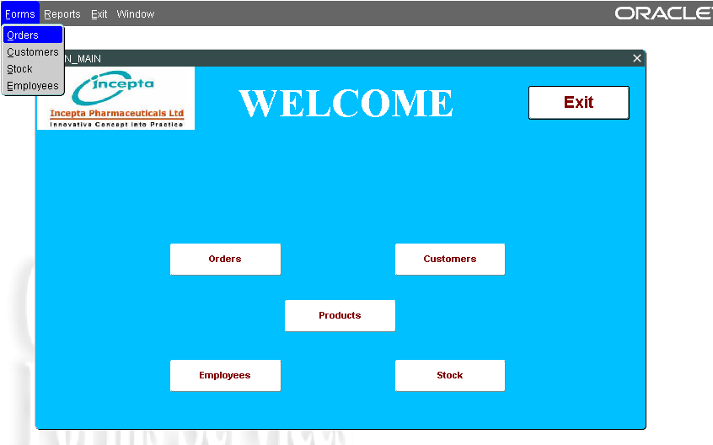
Form : Main

Slide 46
Event Management System
VERSION ONE
        Represent By
Developed by:
ALAMIN SOFTWARE
A Leading It Solution Company

Slide 47
DATA FLOW DIAGRAM (DFD)
OF Event Management System
Clint
Showbizes
Event
Others
Event
Management
System
Event_
Orders
Venues
Cost
Facilities

Slide 48
Module of Event Management
Events
Event_Orders
Clints
Showbizes
Venues
Facilities
Costs
Users

Slide 49
Interfaces of the system
Home Page
Main Form
Events
Event Information
Event_order Information
Category & Subcategory
Event_order_clint Information
User Create Form
Change Password form
Showbiz Information
Clint’s Information

Slide 50

Thanks for your attention

