Slide 1
GRADUATION PROJECT · COURSE 307498
SolarWise Jordan
Is Solar Wise For Me?
Predicting rooftop solar generation anywhere in Jordan from weather alone — and turning it into an answer in dinars.
Shahed Farraj
Graduation Project · 2026

Slide 2
01 · INTRODUCTION
Why Solar, and What the Problem Is
A national opportunity, and a decision people currently make blind.
WHY SOLAR IN JORDAN
THE PROBLEM
We help someone in Jordan answer one question: if I put solar panels on my roof, will I actually save money?
• Weather data is used to estimate how much electricity solar panels could produce at a specific location.
• The estimated generation is then compared with household electricity usage and the applicable tariff.
• The same country-wide data can also answer a second question: where in Jordan is solar most worth it?
• Solar panels do not produce the same amount of electricity everywhere in Jordan.
• Solar generation depends on factors such as sunlight, temperature and location.
• A person considering solar may not have an easy way to estimate what their own location can produce.
• Without a location-based estimate, the decision can become a guess or depend heavily on a salesperson's estimate.
The question this project answers: for this roof, in this month — how much will it generate, and is it worth the money?
SolarWise Jordan
2

Slide 3
01 · INTRODUCTION
Objectives
Four goals, each one tested later in this presentation.
1
Cover all of Jordan
2
Predict generation anywhere
Build a national grid of weather data — 131 locations, not a handful of cities.
From weather alone, at any coordinate a user can point to on a map.
3
Prove it works on new places
4
Turn it into a decision
Test on a year and a location the model never saw during training.
A verdict in dinars for a household, and a ranked map for an investor.
Objectives 2 and 3 are the ones this deck returns to with numbers.
SolarWise Jordan
4

Slide 4
02 · THE SYSTEM
How the System Works
Four stages, from a satellite record to an answer on a screen.
1
2
3
4
Collect
Prepare
Learn
Deliver
NASA POWER daily API pulls 6 years of weather for 131 points across Jordan. Nominatim turns an address into coordinates and checks the point is inside the border.
▸
Duplicates, hidden −999 codes and impossible readings removed. Dates converted, season encoded, target built.
▸
Three models trained and compared. The winner is saved to disk with its feature list, ready to serve.
▸
A Streamlit web app answers the household question. A Power BI dashboard ranks sites for investors.
NASA POWER · Nominatim
pandas · NumPy
Linear Regression · Random Forest · XGBoost
Streamlit · Power BI
Two surfaces, one model. The household app and the investor dashboard read the same trained model and the same cleaned dataset — so they can never disagree.
SolarWise Jordan
5

Slide 5
03 · THE DATA
Where the Data Comes From
NASA POWER — satellite weather and solar data for any point on Earth, used across 2020–2025.
285,699
131
6
7
Records after cleaning
Locations across Jordan
Years · 2020–2025
Weather variables per day
WHY WE CHOSE IT
Covers every coordinate in Jordan — not just a few weather stations.
Gives the same variables at prediction time as it did at training time.
Free, well documented, and needs no registration; a regular grid, so no district is favoured.
THE SEVEN VARIABLES
Sunlight · Clear-sky sunlight · Cloud cover
Temperature · Humidity · Wind · Rainfall
Addresses are handled too — OpenStreetMap Nominatim converts a typed address into coordinates and confirms the point falls inside Jordan.
Data used in the project covers 2020–2025. The dashboard summarizes the collected data through geographic locations, districts and solar-resource indicators.
SolarWise Jordan
6

Slide 6
03 · THE DATA
Cleaning the Data
Four steps, in order — and one of them is easy to miss.
1
Removed duplicates
2
Found hidden missing values
2,871 repeated records left behind by overlapping downloads.
NASA writes −999 instead of leaving a blank — 1,448 records. pandas reported no missing data, because −999 is a number.
3
Removed impossible readings
4
Prepared for the model
Temperatures of 150°C and −80°C. Only 5 records in total.
Converted dates, encoded the season, and built the prediction target.
290,023 → 285,699
1.49%
131 / 131
records kept
of rows removed
locations retained
SolarWise Jordan
9

Slide 7
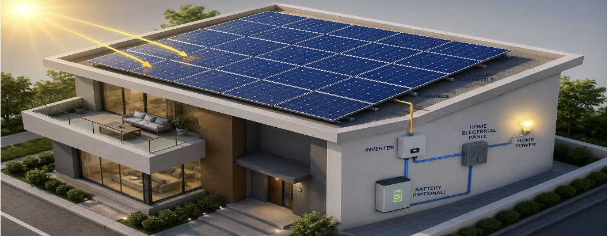
04 · THE MODEL
What the Model Predicts
Daily energy per kilowatt-peak of installed panels — kWh/kWp/day.
Energy = Sunlight × Performance Ratio
the performance ratio falls as the panel heats up
HEAT REDUCES OUTPUT
EXTERNAL VALIDATION
A panel loses about 0.4% of its efficiency for every degree above 25°C.
Panels run hotter than the air — 27.4°C on average, against 19.7°C ambient.
An outside check, not one of our own metrics confirming itself — our modeled output agrees with published figures for solar performance in Jordan.
SolarWise Jordan
11

Slide 8
05 · FINDINGS
Finding 1 — The Season Matters Most
Share of the variation in daily output explained by each factor.
WHAT THIS MEANS
WHEN you generate matters far more than WHERE in Jordan you are.
June: 6.17 kWh/kWp per day December: 2.48 kWh/kWp per day
That is 2.5× more in summer. Location and year barely move the needle — together they account for under 2%.
So the answer we give a user must be monthly — a single yearly average would hide the months that actually decide whether solar pays.
SolarWise Jordan
12

Slide 9
05 · FINDINGS
Finding 2 — Heat Hurts, and It Is Hidden
The raw correlation says one thing; a fair comparison says the opposite.
WHAT THE NUMBERS SEEM TO SAY
WHAT ACTUALLY HAPPENS
+0.69
−0.64
correlation between temperature and output
once days with the same sunlight are compared
Hotter days appear to produce more. But that is the season talking — hot days in Jordan are also sunny days.
Hold sunlight constant and hot days produce 5.2% less. The physics was there all along, hidden by the season.
WHY THE PEAK MONTH IS JUNE, NOT JULY
July receives slightly more sunlight, but it is hotter — and the panels pay for it. The model reproduces this without being told.
SolarWise Jordan
13

Slide 10
05 · FINDINGS
Finding 3 — Location Matters Less Than People Think
Annual yield across Jordan, in kWh per kWp per year.
1,737
1,532
13%
2.5×
Best — southern desert
Lowest — northern hills
Difference across Jordan
Difference across seasons
FOR A HOUSEHOLD
FOR AN INVESTOR
Your location inside Jordan is not the deciding factor. What matters is how much electricity you use, and in which months you use it. System size and consumption dominate the result.
13% is worth having on a large project — but land price and grid access usually differ by more. The map ranks sites; it does not pick one — use it to shortlist, then decide on cost and grid connection.
Figures are per grid location. The dashboard aggregates to district level, which narrows the range to 1,557–1,733.
SolarWise Jordan
14

Slide 11
06 · THE AI PART
We Compared Three Models
Same features, same split, same test set — only the algorithm changes.
Weather Inputs
→
Prediction Model
→
Solar Output
→
Validation
Model | RMSE | MAE | R²
Linear Regression | 0.2273 | 0.152 | 0.971
Random Forest | 0.1942 | 0.100 | 0.979
★ XGBoost | 0.1781 | 0.097 | 0.982
Heat helps on cloudy days and hurts on sunny days. A straight line cannot describe an effect that changes direction — trees can.
We did not choose XGBoost because it is popular. We chose it because the relationship is not a straight line — it reduced error by 36% compared with the linear model.
MAE is the average size of the mistake, in kWh/kWp/day. R² is the share of the variation the model reproduces — 1.0 would be perfect.
SolarWise Jordan
15

Slide 12
06 · THE AI PART
How We Tested It — Does It Generalize?
Two separate questions, answered with two separate held-out sets.
CAN IT PREDICT A FUTURE YEAR?
CAN IT PREDICT A NEW PLACE?
2020 – 2023
Training
One location was removed from the dataset completely — the model never saw a single record from it during training.
2024
Validation — choosing the model
0.9912
2025
Final test — used once, at the end
R² at the unseen location
2025 was opened only once, after every decision had already been made — that is what makes the final number honest.
SolarWise Jordan
16

Slide 13
06 · THE AI PART
Performance Measurements
Results on the final test year, 2025.
0.9829
2.1%
0.9912
0.9892
R² — accuracy of fit
Average error
R² at a new location
R², new location + new year
NO OVERFITTING
WHY THESE METRICS?
An overfitted model scores well on the data it was tuned on and badly on anything new. Our validation and test scores are effectively identical — so the model learned the pattern, not the examples.
The answer is a number, not a category — so R² and mean error replace accuracy, precision and F1.
Validation year 2024: 0.9821 Test year 2025: 0.9829
SolarWise Jordan
17

Slide 14
07 · THE APP
The App — From Question to Answer
One page for a household: three things in, one verdict out.
1
2
3
You give three things
The model answers
You get a decision
Location — address, map tap, or GPS. Electricity bill — average monthly JOD. System size — installed kWp.
▸
NASA POWER supplies the weather for that coordinate. XGBoost predicts generation, month by month.
▸
Monthly generation set against usage. Share of the year covered, saving in dinars, and a final verdict.
NASA POWER
XGBoost
Worth it · Partially · Not enough
Nothing technical is asked for. Three ways to give a location — type an address, tap a point on the map, or let the browser detect where you are. All three end in one coordinate, checked against Jordan's border before anything is predicted.
SolarWise Jordan
19

Slide 15
07 · THE APP
The App — What the Verdict Means
The same model, three households, three different answers.
Aqaba
Irbid
Ajloun
Worth it
Partially worth it
Not enough
Generation covers what the household uses across the year.
Generation helps and cuts the bill, but the cover is incomplete.
Generation is not sufficient for what this household uses.
The location is not what decides it — how much electricity the household uses, and how big the system is, decide the verdict.
SolarWise Jordan
20

Slide 16
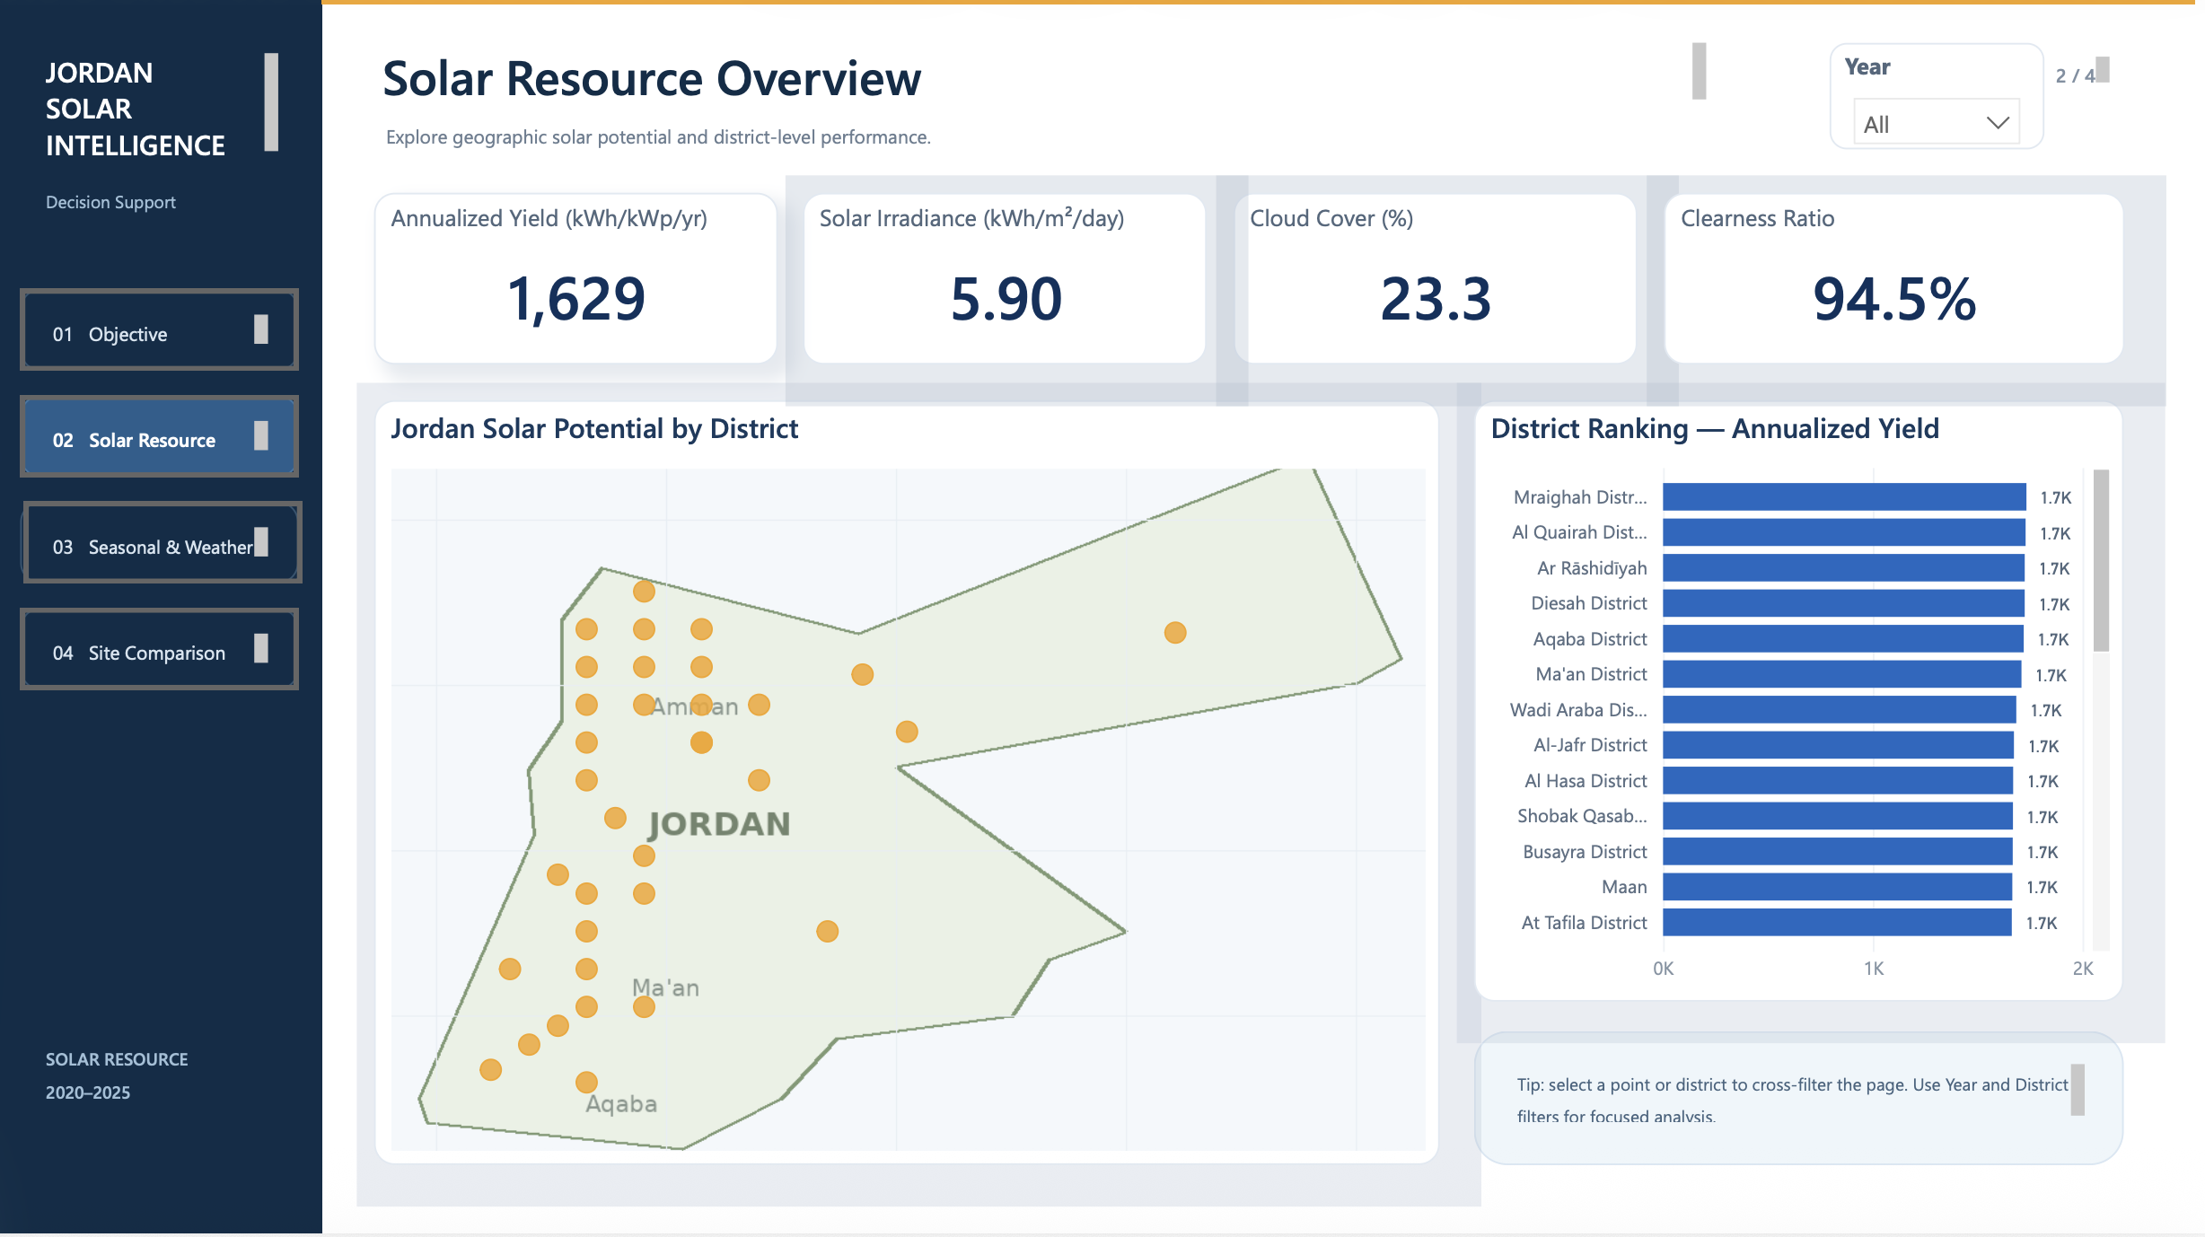
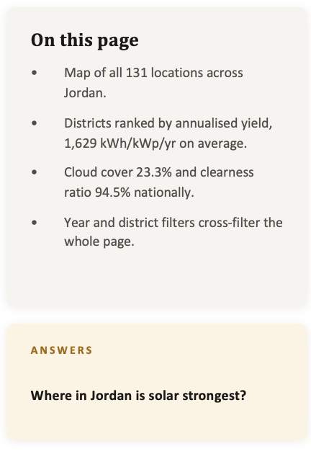
Solar Resource Overview
SolarWise Jordan

Slide 17
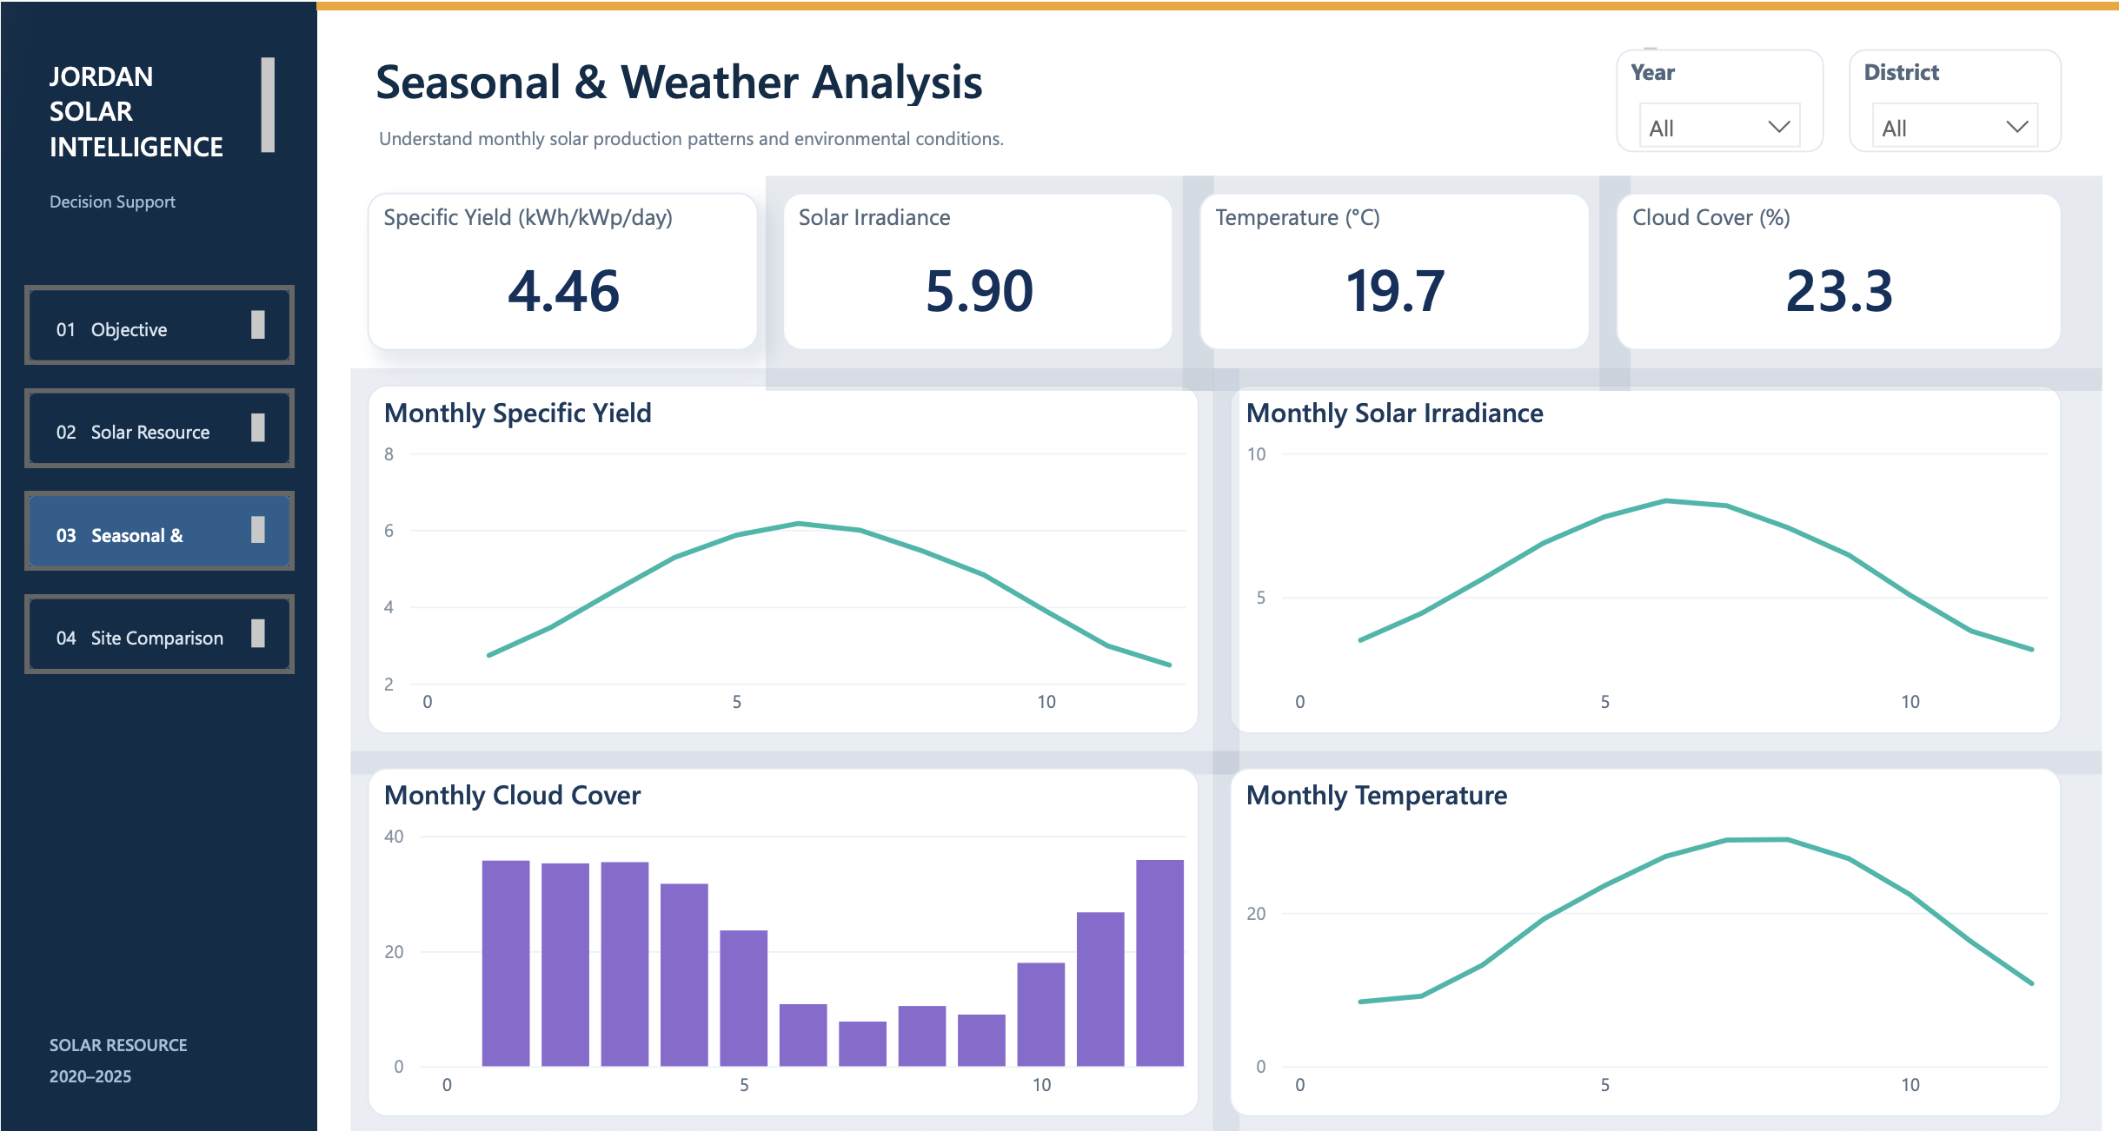
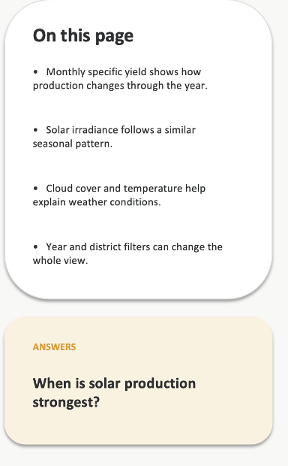
Seasonal & Weather Analysis
SolarWise Jordan

Slide 18
9 · CONCLUSION
Conclusion
What we built, what it cannot do yet, and where it goes next.
WHAT WE DID
LIMITATIONS
NEXT STEPS
131 locations and 6 years of data
R² 0.9829 on an untouched test year
Tested on locations it never saw
A verdict in dinars, not a guess
Output is modelled, not measured from real panels
Nearby points can share similar weather data
Winter predictions are less certain
Selling surplus is not yet counted
Compare against real installed systems
Show a range instead of a single number
Include income from selling surplus
Test on more unseen locations
SolarWise turns weather and location data into a practical answer about solar potential in Jordan. Thank you — questions welcome.
SolarWise Jordan
25

