Slide 1


Skin Care Recommendation model using AI and CNN
TEAM MEMBERS:
S.Mohammad Shaheed
V.Panith raj reddy
Name Of the Institute :
Srinivasa Ramanujan Institute of Technology

Slide 2

Abstract
This project introduces a comprehensive Skin Analyzer System that combines Convolutional Neural Networks (CNNs), n8n workflow automation, and a custom-built CSS-based user interface to deliver personalized skincare insights. Users can upload facial images through a clean and responsive front-end interface styled with CSS. These images are processed by a trained CNN model that identifies the user’s skin type (e.g., oily, dry, combination) and detects common skin concerns such as acne, pigmentation, or dryness. The analysis results are then passed through n8n workflows, which automate tasks such as data handling, result formatting, and delivering customized skincare advice and recommendations. This seamless integration of deep learning, automation, and user-friendly design demonstrates an efficient, end-to-end solution suitable for skincare apps, wellness platforms, or cosmetic advisory systems.

Slide 3
Content
1. Introduction
2. Problem Statement
3. Objectives
4. Literature Survey
5. Methodology Overview
6. Skin Tone Detection
7. Skin Type & Acne Classification
8. Recommendation Engine
9. Dataset & Tools
10. System Architecture
11. Conclusion
12. References

Slide 4
INTRODUCTION
- Skin care is an essential part of daily routine, but choosing the right products can be overwhelming.
- With the wide variety of skin care products available, it’s difficult to determine which one suits an individual's unique skin type and condition.
- Objective: To automate the skin care recommendation process using facial analysis and machine learning, so users can get personalized skin care product suggestions.
- Importance: By using facial analysis, this project seeks to provide tailored recommendations that could improve skin health and simplify the skin care routine for individuals.

Slide 5

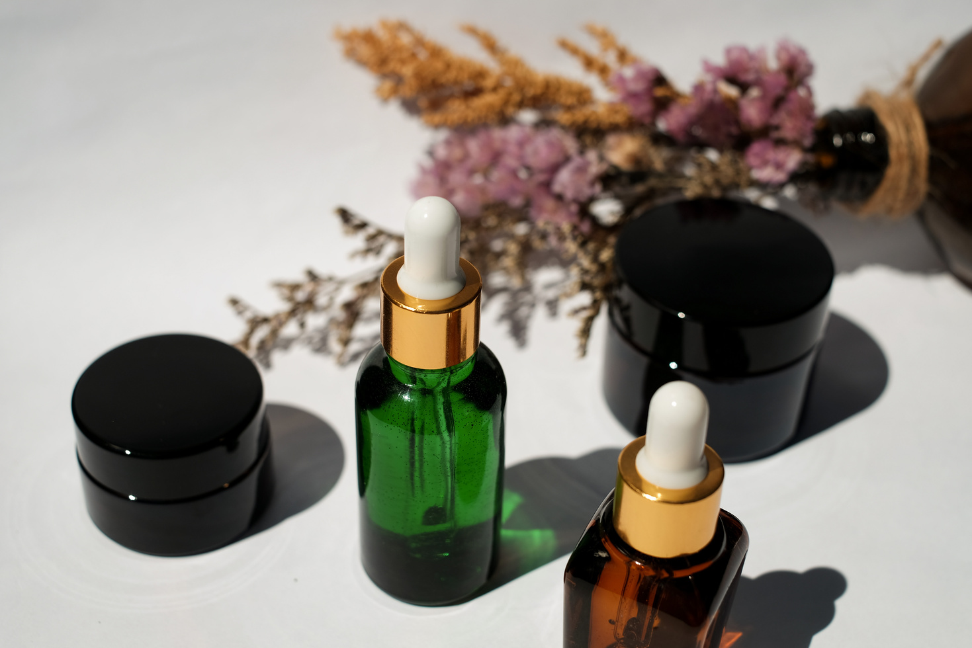
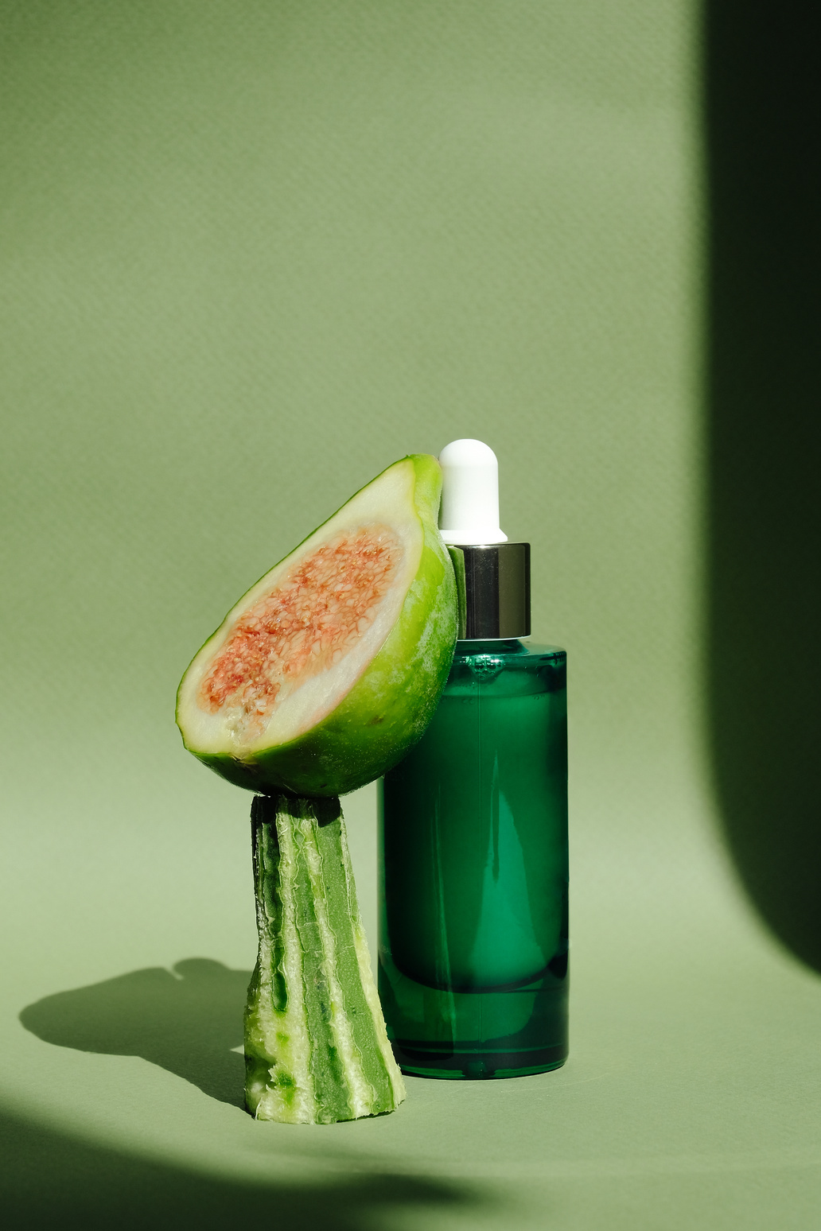
PROBLEM STATEMENT
- Selecting the right skin care product can be difficult due to variations in skin types, conditions, and personal preferences.
- People often don't know what products suit their specific skin needs.
- Project Goal:
To develop a machine learning model that analyzes facial features and recommends the most suitable products for each individual.

Slide 6
Literature survey

Slide 7
STUDY | TITLE | YEAR | KEY CONTRIBUTIONS | TECHNIQUES USED | FINDINGS
Deep Learning for Skin Type Classification | Deep Learning for Automatic Skin Type Classification from Facial Images | 2020 | Proposed CNN for classifying skin types like dry, oily, and normal | Convolutional Neural Networks (CNN) | Achieved 90% accuracy in classifying skin types from facial images
Facial Skin Condition Recognition for Personalized Treatmen | Facial Skin Condition Recognition for Personalized Treatment* | 2019 | Facial Skin Condition Recognition Using Machine Learning for Personalized Treatment | Image processing, Machine learning (SVM, Random Forest) | Successfully detected and recommended treatments for acne and other skin conditions
Skin Care Product Recommendation System Using SVM | Skin Care Product Recommendation System Using SVM | 2021 | Skin Care Product Recommendation Using Support Vector Machines | Support Vector Machines (SVM) | Efficient product recommendation based on skin type and user preferences
Acne Detection and Treatment Recommendation Using Machine Learning | Acne Detection and Treatment Recommendation Using Machine Learning Algorithms | 2022 | Hybrid model combining deep learning and decision trees for personalized skin care | Deep learning (CNN), Decision trees | Enhanced recommendation accuracy by integrating facial recognition and user feedback

Slide 8
OBJECTIVES
Presentations are communication tools that can be used as demonstrations.
Accurately Detect Facial Skin Tone Using Image Segmentation
Classify Skin Type Using a Pre-trained Deep Learning Model
EfficientNetB0 is used
Automated Workflows Generated using JSON and n8n
An Integration of AI and Deep Learning models

Slide 9
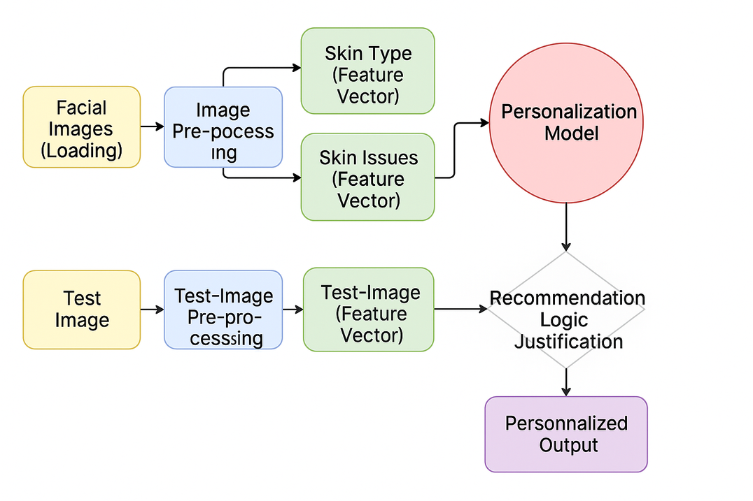
ARCHIETECTURE
Working of the System
- User uploads a facial image.
- The system detects facial features and analyzes skin condition (e.g., acne, dryness).
- Based on the analysis, the system suggests skin care products (e.g., moisturizers, acne treatments).

Slide 10
SOFTWARES USED
Feature Extraction:
convolutional neural networks (CNNs) to detect facial features and skin conditions
As per the judgement and Accuracy Gained by the following model after going through alot of Datasets from Dermnet and ISIC
We Have gained an accuracy of 84%
USER INTERFACE
The User Interface of our Model was made using CSS and HTML
This Helped us make a very interactive and clean Web Application
In the USER INTERFACE, Communicate with the User and ask for the Picture of the User
Recommendation System:
Recommendation Systems are developed by Deepseek r1 AI

Slide 11
Challenges Faced
Data Quality: Difficulty in gathering diverse, high-quality skin images.
Model Accuracy: Ensuring the model gives accurate recommendations.
Real-World Variability: Skin care needs vary significantly from person to person.

Slide 12
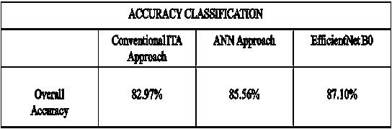
RESULTS
The model was able to recommend appropriate products with reasonable accuracy.
IMPROVEMENTS
- Expand dataset to cover more skin types and conditions.
- Use more advanced machine learning models (e.g., deep learning models) for improved accuracy.
- Implement real-time feedback from users to refine recommendations over time.

Slide 13
Conclusion
- This project demonstrates the application of machine learning to personalize skin care recommendations.
- It can help users select products tailored to their skin's unique needs.
- Thank you for your attention. I am happy to answer any questions!

Slide 14
Thank You

