Slide 1

Web application vulnerability assessment
By Akhmal and Shaheed

Slide 2
Chosen 2 vulnerabilities
A1:2017-Injection
A9:2017-Using Components with Known Vulnerabilities

Slide 3
SQLi
Definition: SQL injection is a type of attack that allows an attacker to interfere with the queries an application makes to its database.
Common Target: Web applications that directly interact with a database through user inputs (e.g., login forms, search bars).
Example Attack: An attacker entering malicious SQL code in form fields to manipulate the query and gain unauthorized access to the database.

Slide 4
SQLi
What is SQL Injection?
SQL Injection (SQLi) is a vulnerability that allows attackers to manipulate database queries by injecting malicious SQL code.
Occurs when user input is not properly sanitized in dynamically constructed queries.
Can lead to unauthorized access, data breaches, and manipulation of database records.

Slide 5
SQL Injection in the Application
Vulnerability Found In:
/search/:query endpoint in app.js
getOtherUsersListings function in listing.js
Problem:
User input was accepted and injected into SQL queries without proper sanitization.
Allowed attackers to manipulate queries and extract unauthorized data.

Slide 6
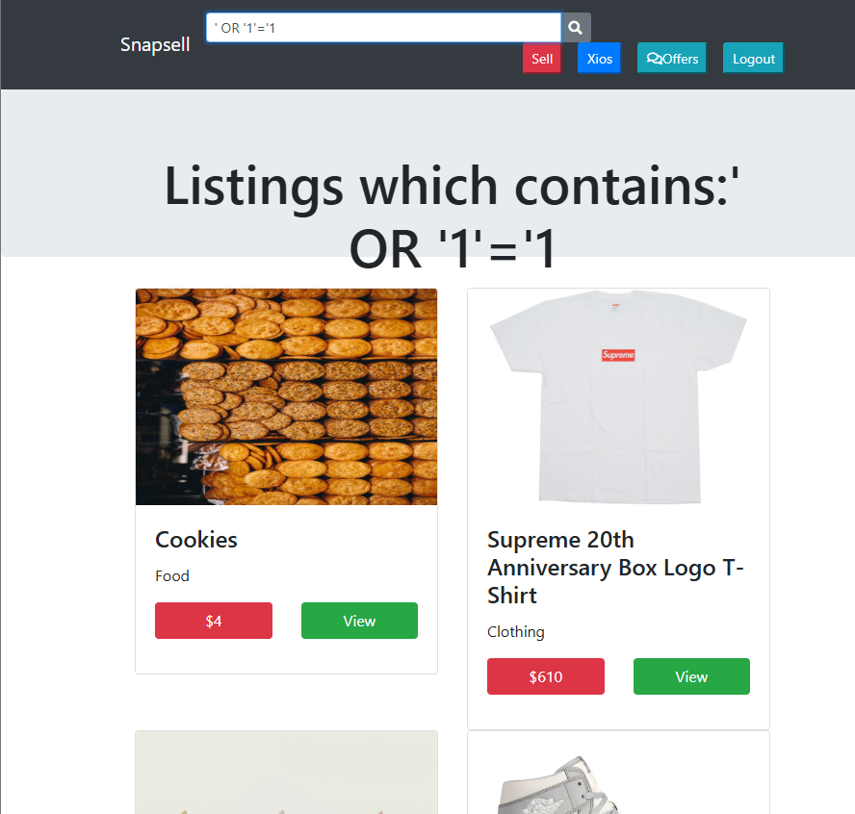
SQLi
Payload Sent:
Attack Method: Boolean-Based SQL Injection
Impact:
Bypasses search filters.
Returns all listings instead of filtered results.
Allows attackers to extract entire database content.

Slide 7
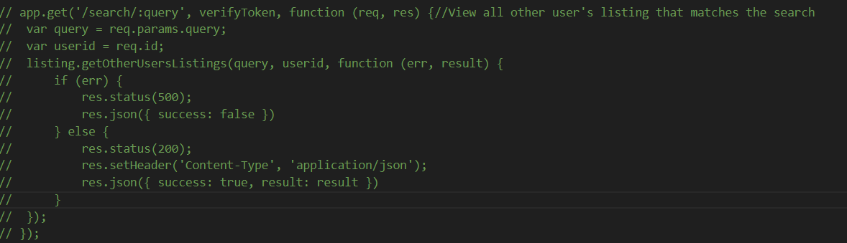
SQLi: Vulnerable code (App.js)

Slide 8
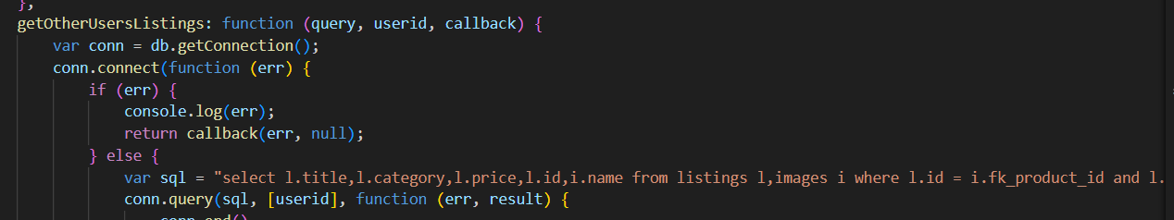
SQLi: Vulnerable code (listing.js)

Slide 9
Using Components with Known Vulnerabilities
This refers to the practice of using outdated or insecure libraries, frameworks, or software components that contain known security vulnerabilities.
Common Sources:
  Open-source libraries
  Third-party packages
  Frameworks with unpatched vulnerabilities

Slide 10
Risks of Using Vulnerable Components
Exploitability: Attackers can exploit known vulnerabilities in these components to gain unauthorized access or perform malicious activities.
Lack of Vendor Support: Older or unsupported components may not receive patches or security updates.
Data Breach Risk: Vulnerable components can lead to unauthorized access to sensitive data, similar to SQL injection or other attacks.
Compliance Issues: Failing to patch known vulnerabilities can lead to compliance violations (e.g., GDPR, HIPAA).

Slide 11
Mitigation Strategies for Known Vulnerabilities
Regular Updates: Continuously update libraries and components to the latest stable versions that fix known security issues.
Automated Scanning: Use tools like OWASP Dependency-Check or Snyk to identify vulnerable components in your software stack.
Version Control: Always track and control the versions of components used, and avoid using deprecated or end-of-life versions.
Security Patches: Apply security patches as soon as they are available to minimize the window of exposure.

Slide 12
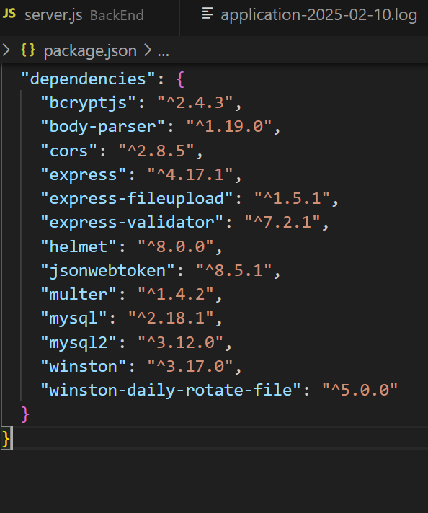
Vulnerabilities in Busboy and Its Impact on Multer
Busboy Overview: A streaming parser for HTML form data, often used in conjunction with multer for handling file uploads in Node.js applications
Known Vulnerabilities:
  Denial of Service (DoS): Certain versions of busboy have been found vulnerable to DoS attacks, which can overwhelm the server.
  Injection Flaws: Earlier versions lacked proper input validation, making them susceptible to injection attacks.

Slide 13
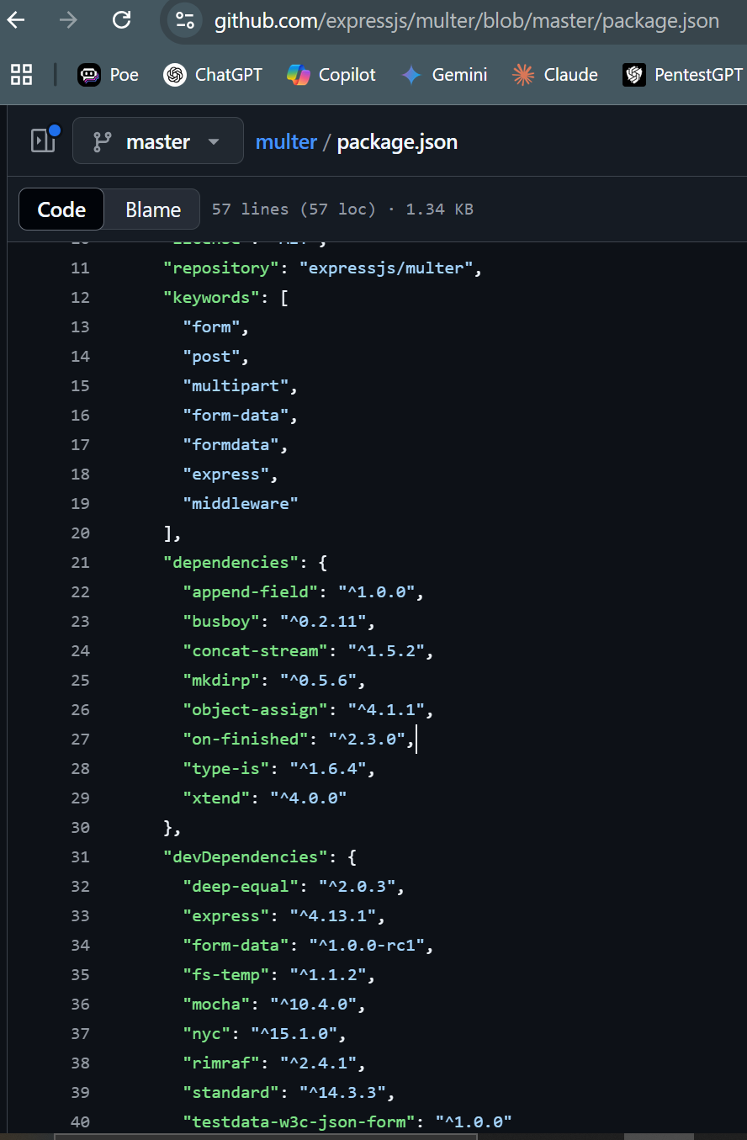
Vulnerabilities in Busboy and Its Impact on Multer
Busboy Overview: A streaming parser for HTML form data, often used in conjunction with multer for handling file uploads in Node.js applications
Known Vulnerabilities:
  Denial of Service (DoS): Certain versions of busboy have been found vulnerable to DoS attacks, which can overwhelm the server.
  Injection Flaws: Earlier versions lacked proper input validation, making them susceptible to injection attacks.

Slide 14

Summary
SQL Injection: A critical vulnerability that allows attackers to manipulate database queries and access sensitive data. Use parameterized queries and input validation to mitigate risks.
Using Components with Known Vulnerabilities: Avoid using outdated or unsupported components. Regular updates and automated tools help ensure your software remains secure.
Security Best Practices: Both SQL injection and vulnerable components can lead to serious risks. Adopting a proactive security posture is essential for protecting applications and data.

Slide 15
Thank you

