Slide 1
KLA · Image Restoration Challenge
Recovering clean images from
speckle, noise and ×2 downsampling
A 4.02 M-parameter NAFNet-style restoration network, trained from scratch — no pretrained weights, no GAN loss.
27.52 dB
+4.79 dB
4.02 M
0
val PSNR
over bicubic
parameters
pretrained weights
Team ViSaSha · Mohamed Shaheem · Sahasra Reddy · Vishnu Vardhan
Notes:
Task: learn the inverse of speckle + Gaussian noise + 2x downsampling, applied in undisclosed random order. Single-channel grayscale natural imagery.

Slide 2
Problem understanding
Learn f⁻¹ : y → x, where y is the degraded low-resolution observation
1
Speckle noise
2
Additive Gaussian
3
Downsampling ×2
Multiplicative, PDF centred at 1.0. Scales with local intensity, so flat bright regions suffer most.
Organizer sweep spans σ ≈ 0.05 → 0.50. Independent of signal level.
256×256 → 128×128. Anti-aliased kernel — we measured this rather than assuming it.
Blur is NOT a benchmark degradation
Order is undisclosed
It appears in the organizer deck only as illustration. We deliberately build no deblurring stage — adding one would spend capacity and latency on a degradation that is not scored.
The three degradations are applied in random order, so no fixed inverse sequence exists. We learn one joint mapping instead of chaining separate stages.
Output contract: KLA does not clip or renormalize. Whatever we save is scored verbatim — our pipeline clips to [0,1] and formats.
Notes:
Key decision: one joint mapping, not a cascade, because the degradation order is not disclosed.

Slide 3
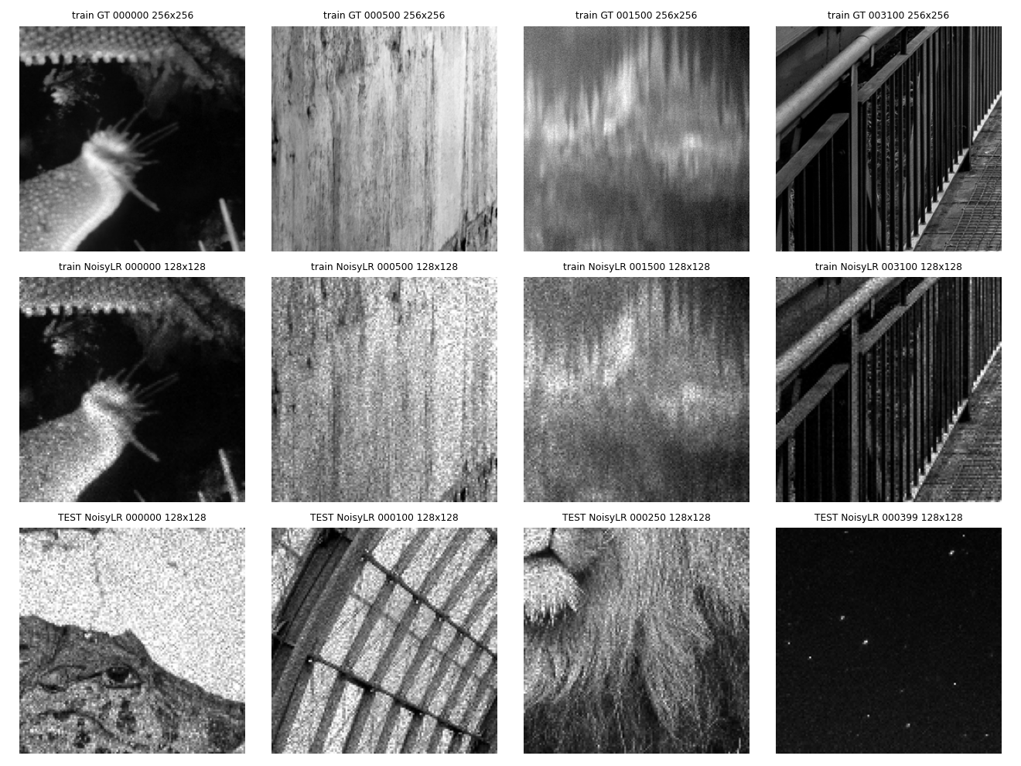
Dataset analysis
Every one of the 6,800 arrays was inspected — no sampling, no assumptions
count
shape
range
outside [0,1]
train GT
3,200
256×256
0.000 … 1.000
0.00%
train NoisyLR
3,200
128×128
−0.279 … 2.158
3.39%
test NoisyLR
400
128×128
−0.225 … 2.158
3.74%
Pairing rule: identical filename
GT/000123.npy ↔ NoisyLR/000123.npy — no suffix, no offset, no index table
×2 scale confirmed on every pair checked; zero exceptions
Train and test NoisyLR statistics match (mean 0.4335 vs 0.4427) — the OOD half differs in content, not degradation strength
Measured, not assumed
GT (top) · train NoisyLR (middle) · test NoisyLR (bottom). Natural imagery, not wafer scans.
Downsampler is anti-aliased, not nearest (residual RMSE 0.0853 vs 0.0979). Effective noise std varies per image from 0.025 to 0.20 — the model must be blind to noise strength.
Notes:
GT is exactly in [0,1] over all 3200. NoisyLR exceeds on BOTH ends, including negative values, which the brief did not mention.

Slide 4
End-to-end pipeline
One joint mapping — no cascade of per-degradation stages
Load
Normalize
NAFNet-SR
PixelShuffle ×2
+ bicubic
Clip & save
.npy float32
raw, unclipped
›
fixed mean shift
−0.4335
›
enc–dec at LR res
4.02 M params
›
upsample deferred
to the last layer
›
global residual
zero-init tail
›
[0,1] float32
same filename
Two properties this buys us
Resolution-agnostic
Starts at the baseline, never below
Fully convolutional; inputs are reflect-padded to a multiple of stride 8 and cropped back exactly. No spatial dimension is hardcoded anywhere. Verified on 128², 256² and a deliberately odd 130×97.
The tail convolution is zero-initialized and the bicubic upsample is added back, so an untrained model outputs exactly the bicubic baseline. Training can only improve on the floor — and convergence starts from a sensible point instead of noise.
Notes:
The global residual means the network only learns the correction, which converges faster and preserves structure.

Slide 5
Preprocessing and data handling
The rule that matters: never clip the input, only the output
Normalization
Why the input is never clipped
x_norm = y_raw − 0.4335
3,120 of 3,200 training images contain a pixel above 1.0, and 1,967 contain a pixel below 0.0. Those out-of-range values are signal, not error — they carry the noise realization. Clipping the input would destroy evidence the network needs to estimate and remove the noise.
A single fixed dataset-level constant, recorded in configs/final.yaml
No per-image statistics — those would leak test-time information
std deliberately left at 1.0: mean-shift only
Augmentation and cropping
Random crop on the LR grid
Flips + 90° rotations only
Validation: 200 images
LR 64×64 with the exactly matched GT 128×128 crop
Nothing that touches intensity statistics
Held out by image, seeded, file list committed to the repo
Test_NoisyLR is never trained on, never validated on, and never used for checkpoint selection.
Notes:
Augmentation is restricted to geometry because intensity augmentation would change the noise statistics we are trying to model.

Slide 6
Architecture
NAFNet-style encoder–decoder, ×2 upsample deferred to the very end
Encoder
Bottleneck
Decoder
Head
width 32 → 64 → 128
width 256
128 → 64 → 32
PixelShuffle ×2
blocks [2, 2, 4]
6 NAFBlocks
blocks [2, 2, 2]
1 channel out
Why this shape
Post-upsampling: the whole encoder–decoder runs at 128×128, not 256×256 — roughly 4× cheaper for the same depth, and throughput is scored
SimpleGate + simplified channel attention replace softmax attention, keeping quality-per-FLOP high without transformer cost
Three downsample levels give the receptive field needed to separate speckle from texture
Fully convolutional, so 128² and 256² inputs both work unchanged
4.02 M
8
parameters
network stride
38.9 ms
4.98 ms
fwd @ 128², bs 1
per image @ bs 16
Latency measured with CUDA events, median of 30 after warmup, on an RTX 4050 Laptop GPU.
Notes:
Independent implementation of the NAFNet block design (Chen et al., ECCV 2022). No code or weights copied.

Slide 7
Loss design
Optimizing for fidelity, not for plausibility
L = Charbonnier(ε = 1e-3) + 0.15 · (1 − MS-SSIM)
Charbonnier
MS-SSIM (0.15)
No adversarial loss
A smooth L1. Robust to the heavy-tailed residuals that speckle produces, where plain L2 would let a few bright outliers dominate the gradient.
Multi-scale structural term. Pulls LPIPS in the right direction without a VGG download or perceptual-weight tuning we cannot afford tonight.
A GAN would invent texture that looks right and is not there. The objective scores against real ground truth, so hallucinated structure is penalised — and with the metric weights undisclosed, trading dB for perceptual sharpness is an uncontrolled bet.
Rejected alternatives, and why
Real-ESRGAN / BSRGAN initialization — GAN-trained priors synthesize plausible detail rather than recovering real detail; several dB of PSNR traded for LPIPS
Full SwinIR / Restormer — window attention is slow, and end-to-end throughput is an explicitly scored axis
Perceptual (VGG) loss — weight tuning and a 500 MB download were not affordable inside the build window
Notes:
Every rejection here is a deliberate, defensible engineering decision, not an oversight.

Slide 8
Experiments and baseline
One config, one seed, one checkpoint — the training budget was spent, not scattered
Mandatory baseline: bicubic ×2
A plain ×2 bicubic upsample of the raw input, clipped at save time. It does no denoising at all, which is exactly why its SSIM and LPIPS are poor while PSNR is merely mediocre — the noise survives the upsample intact. It is the honest floor.
Optimizer
AdamW, lr 2e-4, cosine → 1e-6, 500-step warmup
Batch / crop
64 · LR 64 → GT 128
Precision
bf16 autocast, channels_last, TF32
EMA
0.999 — EMA weights are what get validated and saved
Seed
1337, logged with the git hash in every checkpoint
Every point is above the bicubic floor of 22.73 dB. Validation peaks at step 4,000 (27.52 dB) and then declines while training loss keeps falling — overfitting. The submitted checkpoint is that peak.
Pipeline sanity checks — both pass before any training was launched
A · memorize 2 fixed pairs (no crop, no augmentation): 26.36 → 52.13 dB, +25.77 over bicubic — the network can represent the mapping. B · save/reload round trip: bit-exact float32, clip exact, channel axis stripped — saving costs nothing.
Notes:
Sanity A is the check that de-risks everything: if a 4M net cannot overfit 2 images, the pipeline is wired wrong.

Slide 9
Results: PSNR · SSIM · LPIPS
KLA's blend over the three is undisclosed, so all three are reported unweighted
PSNR ↑
SSIM ↑
LPIPS ↓
bicubic baseline
ours
bicubic baseline
ours
bicubic baseline
ours
22.7300
27.5150
0.5215
0.7430
0.4395
0.2676
improvement +4.79 dB
improvement +0.222
improvement −0.172
Fidelity — how close each pixel is to ground truth.
Structure — local luminance, contrast and correlation.
Perceptual distance (AlexNet). Lower is better.
Computed on the saved files
Metric code validated, not trusted
OOD proxy: read 24.40 dB, not 27.52
scripts/evaluate.py reads the written .npy outputs back off disk rather than scoring in-memory tensors, so any dtype or range loss at save time is captured in the number we report.
PSNR and SSIM are implemented in torch, then checked against scikit-image across six noise levels. Maximum deviation 1.6e-07 (SSIM) and 9.0e-07 (PSNR).
Half the hidden test is OOD content we cannot measure directly. Partitioning the held-out split by content character gives 31.36 / 26.73 / 24.40 dB for smooth / edge-dominated / texture-heavy. We treat the weakest as our OOD expectation.
Method and per-group table in results/ood_analysis.md; figure in results/figures/ood_groups.png.
Notes:
Validation split is 200 images held out by image from train/, seeded and committed.

Slide 10
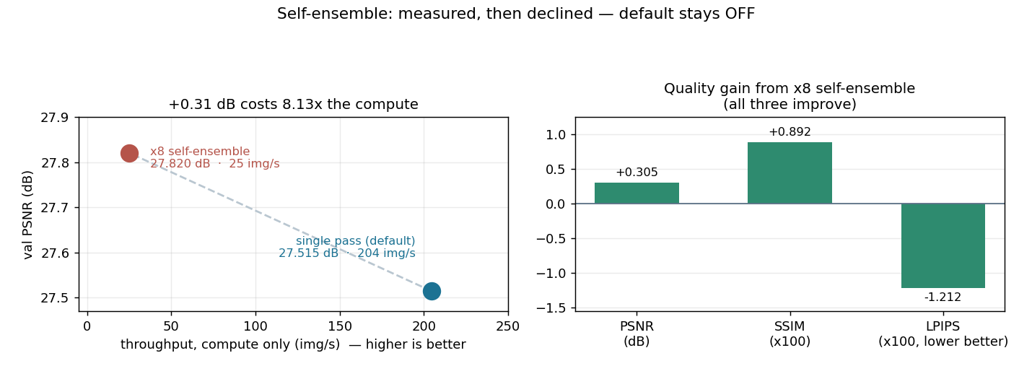
Runtime and optimization
Throughput is scored end-to-end — including disk read and file writing
172.4
2.32 s
4.98 ms
4.02 M
images / sec
for 400 test images
forward, per image
parameters
What we did to make it fast
Post-upsampling: the network runs at LR resolution, so the expensive layers never see 256×256
Threaded output writing — the classic hidden bottleneck in this task
inference_mode, channels_last, bf16 autocast, TF32, shape-grouped batching
Honest caveat on these numbers
All timings are from an RTX 4050 Laptop GPU (6 GB, sm_89), not an H100 — read them as relative, not as a prediction of evaluation-hardware throughput. Method: CUDA events with explicit synchronize, warmup discarded, median of repeats; per-stage breakdown in results/runtime_report.md.
Self-ensemble: measured, then declined
x8 flip/rotate averaging is implemented behind --self_ensemble and defaults OFF. It buys +0.305 dB PSNR, +0.009 SSIM, -0.012 LPIPS for 8.13x the compute (204 -> 25 img/s). Quality and throughput are scored separately with undisclosed weights, so we took the option strong on both rather than trading a large certain cost for a small uncertain gain.
Resolution paths verified beyond the released data. All 400 released test inputs are 128×128, so the 256×256 → 512×512 path was never exercised by them. It is now checked explicitly (scripts/verify_resolution_paths.py): correct ×2 shape, filenames, float32 dtype and [0,1] range at 256×256, plus 250×250 and 129×129 to force the reflect-padding path that multiples of the stride never touch — no seam, and a mixed-shape directory batches correctly. Peak VRAM: 0.124 GB at 256×256, 0.350 GB at 512×512, 1.256 GB at 256×256 batch 16.
Notes:
The scoring clock includes I/O, which is why writing is threaded and reads are overlapped.

Slide 11
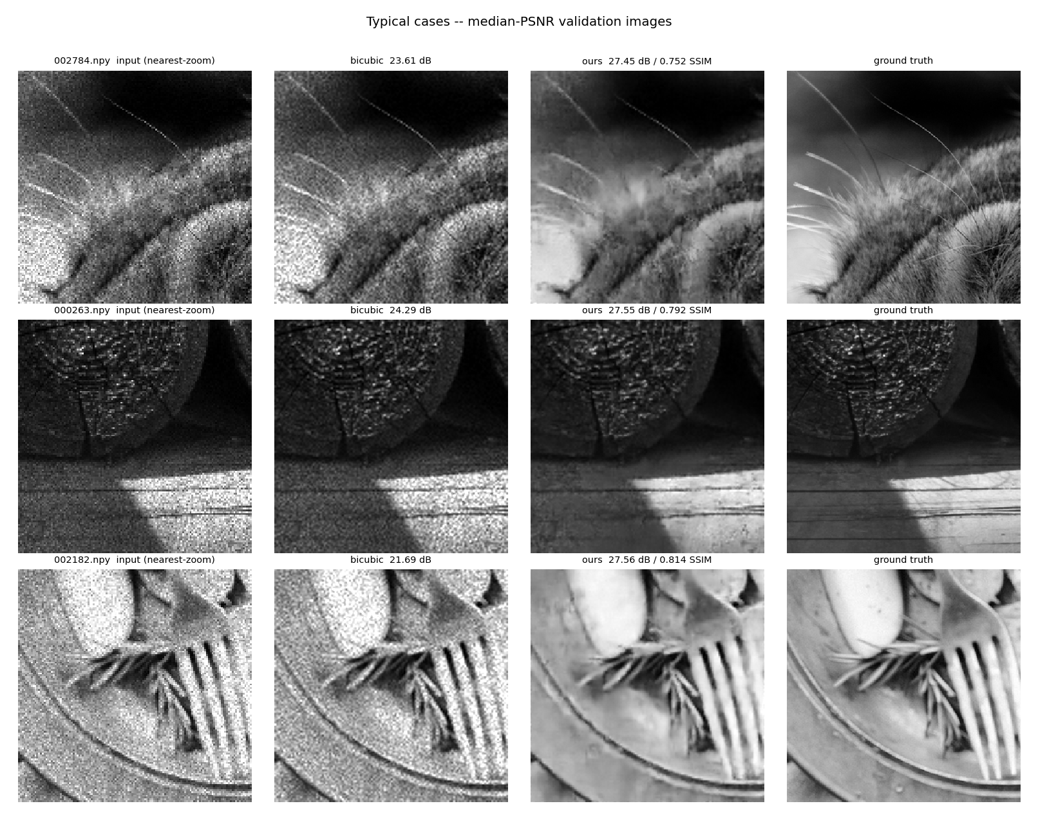
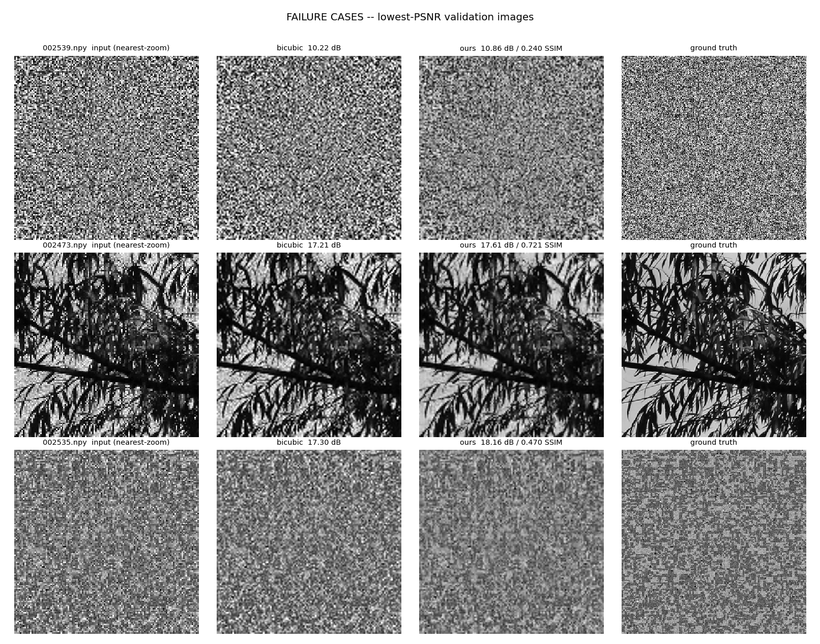
Visual results and failure cases
Looking at the images, not only at the averages
Typical cases — median-PSNR validation images
Failure cases — lowest-PSNR validation images (all three are texture-heavy: our OOD proxy group)
Where the model struggles
All three lowest-PSNR validation images fall in the texture-heavy group — the partition and the failure analysis agree independently. The model over-smooths when the ground truth is itself dominated by dense high-frequency texture: 002539 (10.86 dB) and 002535 (18.16 dB) have near-noise-like GT, 002473 is dense foliage. A fidelity objective correctly suppresses high-frequency content that looks like noise, which is right on average but erases genuine fine texture. That group averages 24.40 dB against 27.52 dB overall, and it is our honest OOD estimate. Even here the model beats bicubic on all three (10.86 vs 10.22, 17.61 vs 17.21, 18.16 vs 17.30) — it never does worse, it simply cannot win much.
Notes:
Mandatory checklist item: at least one honest failure case is shown.

Slide 12
Conclusion
1
Beats the mandatory baseline
Disclosure
27.52 dB vs 22.73 dB bicubic (+4.79 dB), on a held-out split never used for training
External datasets used: NONE.
Pretrained weights in the submitted model: NONE — trained from random initialization on the organizer pairs only.
Evaluation only: LPIPS (pypi lpips 0.1.4, github.com/richzhang/PerceptualSimilarity, BSD-2) and its AlexNet backbone (torchvision, BSD-3). Both licences were read from the shipped LICENSE files, not from memory. Neither is imported by inference.py — verified by tracing its full import graph and re-running it with those packages blocked and sockets disabled.
Test_NoisyLR was used only to produce submission outputs — never trained on, never validated on.
Full detail in EXTERNAL_RESOURCES.md.
2
Reproducible by construction
One config, one seed, committed val split, git hash inside every checkpoint, metrics computed from the saved files
3
Training hygiene: we caught our own overfitting
Validation PSNR peaked at step 4,000 of the approved 15,000 while training loss kept falling. We identified this as overfitting — 3,000 images against 4.02 M parameters, no weight decay — stopped at ~9.4k and submitted the peak checkpoint best.pt had already captured. Next step is weight decay, not more steps.
Team ViSaSha · Mohamed Shaheem · Sahasra Reddy · Vishnu Vardhan
Repository
github.com/shaheeeeeeeeem/kla-restoration
python inference.py --input_dir <degraded> --output_dir <restored>
Zero other required arguments. No config edits, no notebooks, no path edits.
Notes:
Repo is public; weights resolve relative to the script, not the CWD.

