Slide 1

A
Dissertation
Submitted to
DEPARTMENT OF COMPUTER SCIENCE ENGINEERING,
AMITY SCHOOL OF ENGINEERING AND TECHNOLOGY
In
the partial fulfillment of the requirements for the award of the degree of
Master of Technology
in
Computer Science & Engineering
Submitted By
SHAHEEN PARVEEN
Enrollment No.: A7600918001
under the guidance of
Dr. Pawan Singh (Associate Professor)
Dr. Deepak Arora (Professor & Head CS&E)

Slide 2
Energy Conservation Using Fog Node with Processor Temperature
Fog Computing

Slide 3
Index
Introduction
Comparison of Cloud and Fog Computing
Working of Fog Computing
Architecture of Fog Computing
Recent Surveys on Fog Computing
Application of Fog Computing
Advantages Of Fog Computing
Emerging Challenges
Major Contribution of the thesis
Summary of Notation
Proposed Algorithm of model
Flow Chart of System
Glimpse of implementation
Research Papers Published/Communicated
References

Slide 4
Introduction
Acts as an intermediation and complementing to Cloud Network.
It is an extension of Cloud Computing and sometimes called Edge Computing or Fogging also.
It’s not the replacement of the cloud computing.
Provides the functionality to Internet of Things(IOT).
Minimize the latency
Save the expense of computation in terms of bandwidth

Slide 5
Comparison Of Cloud And Fog Computing
Main Features | Cloud Computing | Fog Computing
Server nodes location | Within the internet | At the local network edge
Density of nodes(If IoT devices are in millions) | Few(Hundreds) | Plenty(Thousands)
Distance between devices and server | Multiple steps | Single step
Latency | High | Low
Distribution | Centralized | Distributed
Scalability | Less(Big cloud centers - Cost prohibited) | More (Micro fog centers – Easy to deploy)
Mobility support | Limited | Supported
Real-time interactions | Supported | Supported
Security | Less secure | More secure

Slide 6
Working of Fog Computing
It receives data from the edges of network using any protocol.
It gives milliseconds respond time .
After processing, it sends data summaries back to cloud server periodically.
The most time-sensitive data is analysed on the fog node closest to the things generating the data.
Data that can wait seconds or minutes for action is passed along to an aggregation node for analysis and action.
Data that is less time sensitive is sent to the cloud for historical analysis, big data analytics, and long-term storage.
For example, each of thousands or hundreds of thousands of fog nodes might send periodic summaries of grid data to the cloud for historical analysis and storage.
Notes:
Working of fog computing….fog nodes usually receives data from the edge of network and responds in milliseconds. After processing, it sends data summaries to cloud server periodically.. Here..data can be categorized into three types …first is most time sensitive data..which is processed by directly connected fog nodes…the second is those data which can wait for seconds or minutes for the action…so it could be passed along to the aggregated node for the analysis and action…the third type of data is …less time sensitive data..which can be sent to cloud for historical analysis and long term storage..its example is…grid data network..

Slide 7
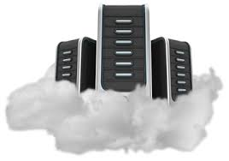
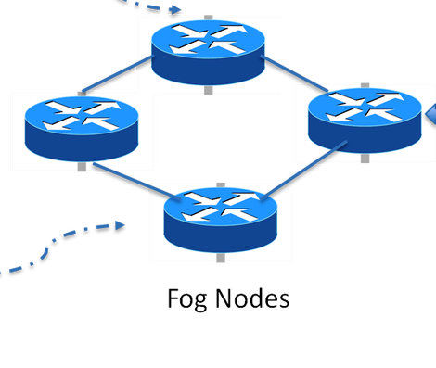
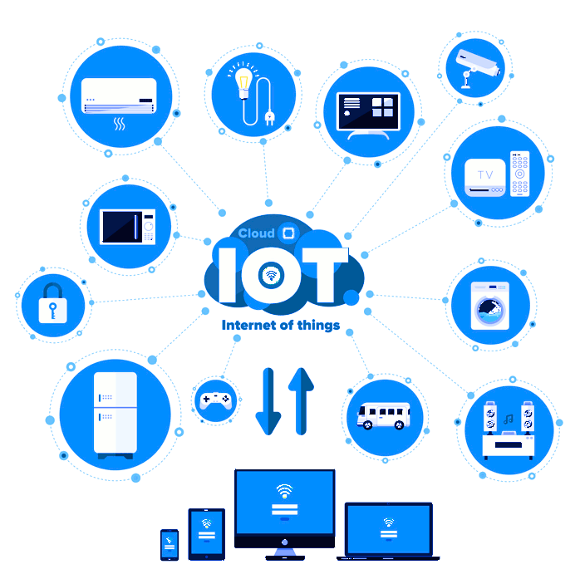
Architecture of Fog Computing
IN THOUSANDS
Cloud Computing
Cloud
IN MILLIONS
Fog Computing
IN BILLIONS
IoT or EndUsers

Slide 8
Summary of Important literatures (2012-2020)
Author(s) | Year | Major Contribution
F. Bonomi et al. | 2012 | Vision and characteristics of fog computing for serving the edge device in terms of compute, store and network.
J.B.M.Numhauser et al. | 2013 | Distributed topology XMPP for fog computing solution.
I. Stojmenovic et al. | 2014 | Investigated the security issues in fog computing environment by invoking man in middle attack.
A.V. Dastjerdi et al. | 2016 | Reference architecture for fog computing environment
H. Gupta et al | 2017 | iFogSim tool to model the IoT and Fog computing environment and evaluate the resource management technique
R. Mahmud et al. | 2017 | Demonstrated the feasibility of interoperable fog based IoT healthcare solution.
T. Qayyum et al. | 2018 | Developed the GUI based simulator using C++ language as an extension of OMNET++ called FogNetSimCC
I. Lera | 2019 | YAFS simulator based on python language for dynamic scheduling.
M. Scarpiniti et al. | 2019 | VirtFogSim to optimize energy saving dynamic allocation of task and resources.
P. Kayal | 2020 | Kubernetes as the solution of fog computing for managing containerized IoT applications.

Slide 9
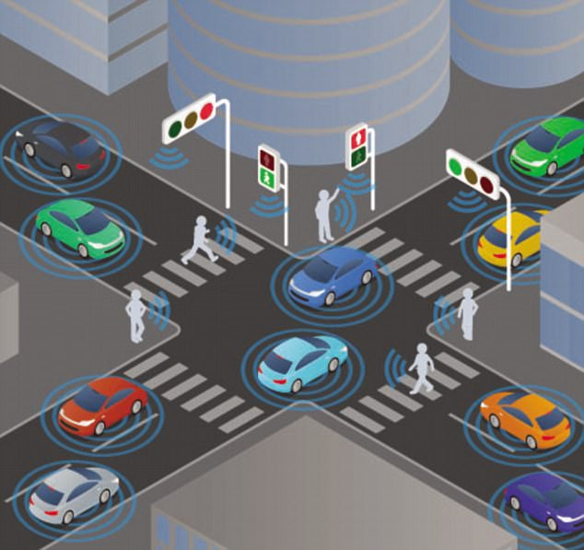
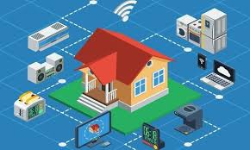
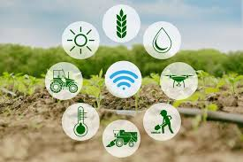

Applications of Fog Computing
Traffic system Home Automation
Smart Agriculture Smart Manufacturing

Slide 10
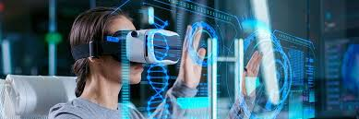
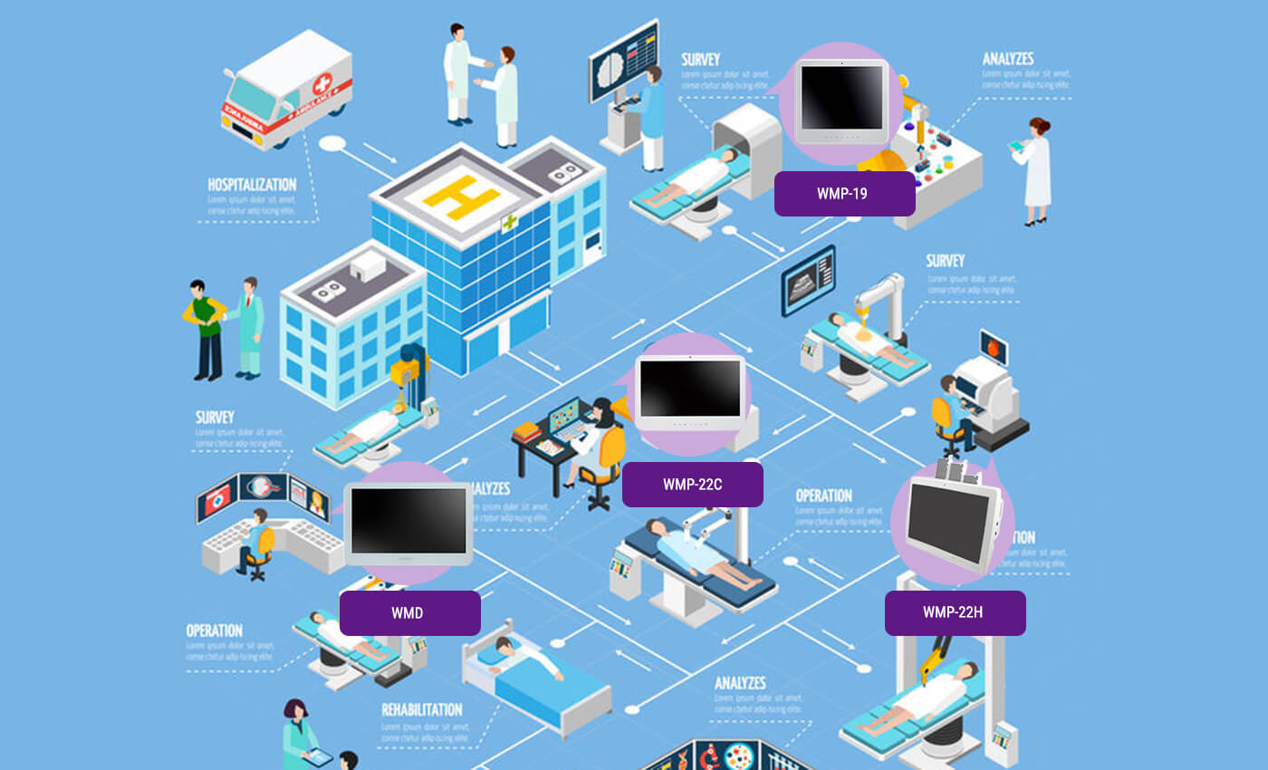
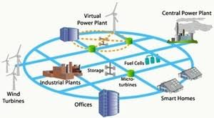
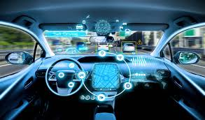
Continu…
Augmented reality Healthcare System
Smart Grid of Energy Connected Car

Slide 11
Emerging Challenges
Challenges For Fog Computing
Heterogeneity
Scalability
Patient’s Data Security
Complexity
Dynamicity
Energy Consumption
Resource Management
Latency

Slide 12
Advantages Of Fog Computing
Minimize the latency rate : Fog node can compute the result faster than cloud server.
Optimization of Energy consumption : Energy consumed by the cloud server can be optimized with the help of fog nodes.
Greater business agility: With the right tools, developers can quickly develop fog applications and deploy them where needed. Machine manufacturers can offer MaaS to their customers. Fog applications program the machine to operate in the way each customer needs.
Better security: Protect your fog nodes using the same policy, controls, and procedures you use in other parts of your IT environment. Use the same physical security and cybersecurity solutions.
Deeper insights, with privacy control: Analyse sensitive data locally instead of sending it to the cloud for analysis. Your IT team can monitor and control the devices that collect, analyse, and store data.
Lower operating expense: Conserve network bandwidth by processing selected data locally instead of sending it to the cloud for analysis.

Slide 13
Major Contribution of the thesis
A pricing Fog-Cloud based model that enhances the profit of consumer as a provider without any extra expense on maintenance.
A comprehensive literature review on fog computing is presented by categorizing on differently
A web based application model that facilitate the extracting of processor data for alarm triggering.
An energy conservation technique is integrated with self maintenance which saves time, energy, space and bandwidth.
Analysis on the efficiency of fog Computing.
Some future aspects are also proposed.

Slide 14
Summary of Notation
Variable | Definition
Tem | Temperature Fetch From Processor
T_{S} | Timestamp Fetch From Processor
I_{n} | Interval
Count | Counter
T_{H} | Threshold Value
A_{R} | Alarm (1=ON,0=OFF)
Tem^{in} | Increasing temperature
Tem^{dec} | Decreasing Temperature
Tem^{max} | Maximum Temperature
Tem^{min} | Minimum Temperature

Slide 15
Proposed Algorithm of model
Input: <fog node> Tem, T_{S,} I_{N,} Count, assign <Cloud server> T_{H}, A_{R}
Output: Tem^{in}, Tem^{dec}, Tem^{max}, Tem^{min}
Set I_{N=} 15 min or 900sec,Count=0, Tem^{max} = 27, Tem^{min} = 16, Tem^{max} <=T_{H}< =Tem^{min};
Set Tem^{in}=0, Tem^{dec}=27, A_{R} = 0
Count=Count++;
if (Count= =I_{N})
Tem ← assign.fog
if( Tem==T_{H})
return 0;
else
Set A_{R} = 1
if( Tem> Tem^{max})
Tem^{Dec}--;
else
Tem^{in}++;
end
end
Reset Count, A_{R} =0;
Repeat 5 to 17

Slide 16
Flow Chart of System
Set the threshold, Interval and other values (T_{H)}
Processor Sensor
Fetch the data from Processor (Tem)
Yes
No
if (Tem==T_{H)}
Set A_{R} = 0
Set A_{R} = 1
Actuator
Yes
No
if (Tem<Tem^{max})
Increase Tem^{in}++
Decrease Tem^{Dec}
Actuator
End

Slide 17
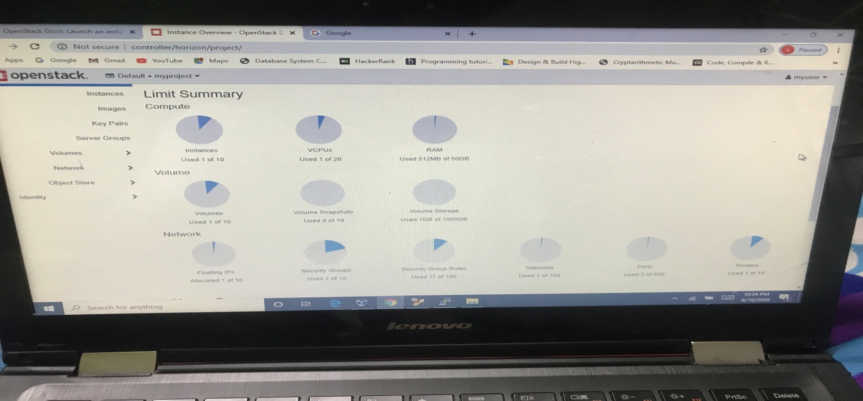
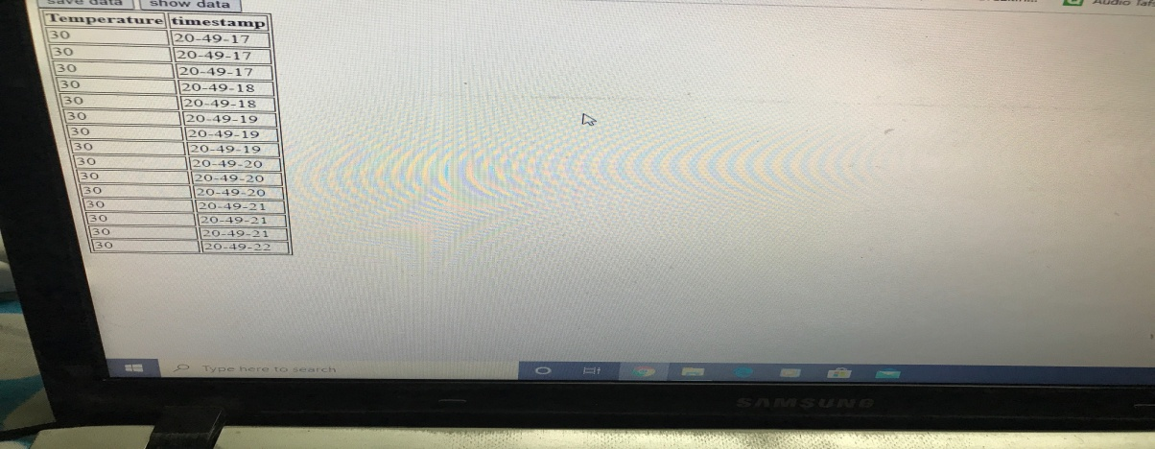
Glimpse of implementation

Slide 18
Research Papers Published/Communicated
Paper titled: “Fog computing research Opportunities and Challenges: A Comprehensive Survey” is published in Lect. Notes in Networks, Syst. (Springer), vol. 121, Pradeep Kumar Singh et al. (Eds).In the Proceedings of First international Conference on Computing, Communications, and Cyber-security (IC4S 2019), Chandigarh, India, 12-13 October 2019.
Paper is accepted In the Proceedings of 3rd International conference on Recent Innovations in Computing (ICRIC-2020) LNEE Springer approved, Jammu, India.

Slide 19
References
Bar-Magen Numhauser, Jonathan (2012). Fog Computing introduction to a New Cloud Evolution. Escrituras silenciadas: paisaje como historiografía. Escrituras Silenciadas: Paisaje Como Historiografía / José Francisco Forniés Casals (Ed. Lit.), Paulina Numhauser (Ed. Lit.), Proceedings from the Cies III Congress, January 2012. Spain: University of Alcala. pp. 111–126. ISBN 978-84-15595-84-7.
Bonomi, Flavio; Milito, Rodolfo; Zhu, Jiang; Addepalli, Sateesh (2012-08-17). Fog computing and its role in the internet of things. ACM. pp. 13–16. doi:10.1145/2342509.2342513. ISBN 9781450315197. Bonomi, Flavio (September 19–23, 2011). "Connected Vehicles, the Internet of Things, and Fog Computing, The 8th ACM International Workshop on VehiculAr Inter-NETworking (VANET 2011), Las Vegas, NV, USA". www.sigmobile.org. Retrieved 2019-08-07.
Bonomi, Flavio (June 4–8, 2011). "Cloud and Fog Computing: Trade-offs and Applications. EON-2011 Workshop, International Symposium on Computer Architecture (ISCA 2011), San Jose, CA, USA". sites.google.com. Retrieved 2019-08-07. ^ "IoT, from Cloud to Fog Computing". blogs@Cisco - Cisco Blogs. 2015-03-25. Retrieved 2017-04-07. ^ "What Is Fog Computing? Webopedia Definition". www.webopedia.com. Retrieved 2017-04-07.
Bar-Magen Numhauser, Jonathan (August 25, 2013). XMPP Distributed Topology as a Potential Solution for Fog Computing. MESH 2013 the Sixth International Conference on Advances in Mesh Networks. pp. 26–32. ISBN 9781612082998. ^ Forti, Stefano; Ferrari, Gian-Luigi; Brogi, Antonio (January 2020). "Secure Cloud-Edge Deployments, with Trust". Future Generation Computer Systems. 102: 775–788. doi:10.1016/j.future.2019.08.020. ^
Brogi, Antonio; Forti, Stefano (2017). "QoS-aware Deployment of IoT Applications Through the Fog" (PDF). IEEE Internet of Things Journal. PP (99): 1185–1192. doi:10.1109/JIOT.2017.2701408. ISSN 2327-4662. ^ Cisco RFP-2013-078. Fog Computing, Ecosystem, Architecture and Applications: [1]Also available from the Internet Archive: [2].

Slide 20
THANK YOU

