Slide 1
How Do I Analyze Action Research Data?
There is a close relationship between the collection of action research data and its analysis.
The better the research instruments we develop to collect data, the more reliable those data will be. The more reliable our data, the greater are our chances of undertaking research that merits the label "rigorous". The more rigorous our research, the more likely it is that our conclusions and recommendations will be significant.

Slide 2
outlined three research projects and suggested methods by which action research data might be collected..
It is not possible to examine in any depth, in this limited number of pages, the particular advantages and possible disadvantages of using questionnaires, interviews, observations, etc., within your action research project. However, both Hopkins (2002)and Macintyre (2000) discuss this topic at some length.
some authors have devoted entire volumes to discussing themes such as 'developing a questionnaire' (Gillham, 2000a), 'the research interview‘ (Gillham, 2000b) and 'case study research methods‘ (Gillham, 2000c).

Slide 3
Analyzing research data
purpose here is to offer some practical examples of data collection instruments utilized in the three projects mentioned previously and to discuss possibilities for data analysi"s arising from them.
Example 1, 'Developing an effective school governing body”
Mrs A, through triangulation method and collects data by utilizing three research methods: observation, questionnaire and interview.
The observation chart details the agenda items for the meeting of the school's governing body, the number of minutes for which each member speaks on a particular topic, and the total number of minutes for which members speak expressed as a percentage of the whole.
Three Questions to be answered. How might this data be analysed? What might Mrs A conclude from it? What is she entitled to conclude from it?

Slide 4
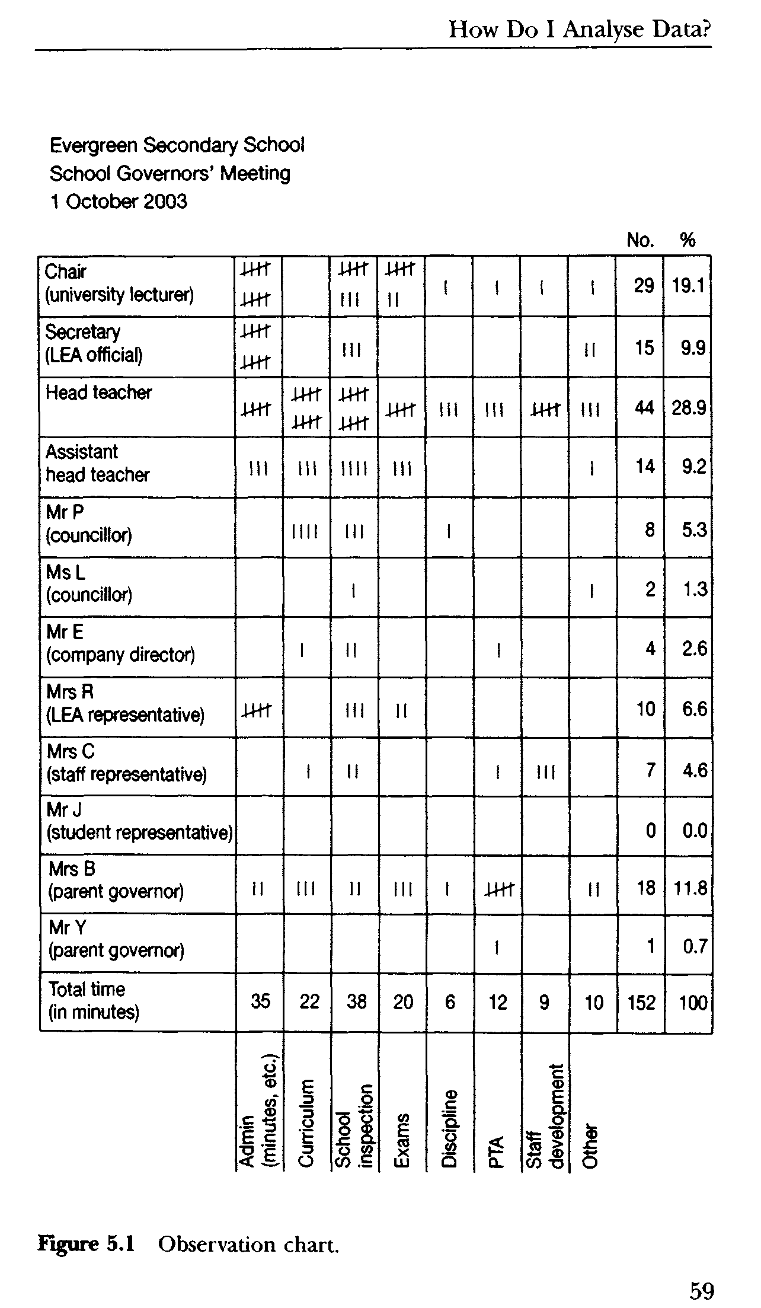

Slide 5
collecting quantitative data may make an important contribution to an action research project, it should be remembered that information represented in an observation chart needs to be interpreted in exactly the same way as other data gathered during a research study. The so-called 'facts' that emerge from quantitative research never speak for themselves: they have to be supported by reasons, evidence, and argument.
A number of questions to pursue via other research methods, such as the questionnaire and interview schedule developed by Mrs A.
She piloted a questionaire and circulated it for suggestions and proof reading among colleagues and made amendments according to responses.
She is aware of the need to pilot all data-gathering instruments, in order to ascertain the amount of time recipients take to complete them, to ensure that all the questions and accompanying instructions are outlined clearly and to enable items to be removed or amended as necessary (Bell,1999).

Slide 6
Mrs A Is collecting both quantitative and qualitative data so the options she has used for response for each question is different.
This reduces the possibility that respondents may reply automatically to questions, or persist in choosing the middle option in a non-reflective manner. On several occasions, Mrs A offers respondents the opportunity to write comments.
In analysing action research data, Macintyre (2000, p. 91) offers a concise explanation of four key terms: themes ('the consistent ideas which emerged'); incidence ('how often something occurred, or the number of questionnaire replies which said the same thing'); patterns ('the timing of the occurrences - whether they were single or in a cluster'); and trends ('the frequency of the patterns'). These enable researchers to offer explanations for what has taken place, rather than just descriptions of events .

Slide 7
A model of action research revisited
Having analysed the research data, Mrs A is now able to translate her findings into an action plan (stage 4 of Denscombe's (1998) action research model: strategic planning)
Once the strategies have been implemented (stage 5: action), they will have an impact on professional practice (stage 1) and so the action research cycle begins again.
Mr B during his project on 'Developing questioning in organizations‘
'Developing thinking skills in the early years classroom Ms C amended model of argument she uses when introducing a thinking skills programme to develop young children's moral thinking.
regarding data analysis. All the data you collect should be discussed in your project report. If you are unable to analyse all of it, the reasons for your selection of particular data should be made clear. Remember that it is possible to display your results in a variety of ways (e.g. observation charts, pie-charts, bar graphs, etc.). Finally, use appendices to offer the reader a more extensive account of your research than is permitted within individual chapters.

Slide 8
How Do I Produce an Action Research Report
Once you have collected and analysed your action research data, you are ready to produce a report of your findings. In doing this, it is useful to consider two preliminary questions:
For whom are you writing the report?
What are the particular requirements or guidelines for writing the report
undertaking an action research project as part of a course of study for an academic qualification, your audience will include your supervisor and (potentially) an external examiner.
Requirements and guidelines for writing action research reports:
Three formats shown for writing the action research report generic info is as follows:
Paper size: A4.
Your project must be word-processed using Times or
Times New Roman 12 point
Margins: left-hand - 3 cm; right-hand - 2 cm; top -
cm; bottom - 2 cm.
All pages should be numbered.
Use double spacing throughout.
Either spiral ring binding, or soft binding for initial
submission and hard binding after examination.

Slide 9
Action research reports: a possible format
Contents page
Declaration
Summary
Acknowledgements
Introduction
Chapters:
1. a critical review of the relevant literature;
2. information about the nature and context of your research (including methods of data collection and analysis);
3. a discussion of the results of your research;
4. conclusions and recommendations.
Appendices
Bibliography

Slide 10
when writing your research report You should demonstrate continuity and progression throughout the text, so that it reads as a coherent and developing narrative. The best way to do this is to make explicit connections between chapters.
Remember to avoid plagiarism. According to Webster's Collegiate Dictionary, to plagiarize means 'to steal or purloin and pass off as one's own the ideas, words, writings etc. of another.
The best way to avoid plagiarism is to ensure that, when quoting from a source such as a book or journal article, you acknowledge the source by using speech marks and providing a full reference in the text.
Do not attempt to disguise the problems that you may have experienced with it, or the fact that you have been unable (due to circumstances beyond your control) to fulfil all the aims with which you began. For example, it is possible that, having intended for your project to take place over eight weeks, you had to complete it in four weeks.

Slide 11
The Theory and Practice of Action Research:Conclusion
His purpose tio enable us to undertake to undertake and to offer an account of an action research project. Given this, my primary emphasis has been on the practice of action research.
wanted you to experience each stage of the action research process without having to undertake too much preliminary thinking about its individual stages
it should help to dispel potential anxieties that would-be researchers may have concerning the nature of the project, the methodologies involved, the theoretical reflection required, etc.
To illustrate relationships between educational theory and practice;
2. to offer practical examples of quotation and citation, so that you can consider how these might be incorporated into your project

