Slide 1


Matrix multiplier using systolic array and modified booth-wallace tree for ai on edge applications
Team Members
Shaheer Ashraf
Ali Sabir
Faizan Khan
Muhammad Uzair
Hafiz Saleem Ullah

Slide 2
Motivation
Artificial Intelligence is an emerging field which employs matrix multiplication.
General purpose micro-controllers due to area & power constraints cannot run multiply & accumulate (MAC) operations efficiently.
Parallel computational algorithms such as systolic array decrease area while increasing performance.

Slide 3
Background
Booth Radix-4 Encoding:
Booth encoding is used to generate partial products. We use radix-4 encoding to do 4:2 compression and to cater worst case i.e., 1010.
Wallace Tree:
Wallace tree is used for addition of partial products. Wallace tree enables us to use less number of half adder (HA) and full adders (FA).
Systolic Array:
Systolic array is a parallel computational algorithm for matrix multiplication, which is core operation in running ai algorithm.

Slide 4
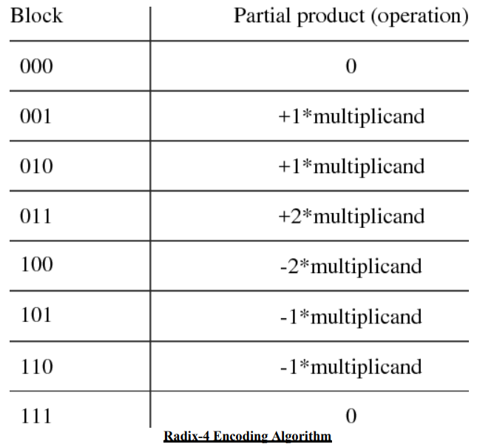
Booth Radix-4 Encoding
Radix_4 Encoding is 4:2 compressor. We are using this algorithm to generate less number of partial products which would use less hardware, less power and would result in less computational delay.
For 8-bit Multiplier the partial products generated after radix-4 encoding are “4” instead of “8”.

Slide 5
Booth Radix-4 Encoding
Module Name:
booth_recoding_8
Input Ports:
Input signed [7:0] a;
Input signed [7:0] b;
Note: Input “b” is multiplicand.
Output Ports:
output reg signed [9:0] p0;
output reg signed [11:0] p1;
output reg signed [13:0] p2;
output reg signed [15:0] p3;

Slide 6
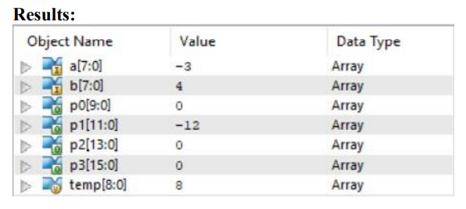
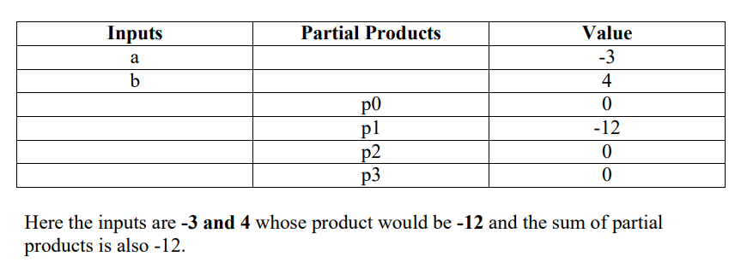
Booth Radix-4 Encoding
Challenges:
Ensuring bit extension for signed numbers.
Implementation using minimum hardware.

Slide 7
Wallace Tree
Addition of Partial Products is implemented using Wallace tree due less usage of adder.
Wallace tree uses 6 Half adders and 10 full adders.
Our Wallace tree uses 6 stages.

Slide 8
Wallace Tree
Module Name:
wallace_tree
Input Ports:
input [9:0] p0;
input [11:0] p1;
input [13:0] p2;
input [15:0] p3;
Output Ports:
output [15:0] s ; // sum is "s"
output [15:0] c ; // carry is "c"

Slide 9
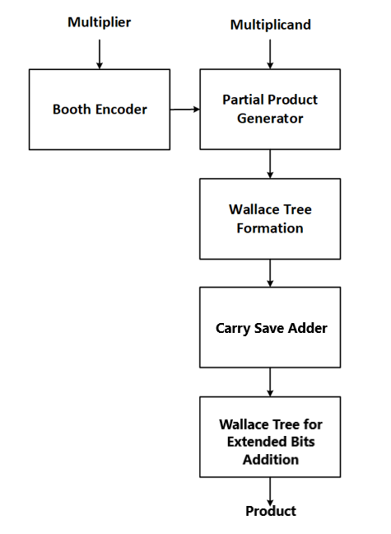
Processing Element
Block Diagram of Processing Element

Slide 10
Processing Element
Multiplier uses Radix-4 Encoding and Wallace tree for end result.
We have integrated both modules to develop processing element. It takes 8-bit input “a” and “b” and outputs a 16-bit “out”.
Bit extension is compensated using Wallace tree after final addition using Carry Save Adder.

Slide 11
Processing Element
Module Name:
top_adder_pe
Input Ports:
input signed [7:0] in_a;
input signed [7:0] in_b;
Output Ports:
output [15:0] out_v2;

Slide 12
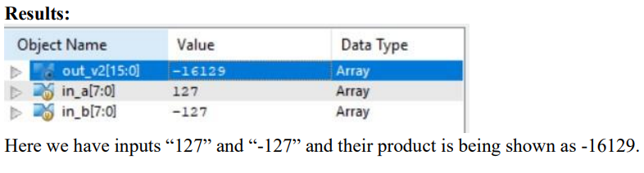
Processing Element
Challenges:
Challenge integrating Wallace tree and radix-4 encoding.
Develop a new design to handle signed bit extension.

Slide 13
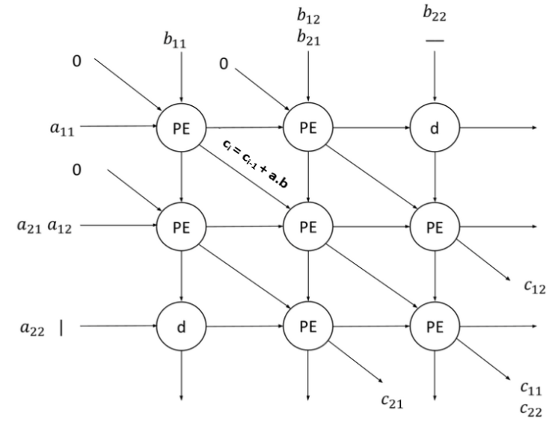
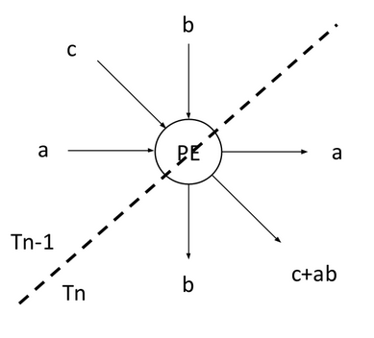
Systolic Array 2 x 2
Block Diagram of 2 x 2 Systolic Array

Slide 14
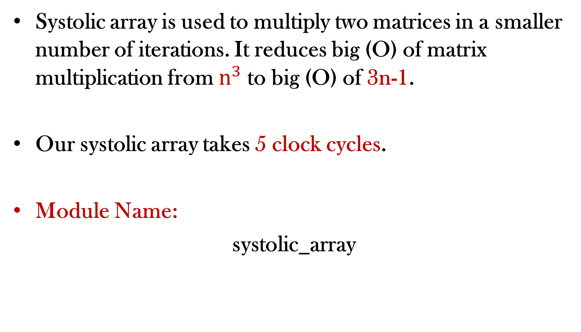
Systolic Array 2 x 2
Systolic array is used to multiply two matrices in a smaller number of iterations. It reduces big (O) of matrix multiplication from $n^{3}$to big (O) of 3n-1.
Our systolic array takes 5 clock cycles.
Module Name:
systolic_array

Slide 15
Systolic Array 2 x 2
Input Ports:
//matrix "a" inputs
input signed [7:0] a11;
input signed [7:0] a12;
input signed [7:0] a21;
input signed [7:0] a22;
//matrix "b" inputs
input signed [7:0] b11;
input signed [7:0] b12;
input signed [7:0] b21;
input signed [7:0] b22;

Slide 16
Systolic Array 2 x 2
Output Ports:
//output reg
output reg signed [16:0] c11;
output reg signed [16:0] c12;
output reg signed [16:0] c21;
output reg signed [16:0] c22;

Slide 17
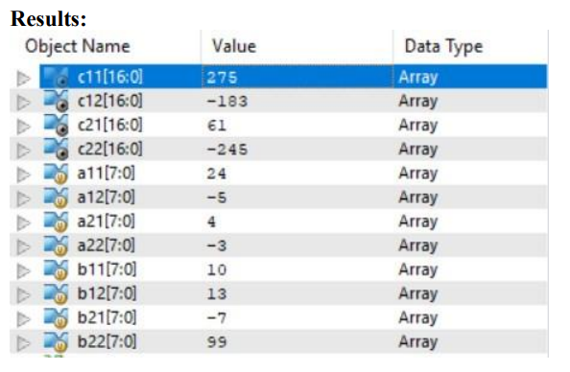
Systolic Array 2 x 2

Slide 18
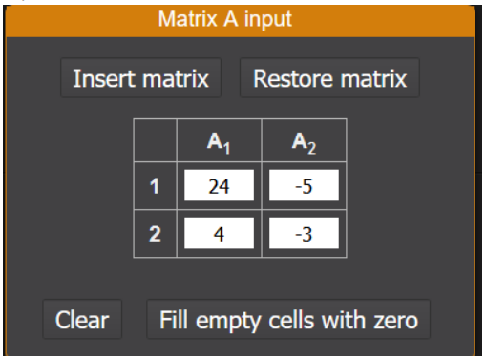
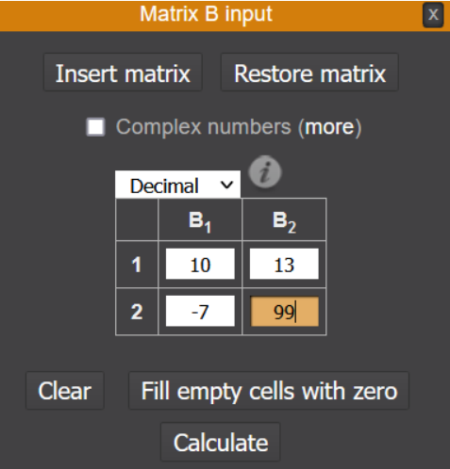
Systolic Array 2 x 2
Matrix Multiplication Verification:
Matrix “A”:
Matrix “B”:

Slide 19
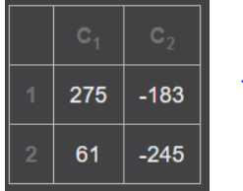
Systolic Array 2 x 2
Matrix Multiplication Verification:
Result:
Challenges:
Race Condition.
Algorithm development and implementation.

Slide 20
Timeline
Implementation of 4x4 Systolic Mesh with 2x2 nested Systolic array | 5 Days
Final Testing | 5 Days
Backend Runs and GDS-1 Creation | 13 Days
Top Level Integration and final GDS-II Creation | 15 Days

Slide 21
Thank You

