Slide 1
Database Systems

Slide 2
Course Outline
Why study Database?
Who Needs to Study Database?
Overview of Database
DBMS Architecture & Database Models
Three Schema Architecture
Entity Relationship Modeling
Enhanced Entity Relationship Modeling
Cardinality Constraints
Normalization

Slide 3
Lecture Outline
Basic Terminologies and Concepts
Manual File Management Systems Approach
File Processing Systems Approach
Database Management System Approach
Database and its types
Components of Database Environment
Database Evolution
Data Models

Slide 4
Database Overview

Slide 5
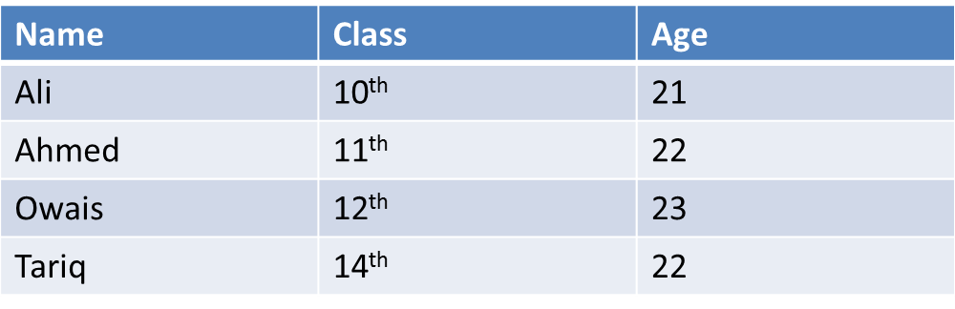
Basic Terminologies
Data: Data is a collection of any thing it can be collection of names of students of class, contacts of person in contact book, DVDs collection names etc. Data is basically a facts and figures.
Why we need data ?? Data is as important as any other asset is valuable. Data is important in lawful decision making.
Example of data in Table is below.

Slide 6
Basic Terminologies
Information: Processed data yields us information. Or we can say that information is a useful data which we extracted after applying any operation or query on data.
Processing is done under some condition
Consider a data in table below
Information is that Ahmed and Tariq are 22 years old.
Name | Class | Age
Ali | 10th | 21
Ahmed | 11th | 22
Owais | 12th | 23
Tariq | 14th | 22

Slide 7
Basic Terminologies
Data vs Information : Data is collection of any thing which after processing gives us useful data which is called Information, we use information to make decisions.
Metadata : Metadata is simply a data about data. Metadata contains information about format of data means what type of data can be stored into the table and what will be source of data.
In above table we can see the table structure which is described by Names of fields, Types of fields and length then source is described.
Name | Type | Length | Source
CourseName | Alphanumeric | 30 | Academic
StudentID | Integer | 10 | Student IS
Semester | Integer | 7 | Student IS
Class | Alphanumeric | 15 | Student IS
CGPA | Alphanumeric | 12 | Result Section

Slide 8
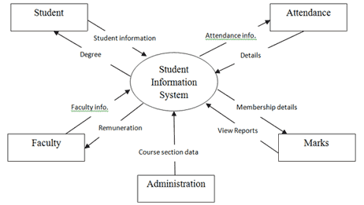
Basic Terminologies
Database : Database is a collection of logically related data which can be shared by multiple users.
Example: Student Information Database

Slide 9
Manual File Management Systems
Ledgers and record registers are example of Manual file management systems. Storing record in MFMS causes lot of inconvenience.
Disadvantages:
Data Dependence
Data Redundancy
Limited Data Sharing
Chance of loss

Slide 10
File Processing Systems
File processing systems are just a replacement of Manual File Management system. It has same problems as Manual File Management System has.
Disadvantages:
Data Dependence
Limited Sharing
Data Duplication
Excessive Program Maintenance
Concurrency Issues
Atomicity Issues

Slide 11
Database Management System
Database Management system is a solution to problems which were arising in previously described two systems. Database Management system uses Database approach to overcome problems such as data sharing, Data redundancy etc.
Advantages of DBMS
Data Independence
Data Sharing Made easy
Limited Data Redundancy
Improved Data consistency
Examples of DBMS are MS ACCESS, SQL SERVER, ORACLE etc
Database Management system is a software which manages the Database and enables us to perform operations on the data.

Slide 12
Database
Database is a collection of organized and logically related data which can be shared by multiple users.
Main Types of Database
1.) Centralized Database
2.) Distributed Database
Centralized Database: It is a type of database which is located on a single location and different users from different places access this database from a single location.
There are again two types of Centralized Database
1.) Personal Computer Database
2.) Centralized MULTI-USER Database

Slide 13
Database
Personal Computer Database: It is a type of database which is installed on only one computer for example a shopkeeper inventory system on shop uses a personal computer database.
It is a low scope database , because it is dedicated to only one system.
Central Computer Database: Central computer database is a type in which there is a central computer (server) on which database is installed and other systems which are called (client/dumb terminals) are connected with this Central computer by any network.

Slide 14
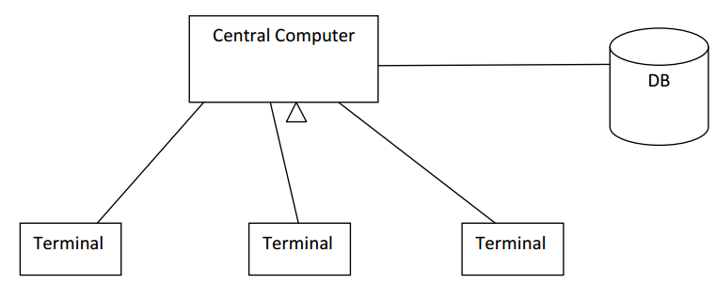
Database
Central Computer Database Diagram
Central Computer:
a.) All processing is done by CC.
b.) All load on CC.
c.) CC should be a power ful machine.
Terminals:
a.) Provide only interface.
b.) Not so much powerful systems.
c.) Don’t have load.

Slide 15
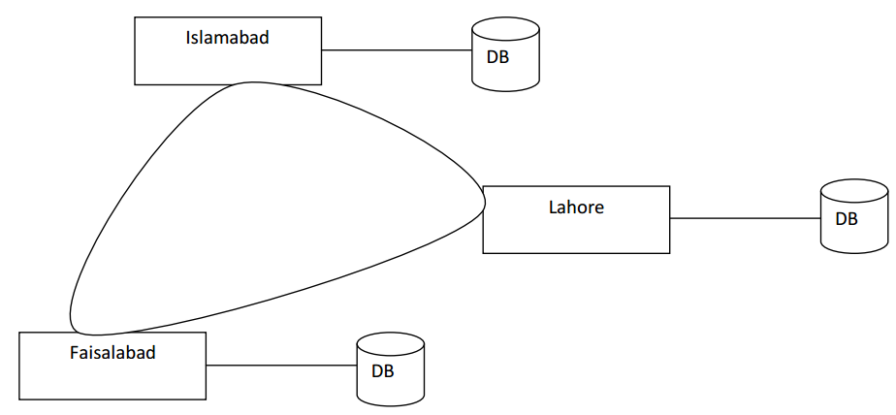
Database
Distributed Database: It is a type of a database which is located on the more then one locations. Different users from different locations access database with the help of Network.

Slide 16
Database
Distributed Database: It has again two types.
Homogenous
Heterogeneous
Homogeneous
▪ H/W
▪ OS
▪ DBMS
▪ Data Model*
▪ Data flow
If all these components are same at all nodes then it is known as homogeneous DB.
Heterogeneous
▪ H/W
▪ OS
▪ DBMS
▪ Data Model*
▪ Data flow
If any of these components differ at different levels then such DB is called heterogeneous DB.

Slide 17
Database
Advantages of Distributed Database:
a.) Provides Load Balancing
b.) Low chances of Data Loss.
c.) Easy Data Sharing
d.) Data consistency

Slide 18
Components of Database Environment
Components of database environment describes those components which are involved with database could me DB Administrators, System Developers or End users. They are mostly nine in number. Detail of them are given below.
Main Components
Data and Database System Administrators
System Developers
End Users
CASE Tools
User Interface
Application Programs
Repository
DBMS
Database

Slide 19
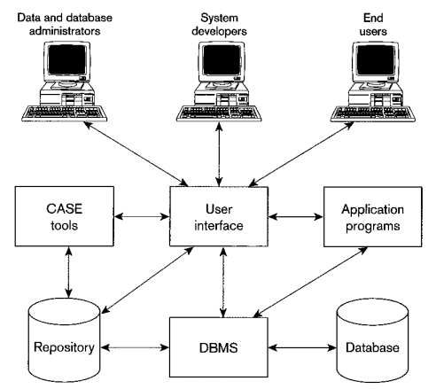
Components of Database Environment

Slide 20
Components of Database Environment
Computer Aided Software Engineering Tools (CASE TOOLS) : Automated tools to design database and application programs. CASE tools are used for system Requirement analysis and design.
Repository: Repository contains a broad set of metadata which is important for managing database.
DBMS: A software which is used to manage the database, this management includes the creation of database upto whole maintenance of DB. DBMS provides the controlled access to the Database.
Database: A collection of organized and logically related data which can be shared by multiple users is known as a database.
Application Programs: Application Programs are those programs which uses database and manipulate the database according to there purpose. For instance we develop a Library Management system application in .Net and for record storing purpose we use Access DB. Hence Library Management system is a Application Program.
Database Administrators: DB Administrator is a one who manages a Database.
System Developers: System Developers are those who develop Application Programs they use case tools to dug out requirements and design of a application.
End Users: Suppose a Database is used into an school organization then end users are those persons who get facilities from the database and to whom services are been provided.

Slide 21
Data Models
Data model is first step in Database design process which describe the logical structure of database. It tells us how data is connected to each other and how is stored, Processed. It describes what type of relations will be between data.
ER Data Model
Object oriented Data Model
Network Data Model
Hierarchical Data Model

Slide 22
Home Work
1.1 List four significant differences between a file-processing system and a DBMS.
1.2 This chapter has described several major advantages of a database system. What are two disadvantages? Due Date and Other Details are given on CMS.

Slide 23
Any Questions?

