Slide 1




STUDENT INTEREST SYSTEM
BITF20M005

Slide 2
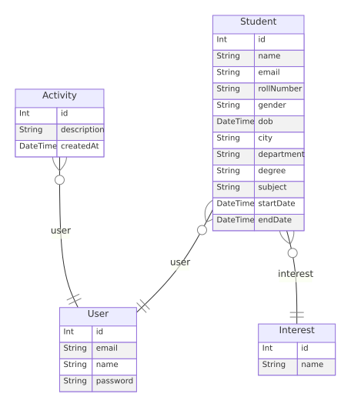
ENTITY RELATION DIAGRAM

Slide 3



TOOLS & TECHNOLOGIES
REACT JS
NODEJS
TYPESCRIPT

Slide 4
REASONING FOR USING TOOLS
WHY REACT JS?
Declarative Syntax
Components Based Architecture
Virtual DOM
NODEJS WITH EXPRESS
PRISMA ORM
Efficient Sever-side javascript
Fast and scalable
Well-written framework Express
Type-safe database queries
Declarative database modeling
Automatic Migration
TYPESCRIPT
Static Typing
Enhanced code maintainability
ECMAScript compatibility

Slide 5
FONTS & COLORS
There’s only one font is used in the whole application which is Inter font
The color pallet is:

Slide 6
THANK YOU
Muhammad Shaheer (BITF20M005)

