Slide 1
Predictive Maintenance for Industrial Robotic Arms
Comparative Analysis of ML Models Using the CWRU Bearing Dataset
Course Project - Machine Learning for Robotics
Shaheer Zafar | Member 2 | Member 3 | Member 4 | Member 5
April 2026

Slide 2
Agenda
15-Minute Presentation Outline
1. Problem Statement
2. Dataset & Preprocessing
3. Exploratory Data Analysis
4. Classification Models
- KNN, SVM, Decision Tree
5. Polynomial Regression
6. K-Means Clustering
7. Q-Learning (Reinforcement)
8. Ensemble Learning
9. Comparative Analysis
10. Robotics Suitability
11. Live Demo & Conclusions

Slide 3
1. Problem Statement
Why Predictive Maintenance?
Bearing failures cause ~40-50% of all rotating machinery downtime
Unplanned downtime costs manufacturing $50B+/year globally
Reactive maintenance: Fix AFTER failure (costly, dangerous)
Preventive maintenance: Fix ON SCHEDULE (wasteful)
Predictive maintenance: Fix BEFORE failure (optimal)
OUR GOALS:
Classify bearing faults
(Normal/Ball/Inner/Outer)
Predict fault severity
(0.007 / 0.014 / 0.021 in.)
Automate maintenance
decisions via RL

Slide 4
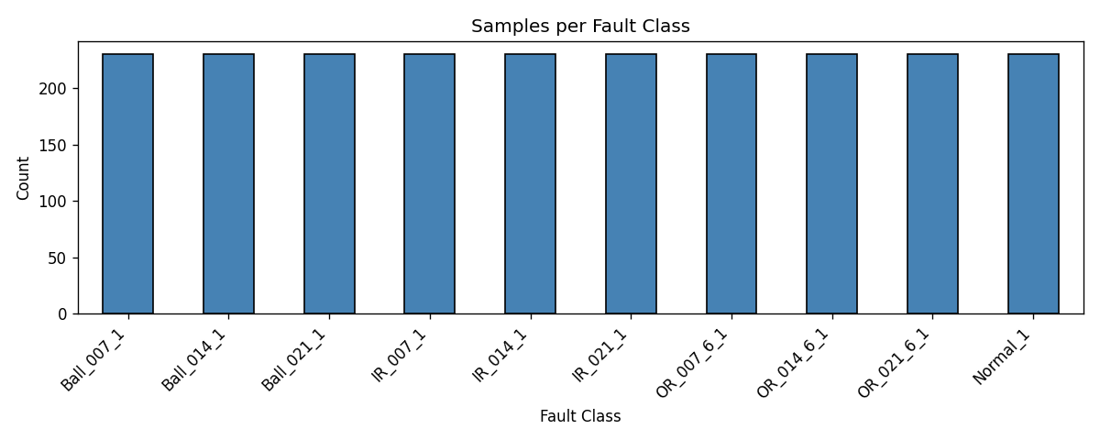
2. Dataset - CWRU Bearing Dataset
Case Western Reserve University Bearing Data Center
Source: CWRU Bearing Data Center (benchmark dataset)
Motor: 2-HP Reliance Electric with accelerometer sensors
Sampling Rate: 48,000 Hz | Window: 2,048 samples
Total Samples: 2,300 (perfectly balanced)
Fault Locations: Ball, Inner Race, Outer Race + Normal
Severity Levels: 0.007", 0.014", 0.021" diameter
9 Features: max, min, mean, sd, rms, skewness,
kurtosis, crest factor, form factor
Zero missing values | 10 classes, grouped into 4

Slide 5
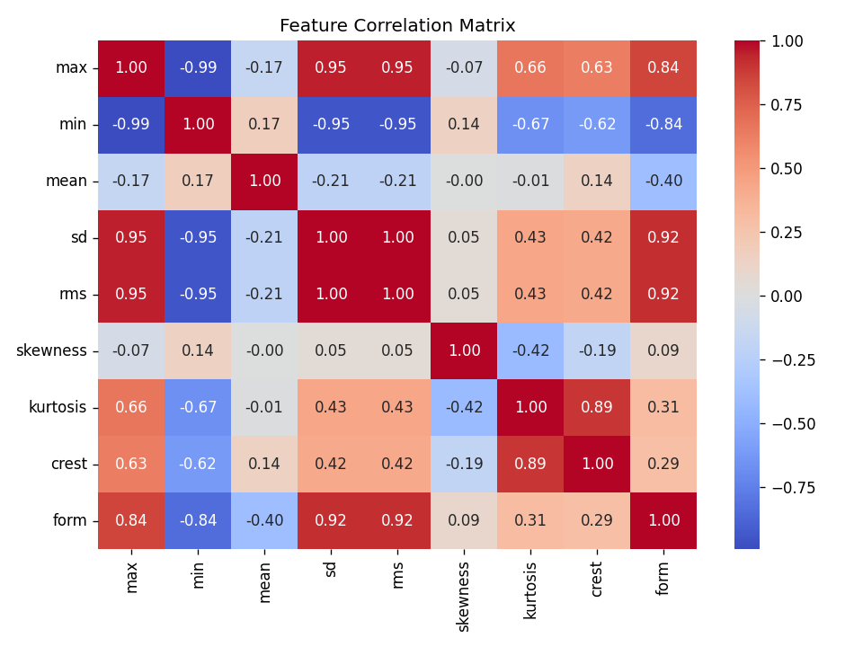
3. Data Preprocessing & Feature Engineering
Data Cleaning:
- No missing values, no duplicates
- All features float64, label is string
Feature Engineering:
- fault_type: 10 classes -> 4 groups
- severity: Numerical fault diameter (regression target)
Feature Scaling:
- StandardScaler (zero mean, unit variance)
- Fit on train only (no data leakage)
Train/Test Split:
- 80/20 stratified split (random_state=42)
- Train: 1,840 | Test: 460 samples

Slide 6
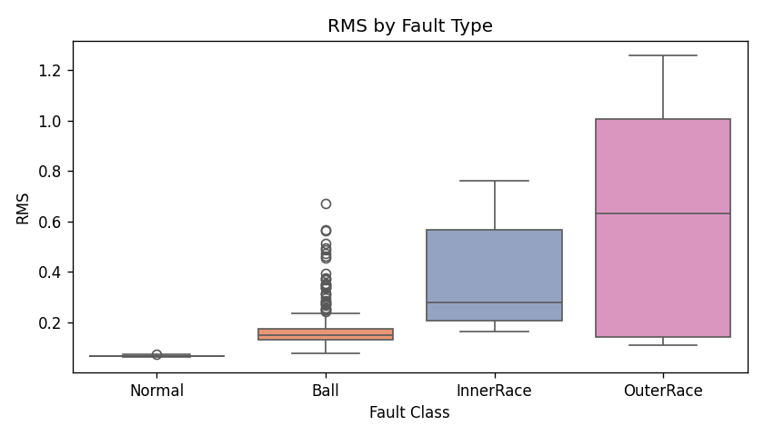
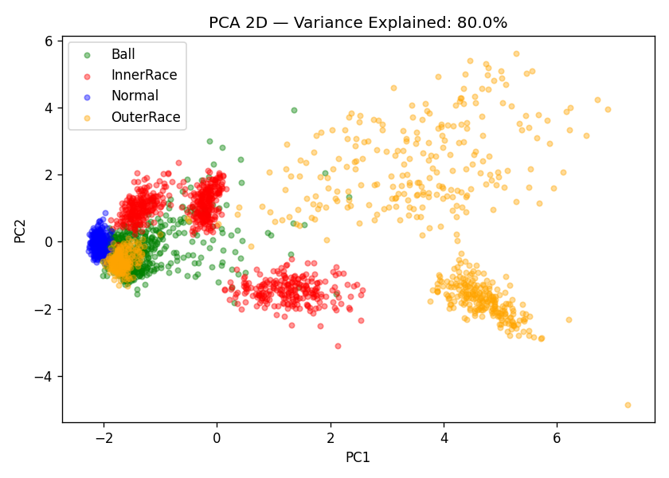
4. Exploratory Data Analysis
Understanding data distribution and feature relationships
RMS separates Normal vs Faulty clearly
PCA shows natural clustering of fault types

Slide 7
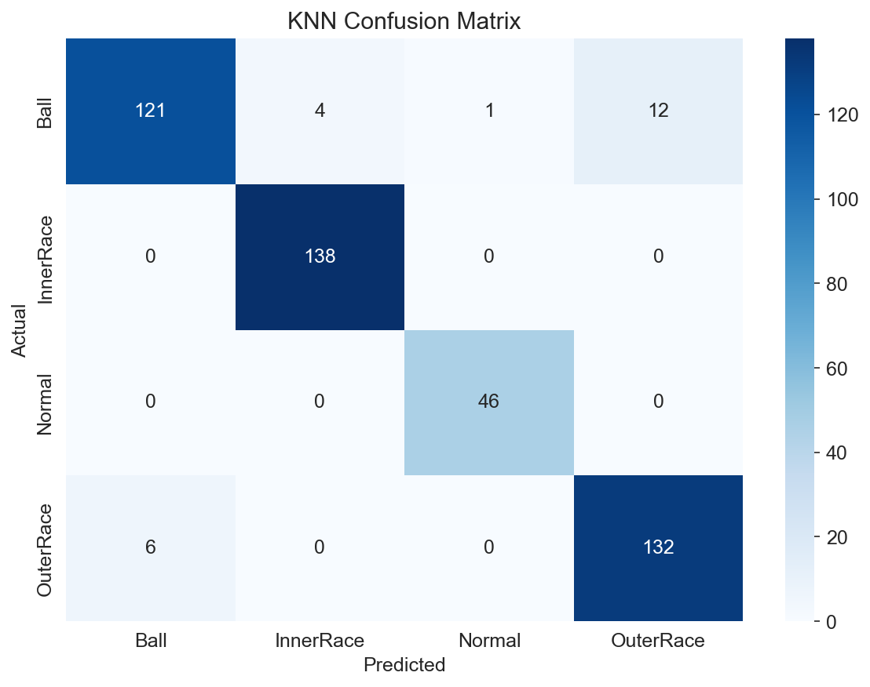
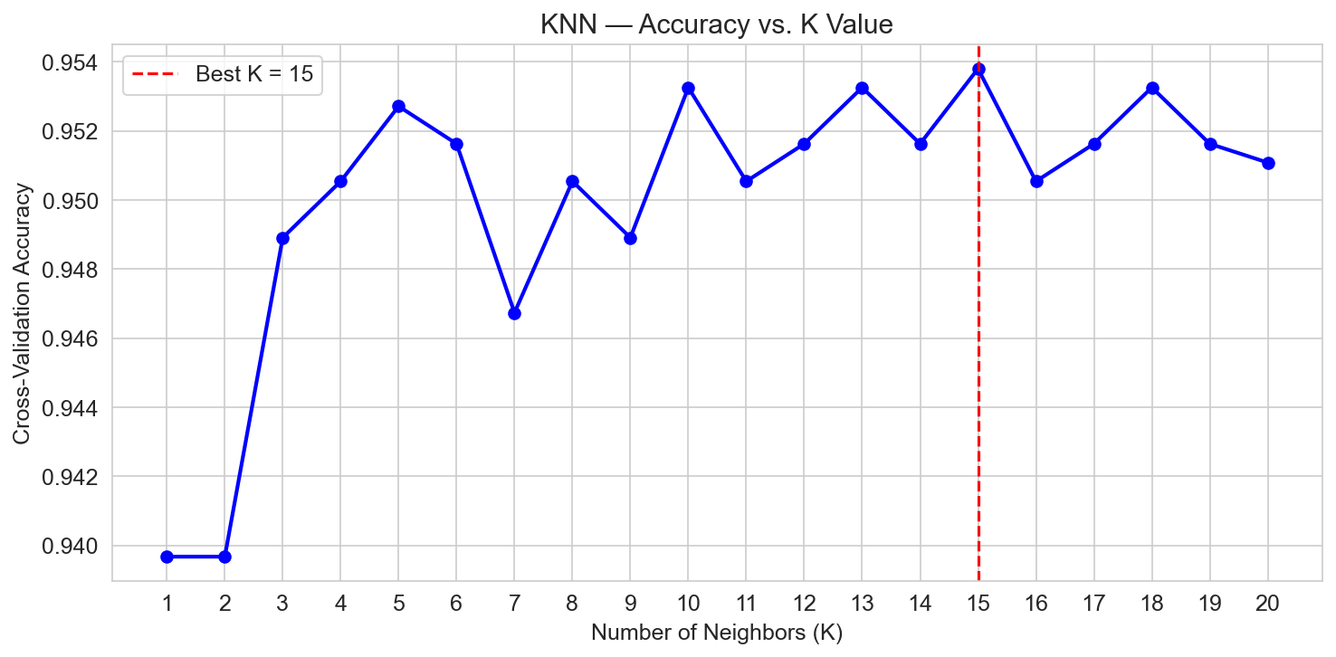
5.1 Classification - K-Nearest Neighbors (KNN)
Non-parametric, instance-based learning
Classifies by majority vote of K neighbors
GridSearchCV (5-fold CV):
- K: 1-20, Weights: uniform/distance
- Metric: euclidean/manhattan
Best: K=3, distance, manhattan
Strength: Simple, effective for localized clusters
Weakness: O(n*d) prediction time

Slide 8
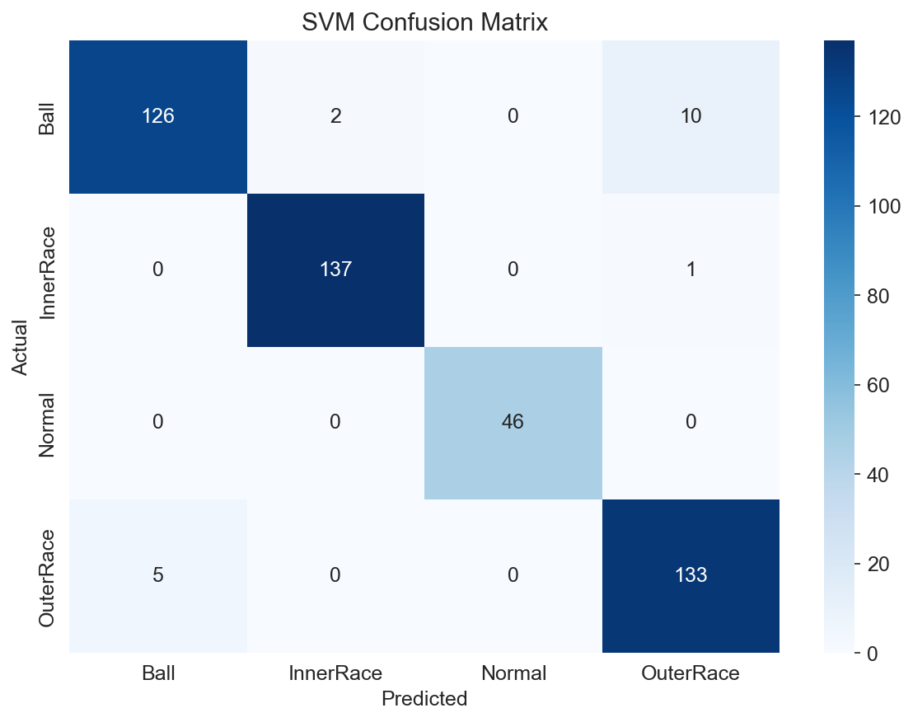
5.2 Classification - Support Vector Machine (SVM)
Finds optimal hyperplane with max margin
RBF kernel for non-linear boundaries
GridSearchCV (5-fold CV):
- C: 0.1, 1, 10, 100
- gamma: scale, auto, 0.01, 0.1, 1
Best: C=10, gamma=scale
Strength: Strong generalization
Weakness: Sensitive to scaling, slow on large data

Slide 9
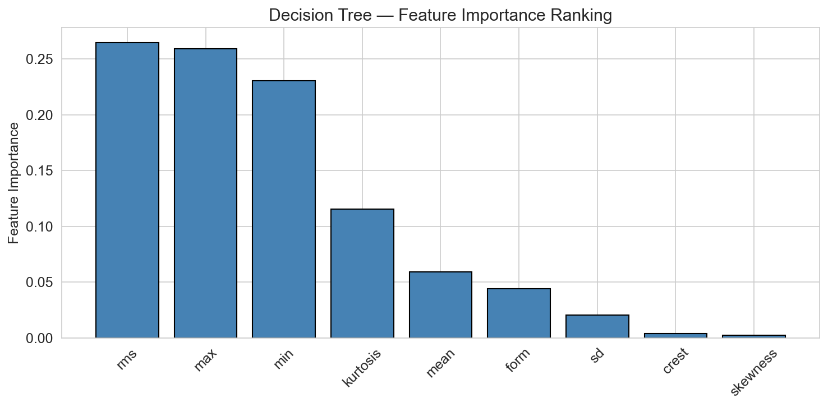
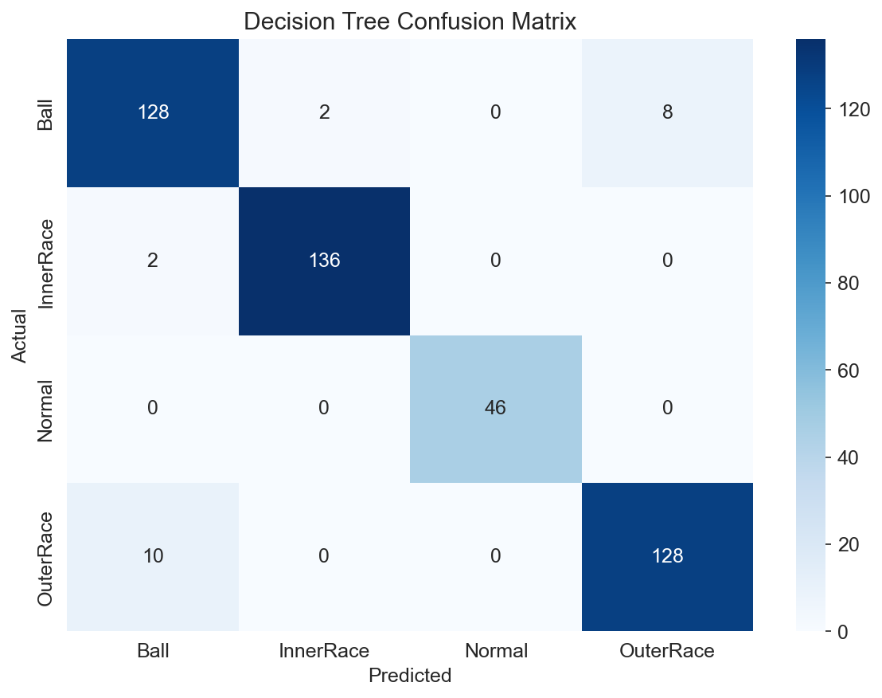
5.3 Classification - Decision Tree
Recursive partitioning with threshold rules
Most interpretable classifier
GridSearchCV (5-fold CV):
- max_depth: 3-15, None
- criterion: gini, entropy
Strength: Transparent, fast prediction
Weakness: Prone to overfitting

Slide 10
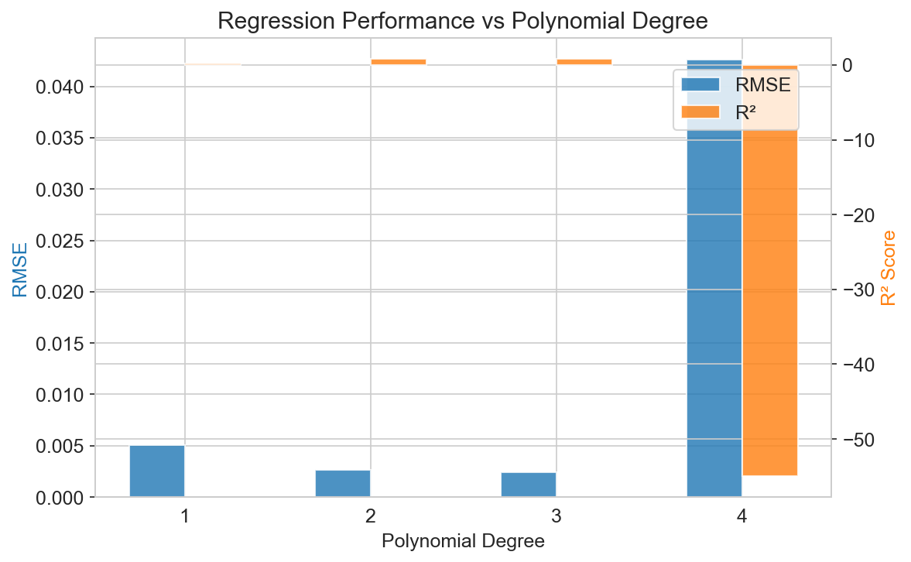
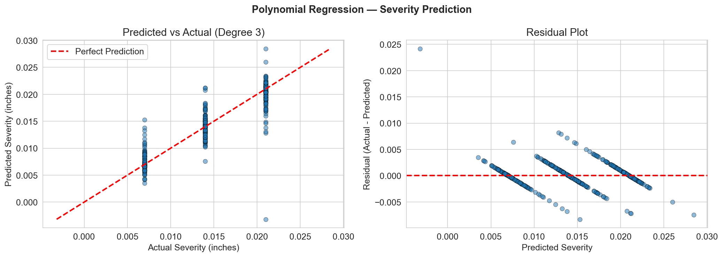
5.4 Polynomial Regression - Severity Prediction
Goal: Predict fault diameter from features
Compared degrees 1-4 (train on faulty only)
Degree 1: R2=0.2175 (underfits)
Degree 2: R2=0.7801
Degree 3: R2=0.8232 << BEST
Degree 4: R2=-54.98 (overfits!)
Bias-Variance Tradeoff demonstrated
Best RMSE: 0.002394

Slide 11
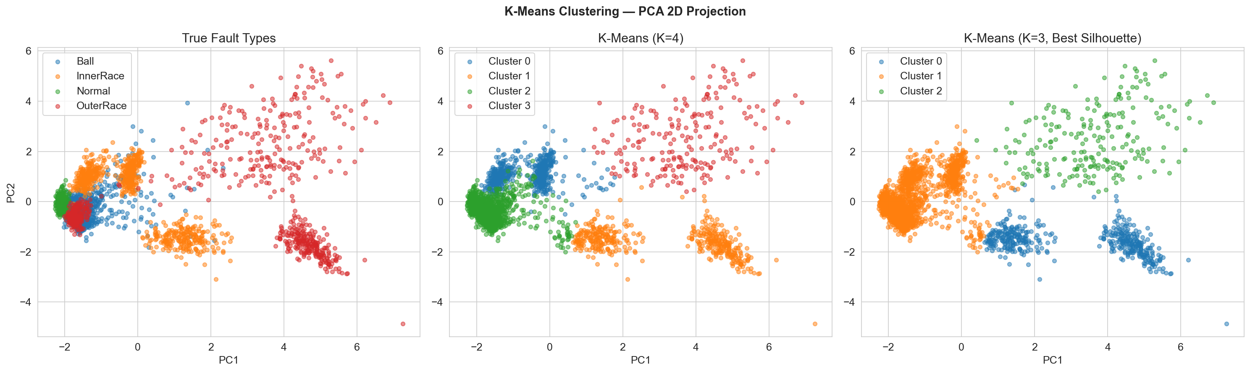
5.5 K-Means Clustering
Unsupervised fault grouping
Groups data without labels
Evaluated K=2 to 15
Metrics:
- Elbow Method (Inertia)
- Silhouette Score (higher = better)
- Davies-Bouldin Index (lower = better)
K=4 matches actual fault types
Enables anomaly detection on unlabeled data

Slide 12
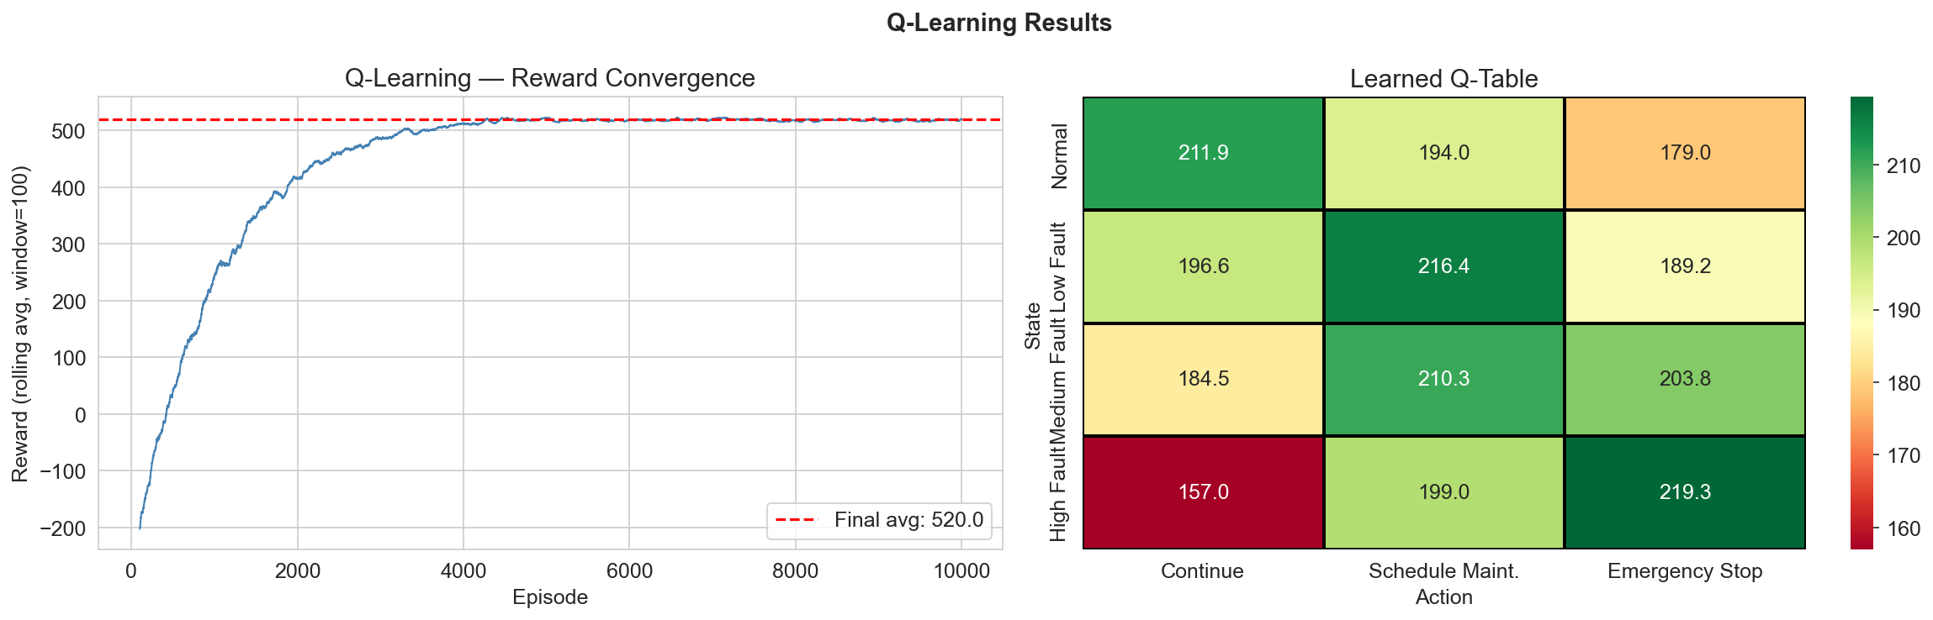
5.6 Q-Learning - Maintenance Decision Making
Model-free reinforcement learning
States: Normal, Low, Medium, High Fault
Actions: Continue, Schedule, Emergency Stop
Training: 10,000 episodes x 50 steps
Alpha=0.1, Gamma=0.95, Epsilon decay
Learned Policy:
Normal -> Continue Operating
Low/Medium -> Schedule Maintenance
High Fault -> Emergency Stop

Slide 13


6. Ensemble Learning
Combining models for better performance
Random Forest (Bagging)
AdaBoost (Boosting)
Gradient Boosting
Ensemble of Decision Trees
Bootstrap + random features
Reduces overfitting
GridSearchCV: n_est, depth
Sequential weak learners
Focus on misclassified samples
Base: DT (depth=2)
GridSearchCV: n_est, lr
Fits trees to residual errors
Gradient descent optimization
Often highest accuracy
GridSearchCV: n_est, lr, depth
Key Result: Ensemble methods improve accuracy by 1-3% over individual classifiers with lower variance and better generalization.

Slide 14
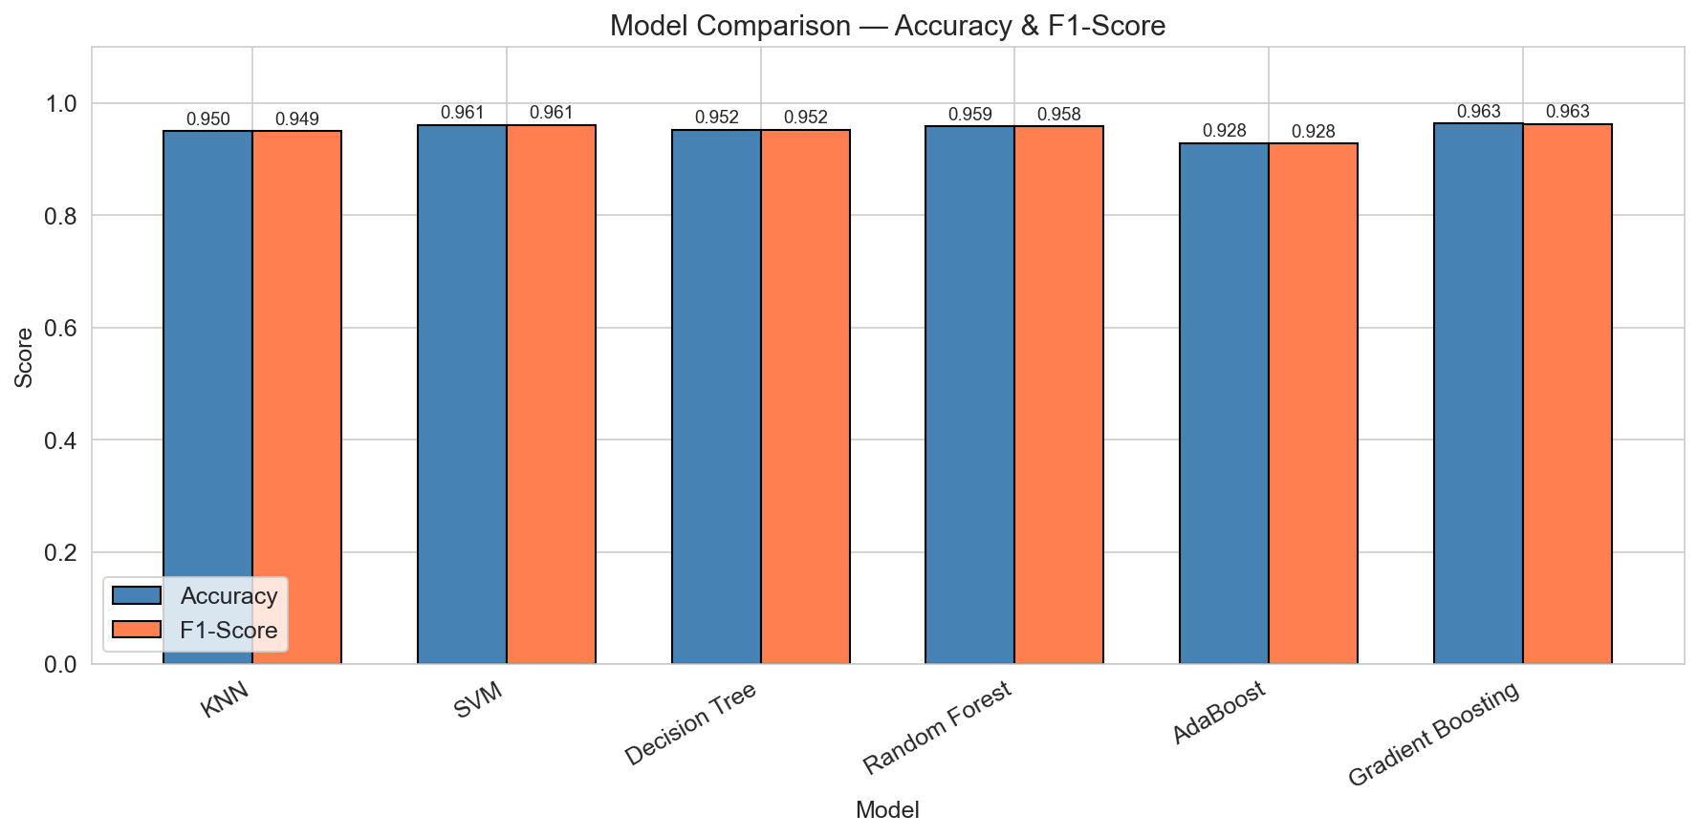
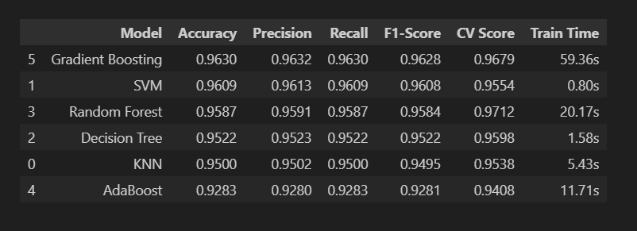
7. Comparative Analysis - Accuracy & F1-Score

Slide 15
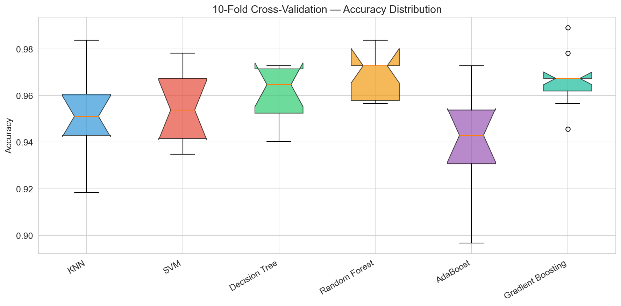
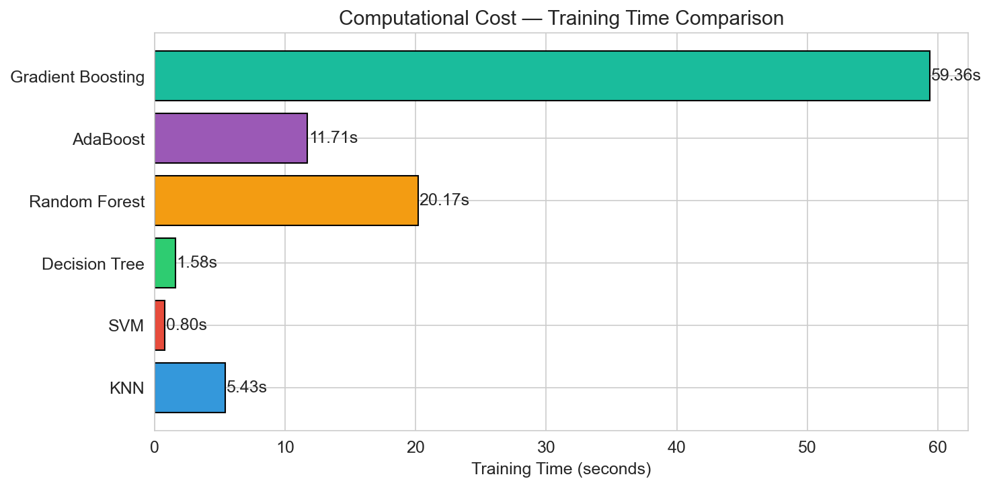
7. Comparative Analysis - Stability & Speed
10-Fold CV: Ensemble methods show lower variance
Gradient Boosting: highest accuracy, moderate speed

Slide 16
7. Computational Complexity & Metrics Summary
Model | Train | Predict | Memory | Key Strength
KNN | O(1) | O(n*d) | High | Simple, no training
SVM | O(n^2*d) | O(sv*d) | Med | Strong margins
Decision Tree | O(n*d*logn) | O(logn) | Low | Interpretable
Random Forest | O(T*n*d*logn) | O(T*logn) | Med | Low variance
Gradient Boost | O(T*n*d) | O(T*logn) | Med | Highest accuracy
Poly Regression | O(n*d^p) | O(d^p) | Low | Severity prediction
K-Means | O(n*K*d*I) | O(K*d) | Low | Anomaly detection
Regression: Degree 3, R2=0.8232, RMSE=0.002394
Clustering: Silhouette Score + Davies-Bouldin Index evaluated for K=2-15
Q-Learning: Converged in ~2000 episodes, correct policy learned

Slide 17
8. Suitability for Robotics Applications
Real-Time Speed
Interpretability
Adaptability
Recommendation
DT & ensembles: fast prediction
KNN: bottleneck on large data
Sub-second detection needed
DT: human-readable rules
RF: feature importance
Critical for safety decisions
Q-Learning adapts online
No full retraining needed
Handles changing conditions
Gradient Boosting: classifier
Poly Reg: severity tracker
Q-Learning: decision maker

Slide 18
9. Live Demo - Streamlit Dashboard
streamlit run app.py
Dashboard Features:
Interactive sensor input sliders
Real-time fault classification
Model selector (5 classifiers)
Bearing fault visualization
Polynomial regression analysis
Q-Learning decision matrix
All models comparison table
LIVE DEMO streamlit run app.py
http://localhost:8501

Slide 19
10. Conclusions
Key Findings & Takeaways
Classification: All 3 classifiers achieve strong accuracy; ensembles add 1-3% improvement
Regression: Polynomial degree 3 best (R2=0.8232), clear bias-variance tradeoff
Clustering: K-Means discovers natural fault groups without supervision
Q-Learning: Converges to correct maintenance policy (10K episodes)
Best Classifier: Gradient Boosting (highest accuracy + low variance)
Fastest Model: Decision Tree (O(log n) prediction, interpretable)
Real-World: Combined pipeline of GB + Poly Reg + Q-Learning recommended
Future Work: Deep learning on raw signals | Transfer learning | Edge deployment

Slide 20
Questions & Discussion
Thank you for your attention!
Predictive Maintenance for Industrial Robotic Arms
Shaheer Zafar | Member 2 | Member 3 | Member 4 | Member 5

