Slide 1


Sarvajanik College of Engineering & Technology,
Computer Engineering Department
Overview Of Morphological Operations &
Its Use for Car License Plate Extraction
Prepared By:
Harsh N. Shah (Roll no. 41)
BE 4th (Computer Engg. Dept. ) Semester 7
Guided By:
Prof. Bintu Kadhiwala

Slide 2

Presentation Outline
Introduction
Different Morphological Operations
What Car License Plate Detection is ?
Proposed Methodology
Implementation Of the Methodology
Conclusion

Slide 3
Introduction
What is Morphology ?
What are Morphological operation?

Slide 4

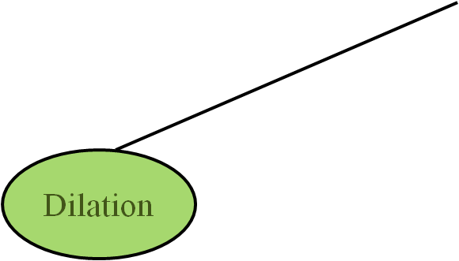
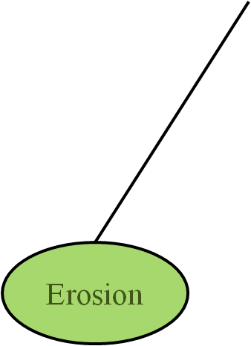
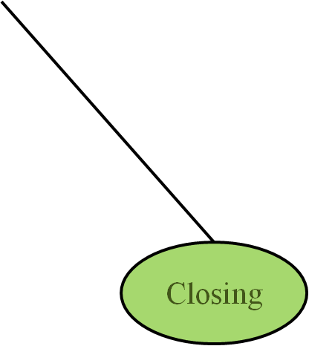
Different Morphological Operations
Morphological Operations
Opening
Hit or Miss

Slide 5
Different Morphological Operations
Morphological Operations
Opening
Hit or Miss

Slide 6
Dilation
Dilation is defined by the equation:
A B = { z | ( Ḃ )_{z} ∩ A ≠ Ø }.

Slide 7
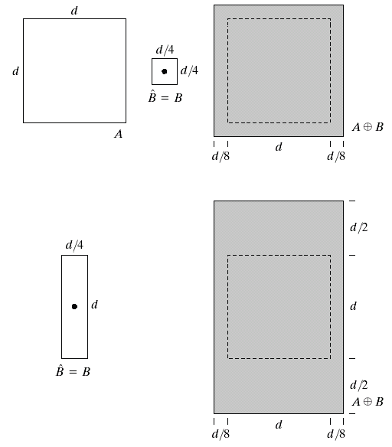
a | b | c
d |  | e
Fig:-(a) Set A. (b) Square structuring element (c) dilation of A by B shown shaded (d) Elongated structuring element (e) dilation of A using this (c and e) element

Slide 8
Different Morphological Operations
Morphological Operations
Opening
Hit or Miss

Slide 9
Erosion
For sets A and B in Z², the erosion of A by B is defined as
A Ө B ={ Z | (B)_{z} ⊆ A}

Slide 10
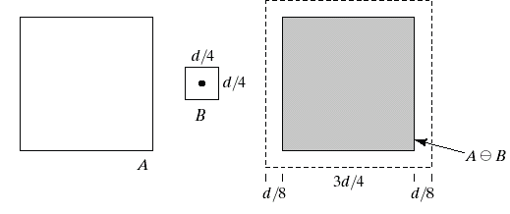
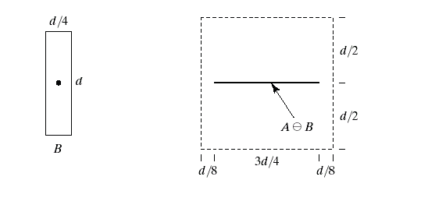

a | b | c
d |  | e
Fig:-(a) Set A (b) Square structuring element, B (c) Erosion of A and B, shown shaded (d) Elongated structuring element (e) Erosion of A by B using this element

Slide 11
Different Morphological Operations
Morphological Operations
Opening
Hit or Miss

Slide 12
Opening
The opening of set A by structuring element B , denoted by A o B, is defined as
A o B = (A Ө B) ⊕ B

Slide 13
Different Morphological Operations
Morphological Operations
Opening
Hit or Miss

Slide 14
Closing
The closing of set A by structuring element B ,denoted by A • B , is defined as
A • B = (A ⊕ B) Ө B

Slide 15
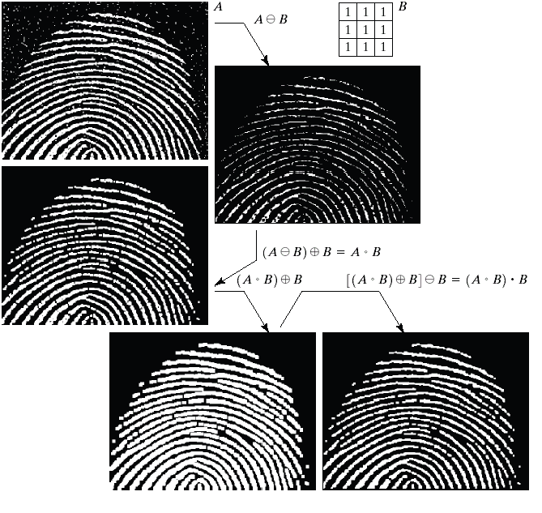
a | b
 | c
d
 | e | f
Fig:-(a) Noisy image (b) structuring element (c) eroded image (d) opening of A (e) Dilation of the opening (f) closing of the opening

Slide 16
Types of Morphological Operations
Morphological Operations
Opening
Hit or Miss

Slide 17
Hit or Miss Transformation
The Hit-or-Miss transform is a basic tool for shape detection and defined by
A ∗ B = (A Ө X) ∩ [A^{c} Ө (W − X)]

Slide 18
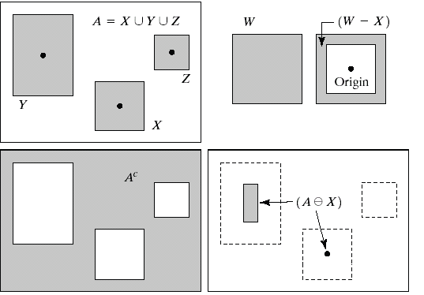
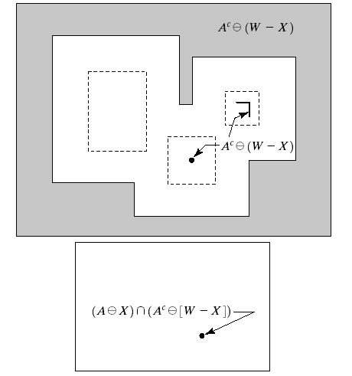
a | b
c | d | e
f
Fig:-(a) set A (b) A window, W and the local background of X with respect to W,(W-X) (c) complement of A (d) erosion of A by X (e) erosion of A^{c} by (W-X) (f) intersection of (d) and (e)

Slide 19
What is Car License Plate Recognition?
Car LPR is an important application of computer’s vision.

Slide 20
Proposed Methodology
The Car LPR system consists of mainly three parts viz.
        Vertical edge detection
        Morphological operations
        Connected component analysis.

Slide 21
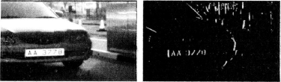
Vertical Edge Detection
Fig:-Original car image Fig:- Vertical edge detection

Slide 22
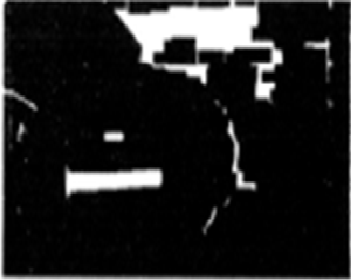
Morphological Operations
Closing operation
Fig:-Character fusion into rectangle

Slide 23
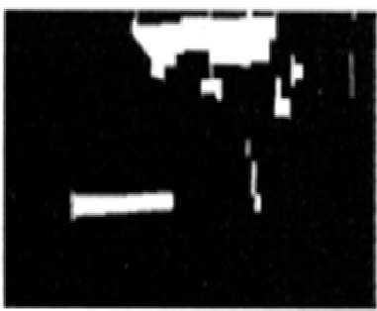
Morphological Operations (contd…)
Opening operation
Fig:-Elimination regions with height less than minimum character height

Slide 24
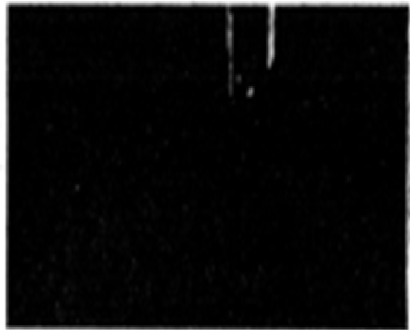
Morphological Operations (contd…)
Opening operation
Fig:- Noise blobs taller than the plate

Slide 25
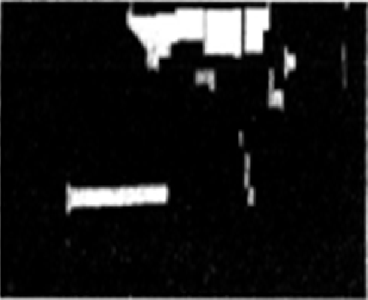
Morphological Operations (contd…)
Subtraction operation
Fig:- Taller Noise blobs are eliminated

Slide 26
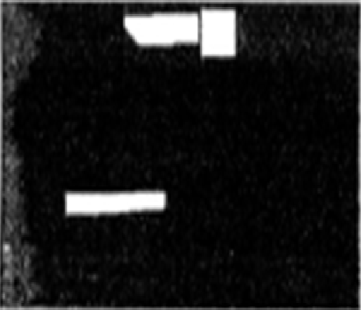
Morphological Operations (contd…)
Opening operation
Fig:-Plate with some noise blobs

Slide 27
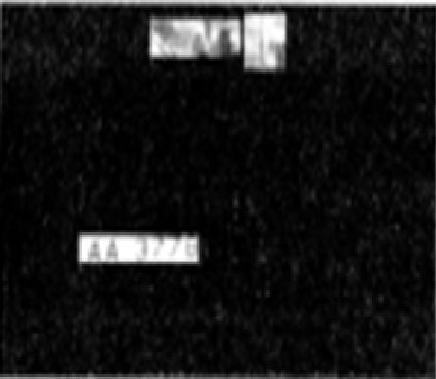
Morphological Operations (contd…)
Using the o/p the corresponding regions of original car image are obtained
Fig:-Regions from original images

Slide 28
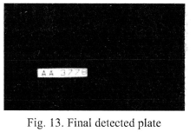
Connected Component Analysis
The license plate region consists of characters with well-defined width and height and so a eight-connected-component extraction algo is used.
Fig:-Final detected plate

Slide 29
Implementation Of the Methodology

Slide 30
Conclusion

Slide 31

THANKYOU

